Slide 1
For Day 9
Plan
Responsible
10 Minute Presentation saying:
Intro: How to start?(1m)
What you did in this course (1m)
What was fun / challenging / boring (1m)
What song we decided (1m)
What song we will do NOW (5m)
Where you can find the other materials (1m)
All boy band
All girl band
Solo Male Artist
Dance Rock
Solo Female Artist
All girl band

Slide 2




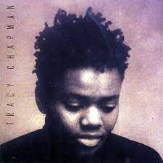
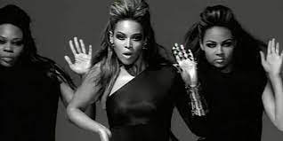


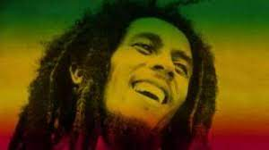
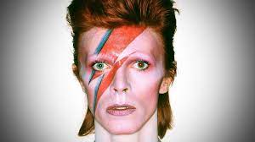
Meiji’s Mainstream Music
Notes:
https://www.youtube.com/watch?v=o50ZkoKx09c
https://www.youtube.com/watch?v=iKdZbI4NU2g https://www.youtube.com/watch?v=A_ZatuoalP0

Slide 3



Concept
Materials
Genre
Artists
Interest

Slide 4

By Thurs
Check on Monday – song choice 1
Check on Wednesday – song choice 2

Slide 5


Slide 6

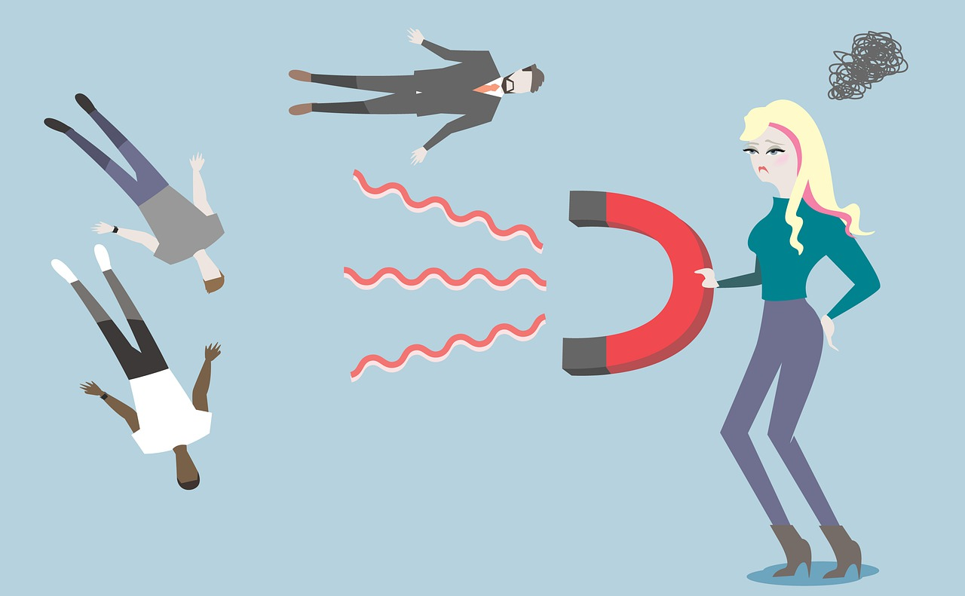




Slide 7
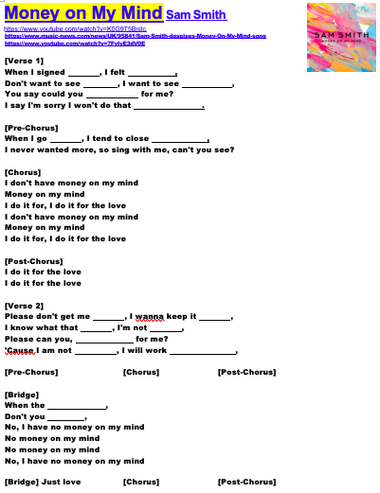
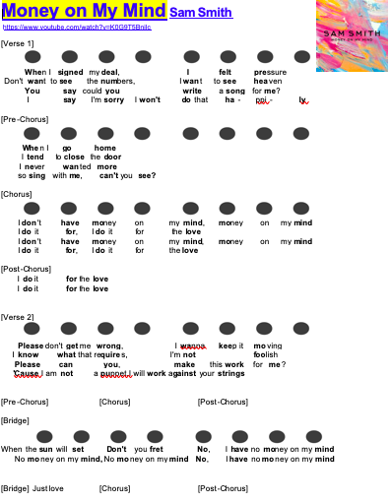
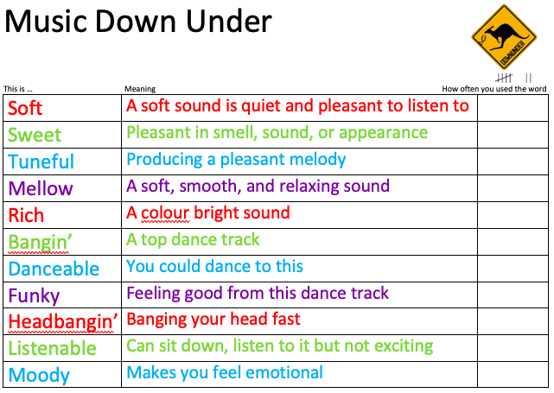
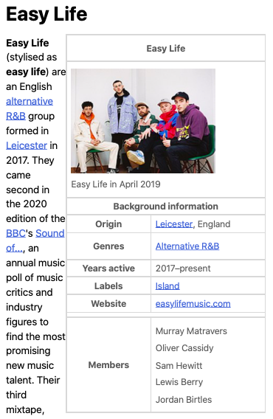
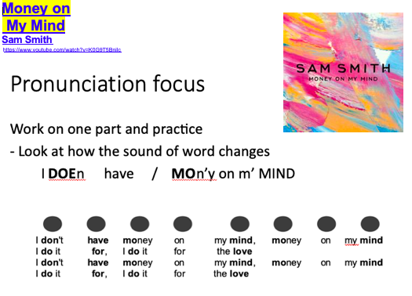

Remember put your materials on ONE document

Slide 8









https://genius.com
www.music-news
www.youtube
https://www.allmusic.com
https://www.biography.com
https://www.thefactsite.com
https://kids.kiddle.co
Notes:
https://www.mentimeter.com/s/3d1c8b0c985a36ba7ef9470b2e0e07c8/b527634a4644/edit

Slide 9

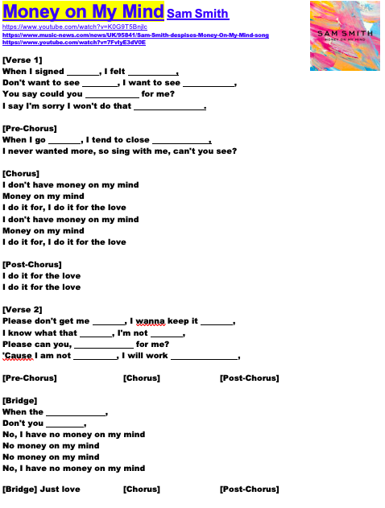
Link about the singer
Link about the song lyrics

Slide 10


Go to kahoot.it and type code from my screen

Slide 11





Filler
– a bit of fun
Draw CD cover
Review of song
More facts / gossip about the artist
View of Concept
Re-enact conversation

Slide 12
Link about the singer
Link about the song lyrics
Link about words
You will decide the gaps
Link about the video
and extra info

Slide 13
Remember put your materials on ONE document

Slide 14
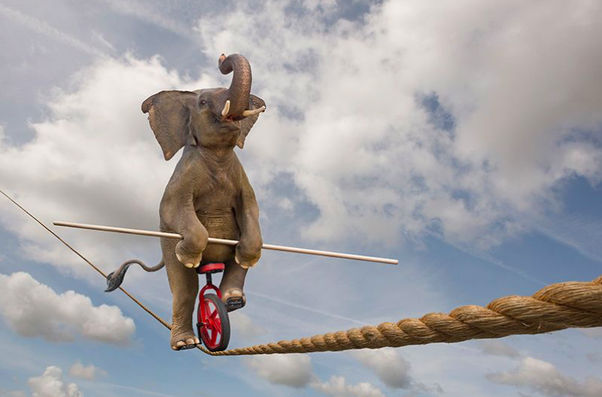

Quick
Informative
Fun
Pronunciation

Slide 15



Battle of the Bands

Slide 16


Seriously!
You know nothing about music!
Ours is the best song choice!
No way! Metal is old!

Slide 17


I want to sing it again, NOW!!!
Did you know..?
I love this…

Slide 18
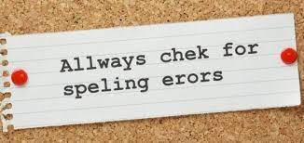

Slide 19



Slide 20
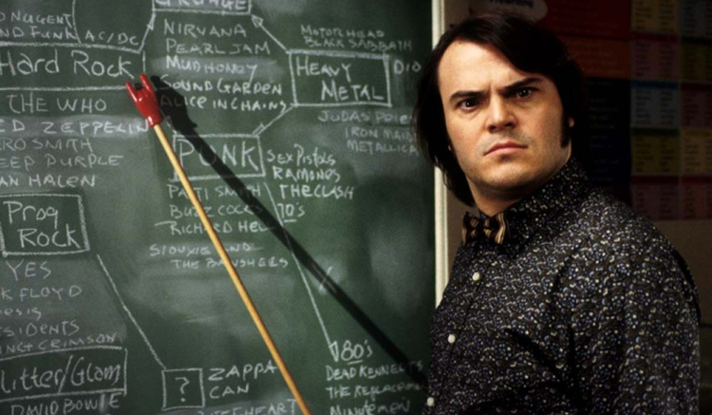
Simple explanations of concept and vocabulary

Slide 21




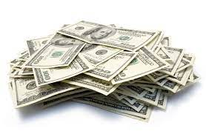
Useful vocab
Stress
Pressure

Slide 22
Quick
Informative
Fun
Pronunciation

Slide 23

Singing

Slide 24


Slide 25
Quick
Informative
Fun
Pronunciation

Slide 26
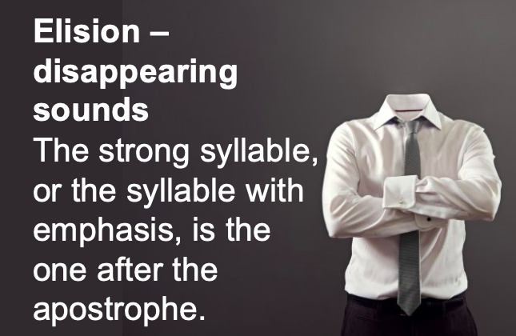
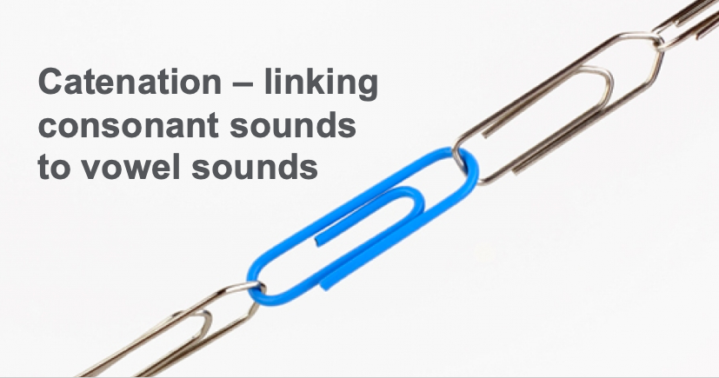
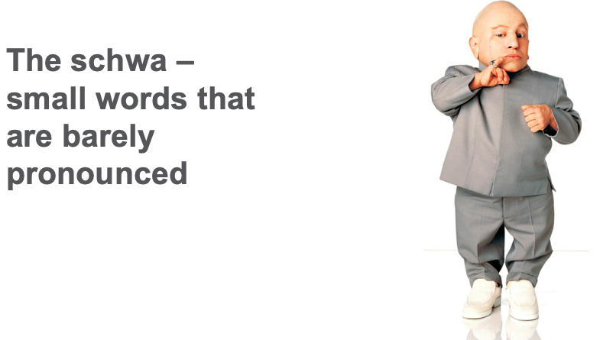
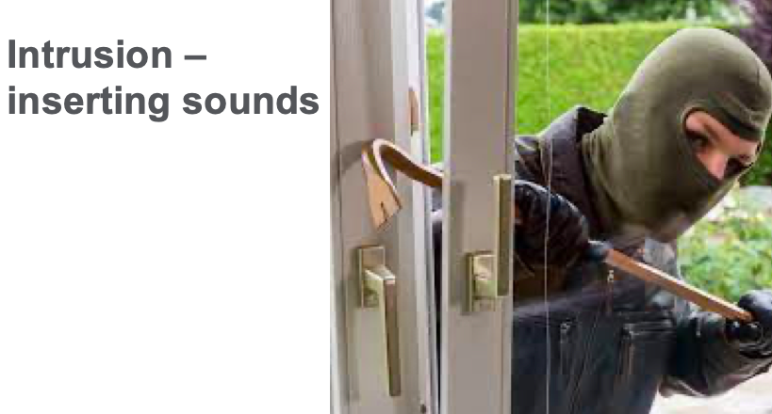
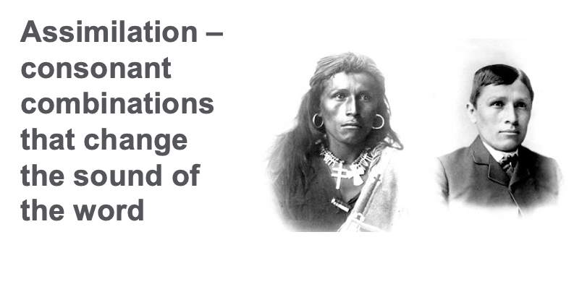

Slide 27

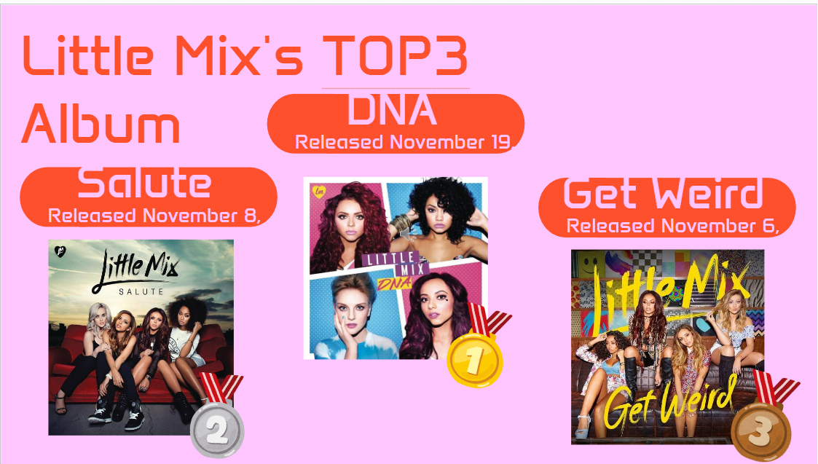
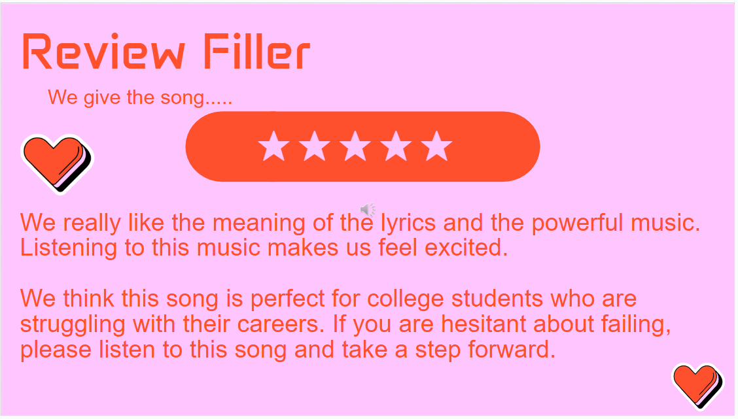
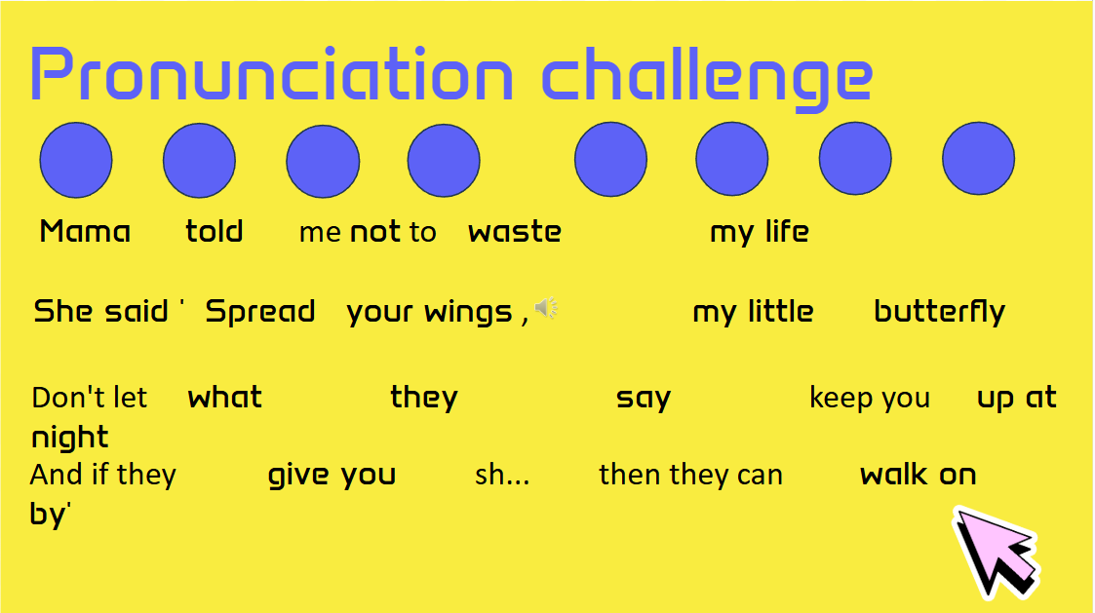
what we did in this course!!

Slide 28
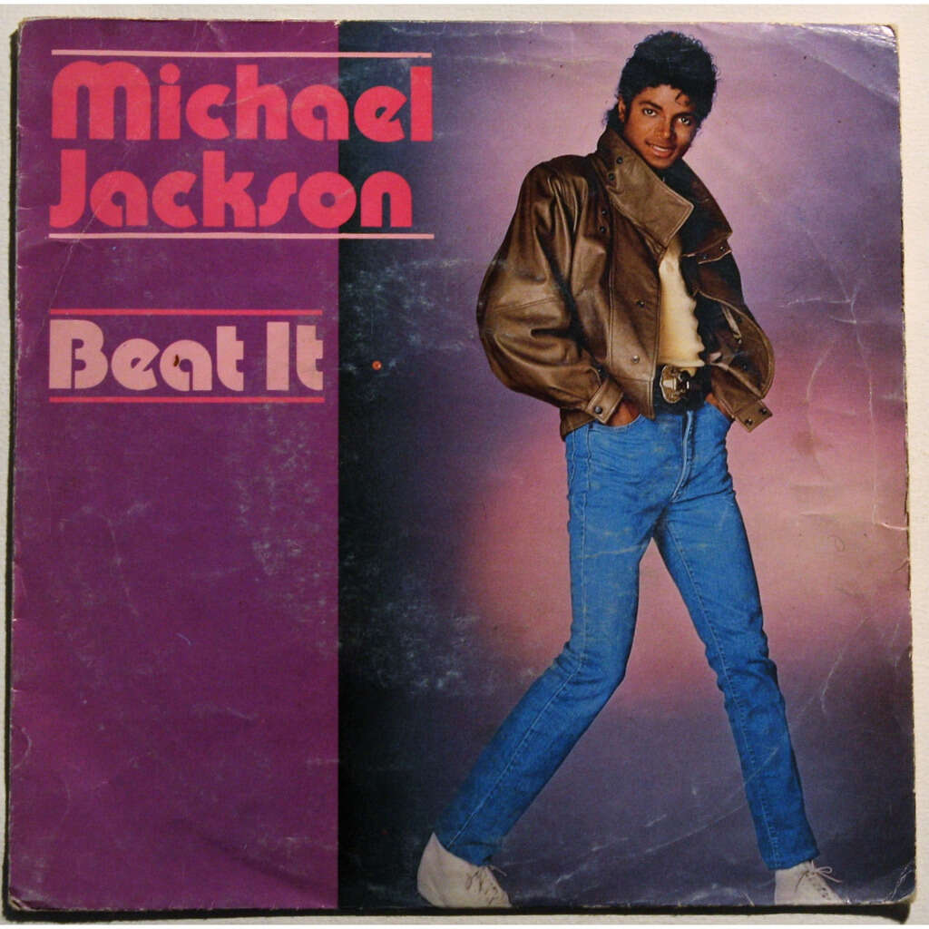
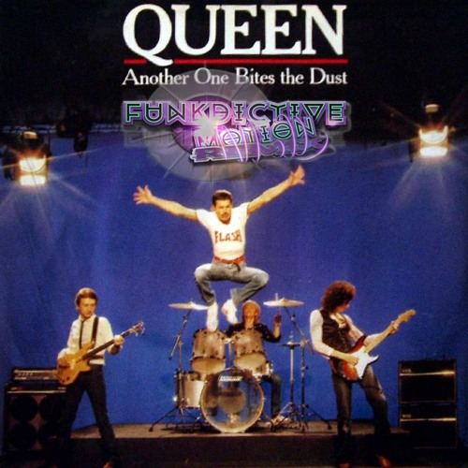
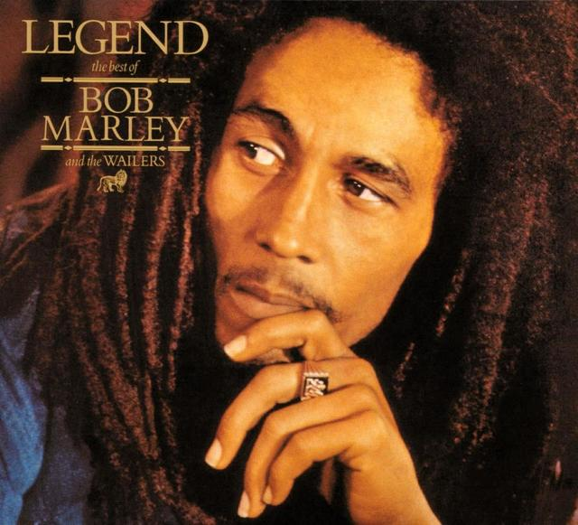






we learned a lot of genre music!!

Slide 29
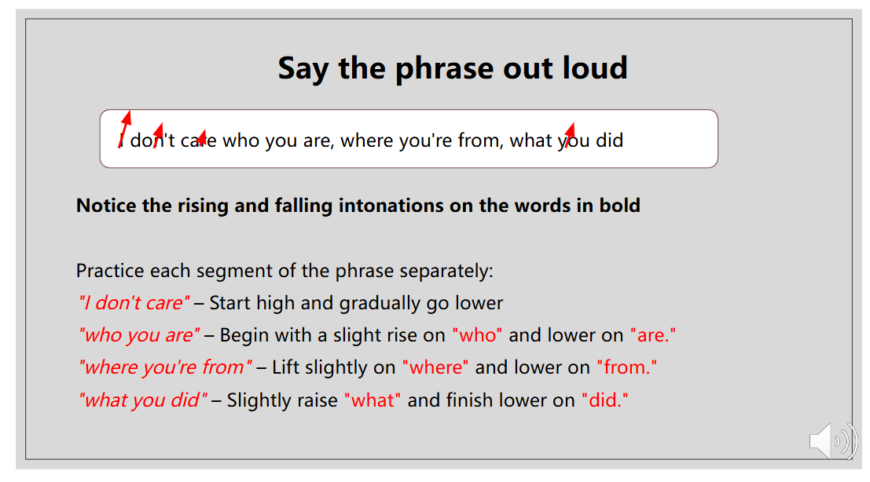
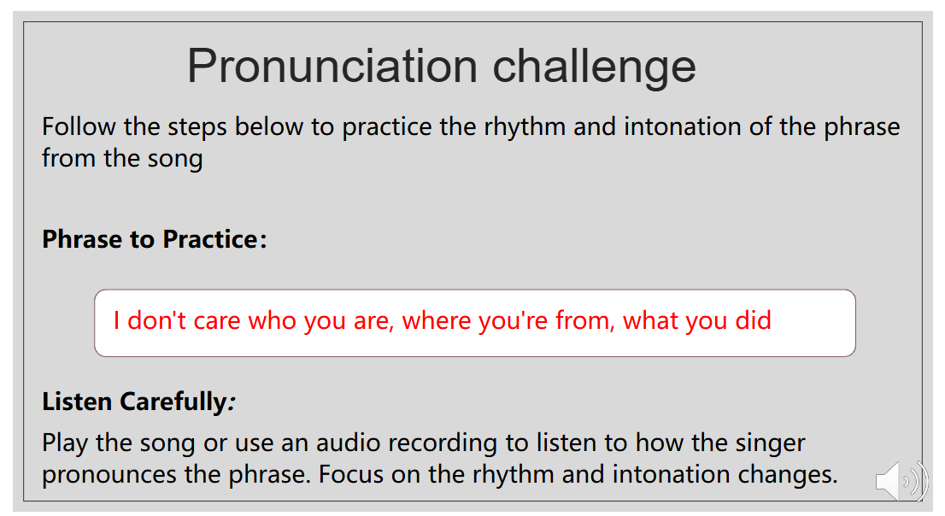
How to pronounce correctly ?

Slide 30
Thank you for listening!!
Please check on the Oh-o! Meiji

