Slide 1
A 3-step guide to believing in yourself

Slide 2

Why I chose this topic
I have always had
little confidence in myself
I realised that I was envious of confident people
and the only thing that seperated me from them was
the negative voices in my head.
I hope that this Ted Talk will give you
the courage to believe in yourself,
or at least start to be kind to yourself.

Slide 3
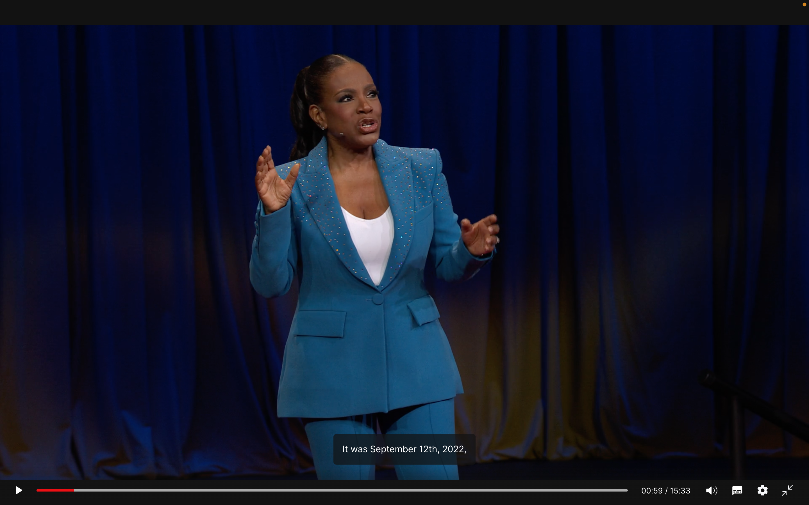
https://www.ted.com/talks/sheryl_lee_ralph_a_3_step_guide_to_believing_in_yourself?utm_campaign=tedspread&utm_medium=referral&utm_source=tedcomshare

Slide 4
Vocabulary
Find the Synonym!
Disbelief
Reframing
Ignorant
Glimpse
Choose from below!
Reevaluate・Quick Look・Uneducated・Skeptisism

Slide 5
Question 1
What is the first thing that we need to do to believe in ourselves according to Sheryl Lee Ralph?
Confidence
See ourselves for who we are
Suround ourselves with positive people

Slide 6
Question 2
How did thinking help her believe in herself according to the Ted Talk?
(Hints: Hollywood, Director, Tom Cruise)
A.

Slide 7
Question 3
What is the greatest relationship you will ever have according to Sheryl Lee Ralph?
The one with your friends and family
The one with your partner
The one with yourself

Slide 8
Thank you for Reading!!

