Slide 1


Scene from
A Man Called Otto
A MAN CALLED OTTO Clip - "Need Help? Ask A Beaver" (2023) Tom Hanks https://youtu.be/GdP7pfbpFQo?t=584
By Unknown - IMP Awards, Fair use, https://en.wikipedia.org/w/index.php?curid=72062744

Slide 2
Why I chose the movie and the scene?
I saw it before, and I thought it was interesting. Main theme of the movie is the solitude and recovery through relationships with others. It taught me the importance of relationships with people.
I like the main character Otto a lot. You may not like him at first just from watching this scene, but I urge you to watch the whole film. He is stubborn, but he is a very human character who complains but can still do things for others!
The scene delicately illustrates the suffering caused by his loneliness and stubbornness. The dis-communication between him and those around him is painful and hard to watch.

Slide 3
Background of the scene
First, he has lost his wife and now lives alone . Everything has gone wrong since he lost his wife and he is not well thought of by people around him because he is stubborn and a poor communicator.
The first scene is in a hardware store, where he tries to buy a rope to do something. He is not happy with the way the store has decided to pay for it, which annoys the shopkeeper.

Slide 4

Background of the scene 2
The second scene is in his work office, where his colleagues are preparing and waiting for his retirement party. However, he does not like this. He has resigned for a certain reason, but there seems to have been a discrepancy in perception with his boss.
The third scene is when he is going home and he blames the driver of the car parked on the street, but he is taken aback and not taken seriously. In fact, he hates bad things.

Slide 5
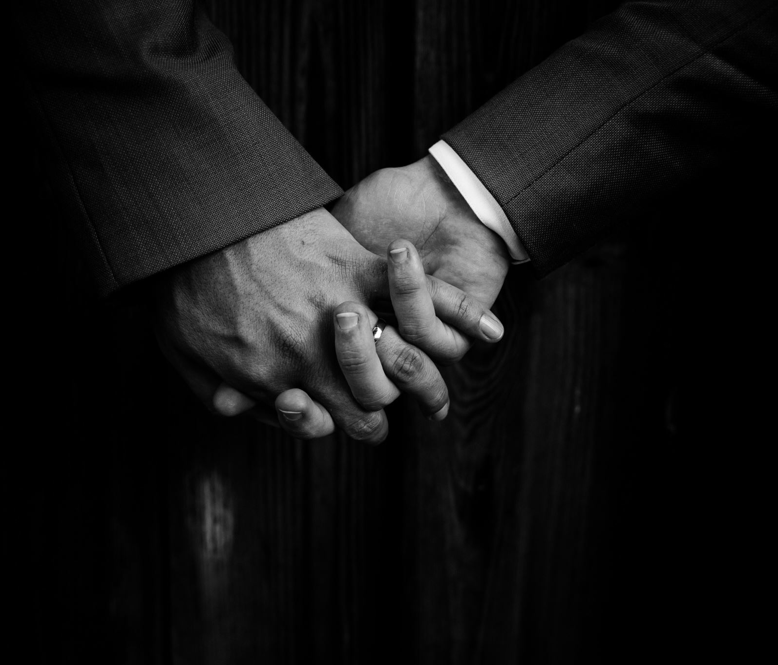
Some words and phrases you should know
Referenced: The Britannica Dictionary https://www.britannica.com/dictionary
・Severance
the act of ending someone's employment, or relationship
severance package: money and other benefits given when employment is ended
・Asset
1. a valuable person or thing
2. something that is owned by a person, company, etc. — usually plural

Slide 6

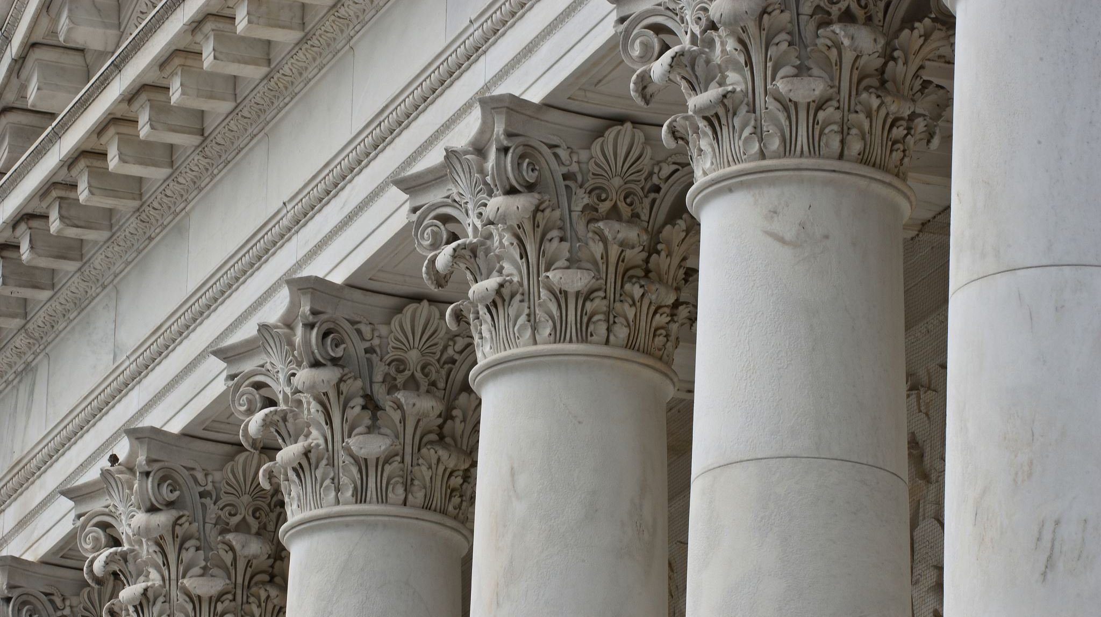
・Busy beaver
It means that the person is hardworking and very industrious. It is often said “busy as a beaver”.
There is a similar word: busy as a bee.
・Sue, Accuse, Prosecute
・Sue: to initiate a civil legal action against someone in court
・Accuse: to claim that someone has done something wrong or illegal, which can be done by anyone, not just legal authorities
・Prossecute: initiating and pursuing criminal charges against someone

Slide 7
Now let’s watch the scene from “A Man Called Otto”
https://youtu.be/GdP7pfbpFQo?t=584

Slide 8


・Get your teeth into~
to become fully involved in (something, such as a new activity) : to do or deal with (something) with a lot of energy, interest, etc.
・Merger
the act or process of combining two or more businesses into one business

Slide 9
Some questions about the content
Why frustrated Otto at the hardware store?
Why did Otto take the severance package? (Why did he quit his job?)
What does Otto mean by “How come it’s always you brown guys? And I don’t mean that racially!”? (09:18~ https://youtu.be/GdP7pfbpFQo?t=558 )

Slide 10
Discussion Topic
:you can write down what you think.
・Why do you think the man at the office said ”Yes! Well, no. Give you a nice sendoff”? (07:47~ https://youtu.be/GdP7pfbpFQo?t=467)
・What kind of person do you think Otto? On the basis of which part did you think so?
・Do you think Otto would be a good friend to you? Why or why not?

Slide 11
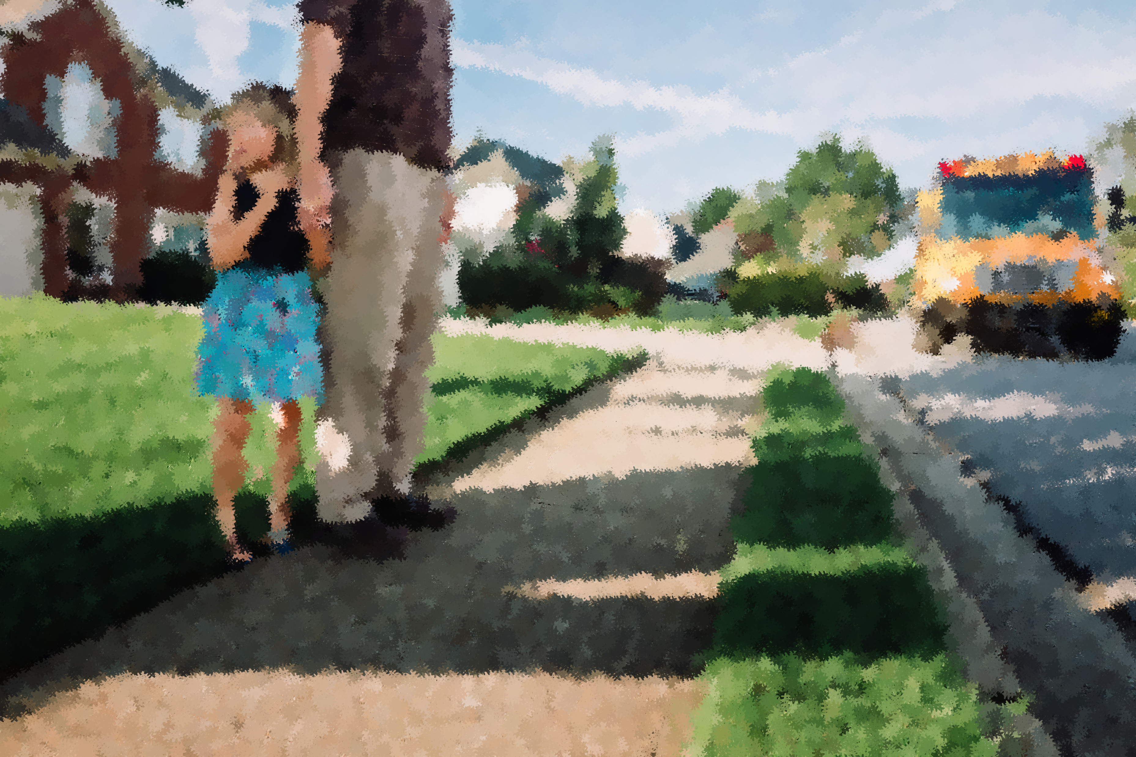

Fun activity: Vocabulary Exercise
Choose the synonyms of the words
1. busy as a beaver
2. sue
3. get teeth into
4. sendoff
5. severance
6. supervisor
7. merger
8. asset
9. as hell
10. through street
chief
prosecute
benefit
throughfare, main street
restless
unification
really
deregistration
be involved in
valediction

Slide 12
Fun Activity: Dictations one words should be in each blanks
Do you think I’m going to cut myself and ( ) all over your floor and ( ) you? (00:48~ https://youtu.be/GdP7pfbpFQo?t=48)
This is the assistant manager? How old is she? ( ) ( ) be in the ( ) ( )? (02:09~ https://youtu.be/GdP7pfbpFQo?t=129)

Slide 13
Fun Activity: Dictations 2
3. I’m sorry you see ( ) ( ) ( ). We all had to adjust after the ( ). But you’ve been quite an ( ) to this company over the years, so.
(08:16~ https://youtu.be/GdP7pfbpFQo?t=495)
4. It says “permits” and you don’t have one. This is not a ( ) ( ).
(09:03~ https://youtu.be/GdP7pfbpFQo?t=543)

Slide 14

What we can learn from the scene
:focus on Otto’s personality
・Basically unhappy
He always wrinkles his brow and this does not change when talking to others.
・A desire not to be disdained and a sense of independence.
In the first part of the scene, Otto turns down more coldly than necessary a clerk who offers to help him favorably. He speaks intensely in a hard tone of voice and refuses help.
[Otto] You think I don’t know how to cut rope?
[Clerk] No it’s just we usually do that for you.
[Otto] Do you think I’m going to cut myself and bleed all over your floor and sue you?
From the dialogue, we can read Otto‘s strong sense of independence, that he can do everything himself, and his fear of being disdained. This is probably due to his feeling of old age and helplessness following the loss of his wife.

Slide 15
・Stubborn and too sensitive
[Otto] This is about the fact that I got 5 feet of rope because I want 5 feet of rope and I shouldn’t have to pay for 6 feet of rope if I don’t want six feet.
He is unwilling to accept the shop's pricing structure. What he says certainly makes sense, but he sticks too much to the details, which annoys the shop and other customers.
・Sense of justice and responsibility
In the middle of the scene, Otto patrols the town. He does this at a set time every day. He has a strong sense of responsibility and hates bad behavior. As evidence of this, in the middle of the film he cautions drivers who do not follow the sign rules. From the last scene, he appears to be a straightforward character who does not approve of things like racism.
[Otto] The other guys don’t do this. The guys with the white trucks. How come it’s always you brown guys? And I don’t mean that racially!
・ Insensitive to the favor of others
He could not have been happier with the retirement party his colleagues had prepared for him. From what his colleagues say, they tries to liven things up with jokes in a fun atmosphere, but he leaves. It seems like he is staying in his shell.

Slide 16
Transcript (There is no sound from 02:37 to 07:15 on the video.)
JoBlo Movie Clips. (2023). A MAN CALLED OTTO Clip - "Need Help? Ask A Beaver" (2023) Tom Hanks. YouTube. https://www.youtube.com/watch?v=GdP7pfbpFQo
00:05~ (https://youtu.be/GdP7pfbpFQo?t=5) –at the hardware store
[Announcement] Welcome to the store! Are you a busy beaver?
[Otto] No. I’m not a busy beaver.
[Announcement] Are you a Frequent Beaver? Join our rewards club for savings. You can get your teeth into our dam good deals.
[Announcement] Don’t forget, if you need help, ask a beaver!
[Clerk] Hey, oh, can I help you that sir?
[Otto] You think I don’t know how to cut rope?
[Clerk] No it’s just we usually do that for you.
[Otto] Do you think I’m going to cut myself and bleed all over your floor and sue you?
[Clerk] No.
[Otto] Then I don’t need your help.
[Clerk] Excellent day.
[Otto] Idiot.

Slide 17
01:06~ (https://youtu.be/GdP7pfbpFQo?t=66) –at the hardware store
[Clerk] Did you um, find everything you’re looking for today?
[Otto] Yes.
[Clerk] Good. See here…. Uh, your total is 347.
[Otto] You charged me for 6 feet of rope.
[Clerk] Oh, yes. It’s 99 cents a yard.
[Otto] I didn’t get 2 yards. I got five feet.
[Clerk] Yeah, we, we don’t charge by the foot by the yard.
[Otto] 99 cents a yard is 33 cents a foot times five. That’s 165. You charged me a dollar 98.
[Clerk] You’re good at math. No, I know but I can’t put it into the computer the way that you just said.
[Otto] What the hell kind of computer can’t do simple math. Can I speak to your manager?
[Clerk] He’s at lunch.
[Otto] Lunch. All anyone cares about these days is lunch. Is there anyone else in charge?
[Clerk] The assistant manager?
[Otto] Yes, I’d like the assistant manager.
[Clerk] Okay. Hey Taylor? Taylor, the front register.

Slide 18
02:08~ (https://youtu.be/GdP7pfbpFQo?t=128) –at the hardware store
[Taylor, Assistant manager] What’s up?
[Clerk] Oh, hey Taylor.
[Otto]This is the assistant manager? How old is she? Shouldn’t you be in the gym class?
[Taylor] Sorry… What?
[Customer] Here, I got some change. Let me cover that extra 33 cents for you –
[Otto] Sir, I do not want your 33 cents! This isn’t about 33 cents! This is about the fact that I got 5 feet of rope because I want 5 feet of rope and I shouldn’t have to pay for 6 feet of rope if I don’t want six feet.
[Taylor] Did you want another foot of rope?

Slide 19
07:29~(https://youtu.be/GdP7pfbpFQo?t=449) -At the office
[man] There he is, the big man himself.
[Otto] What’s all this?
[man] It’s, well, retirement cake, I guess. Call it what you like.
[Otto] “Have fun.”
[man] “Have fun.”
[Otto] Doing what?
[man] Have fun with the rest of your life. We wanted to, you know…
[Otto] Celebrate?
[man] Yes! Well, no. Give you a nice sendoff.
[Otto] “Nice.”
[man] Come on, Otto. You’re the one who decided to leave. And you did get a nice severance package.
[Otto] You took me off Operations. You cut back on my hours. You made Terry, who I trained, my supervisor. Terry, who can barely figure out what year it is without his phone. So, yes, I took the severance package.
[man] I’m sorry you see it that way. We all had to adjust after the merger. But you’ve been quite an asset to this company over the years, so
[Another man] You have. Reliable as hell.
[woman] We’re gonna miss those schedules of yours.

Slide 20
[chattering]
To Otto!
To Otto!
To Otto.
[man]Okay, Otto. Want a piece of your face?
[man]Who’s hungry?
[employees laughing]
08:50 (https://youtu.be/GdP7pfbpFQo?t=530) -Otto go back to his home.
[Otto] Look at this. No, no. Hey, hey, wait! No, no, no. Hey, you cannot use this road without a permit.
[Delivery driver] I’m not parking. I just dropped off a package. The sign doesn’t say anything about packages, does it?
[Otto] It says “permits” and you don’t have one. This is not a through street.
[Delivery driver]Have a nice day, sir.
[Otto] Every time you come in here that means one of the residents can’t park in front of their homes! The other guys don’t do this. The guys with the white trucks. How come it’s always you brown guys? And I don’t mean that racially!
[woman’s voice] Oh, hi. Sorry, can you hear me?
[Otto] Yes.
[woman‘s voice] It’s Susan.
[Otto] Susan who?
[woman’s voice] I have great news about your health insurance.
[Otto] Oh, no, no, no. Robot, robot, robot!

Slide 21
Answers
Questions about the content
1. Why was Otto irritated at the hardware store?
Because he didn't agree that he had to pay for six feet of rope when he only wanted five feet.
2. Why did Otto take the severance package? (Why did he quit his job?)
Because his boss removed him from the operation, reduced his working hours and, on top of that, made Terry, whom he trained, his supervisor.
3. What does Otto mean by “How come it’s always you brown guys? And I don’t mean that racially!”?
He means that people in white trucks do not park on the street, but people in brown trucks always park on the street.

Slide 22
Answers
Vocabulary
busy as a beaver- E. restless
sue- B. prosecute
get teeth into- I. be involved in
sendoff- J. valediction
severance- H. deregistration
supervisor- A. chief
merger- F. unification
asset- C. benefit
as hell- G. really
through street- D. throughfare, main street
Dictations
bleed, sue
Shouldn’t you, gym class
it that way, merger, asset
through street

Slide 23

Thank you very much!
I hope you find this film interesting!

