Slide 1

A Simple Way To
Brake A Bad Habit

Slide 2




Today’s Contents
Fun Activity
The Vocabulary and the Contents of the Video
Engaging Questions
The Reason Why I Chose This Topic

Slide 3
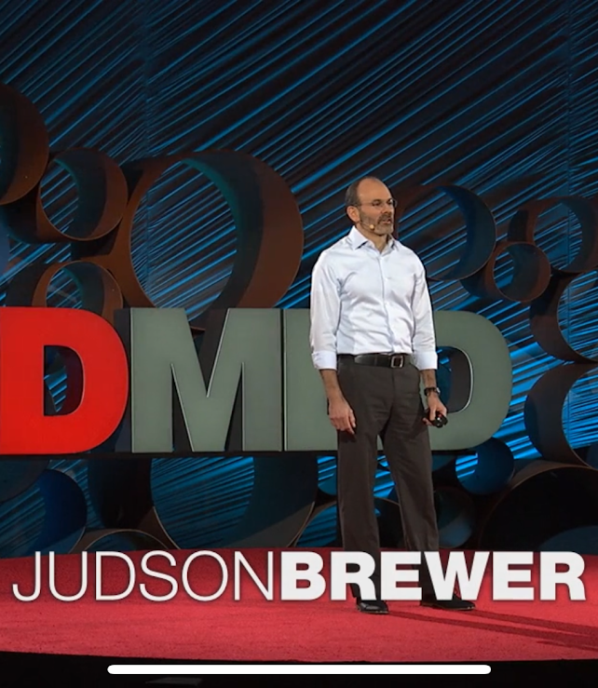
The Reason Why I Chose This Topic
01

Slide 4


The Reason
I was really attracted with the title because I want to stop eating something sweet, but I can’t. Thus, I want to know the reason why I can’t.
In the video, the speaker mentioned the reasons why people can’t quit bad habits and how to solve this problem.
I want you to know the contents from this presentation and I hope that you would be able to quit the bad habits.
01

Slide 5
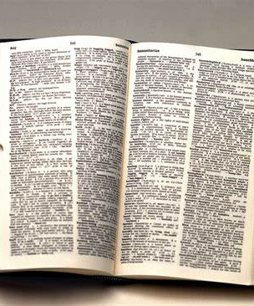
The Vocabulary and the Contents of the Video
02

Slide 6
Vocabulary
Prefrontal Cortex
The front part of the brain , that is important in human behavior such as planning , decision-making, and self-control
Disenchanted
No longer believing in the value of something, especially having learned of the problems with it
02

Slide 7
Contents
The reason Why People cannot quit bad habits is attributed to Context depending memory
ex))
1 See food (trigger)
2 Eat food (behavior)
3 Feel good (reward)
People repeat this process and cannot quit it.
After that, the trigger changed to the stress.
When people feel stress, their brain order to eat food I to feel good.
02

Slide 8
Contents
The way to quit the bad habits is…..
Be curious about what is like when you doing bad habits.
Prefrontal cortex tries to control your behavior using cognition, but it doesn’t work when you feel stress
=It is meaningless when you want to quit bad habits.
So, being curious about bad habits and disenchant with yourselves is so important.
02

Slide 9
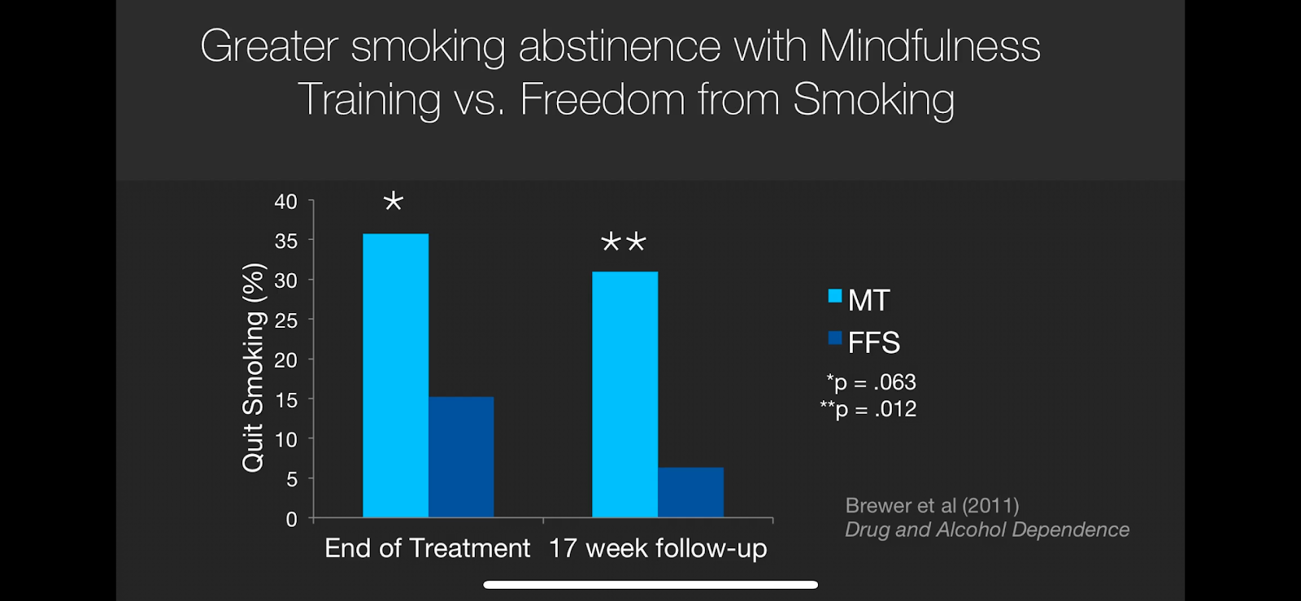
Contents
Seeing really clearly what you get when you get caught up in your behaviors, becoming disenchanted on a visceral level.
From this disenchanted stance, naturally letting go of bad habits.
= Mindfulness Training
02

Slide 10

Engaging Questions
03

Slide 11
Questions
Do you have any bad habits that you want to quit?
If you have bad habits that you want to quit, have you ever failed to quit bad them?
Do you want to try mindfulness training?
03

Slide 12
My Answers
I have bad habit that I want to quit. I cannot stop eating something sweet. Sometimes, I eat sweets instead of meal. I understand that it is not good for my health, but I cannot quit.
I always try not to eat sweets, but I can’t. When I feel tired, I usually eat too much.
I would like to try mindfulness training mentioned in the video. If I were curious about my bad habit, I might quit it.
03

Slide 13

Fun
Activity
04

Slide 14


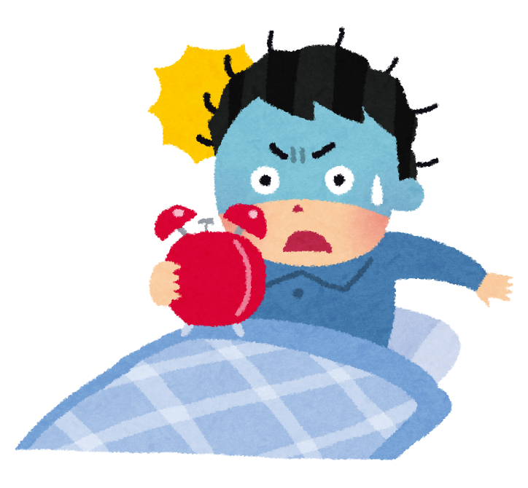
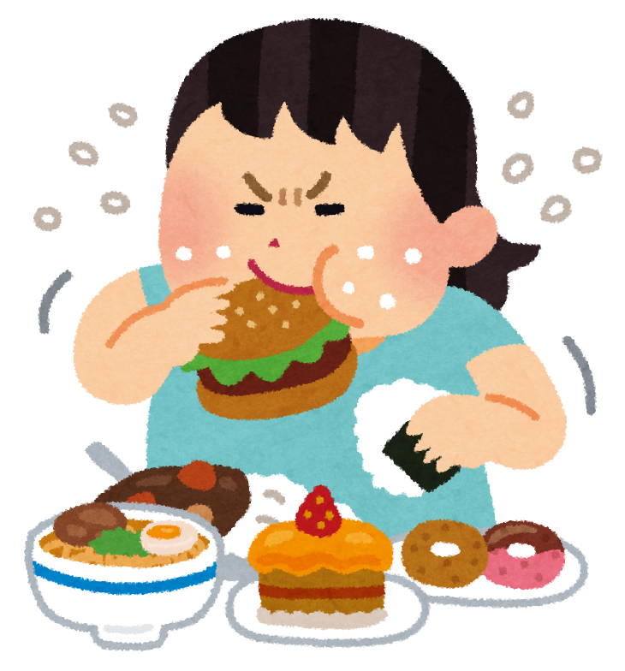



















Ladder Lottery
Who can quit old habits?
04

Slide 15

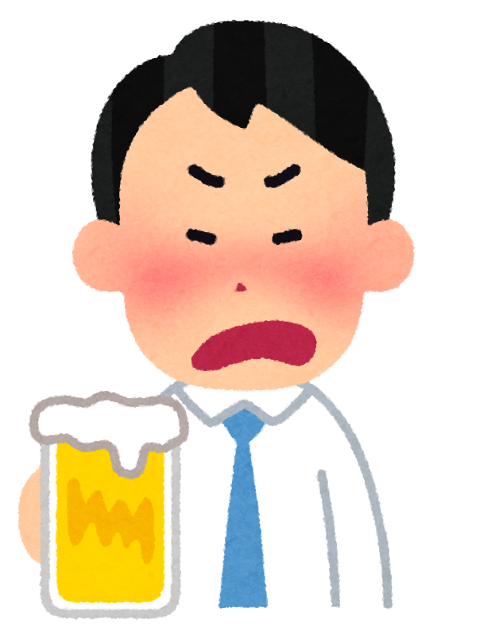
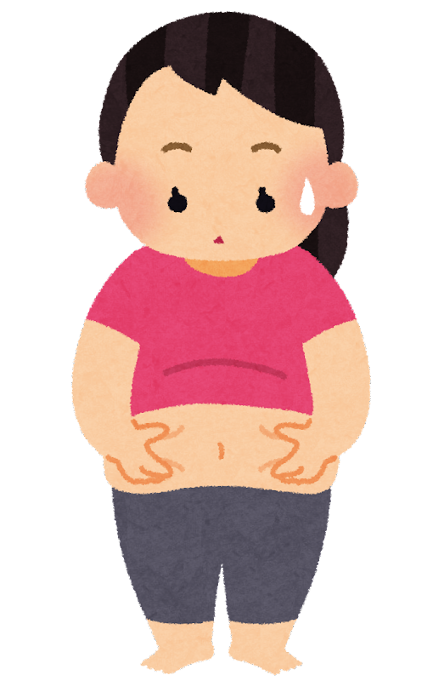





04
I hope you enjoyed it.

Slide 16
Recourses
Title: A simple way to break a bad habit
Speaker: Judson Brewer
Link: : https://www.ted.com/talks/judson_brewer_a_simple_way_to_break_a_bad_habit?utm_campaign=tedspread&utm_medium=referral&utm_source=tedcomshare
03

Slide 17

Thank you!!

