Slide 1


About Time
URL: https://youtu.be/m30r2iDohDg?si=3Ki0siUP3eQTjCdB

Slide 2
1. Background
The movie
The story is about a young man named Tim who can time travel and tries to change his past to make his future better.
Although it is a romantic movie, it also focus on the relationship between Tim and his family, especially his father, who also has the same ability.
I chose this movie because the plot is about time, which all of us have, and shows how precious time we have is and how important the way we spend is.
The scene
In the scene, Tim visits his father, who has got cancer.
I chose this scene because I agree with Tim’s father’s idea about life. No matter who you are, you can never predict the future. There are good things and bad things in your life, but that is the way it is, and you must accept the truth to live each day without regrets.

Slide 3
1. Vocabulary
roll up: to arrive
blub: to weep or cry noisily and without restraint. A slang word for blubber
undo: to reverse the doing of
go out with: to date
let down: to disappoint
mixed bag: an often-unexpected assortment of various things, people, or ideas
turn out: to end up; result
cheat: to lie or behave dishonestly
formula: fixed or conventional method or approach

Slide 4
1. Questions
Q1. How long is Tim’s father supposed to live?
Q2. How was Kit Kat when she came to visit Tim’s father?
Q3. What is the cause of the cancer?
Q4. How did Tim’s father describe life?
Q5. Why did Tim’s father mention Jesus?
Q6. What did Tim want his father to tell him?

Slide 5
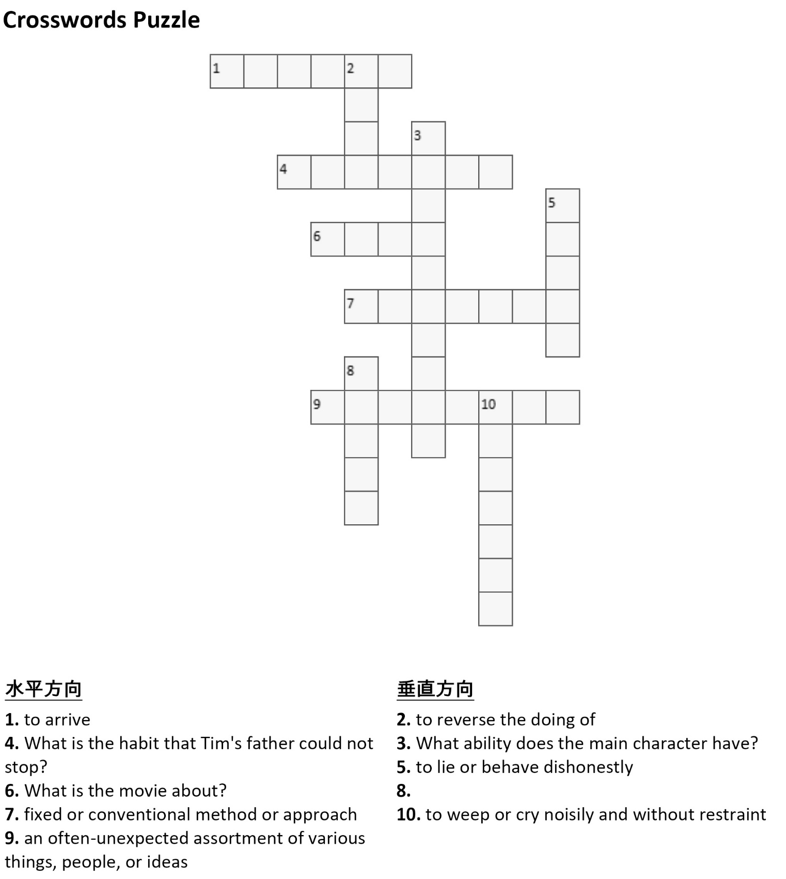
Check your understanding!!

Slide 6
Thank you for reading!!

Slide 7
The answers to the questions
Q1. For weeks.
Q2. She was crying.
Q3. Smoking is.
Q4. He describe life as a mixed bag.
Q5. He mentioned Jesus to explain about uncertainty of life because Jesus was crucified even though he was the Son of God.
Q6. He wanted him to tell him about the secret formula for happiness.

Slide 8
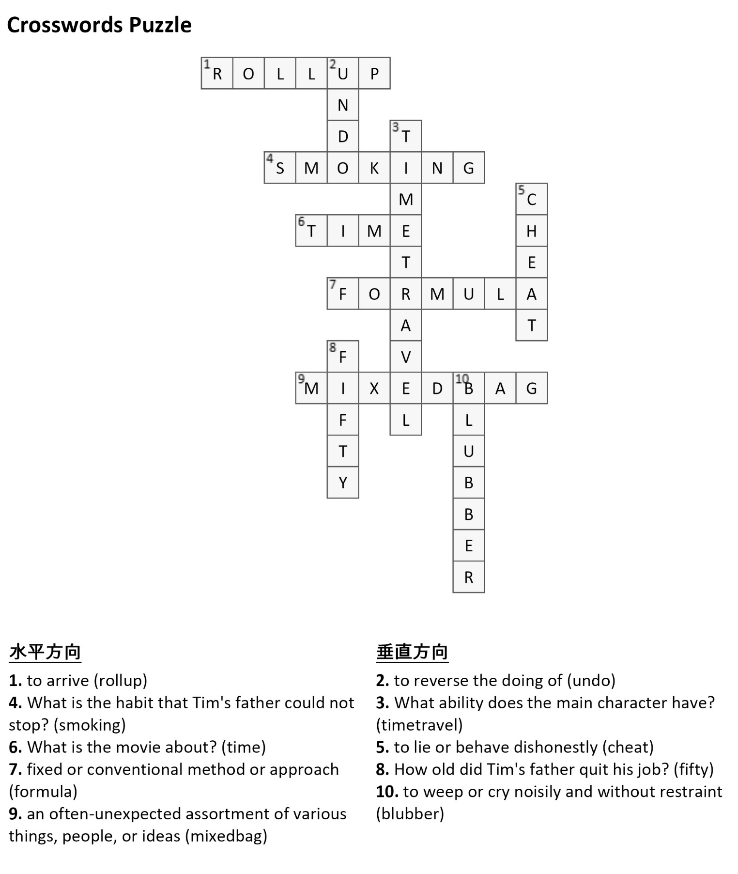

Slide 9
1. Transcript URL: https://youtu.be/m30r2iDohDg?si=3Ki0siUP3eQTjCdB
Tim: Dad.
Tim’s father: Oh, for God’s sake. Not you too.
Tim: What?
Tim’s father: Well Kit Kat’s just rolled up blubbing her eyes out and now you’re here. What’s Mom been saying?
Tim: The truth.
Tim’s father: Yeah, well, apart from that?
Tim’s father: It may have been the smoking, but I couldn’t undo that as it was before you were all born. And anyway, your mother definitely wouldn’t have gone out with me if I hadn’t been such a sexy smoker. I did get diagnosed as soon as possible, but it was too late.
Tim: How long have we got?
Tim’s father: You know, it, it could be years.
Tim: How long really?
Tim’s father: Weeks, I’m afraid.
Tim: Have we had this conversation before?

Slide 10
1. Transcript URL: https://youtu.be/m30r2iDohDg?si=3Ki0siUP3eQTjCdB
Tim’s father: Yeah.
Tim: What happened.
Tim’s father: I rather let myself down. I hugged you.
Tim: Sorry. I think I just thought with the time thing.
Tim’s father: No, I never said we could fix things. I specifically never said that. Life’s a mixed bag, no matter who you are. Look at Jesus. He was the Son of God, for God’s sake, and look how that turned out.
Tim: I know, but you must see I feel a bit cheated.
Tim’s father: Don’t. In fact, feel the opposite. The only people who give up work at 50 are the time travelers with cancer who want to play more table tennis with their sons.
Tim: Right. So that’s been the deal.
Tim’s father: I'm sorry we had to call. It’s suddenly got very bad. And I have something very important to tell you. Or, let me check, do you want to know the big secret, or would you rather find it out for yourself like I did?
Tim: Oh, Christ, there’s another secret?
Tim’s father: Less dramatic. Much more important. The real mothership.

Slide 11
1. Transcript URL: https://youtu.be/m30r2iDohDg?si=3Ki0siUP3eQTjCdB
Tim: No, go on. Tell me. Let’s save some time.
Tim: And so, he told me his secret formula for happiness. Part one of the two-part plan was that I should just get on with ordinary life, living it day by day, like anyone else.

