Slide 1

Thunderstruck
AC/DC

Slide 2

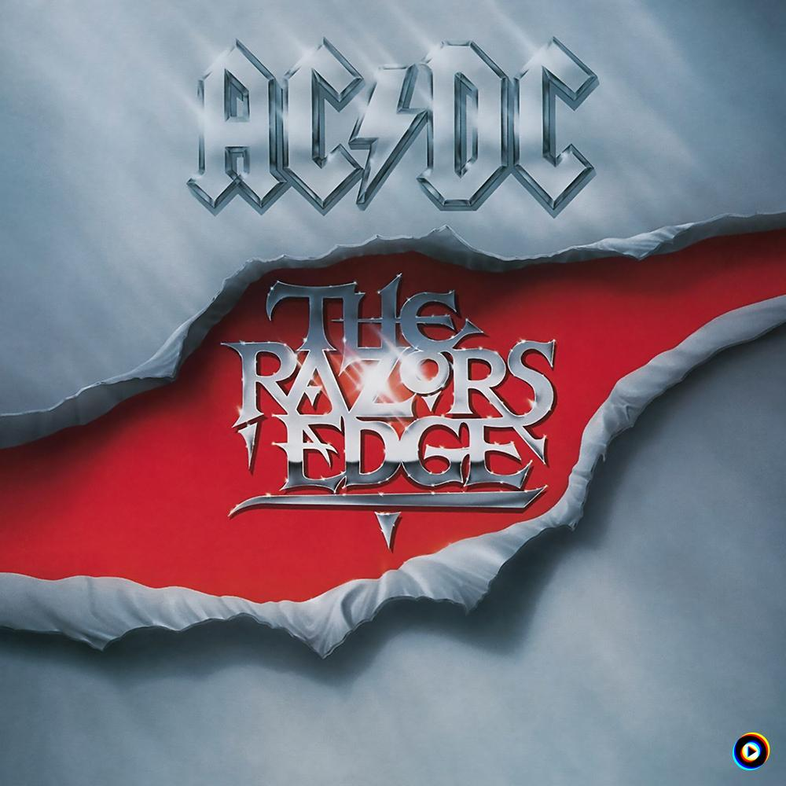
Explanation of AC/DC and Thunderstruck
AC/DC is a world-famous rock band that was formed in Australia in 1973.
It was formed in 1973 by Scottish brothers
Angus Young (lead guitar) and Malcolm Young (rhythm guitar).
“Thunderstruck” is featured on the album “The Rezors Edge”, which was
released in 1990.
It is also often used as an entrance song
for sports teams and a theme song for events.

Slide 3
Vocabulary
Thunderstruck Lexical meaning: feeling sudden and great surprise≒astonishing In song: They used this word to express amazed, overwhelmed feeling
Highway Lexical meaning: A main road for fast traffic In song: AC/DC image symbolizing freedom, speed, danger
No turning back Lexical meaning: A point from which you cannot return In song: Expresses the inevitability that once your thunderstruck

Slide 4
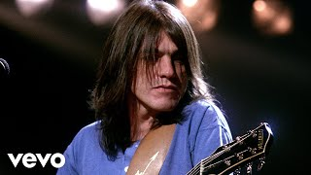
Thunderstruck AC/DC
[Intro]
Thunder,Thunder,Thunder,Thunder,Thunder,Thunder,Thunder,Thunder,Thunder,Thunder
[Verse 1]
I was caught
In the middle of a railroad track(Thunder) I looked ( )
And I knew there was no turning back(Thunder)
My mind raced
And I thought, what could i do?(Thunder)
And I knew
There was no help, no help from you(Thunder)
Sound of the drums
Beating in ( )
The thunder of guns
Tore me ( )
[Chorus]
You’ve been -thunderstruck
[Verse 2]
( ) down the highway
Broke the limit, we ( ) the town
Went through to Texas
Yeah, Texas, and we had some fun
We ( ) some girls
Some dancers who gave a ( )
Broke all the ( ), played all the fools
Yeah-yeah, they, they blew our minds
[Pre-Chorus]
I was shaking at the knees
Could i come again ( )?
Yeah, the ladies were too kind

Slide 5
[Chorus]
You’ve been-thuderstruck, thunderstruck
Yeah-yeah-yeah, thunderstruck
Oh, thunderstruck
Yeah
[Bridge 1]
I was shaking at the knees]Could I come again please?
Yow
[Solo]
[Chorus]
Thunderstruck, thuderstruck
Yeah-yeah-yeah, thunderstruck
Thunderstruck, yeah, yeah, yeah
Said
[Bridge 2]
Yeah, it’s ( )
We’re doing fine
Yeah, it’s ( )
We’re doing fine,( )
[Chorus]
Thunderstruck,yeah-yeah-yeah
Thunderstruck, thunderstruck, thunderstruck
Whoa, baby, baby(Thunderstruck)
You’ve been thunderstruck, thunderstruck
Thunderstruck, thunderstruck
You’ve been thunderstruck

Slide 6
Answer
(round) (my heart) (apart) (Went) (hit) (met) (good time )(rules) (please)
(alright) (so fun)

Slide 7
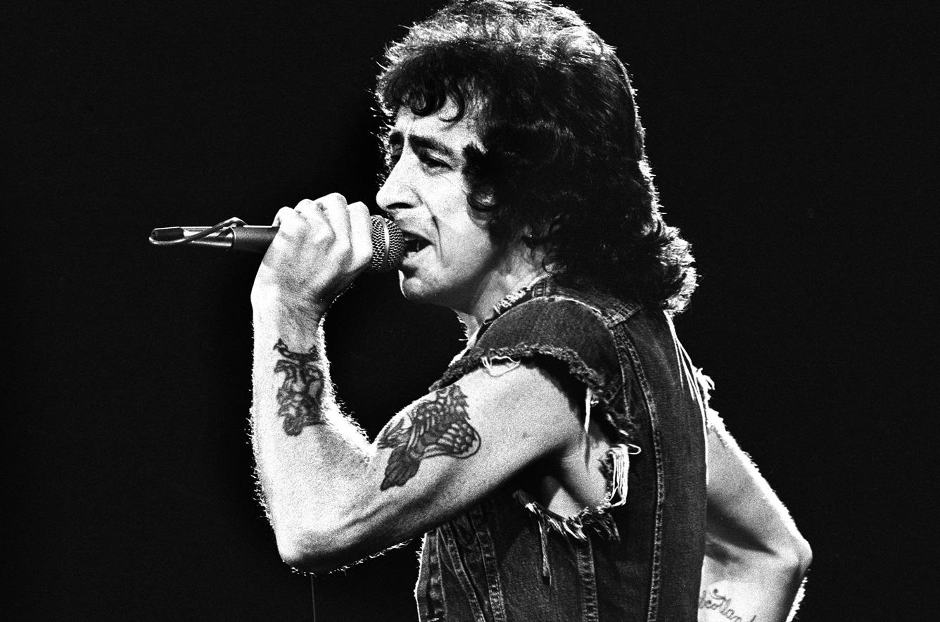
Interesting fact about AC/DC
The Vocalist of AC/DC
AC/DC was originally formed with vocalist Dave Evans. But after about 11 month, He left the band. He was replaced by Bon scott. And with Scott they released great albums such as: High Voltage(1975), Let There Be Rock(1977), Highway to Hell(1979)

Slide 8
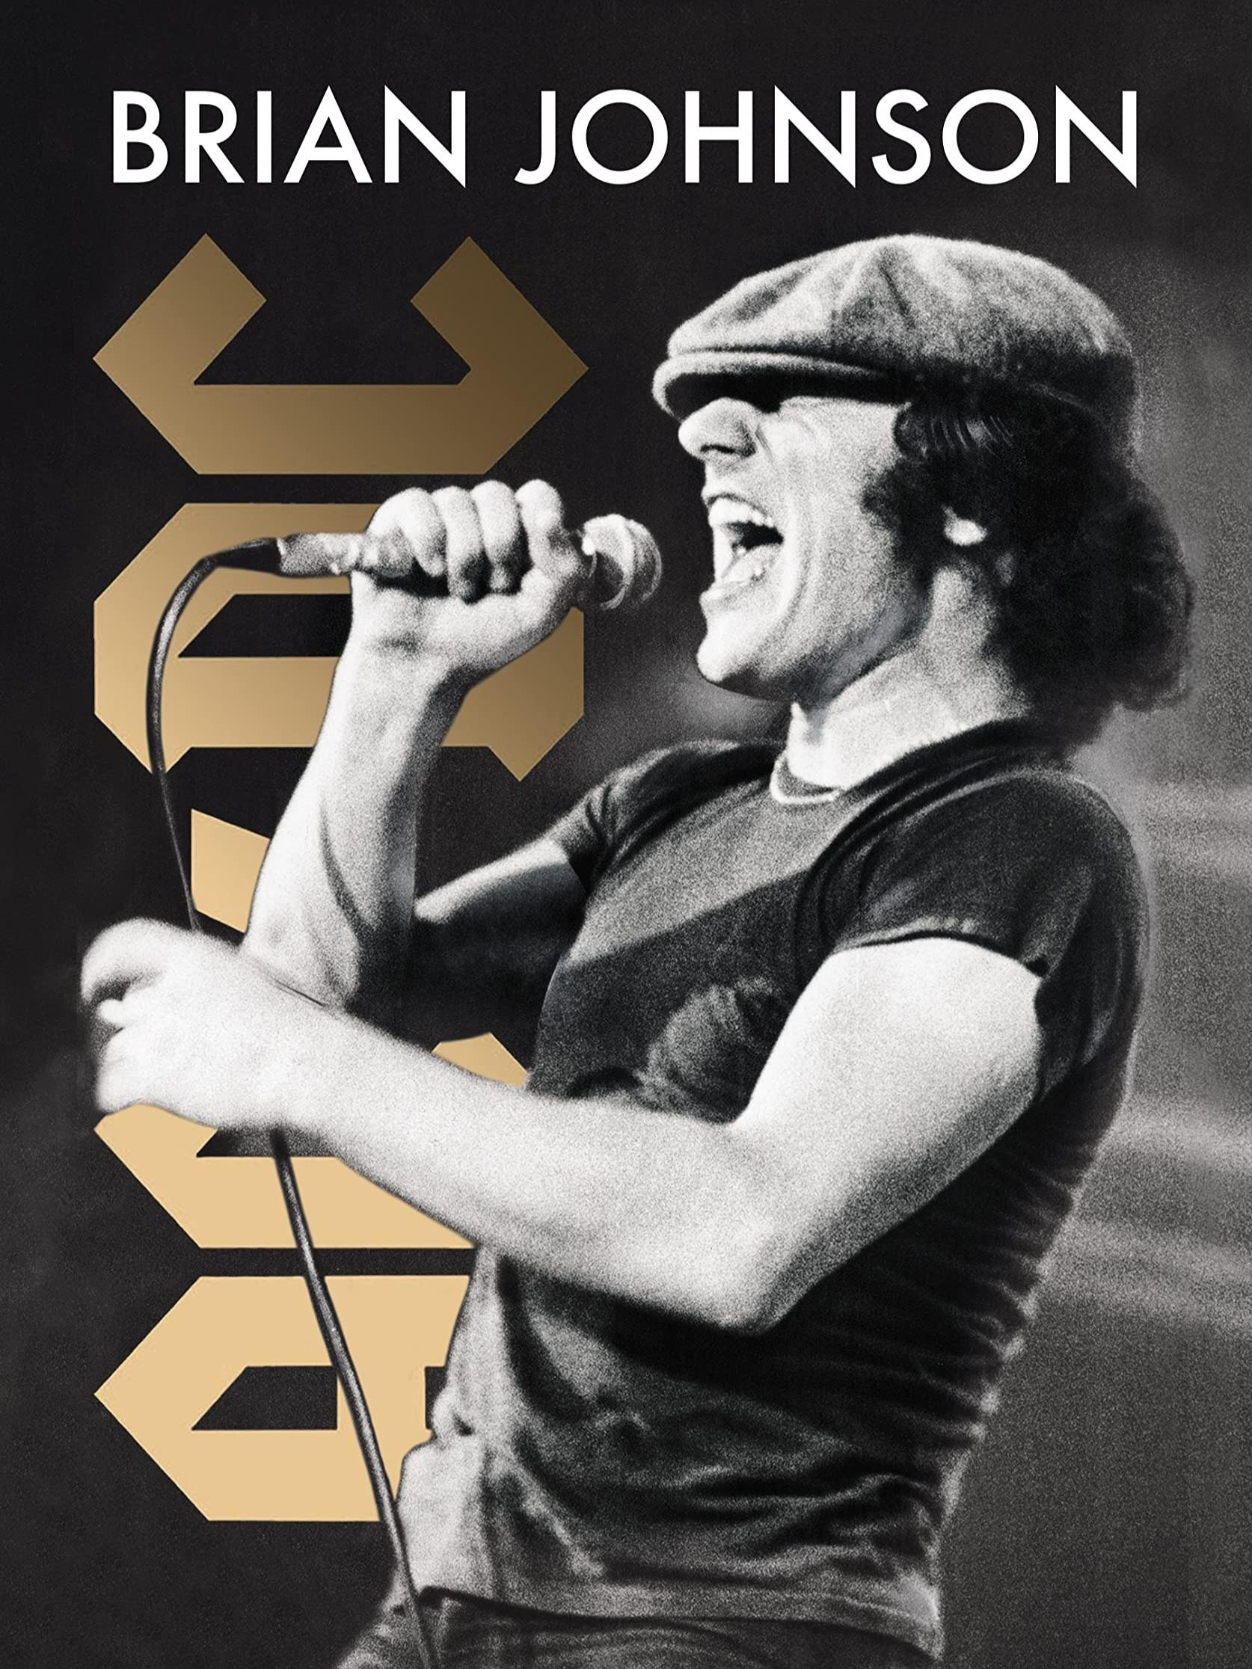
After the dead of Bon scott
In 1980 lead vocalist Bon scott died of alcohol poisoning. Soon after, Brian Johnson joined AC/DC as a new singer. The first album with Johnson, Back In Black(1980) became a world -wide success, selling over 50 million copies and ranking among the best-selling albums of all time After this huge comeback, AC/DC continued their success with such as For Those About to Rock (1981), Which became their first No.1 album in the U.S. This period firmly established the band as one of the greatest name in rock history.

Slide 9
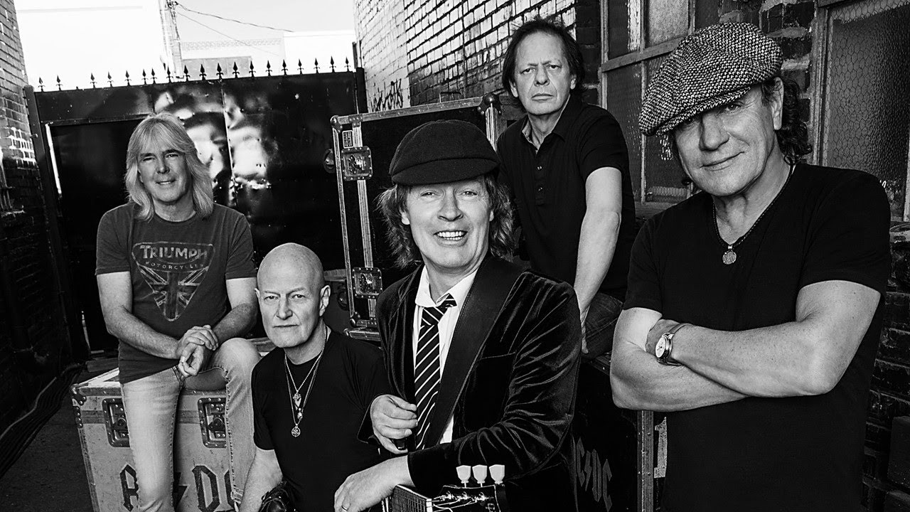
AC/DC’s Records and Achievements
Back in Black (1980) is AC/DC’s best-selling album, with over 50 million copies sold worldwide – the second best-selling album in music history
They have sold more than 200 million albums globally, making them one of the top-selling bands of all time.
For Those About to Rock(1981) became first No.1album in the U.S. Billboard 200.
The band has played sold-out stadium tours across the world for over five deca -des, proving their lasting popularity and influence.

Slide 10
Quiz
1.Who was the original lead vocalist for AC/DC?
A. Bon Scott
B. Angus Young
C. Axl Rose
D. Brian Johnson

Slide 11
2.Which AC/DC album is widely known as the best-selling hard rock album of all time?
High Voltage
B. Back In Black
C. High way to hell
D. Let There Be Rock

Slide 12
3.Who joined the band to replace lead vocalist Bon Scott after his death?
Paul Stanley
Axl Rose
Brian Johnson
Ian Gillan

Slide 13
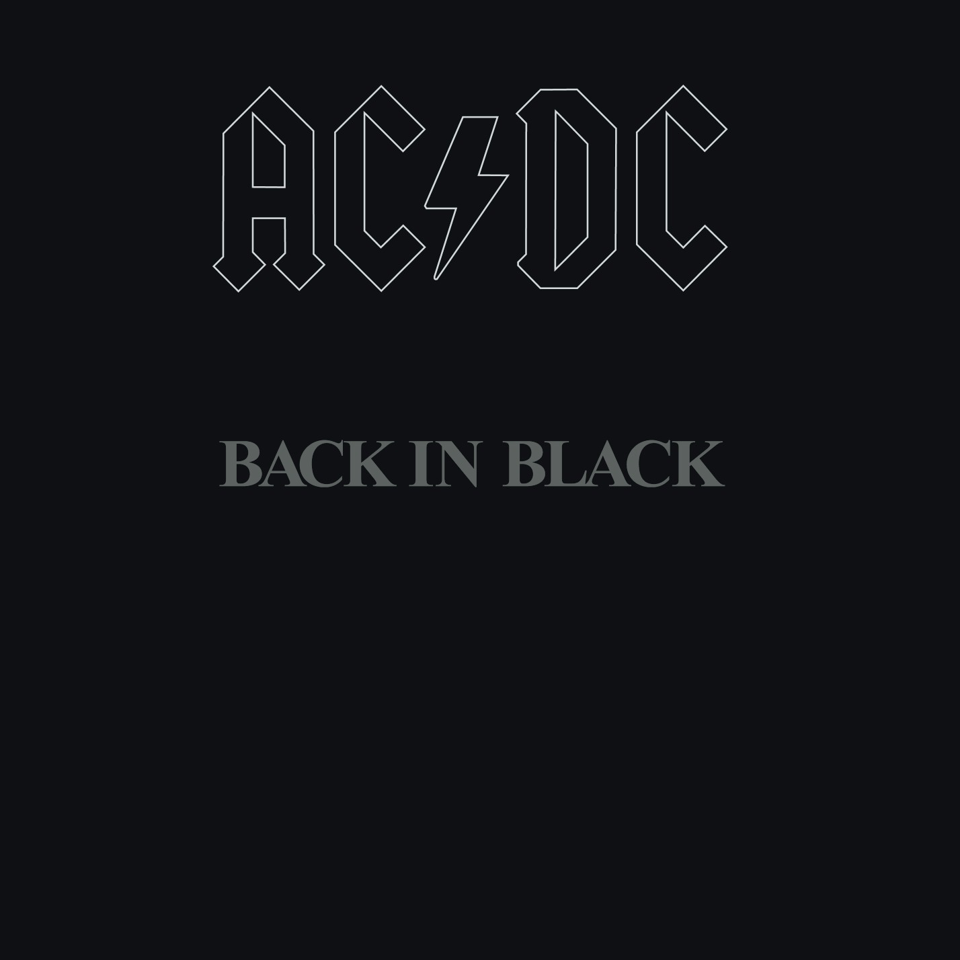
Answer
1.A
2.B
3.C

Slide 14
Pronunciation challenge!
Key phrase
You’ve been Thunderstruck juːv bɪn ˈθʌn↑.dər.strʌk↓
(short)

Slide 15
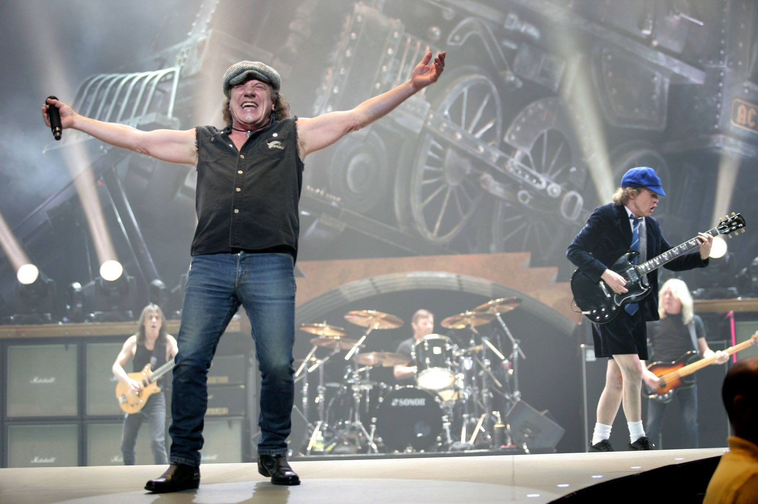
Thankyou for listening!

