Slide 1
Ted Talk Active Learning:
AI is dangerous, but not for the reasons you think

Slide 2
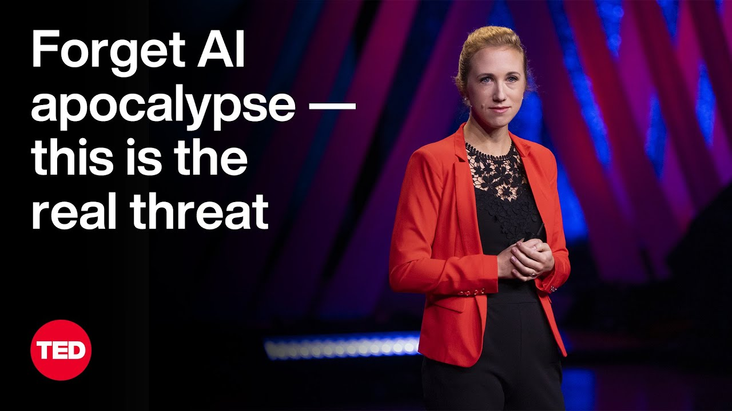
Speaker of the Ted Talk
Sasha Luccioni
She researches societal and environmental impacts of AI
Notes:
https://www.ted.com/talks/sasha_luccioni_ai_is_dangerous_but_not_for_the_reasons_you_think

Slide 3
Question No.1
What is the main topic for this talk?
About her work in AI is going to end humanity
The Pope in a puffer coat
AI’s impact on people and the society
Doomsday scenario

Slide 4
Question No.2
What do we have to do in order to have a safer AI models in the future?
Make the AI discriminate against people
To predict what is going to happen in a decade
Discover new molecules
Disclose information and make the system transparent

Slide 5
Question No.3
What does the word “query” mean in the following sentence: “And each time you query an AI model, it comes with a cost to the planet.”
Question
Uncertainty
Argument
scold

Slide 6
Question No.4
What did she find about the environmental impact of Bloom
It tells a knock-knock joke
It uses as much energy as 30 homes in a whole year
The amount of energy it uses is similar to driving a car daily
It has same environmental impact as GPT-3

Slide 7
Question No.5
What is CodeCarbon?
A smart fridge
A tool to know the amount of energy that the AI consumes and emits
New open large language model
All of the above

Slide 8
Question No.6
What did Karla Ortiz do?
Painted Sasha’s picture
Found the images of bikini models with three arms
She sued the AI companies for using her works without consent
Created the organization Spawning.ai

Slide 9
Question No.7
What did she mention about AI and bias?
Men of color are more detectable than white men
It could result in imprisonment
A pregnant women was wrongfully accused because of the AI system
People need to wear white-colored masks

Slide 10
Question No.8
What does her tool, Stable Bia Explorer do?
Generates pictures of men in glasses in lab coats
Represent the masculinity
Work for the US Labor Bureau of Statistics
Discover the bias of image generation models

Slide 11
Question No.9
What does the underlined word mean?
“…how we can make tools for people from all walks of life”
Hiking
Life
Different types of jobs
Young people

Slide 12
Question No.10
What is the conclusion of this topic?
AI has to stay accessible
We need to create tools to measure AI’s impact
The users could use the information to make a decision properly
All of the above

Slide 13
Answers!
C
D
A
B
B
6. C
7. C
8. D
9. C
10. D

