Slide 1




First Love
2002
By Anne Marie
First Love

Slide 2
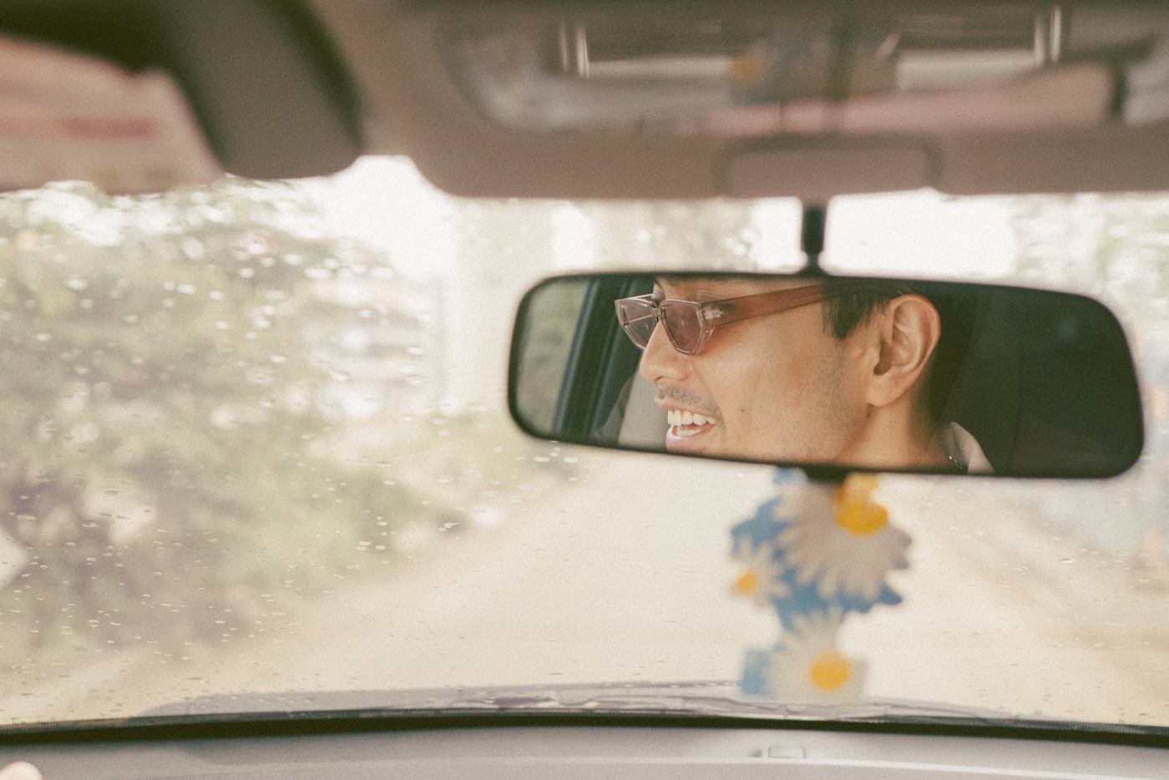

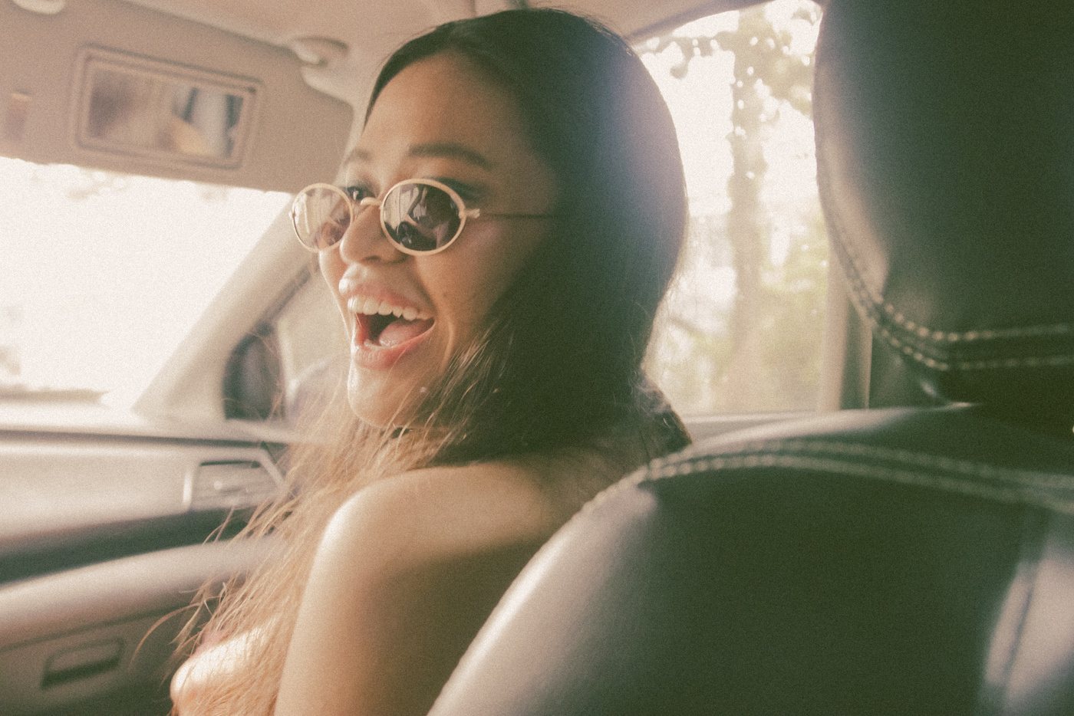
2002
What did you do in 2002?
2002

Slide 3

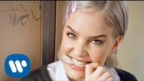
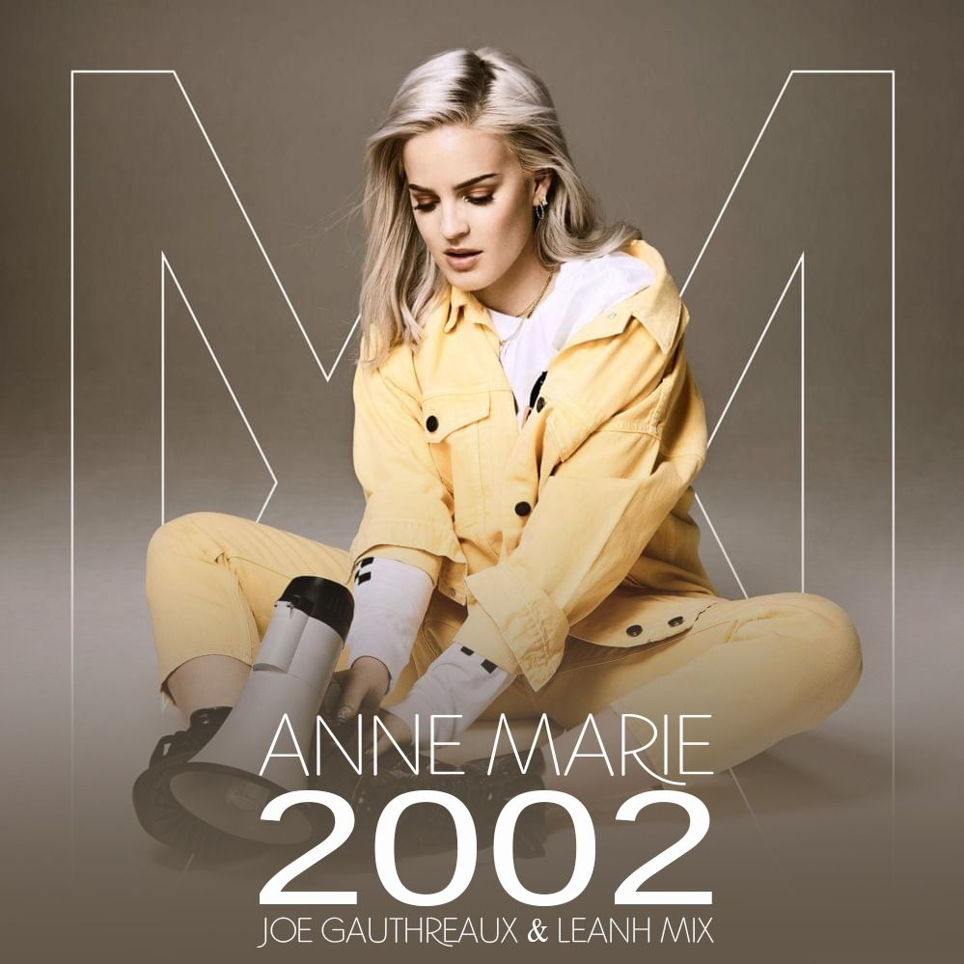
VALENTINE
VALENTINE
Let’s watch the MV “2002” without sound!

Slide 4
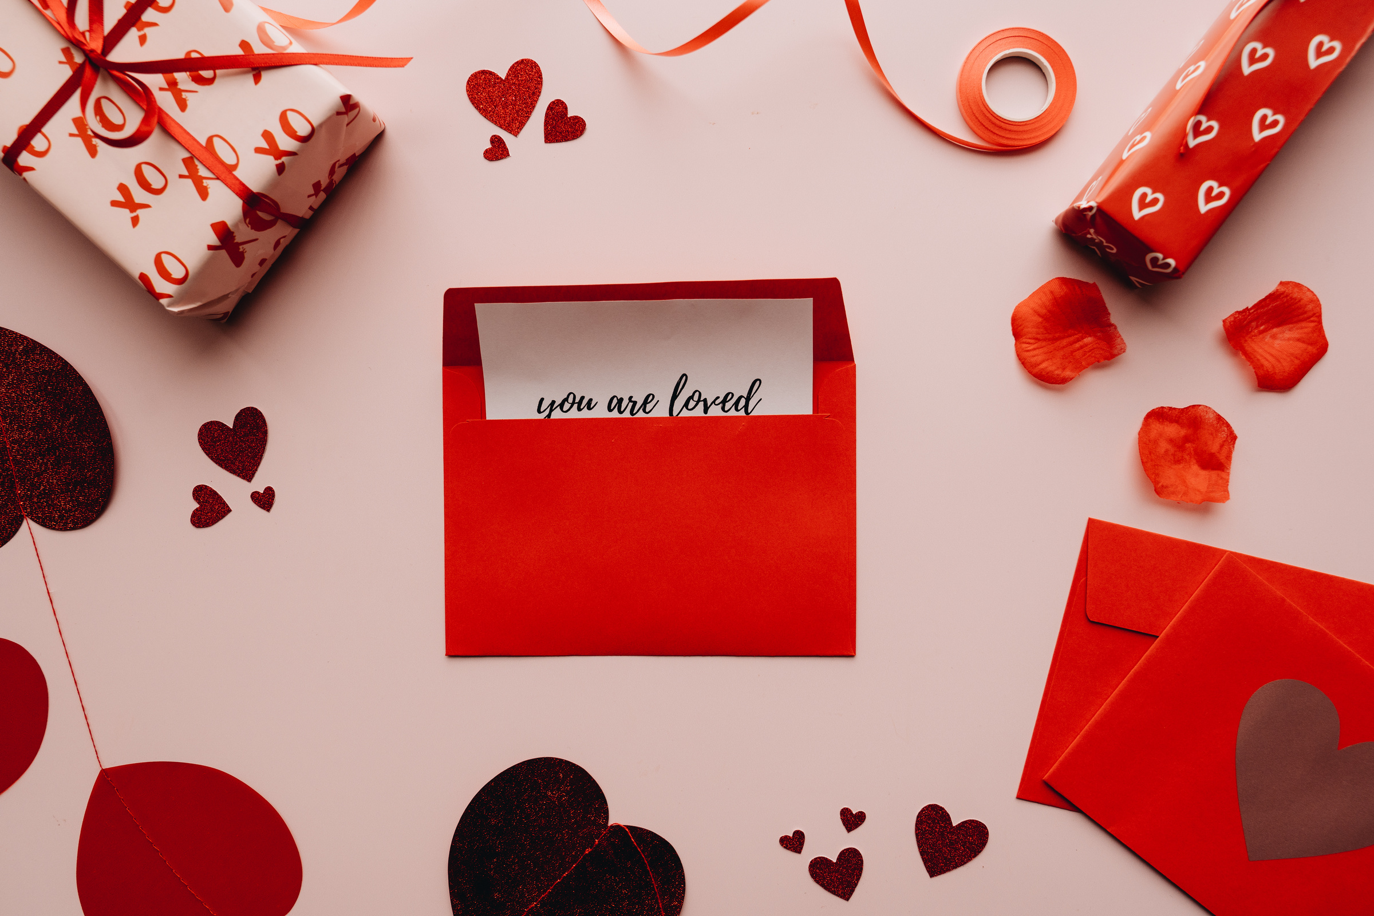
Agenda
★ About a music video
★ About a singer
★ About a theme
★ About a music
★ useful vocabulary
★ Pronunciation Challenge
★ Song Phrases
★ Quiz Question

Slide 5
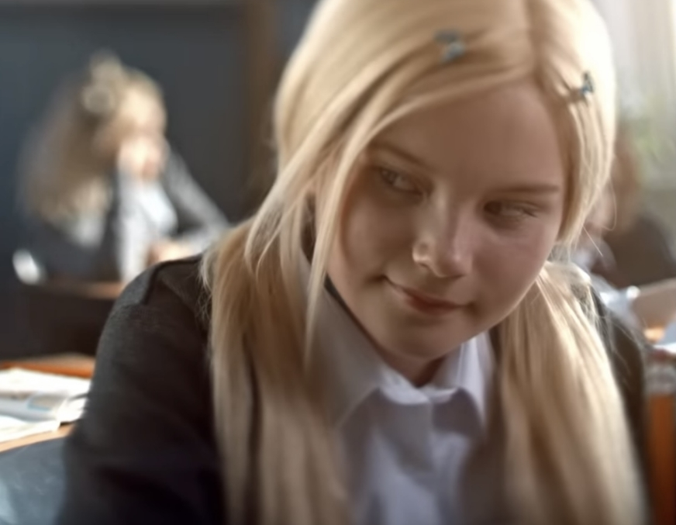
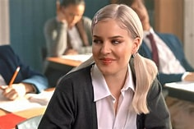
Look at this！！
What we see in this video
For example，
・A boy and a girl are staring at each other.
・A man and a woman are staring at each other
・The situation that man and woman is surprised to see dancing person in the cafeteria.
・Students who have become like puppet.
-----------------------------------------------------------------------
・『The imaginary scene』 that she meets with him again after getting older.
→it’s her dream, she wants to see him again seriously.
childhood
Getting older
Next⇒

Slide 6
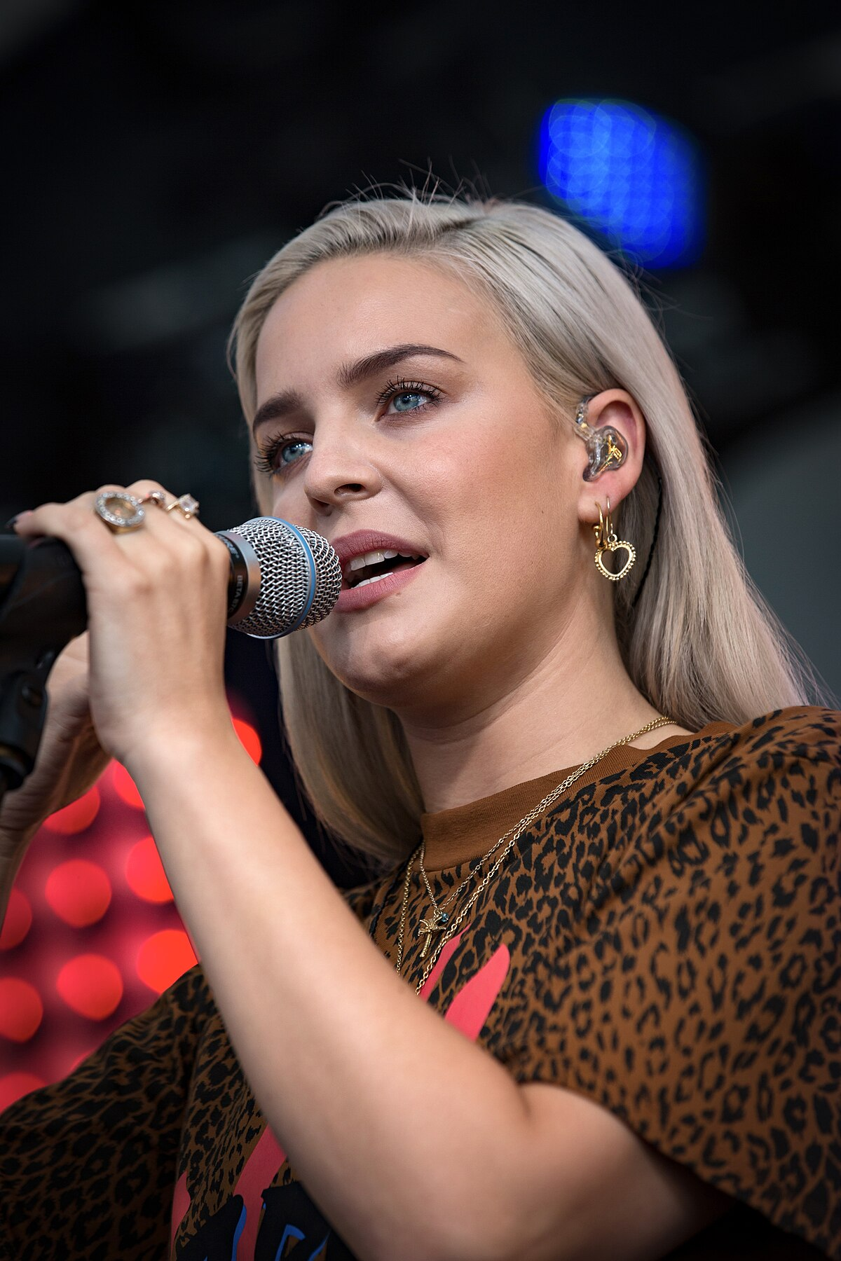
About a singer
Singer
Her job1
Name
Anne marie
Her job2
From
actress
Essex, England
Birthday
Her job3
1991,
April 7th
athlete

Slide 7
About a singer
★Her achievements of acting★
She played roles in the musicals….
・"Les Miserables”
・"The West End"
★Her achievements of sports★
She has won 2 international championships
of Karate.

Slide 8


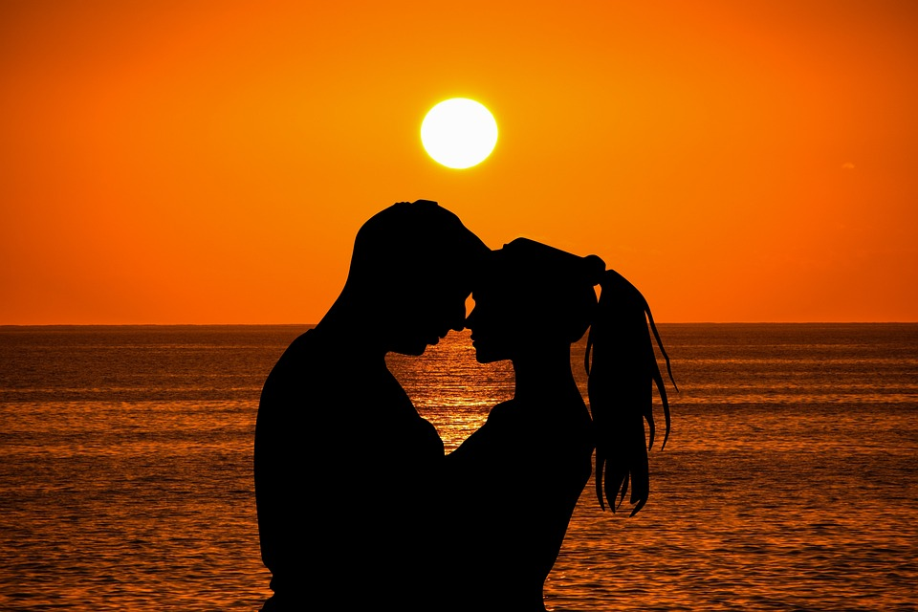
appreciate you
About theme of this song
The theme of this song is ‘’First love’’
Anne Marie wrote these lyrics based on her real experience in 2002.
We think she looks back on the unforgettable memories on 2002 in this song.
The memories remain forever like treasure even as a adult.
VALENTINE
VALENTINE

Slide 9

appreciate you
About theme of this song
In addition to that, she co-produced this with Ed Sheeran who is a good friend of her and is same age!
So, there are some experiences about
‘’first love’’ and the desire to be with one’s first lover together in this song!
VALENTINE
VALENTINE

Slide 10
★The secret behind the lyrics
The chorus is made by connecting the lyrics of 2002 hit songs!!
【Chorus】
"Oops, I got 99 problems singing bye, bye, bye.
Hold up, if you wanna go and take a ride with me.
Better hit me, baby, one more time."
About a music
About a music

Slide 11



About a music
【Chorus】
"Oops, I got 99 problems singing bye, bye, bye.
Hold up, if you wanna go and take a ride with me.
Better hit me, baby, one more time."
①Oops
Brittany Spears
♪ "Oops!...I Did It Again"
About a music
About a music

Slide 12
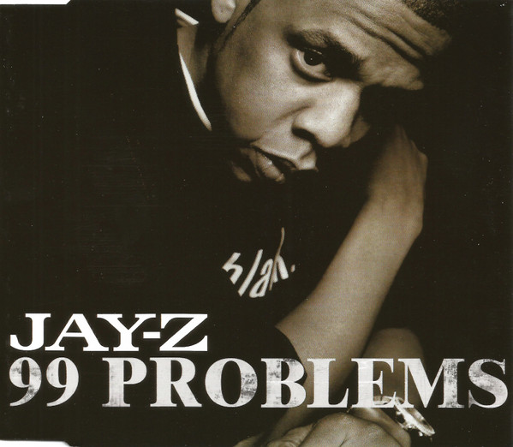
About a music
【Chorus】
"Oops, I got 99 problems singing bye, bye, bye.
Hold up, if you wanna go and take a ride with me.
Better hit me, baby, one more time."
②99 problems
JAY-Z
♪"99 problems"
About a music
About a music

Slide 13
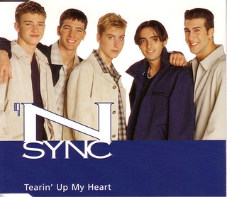
About a music
【Chorus】
"Oops, I got 99 problems singing bye, bye, bye.
Hold up, if you wanna go and take a ride with me.
Better hit me, baby, one more time."
③ bye, bye, bye
'N Sync
♪"Bey, Bey, Bey"
About a music
About a music

Slide 14

About a music
【Chorus】
"Oops, I got 99 problems singing bye, bye, bye.
Hold up, if you wanna go and take a ride with me.
Better hit me, baby, one more time."
④Hold up
Dr.Dre
♪"The Next Episode “
feat. Snoop Dogg, Nate Dogg & Kurupt
About a music
About a music

Slide 15
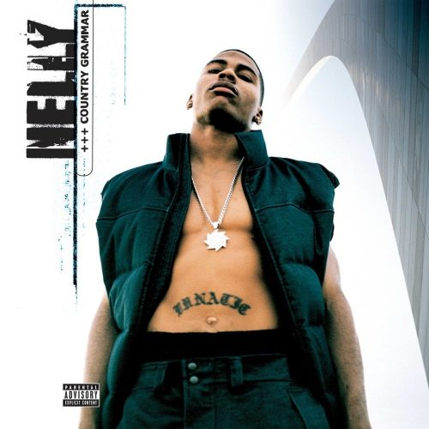
About a music
【Chorus】
"Oops, I got 99 problems singing bye, bye, bye.
Hold up, if you wanna go and take a ride with me.
Better hit me, baby, one more time."
⑤if you wanna go and take a ride with me
Nelly
♪"Ride Wit Me"
ft. St.Lunatics
About a music
About a music

Slide 16
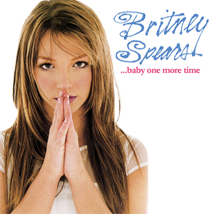
About a music
【Chorus】
"Oops, I got 99 problems singing bye, bye, bye.
Hold up, if you wanna go and take a ride with me.
Better hit me, baby, one more time."
⑥ hit me, baby, one more time.
Brittany Spears
♪"Baby One More Time"
About a music
About a music

Slide 17
Let’s confirm useful vocabulary!
FIRSTLOVE
FIRSTLOVE

Slide 18
Useful vocabulary
“grown-ups”
= adults
(the people who grown up)
Ex.
Children want to act like grown-ups
FIRSTLOVE
FIRSTLOVE

Slide 19
Useful vocabulary
“on the hood”
= the state to lie down on the bonnet of a car
Ex.
The cat lies on the hood of a car.
FIRSTLOVE
FIRSTLOVE

Slide 20
Useful vocabulary
3. “fast forward to ”
= move speedily forward in time
Ex.
Fast forward to 2002,
I ‘d got a reward
FIRSTLOVE
FIRSTLOVE

Slide 21


Song Phrases
Middle of the woods
MIDDlov th’ woods [mɪd.əl.əv.ðəˈwʊdz］
VALENTINE
★2 important points
①MIDDLov
→Catenation (linking)
②th’
→The schwa (barely pronounced vowels)
VALENTINE

Slide 22
VALENTINE
VALENTINE
Let’s watch the MV “2002” with sound again!
And, fill in the blank!!

Slide 23
The answer of the vocabulary sheet
yaki
1,Light as a feather
2,But acting like grown-ups
3,Dancing on the hood in the middle of the woods
4,On the days when we were young, uh
5,Fast-forward to 18
6,When we're holding each other

Slide 24
Then, you try to pronounce!
Pronunciation Challenge
Work on one part and practice!
Oops, I got 99 problems singing bye, bye, bye Hold up,
if you wanna go and take a ride with me Better hit me, baby, one more time
You can do it !!!

Slide 25
Quiz Question
yaki
①What is the topic of this song? Please say in a word.
②Listenning this song, which do you think "2002" is a happy song or a sad song?
③In this song, there was a scene students were tied up with
Ropes. What is it called? (We hear this in our class.)
④Where is Anne Mary from?

Slide 26
Answer of Quiz Question
ki
①What is the topic of this song? Please say in a word.
⇒First Love♡
②Listenning this song, which do you think "2002" is a happy song or a sad song?
⇒It’s happy song.
③In this song, there was a scene students were tied up with
Ropes. What is it called? (We hear this in our class.)
⇒It’s puppet.
④Where is Anne Mary from? ⇒She’s from England.
VALENTINE
And all that
VALENTINE
we could be

Slide 27
2002
Thank you for listening!!
Nanami, Nami, Yuna
2002

