Slide 1
Are Smartphones ruining childhood?
Speaker: Jonathan Haidt

Slide 2

Why I chose this topic
Recently people care too much about the social media and their smartphones
Many people become offensive on social media and intentionally leave comments that attack others
Many teenagers are apprehended with lookism and become depressed
→ I wondered why these things happen and find the measures to stay away from social media

Slide 3

Vocabulary
Section 230 – Limitation of harmful content online
Recall – officially order (someone) to return to a place
Solidarity – unity or agreement of feeling or action
Sextortion – sexual assault from someone by threating to reveal evidence of their sexual activity
Convey – to express a thought, feeling
Pavlovian – relating to classical conditioning as described by Pavlov
Red State/ Blue State - State that vote for republican are red, democratic blue
Collective action – to act together as a group to achieve a certain goal
Condemn – express complete disapprove of
Depravation – the act of making someone or something morally bad or corrupt
Norms – standard, rule
Wildly more – very much

Slide 4
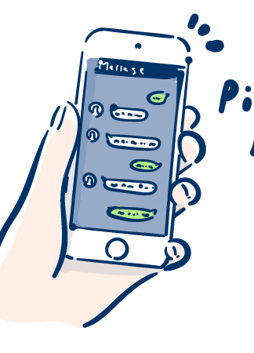
Questions
What solution did Jonathan present to undo the negative effects on children?
Why do parents tend to have more tolerance over iPad than smartphones?
Although we have tools on the internet to hang out with one another, why do the children still become depressed or lonely? (Give two reasons)

Slide 5

Answer to the questions
1. Use letgrow and make the children choose to do something they haven’t done before and to accomplish it by their own to make them confident. And reassure the parents that their children can do much more things on their own and recover the trust for their community so that they don’t keep their children inside the house with only the internet.
2. Smartphones are more portable than iPads which makes it intolerant.
3. Reason 1: On Zoom and other texting tools it is harder or impossible to read other people’s facial expression and timing. → Doesn’t connect people one on one
Reason 2: Because the children have so many people to take contact with, they don’t have time for close people which makes their relationships loose and break apart easily.

Slide 6

Discussion
Other than offensive opinions and addiction, what other factors of social media might be ruining our childhood?
Not including Jonathan’s solution, are there any other solutions to stay away from social media?
What kinds of effect do you think social media have on the adults?
Which do you prefer more: a life with no social media (only phone calls and zoom) or a life with only online communities?

Slide 7

Activity
・Share your experience over the weekends excluding the time you were on your device.

Slide 8

Thank You for Watching

