Slide 1
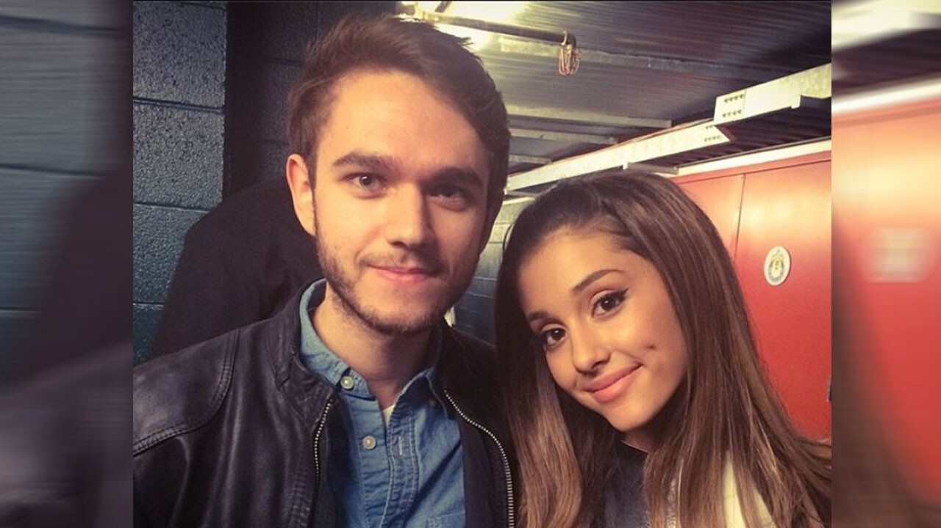

Break Free
Ariana Grande featuring Zedd

Slide 2




Listen to the Break Free
touch here and please discuss how you feel!
この写真 の作成者 不明な作成者 は CC BY のライセンスを許諾されています

Slide 3
Ariana Grande -biography-
She born in Boca Raton in America as a child of Italian Amerikan.
She have loved singing since childhood.
When she was 8 years old , she sang American anthem in NHL ice hockey, and she made a TV debut there.
And she was 10 years old, formed a team called “Kids Who Care’’.
She is working as a singer, songwriter, actress and voice actor .

Slide 4
Zedd ーBiographyー
He was born in Russia and grew up in Germany.
He was a music producer and a DJ .
His parents were musicians so he got an education to be a classical music composer and learned the piano when he was young.
When he was a teenager, he was in a rock band with his brother and he played the drum, but he influenced by Justin Bieber and he decided to set feet in electro music.
He has won two Grammy Awards.

Slide 5
Song
・AT FIRST, THIS SONG IS NOT FOR ARIANA GRANDE.
SO ZEDD HAD TO REPRODUCE THE SONg five semitones
higher BECAUSE ARIANA'S VOICE WAS SO HIGH.
・ THIS SONG IS ABOUT A HEARTBROKEN GIRL,
AND SHE IS BREAKING FREE FROM THE CURSE OF HER EX- BOYFRIND.

Slide 6
Lyrics
・BREAK FREE → BECOME FREE
・I ONLY WANNA DIE ALIVE
→ I WANT TO FULLY ENJOY LIFE
・NEVER BY THE HANDS OF A BROKEN HEART
→ I DON'T WANT TO BE STUCK IN A BROKEN HEART

Slide 7
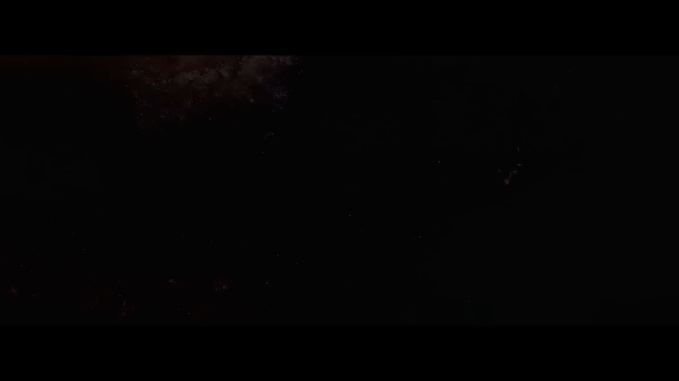

Slide 8

It’s quiz time!!
TOUCH HERE

