Slide 1


The Nights
Avicii

Slide 2
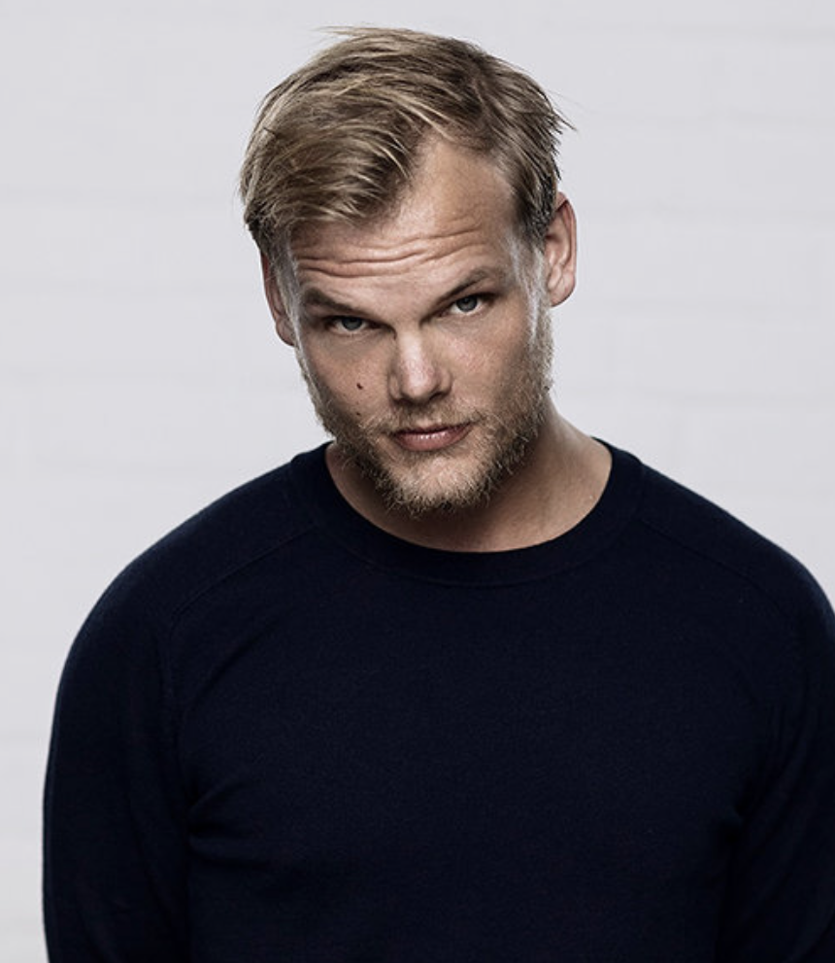
Who is “Avicii”
NAME: Tim Bergling
FROM: Sweden
JOB: Record producer and DJ
AGE: 28(He passed away 6 years ago)
ACHIEVEMENTS:
He released albums (”Levels” and “Wake Me Up”) and made EDM exciting.
He introduced new sounds into the world electronic music and made it universally famous genre.

Slide 3

Are you enjoying life?
What is your important thing in your life?

Slide 4

"One day you'll leave this world behind, so live a life you will remember"
Lyrics and message for “The Nights”
The bond between parents and a child and the cherishing of life's precious moments.

Slide 5
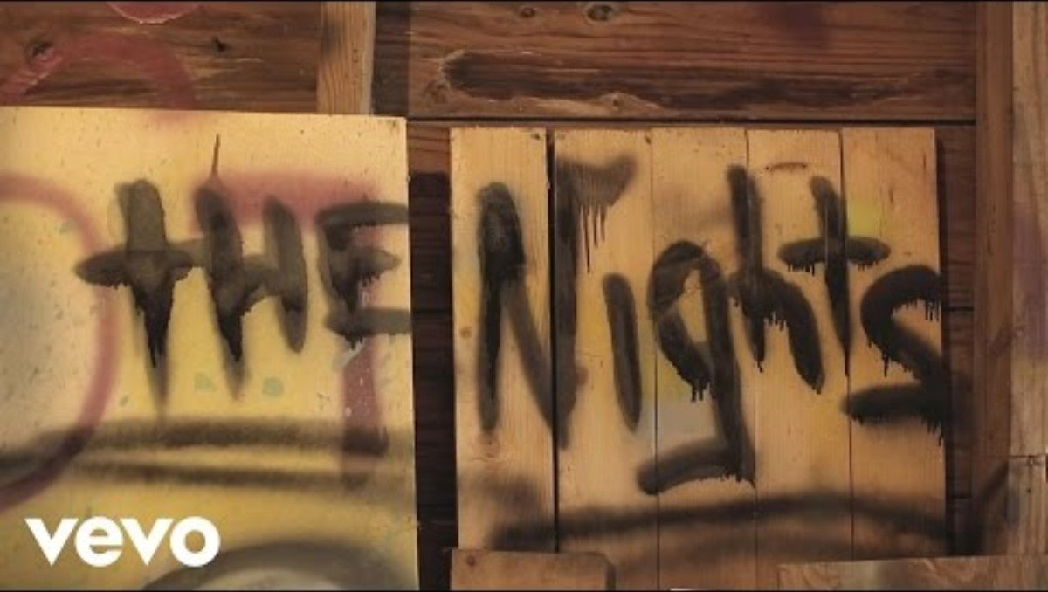

Slide 6


Music Video
This music video depicts the inspiring life of a father and his adult son.
The son is adventurous, likes different sports, and shares his enjoyment with his father

Slide 7

Main Vocabulary
・Verse 1
→The experience of bravely facing fears was a precious memory.
・Pre-chorus
→When the years pass and you feel the fear remembering your youth and wanting to go back, remember your dad and then you can overcome it.
・Verse 2
→If you feel hopeless in your life, take a trip.
If you get lost, I(your father) will go looking for you wherever you are, so don’t worry.

Slide 8

Pronunciation challenge
“The Nights” is 126BPM, but it’s too fast.
So, use 84BPM (this is two-third of 126)
Words are strongly pronunciation.
He said one da - y you’ll leave this world behin - d
So live a li - fe you wi - ll remem - be - r
My father told me when I was just a chil - d
These are the nig - hts that ne - ver di - e My father
told me

Slide 9
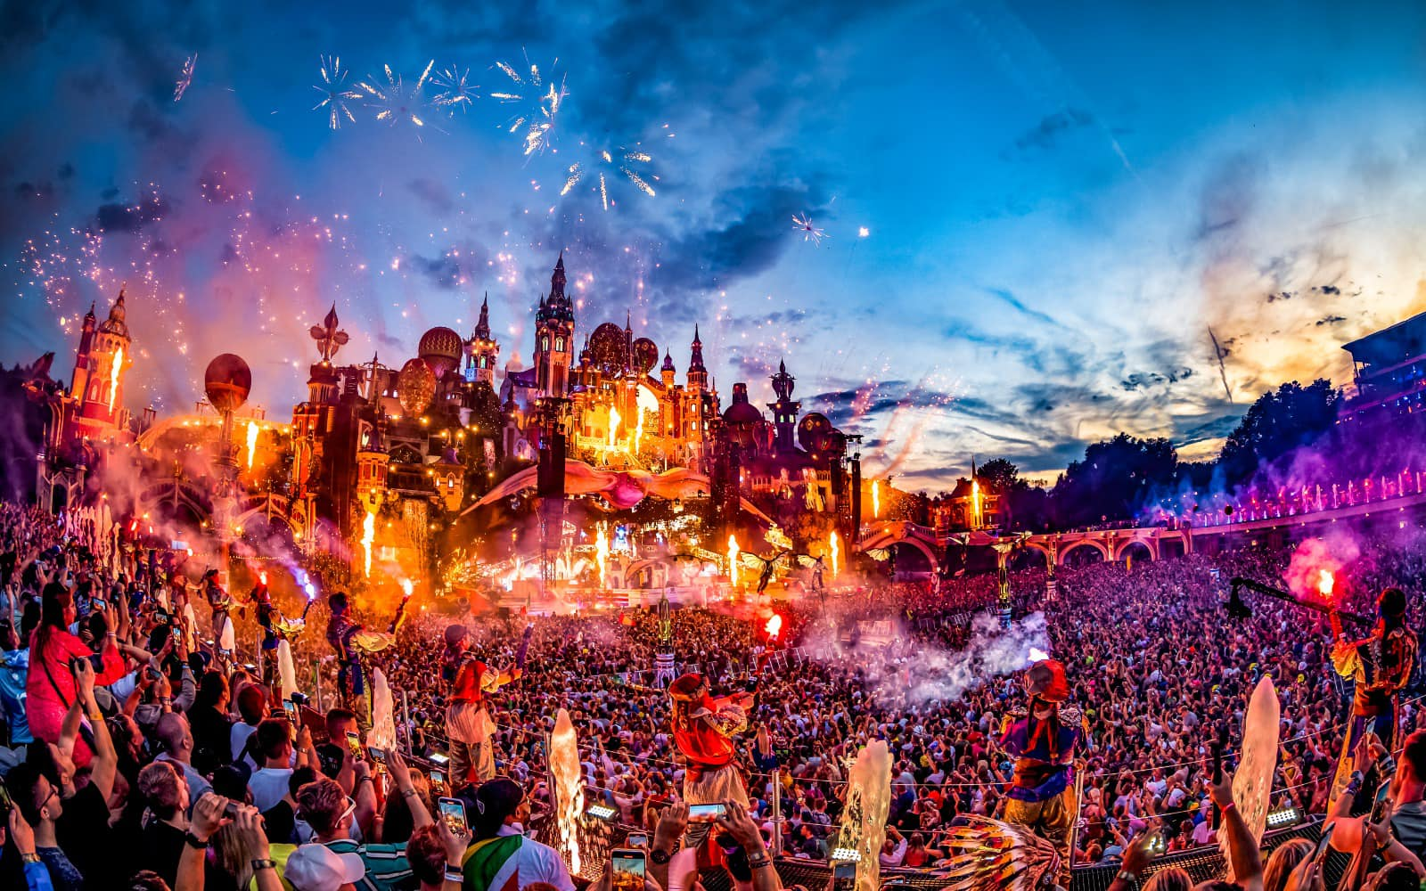
impact on the music industry
Spread of EDM
Fusion of EDM and other genres
The process of music production and the changing image of the artist

Slide 10

Founding of the Tim Bergling Foundation
Since Avicii's death, the music industry has become widely aware of mental health issues among artists.
As his legacy, Avicii's foundation continues to raise awareness for mental health and suicide prevention.

Slide 11

Quiz
What album of his made EDM popular?
“Levels”
“The Nights”
“True”
“SOS”

Slide 12
Quiz
What album of his made EDM popular?
“Levels”
“The Nights”
“True”
“SOS”

Slide 13
Quiz
What is the message in this song?
Money is the best
Live without regrets
Have a family
Make your dreams come true

Slide 14
Quiz
What is the message in this song?
Money is the best
Live without regrets
Have a family
Make your dreams come true

Slide 15
Quiz
How old was he when he died?
30
24
26
28

Slide 16
Quiz
How old was he when he died?
30
24
26
28

Slide 17
Quiz
What did the music industry learn from his death ?
Take care of family
How to make a song
Attention to mental health
How to become popular

Slide 18
Quiz
What did the music industry learn from his death ?
Take care of family
How to make a song
Attention to mental health
How to become popular

Slide 19
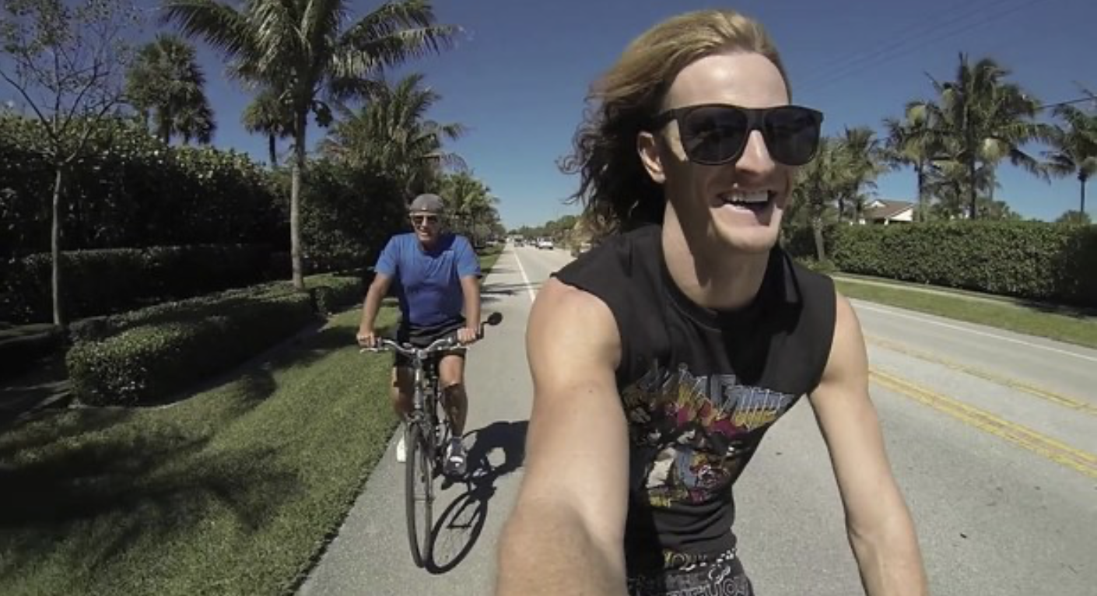
Thank you for watching!!!!!!

