Slide 1


A Timeless Classic—— Exploring the Allure of
As Long as You Love Me
katsumi Kumagae
Jingyao Wu

Slide 2

Over view
Artist Introduction
Song Overview
Main vocabulary
Watch the video with gap fills
Pronunciation challenge
Quiz time
Lyrics scramble

Slide 3
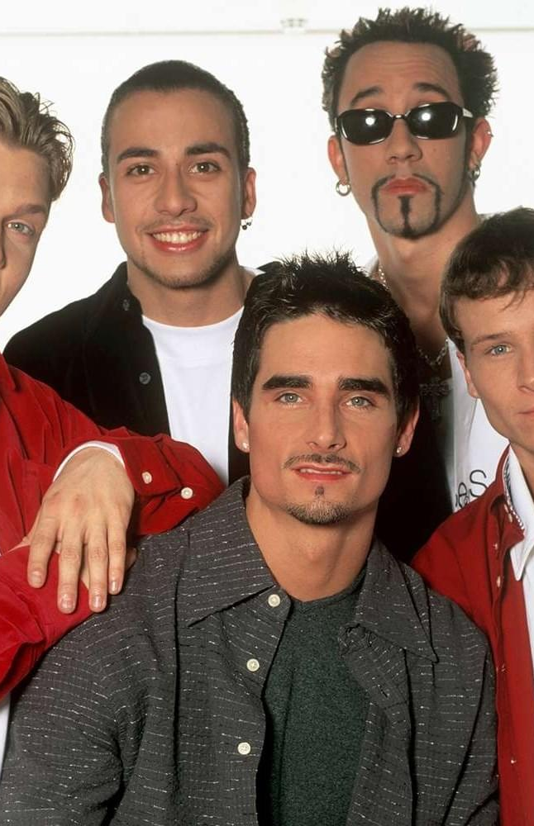
Artist Introduction
Formation Year: 1993
Origin: Orlando, Florida, USA
Music Genre: Pop, R&B, Dance
Members:
A.J. McLean: Lead vocalist known for his distinctive voice and stage presence.
Howie Dorough: Lead vocalist, recognized for his smooth vocals.
Nick Carter: The youngest member, primarily a lead vocalist.
Kevin Richardson: The oldest member, known for his deep voice.
Brian Littrell: Famous for his powerful high notes.
Formation:
The Backstreet Boys were formed under the guidance of music producer Lou Pearlman, who was a pioneer in the boy band industry.
The group underwent rigorous vocal training and dance rehearsals, quickly evolving into a strong musical ensemble.

Slide 4
Song Overview
—As Long as You Love Me
<Release Date> 1997
<Album>Backstreet's Back (also featured on their U.S. debut album Backstreet Boys)
<Genre> Pop
<Lyrical Theme>
・"As Long as You Love Me" is a love song that expresses unconditional love and devotion.
・The lyrics convey the message that the speaker doesn’t care about their partner's past or other superficial aspects, as long as they are loved in return.
・ The song "As Long as You Love Me" tells the story of a deep and committed love. The protagonist expresses their unconditional love and devotion to their partner, stating that they don't care about the partner's past or any external factors.
・ What truly matters to them is being loved in return. The protagonist is willing to overlook any potential obstacles or concerns, focusing solely on the love they share.
・ This song conveys a message of pure, unconditional love, emphasizing the power of love to transcend all other considerations in a relationship.

Slide 5


Main Concept
Love:
Loneliness:
"Love" is the central theme of the song,
emphasizing how powerful and essential love is throughout the lyrics.
"Loneliness" represents the emotions or situations experienced when love is absent.
The song describes the emptiness or sense of isolation that comes when love is missing.

Slide 6
New Vocabulary
<On the run>
Meaning: In a state of fleeing or escaping, often in a hurry; also can mean being constantly busy or active.
Example: They‘ve been on the run from the law for years.
<Risking it all in a glance>
Meaning: Taking a great risk or chance with just a quick look or a brief moment, suggesting that a single action or decision could have significant consequences.
Example: She was risking it all in a glance, hoping he would notice her and feel the same.

Slide 7
<Get you out of my head>
Meaning: To stop thinking about someone or something, often in the context of trying to forget a person or memory.
Example: I can’t get you out of my head; I think about you all the time.
<It’s deep within me>
Meaning: A feeling, thought, or emotion that is deeply ingrained or embedded in someone; something that is an integral part of one’s inner self.
Example: The love I have for you is deep within me and will never fade.

Slide 8
Watch the video with gap fills
[Intro: All]
As long as you love me
[Verse 1: Nick with Brian]
Although loneliness has always been a friend of mine
I'm leavin' my life in your hands
People say I'm ______and that I am blind
Risking it all in a glance
And how you got me blind is still a mystery
I can't get you out of my head
Don't care what is written _______
As long as you're here with me
Please Put it ↓
Backstreet Boys - As Long As You Love Me (Official HD Video) (youtube.com)

Slide 9
[Chorus: All]
I don't care who you are
Where you're from, what you did
As long as you love me
Who you are, where you're from
Don't care what you did
As long as you love me
[Verse 2: Brian with Kevin, Nick]
Every little thing that you have said and done
Feels like it's deep ______ (Oooh, ooh-ooh )
Doesn't really matter if you're on the run
It seems like we're ______ to be

Slide 10
[Chorus: All, Brian & Nick]
I don't care who you are (Who you are)
Where you're from (Where you're from)
What you did, as long as you love me (I know)
Who you are (Who you are)
Where you're from (Where you're from)
_____ What you didAs long as you love me
[Interlude: Nick & All]
Yeah-eh-eh!
As long as you love me

Slide 11
[Bridge: Brian with Howie & Nick, (Nick) & All]
I've tried to hide it so that no one knows
But ________ When you look into my eyes
What you did and where you're coming from I don't care
As long as you love me, baby (Oooh, ooh-ooh)
[Chorus: All, Brian & Nick]
I don't care who you are (Who you are)
Where you're from (Where you're from)
What you did, as long as you love me
Who you are (Who you are)
Where you're from (Where you're from)
Don't care what you did (Yeah-eh-eh)
As long as you love me (As long as you love me)

Slide 12
[Outro: All, Brian & Nick]
Who you are (Who you are)
Where you're from, what you did
As long as you love me
Who you are (Who you are)
Where you're from (Where you're from)
As long as you love me
Who you are, as long as you love me
What you did, I don't care
As long as you love me

Slide 13
Pronunciation challenge
Follow the steps below to practice the rhythm and intonation of the phrase from the song
Phrase to Practice：
I don't care who you are, where you're from, what you did
Listen Carefully:
Play the song or use an audio recording to listen to how the singer pronounces the phrase. Focus on the rhythm and intonation changes.

Slide 14


Say the phrase out loud
I don't care who you are, where you're from, what you did
Notice the rising and falling intonations on the words in bold
Practice each segment of the phrase separately:
"I don't care" – Start high and gradually go lower
"who you are" – Begin with a slight rise on "who" and lower on "are."
"where you're from" – Lift slightly on "where" and lower on "from."
"what you did" – Slightly raise "what" and finish lower on "did."

Slide 15

Quiz Questions 1
What is the main theme of the song "As Long as You Love Me"?
A) Jealousy
B) Unconditional love
C) Regret
D) Betrayal

Slide 16

Answer B

Slide 17
Quiz Questions 2
What does the protagonist of the song express a willingness to overlook?
A) The partner's personality
B) Any potential obstacles or concerns
C) The partner's family background
D) The distance between them

Slide 18
Answer B

Slide 19
Quiz Questions 3
In "As Long as You Love Me," what is emphasized as the strongest force in a relationship?
A) Trust
B) Communication
C) The power of love
D) Financial stability

Slide 20
Answer C

Slide 21
Lyrics scramble 1
Rearrange the following sentences in the correct order.
Q1 (always / loneliness/mine/a/friend / of / been / although / has)
Q2 (say / crazy / people/blind / I’m / that / and / am / I)
Q3 (matter / really / on / the / run / if / you 're/doesn't / it)

Slide 22
Answer
Q1 Although loneliness has always been a friend of mine
Q2 People say I'm crazy and that I am blind
Q3 It really doesn't matter if you're on the run

Slide 23

Thank you for your listening

