Slide 1


Page 01
Movie Clip
Material

Slide 2
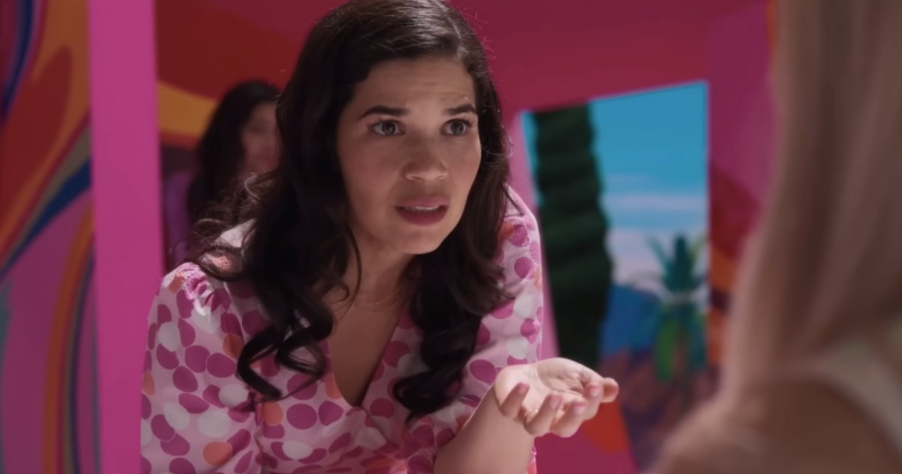

Page 02
America Ferrera's Iconic Barbie Speech | Barbie
https://youtu.be/CBqlDWHkdHk?si=f50wKv9fRnyLwW8M

Slide 3
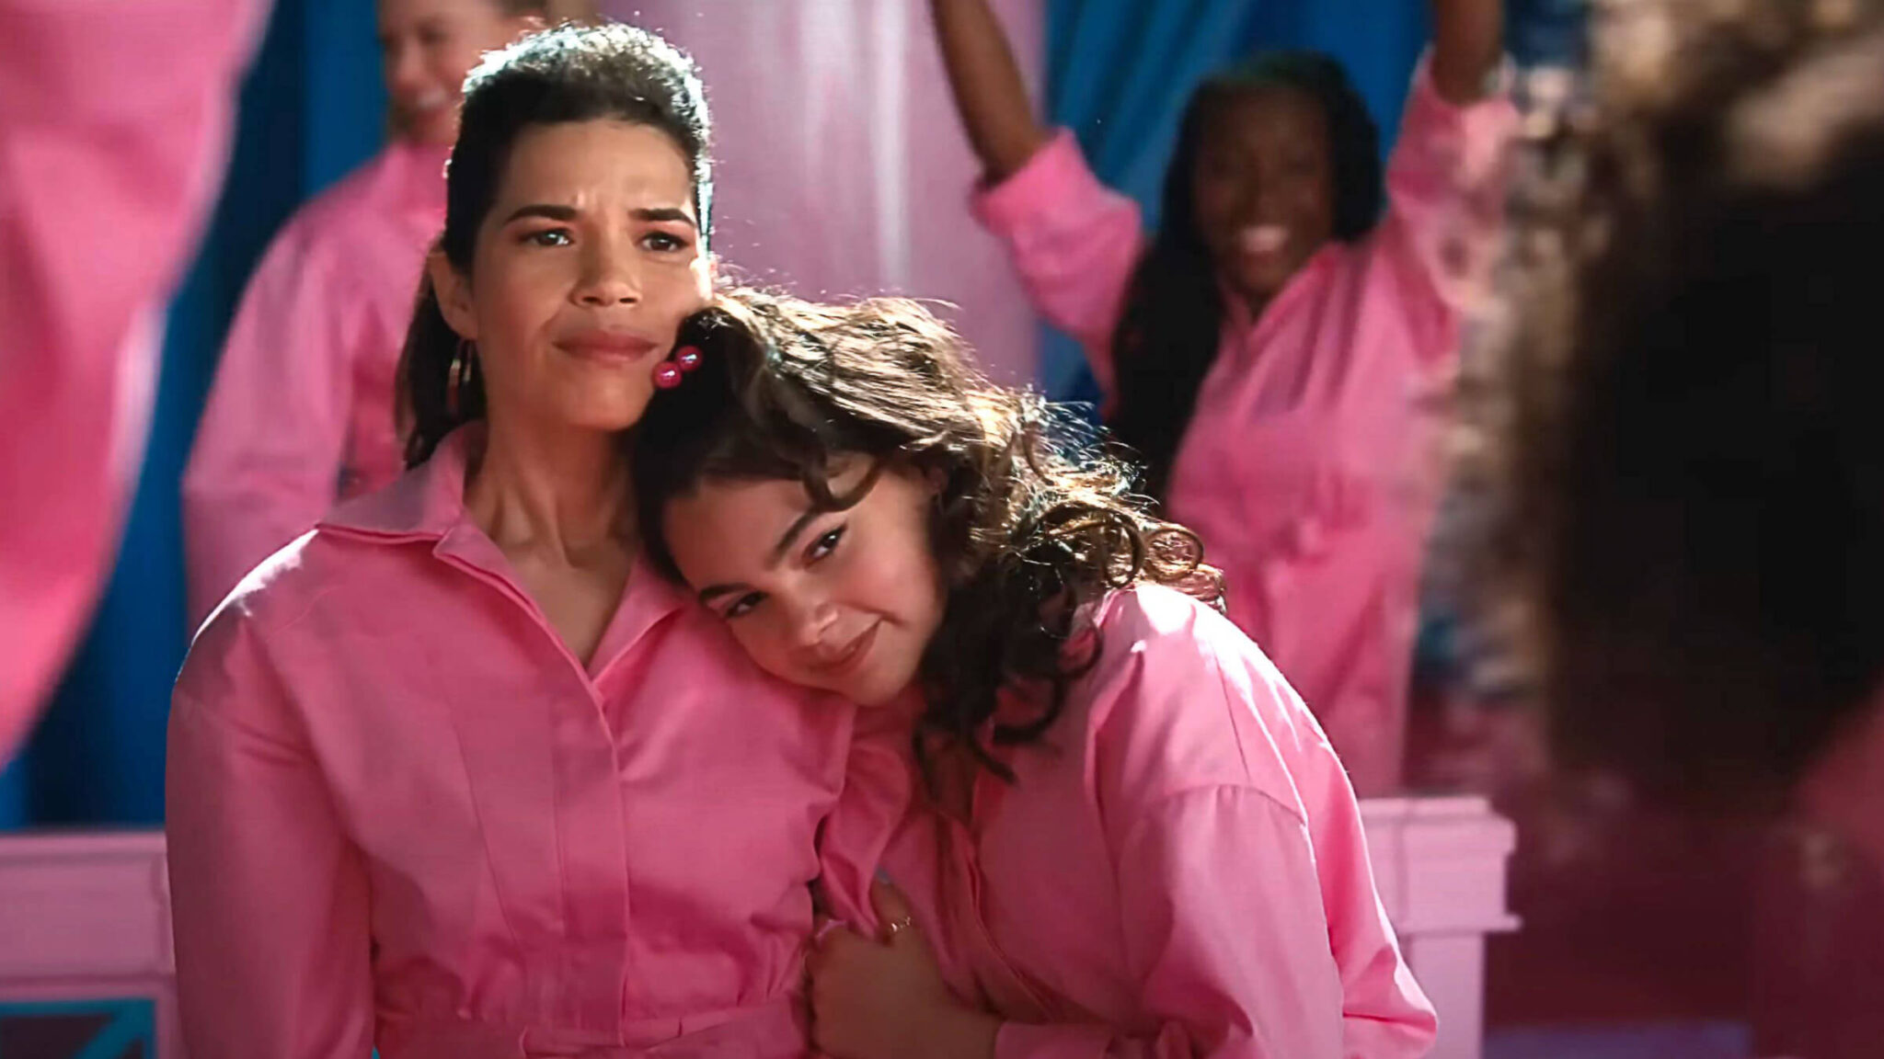
Why I chose this MOVIE Clip
I chose the famous speech scene from Barbie. The film follows Barbie as she leaves "Barbieland" and faces gender stereotypes and social inequalities in the real world, delivering a strong social message with humor and vibrant visuals. And the reason I selected this scene is I resonate with the speaker’s message.In the speech, Gloria, from the patriarchal human world, addresses Barbie struggling with belonging about the unfair social norms and restrictions on women.
This is an issue that concerns all of you as well. I want you to rethink these norms. That is why I chose this scene.
Page 03

Slide 4
Page 04
Before watching
Vocabulary

Slide 5
VOCABULARIES&GRAMMER
Page 05
a) extraordinary
b) tie oneself into knot
c) look out for
d) mean
e) squash
f) tempt
g) crass
h) rigged
j) sisterhood
i) contradictory
Containing statements, beliefs, or qualities that are in opposition to each other, making them seem inconsistent or illogical.
.
To be watchful and take care of someone or something, either for protection, support, or to be aware of potential danger.
To crush, flatten, or squeeze something with force, often making it lose its original shape. It can also mean to suppress an idea or argument.
Acting in a cruel, unkind, or unfair way towards others, often with the intention of hurting their feelings.
A close bond, connection, or support system among women, often based on shared experiences, solidarity, and mutual encouragement.

Slide 6
VOCABULARIES&GRAMMER
Page 06
a) extraordinary
b) tie oneself into knot
c) look out for
d) mean
e) squash
f) tempt
g) crass
h) rigged
j) sisterhood
i) contradictory
To strongly attract or persuade someone to do something, especially something that may not be wise or is difficult to resist.
.
Set up or manipulated in a dishonest or unfair way to produce a particular result, often used to describe elections, games, or competitions.
To become extremely confused, anxious, or worried, often due to overthinking or struggling with a difficult situation.
Showing a lack of sensitivity, refinement, or intelligence, often in a way that seems rude or thoughtless.
Something very unusual, impressive, or remarkable, often in a way that stands out from the ordinary.

Slide 7
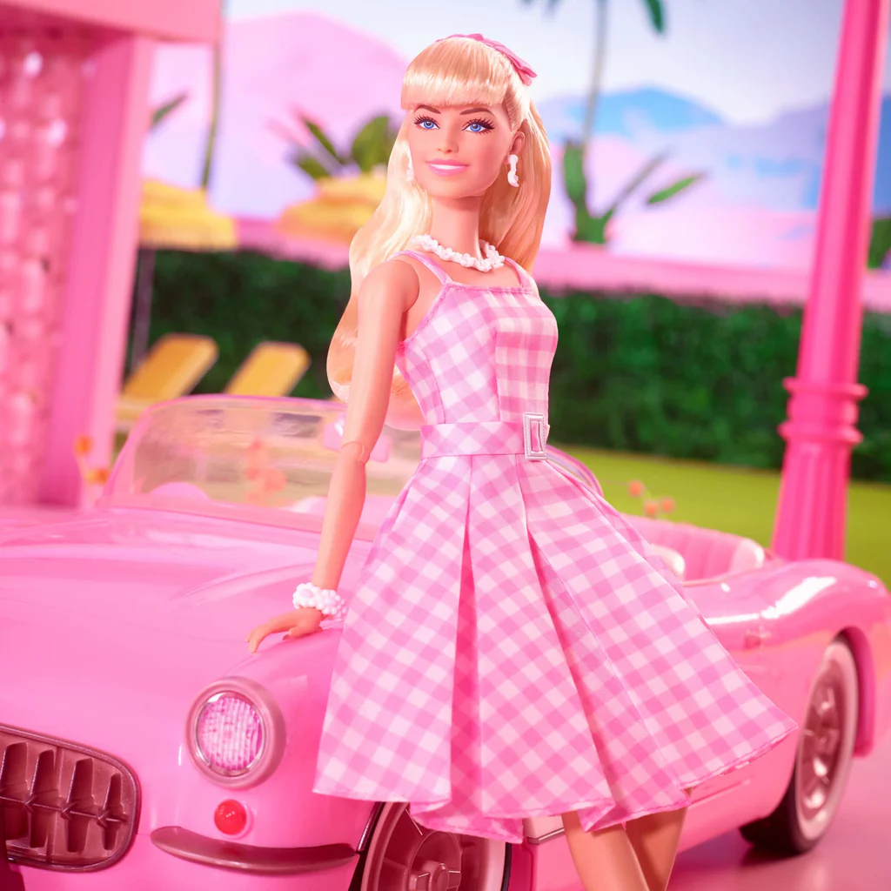
HOME
CONTENT
OTHERS
Page 07
Qustion
Watching the video and answer following question
to Understand
1.Dictaion
2.Question about the content
3. Let’s think further

Slide 8
DICTATION
Page 08
0:40 Level 1
You have to be a boss,but you (3 words). You have to lead,but you can't squash other people's ideas.You're supposed to (4 words), but don't talk about your kids (4 words).
1:01 Level 2
You're , but not so pretty that
too much or that you because
you’re , but always stand out
and always be grateful.

Slide 9
DICTATION
Page 09
1:35 Level 3
And , in fact, ,
.

Slide 10
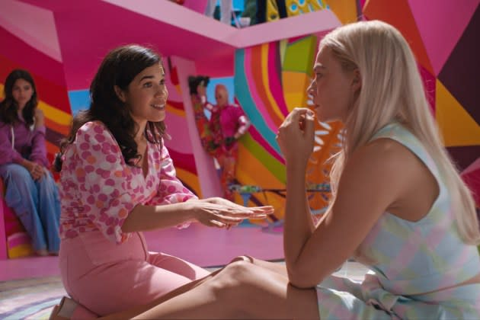
Questions
Page 10
Q1. Why did the women with black hair say that “you can’t ask for money”?
Q2. According to the video, what women must not forget at present society and what should they do?
Q3. Choose two items from the following that are not mentioned as expectations for women in the video.
toughness
career
appreciation
consideration
leadership
beauty
intelligence

Slide 11
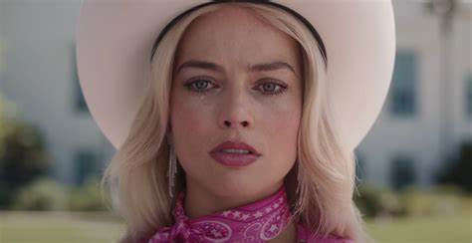
Page 11
Let’s think further
  Have you ever experienced some episode of manhood or womanhood? Tell your experience and your feelings at that time.
  What do you think makes this situation? List at least three.
  Think of the specific culture or system based on conventional manhood or womanhood in Japan or the country you are majoring.
  What do you think can we do to realize the world people can live comfortably based on this video?

Slide 12
Page 12
Fun
Activity
Crossword Puzzle

Slide 13
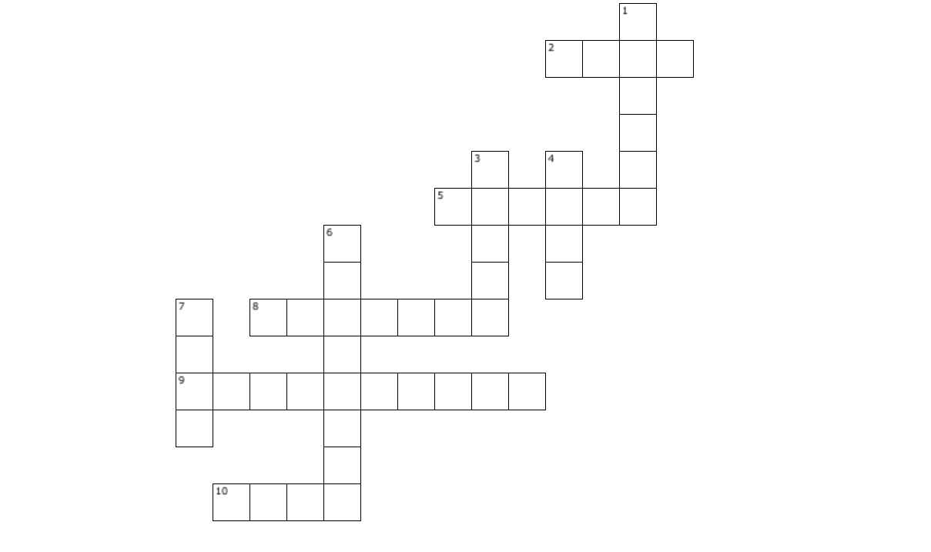
*Please note that the descriptions about “Women” reflect the video content.
Across
2. Women are never allowed to show this emotion.
5. Women are supposed to love this role, but you can't talk about it all the time.
8. The word women have to use instead of saying you want to be thin, even though being thin is still expected.
9. Women are supposed to be part of this, but at the same time, they must stand out.
10. Women must avoid this at all costs because if they do it, everything becomes their fault.
Down
1. Women have to be successful in this, but they must also always take care of others.
3. Women must have it, but asking for it is seen as inappropriate.
4. Women have to be this, but not too much. And they can never say they want to be this.
6. Women must always be this, even while recognizing that the system is unfair.
7. Women should be in this position, but they can't be "mean" while leading.
Page 13

Slide 14
What did you learn from this scene?
Page 14
Through this scene, I learned how the world is trapped in contradictory social norms. While the scene specifically discusses women, I believe this issue is not limited to gender but applies to all forms of categorization.
This learning helped me understand how societal expectations affect individual experiences. By analyzing these contradictions more deeply, I gained a clearer perspective on the seriousness of social norms.

Slide 15
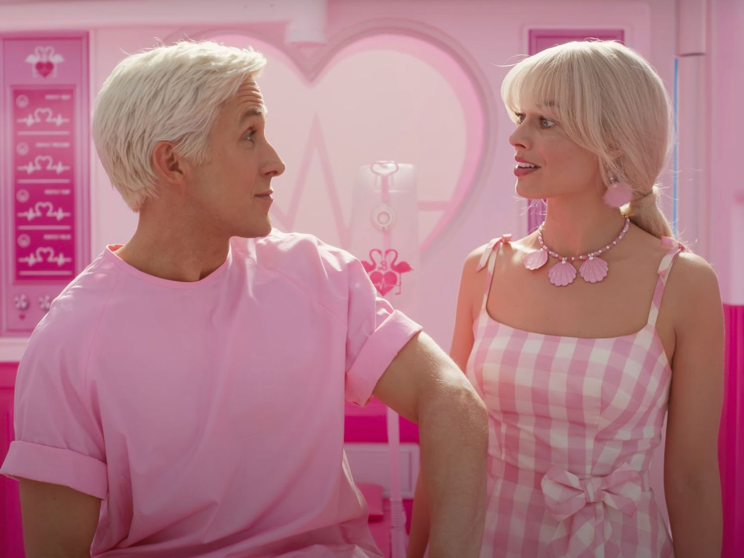
Page 15
Thank
You
-

Slide 16
Page 16
Answer

Slide 17
VOCABULARIES & GRAMMAR
Page 17
a) extraordinary
b) tie oneself into knot
c) look out for
d) mean
e) squash
f) tempt
g) crass
h) rigged
j) sisterhood
i) contradictory
Containing statements, beliefs, or qualities that are in opposition to each other, making them seem inconsistent or illogical.
i
.
c
To be watchful and take care of someone or something, either for protection, support, or to be aware of potential danger.
e
To crush, flatten, or squeeze something with force, often making it lose its original shape. It can also mean to suppress an idea or argument.
d
Acting in a cruel, unkind, or unfair way towards others, often with the intention of hurting their feelings.
A close bond, connection, or support system among women, often based on shared experiences, solidarity, and mutual encouragement.
j

Slide 18
VOCABULARIES & GRAMMAR
Page 18
a) extraordinary
b) tie oneself into knot
c) look out for
d) mean
e) squash
f) tempt
g) crass
h) rigged
j) sisterhood
i) contradictory
To strongly attract or persuade someone to do something, especially something that may not be wise or is difficult to resist.
f
.
h
Set up or manipulated in a dishonest or unfair way to produce a particular result, often used to describe elections, games, or competitions.
b
To become extremely confused, anxious, or worried, often due to overthinking or struggling with a difficult situation.
g
Showing a lack of sensitivity, refinement, or intelligence, often in a way that seems rude or thoughtless.
a
Something very unusual, impressive, or remarkable, often in a way that stands out from the ordinary.

Slide 19
DICTATION
Page 19
0:40 Level 1
You have to be a boss, but you can't be mean. You have to lead, but you can't squash other people's ideas. You're supposed to love being a mother, but don't talk about your kids all the damn time.
1:00 Level 2
You're supposed to stay pretty for men, but not so pretty that you tempt them too much or that you threaten other women because you’re supposed to be a part of the sisterhood, but always stand out and always be grateful.

Slide 20
DICTATION
Page 20
1:35 Level 3
And it turns out, in fact, that not only are you doing everything wrong, but also everything is your fault.

Slide 21
Questions
Page 21
A1. Because that's crass
A2. The fact the system is rigged.
intelligence
toughness
A3.

Slide 22
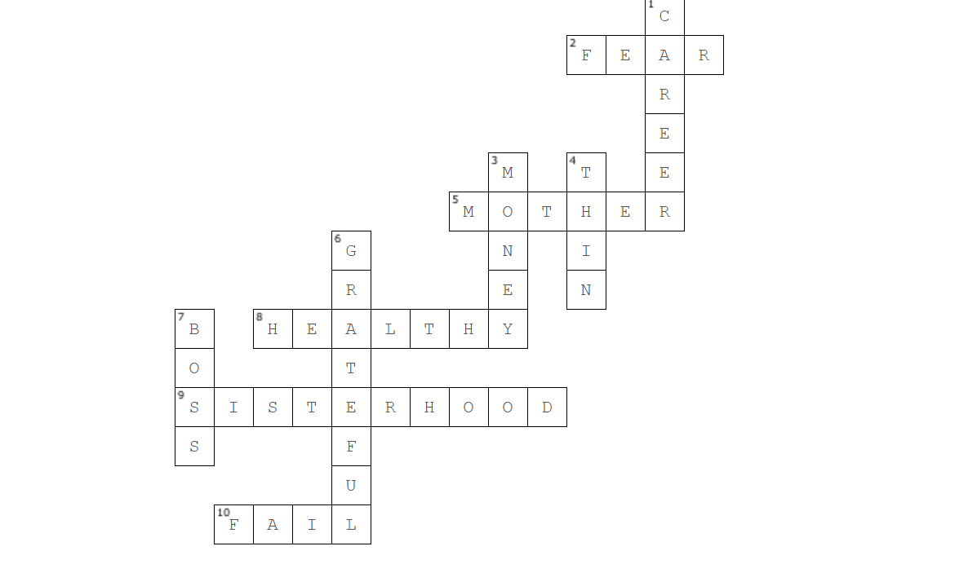
Page 22

Slide 23
Transcript
Page 23
It is literally impossible to be a woman.
You are so beautiful and so smart, and it kills me that you don't think you're good enough.
Like, we have to always be extraordinary, but somehow we're always doing it wrong.
You have to be thin, but not too thin.
And you can never say you want to be thin.
You have to say you want to be healthy, but also you have to be thin.
You have to have money, but you can't ask for money because that's crass.
You have to be a boss, but you can't be mean.
You have to lead, but you can't squash other people's ideas.
You're supposed to love being a mother, but don't talk about your kids all the damn time.
You have to be a career woman, but also always be looking out for other people.
You have to answer for men's bad behavior, which is insane. But if you point that out, you're accused of complaining.

Slide 24
Transcript
Page 24
You're supposed to stay pretty for men, but not so pretty that you tempt them too much or that you threaten other women because you’re supposed to be a part of the sisterhood, but always stand out and always be grateful.
But never forget that the system is rigged.
So find a way to acknowledge that, but also always be grateful.
You have to never get old, never be rude, never show off, never be selfish, never fall down, never fail, never show fear, never get out of line.
It's too hard, it's too contradictory, and nobody give you a medal or says thank you.
And it turns out, in fact, that not only are you doing everything wrong, but also everything is your fault. I'm just so tired of watching myself and every single other woman tie herself into knots so that people will like us. And if all of that is also true for a doll just representing a woman, then I don't even know.

