Slide 1


Uptown Funk!
Mark Ronson ft.Bruno Mars
Yuri,Tesshu,Yuki

Slide 2

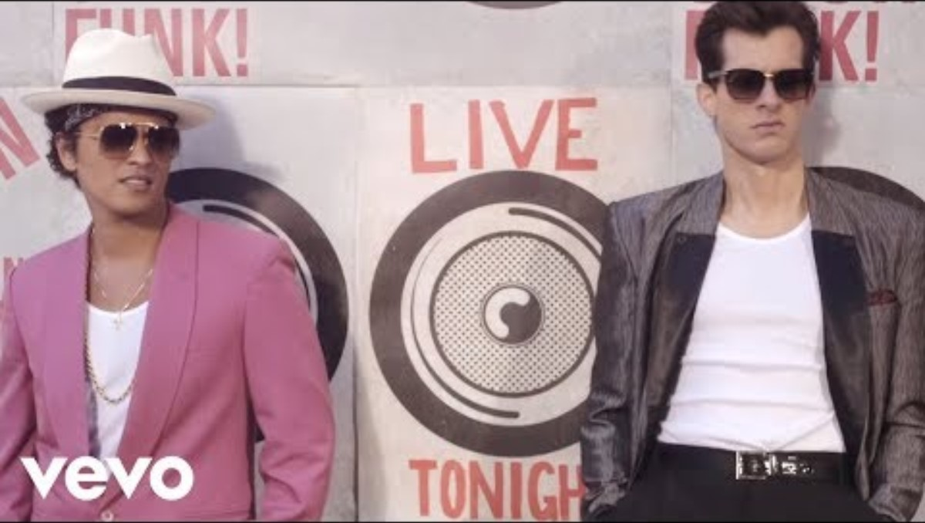
This is funky!​

Slide 3
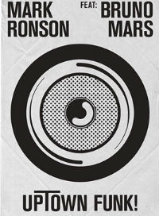
This song about…
this song was released on November 10,2014 by Mark Ronson.
this song means like
"stylish and cool funk will cheer you up!"

Slide 4
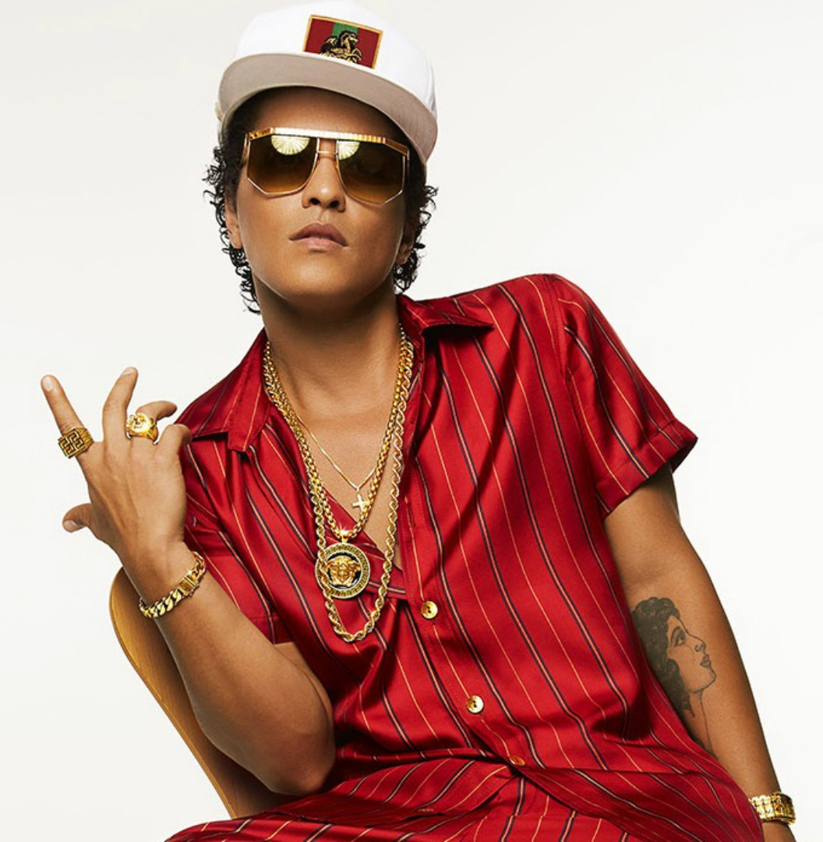
﻿ Bruno Mars
He was born in 1985,Octorber,8th
From : Honolulu in Hawaii
His Father is Drummer.
His mother is Hula Dancer.
His name come from Bruno Sammartino who is pro-wrestler.

Slide 5
His career
As he grew up , his interest of music has shifted to a mix of reggae hip hop and R&B.
He g0t a lot of attention as solo artist as the result of a hit of [Nothin on you] B.O.B and [Billionare] Travie McCoy.
In recent years , he has worked as a duo , Silk Sonic which form with Anderson Paak , and releasing [Leave the door open] in 2021.

Slide 6
﻿hit songs
2010
2010
2012
the lazy song
just the way you are
treasure
2012
2016
2016
when I was your man
that's what I like
24K magic

Slide 7
RHYTHM
cause uptown funk gon' give it to you
saterday night and we in the spot
Don believe me just watch come on
Don believe me just watch

Slide 8
​gap-fill listening test

Slide 9
[Intro]
(Doh)
[Verse 1]
This hit, that ice cold
Michelle Pfeiffer, that white gold
This one for them hood girls
Them good girls, straight masterpieces
Stylin', wilin', livin' it up in the city
Got Chucks on with Saint Laurent
Gotta kiss myself, I'm so pretty
[Refrain]
I'm too hot (Hot damn)
(Doh)
Uh, call the police and the fireman
(Doh-doh-doh, doh-doh-doh, doh-doh)
I'm too hot (Hot damn)
(Doh-doh-doh, doh-doh-doh, doh-doh)
Make a dragon wanna retire, man
I'm too hot (Hot damn)
(Doh-doh-doh, doh-doh-doh, doh-doh)
Say my name, you know who I am
I'm too hot (Hot damn)
(Doh-doh-doh, doh-doh, doh, doh)
And my band 'bout that money, break it down
[Pre-Chorus]
Girls hit your hallelujah (Woo)
Girls hit your hallelujah (Woo)
Girls hit your hallelujah (Woo)
'Cause uptown funk gon' give it to you (Woo)
('Cause uptown funk gon' give it to you)
'Cause uptown funk gon' give it to you
Saturday night and we in the spot
Don't believe me, just watch, come on

Slide 10
when did they release this song ?
1
2
2010
2012
3
4
2014
2016

Slide 11
What is his father's job?
1
2
singer
guiterist
3
4
keyboard
drummer

Slide 12
Where is he from？
1
2
new york
los angels
3
4
guam
hawaii

Slide 13
Thank you

