Slide 1

Can AI create humanness in poetry?

Slide 2
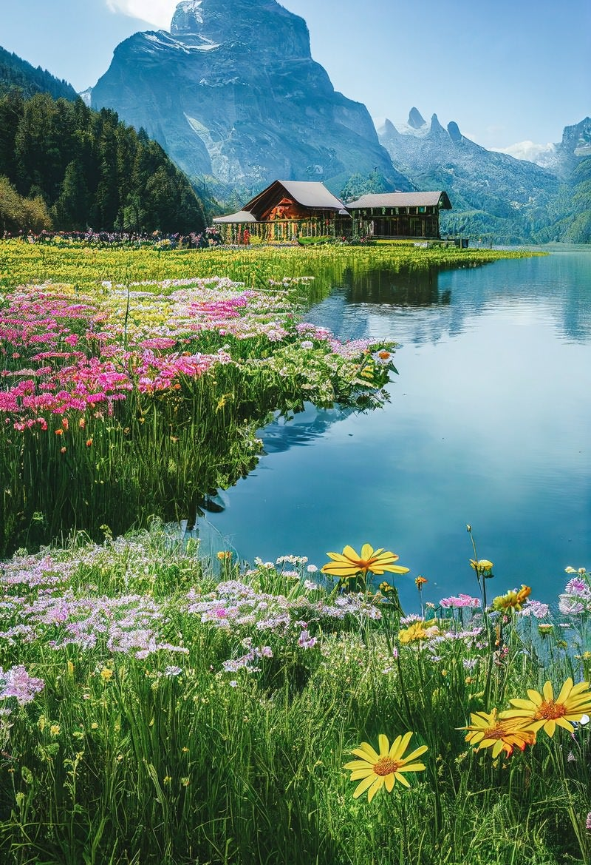

The reason I chose the topic
I know that AI could create pictures and music.
Sometimes I couldn’t realize the difference between a human-made material and an AI-made one. (The picture on the right side is made by AI. )
What about literature? I had never seen any AI-made poems. I think you also have not.
When I found this TED TALK below, I was so curious how AI worked in poetry.
https://www.ted.com/talks/oscar_schwartz_can_a_computer_write_poetry?subtitle=en

Slide 3

Let’s learn new vocabulary
proficiency
the fact of having the skill and experience for doing something
Example - The job ad said they wanted proficiency in at least two languages.
emulate
to copy something achieved by someone else and try to do it as well as they have
Example - They hope to emulate the success of other software companies
fair enough
something you say to show that you understand why someone has done or said something
Example – “I'm just annoyed with him because he's behaved so badly." "Fair enough."
grapple with something
to try to deal with or understand a difficult problem or subject
Example - Today, many Americans are still grappling with the issue of race.

Slide 4

Questions on the TED TALK!
Q1, How many people made a mistake when a poem was made by a human in the bot or not database?
- 65% of people
Q2, What is the important thing about RKCP compared to humans?
- It doesn’t know the meaning of the words it’s using.
Q3, According to the speaker, do people have perfect humanness?
- No, they don’t.
Q4, How should we think about computers writing poetry rather than scientifically?
- We should think about computers philosophically.

Slide 5
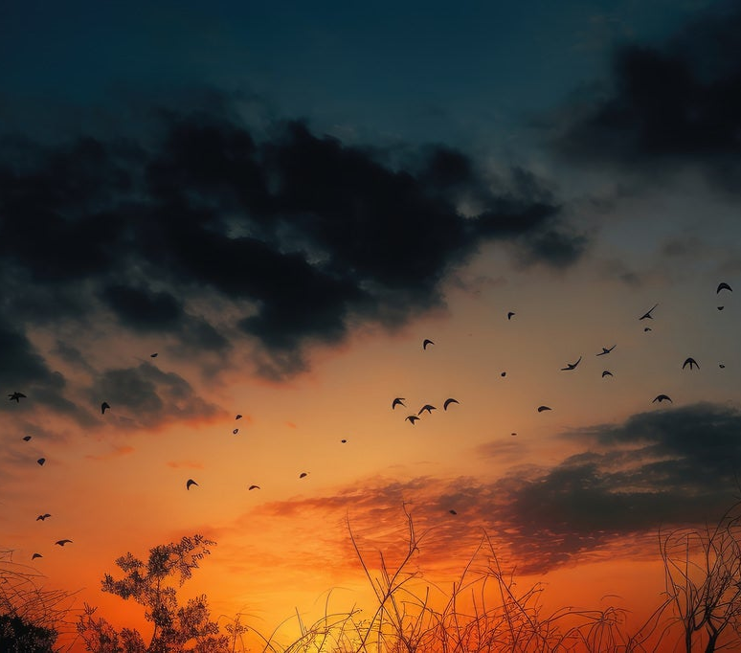
Can you figure this out?
I asked ChatGPT to generate a poem and designated three words.
Q5, What are the three words?
In sunset’s glow of gold and red, An apple’s crispness softly spread. Earphones hum a gentle song, As day to night is drawn along.
The evening whispers through the air, With music sweet and shadows fair. A moment’s peace, a perfect blend, As light and sound in twilight mend.
A apple, sunset and earphones
B music, evening and red
C twilight, apple and music

Slide 6
References
The pictures from “PAKUTASO” https://www.pakutaso.com/
The vocabulary contents from “Cambridge Dictionary” https://dictionary.cambridge.org/ja/dictionary/english/

