Slide 1
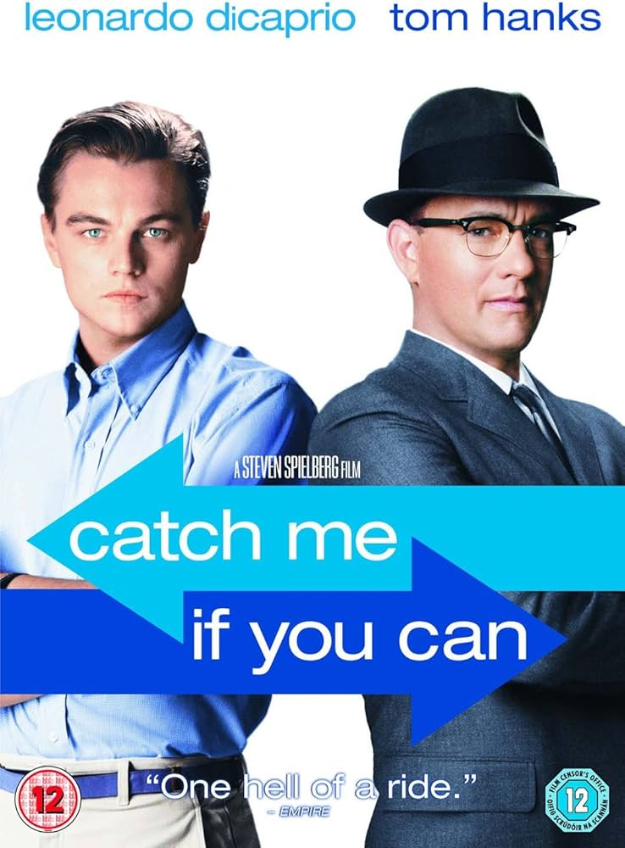
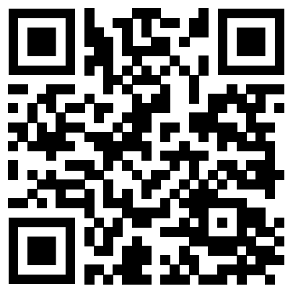
Catch Me If You Can
https://www.youtube.com/watch?v=gFr0_ywVdhY

Slide 2
Why I chose this movie clip
Because I thought it was the best work to learn how much posture and attitude while speaking can influence communication.
In recent years, scams, especially those using social media, have been increasing worldwide, and I wanted to raise awareness about this issue.
the protagonist was played by a famous actor（Leonardo DiCaprio）who also starred in well-known films like Titanic and Romeo + Juliet.
Many Japanese people tend to speak English with a lack of confidence, so I wanted them to use DiCaprio as a role model.

Slide 3
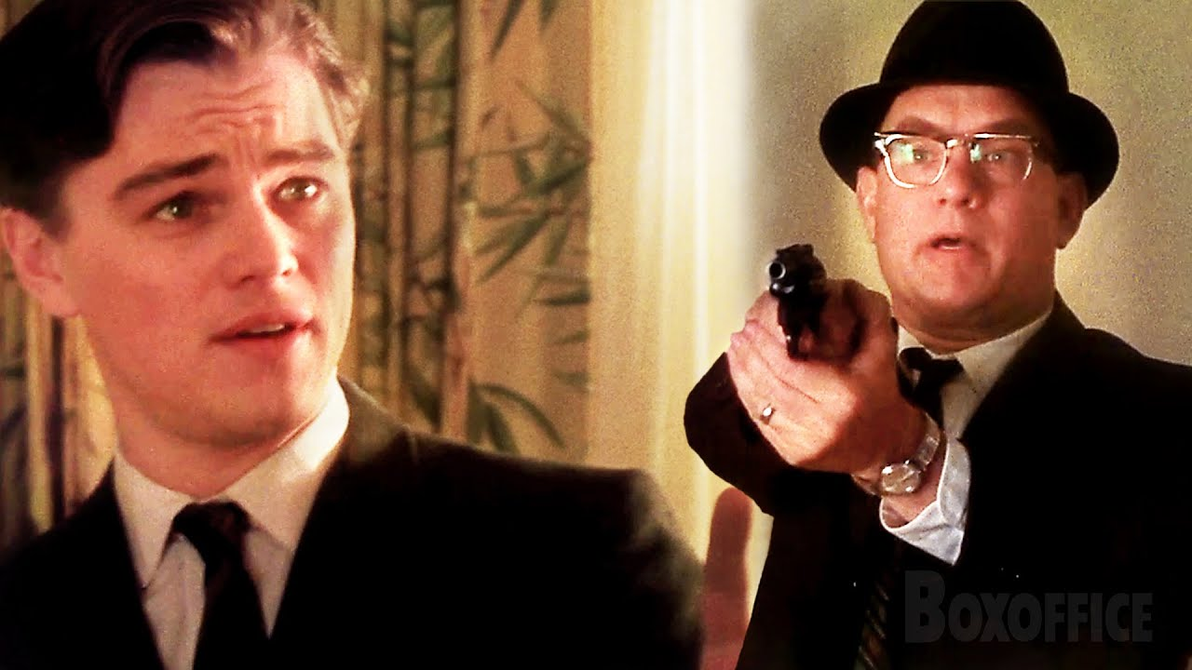
backgrounds
Carl Hanratty (FBI agent)
Situation
The FBI agents catch up to Frank and confront him with their guns drawn. Frank stays calm and uses his quick thinking and charm to handle the situation. Instead of getting scared, he talks to the agents, trying to convince them that he is innocent and that there has been a misunderstanding.
Frank Abagnale Jr (fraudster）

Slide 4
Vocabulary quiz
・ ・ ・ ・
A written order directing a bank to pay money to the bearer.
The state of being kept under police or legal authority
to engaging in an activity in a casual or superficial manner, rather than with serious commitment or expertise
qualifications, achievements, or evidence of a person's suitability for a specific role or task.
・credentials ・
・checks ・
・ dabbling ・
・custody ・
What does the sentence below mean? Please pay attention to “land yourself” and "collar".
2:04 Five minutes earlier, you would've landed yourself a pretty good collar

Slide 5
Questions
① Why do the FBI agents fail to recognize Frank's deception?
② Does Frank speak fast or slow in this scene? Why?
③ If you were the FBI agent, do you think you could tell if Frank
was lying? Why or why not?
④ What lesson can we learn about communication from this
scene?

Slide 6
What I learned from this scene
1.**Building Rapport**: Frank's interactions with the FBI agents illustrate that establishing a
connection, even in opposing situations, can significantly influence the conversation.
Effective communication involves relating to others, regardless of differences.
2. **Nonverbal Communication**: Nonverbal signals—such as body language, tone of voice,
and facial expressions—play a crucial role in conveying emotions and intentions,
potentially easing or escalating tensions.
3. **Speaking Style**: How you speak, including your tone, pace, and word choice, is equally
important as the content of your message, as it affects how well your communication is
understood.

Slide 7
Thank you for reading!

Slide 8
Answer for Vocabulary quiz
・ ・ ・ ・
A written order directing a bank to pay money to the bearer.
The state of being kept under police or legal authority
to engaging in an activity in a casual or superficial manner, rather than with serious commitment or expertise
qualifications, achievements, or evidence of a person's suitability for a specific role or task.
・credentials ・
・checks ・
・ dabbling ・
・custody ・
What does the sentence below mean? Please pay attention to the word "collar".
2:04 Five minutes earlier, you would've landed yourself a pretty good collar
↓
The sentence means that if you had arrived five minutes earlier, you would have made a really good arrest.
"land yourself" means to successfully obtain something.
"collar" is police slang for "an arrest."

Slide 9
Example answer for the question
①
The FBI agents believe Frank because he speaks confidently, stays very calm, looks professional, and controls the conversation. They don’t expect someone to lie so boldly, so they don’t question him enough.
②
Frank speaks at a controlled, steady pace. He doesn’t rush, which makes him seem confident and in control. Speaking too fast might make him look nervous, while speaking too slowly could raise suspicion.
③
I might not be able to tell because Frank is very confident and doesn’t show nervousness. However, if I focused on his body language and double-checked his information, I might catch his deception.
④
This scene teaches us that confidence and calmness can make communication more convincing. Effective communication is not just about what you say, but also how you say it.

Slide 10
Transcript
Frank ＝Frank Abagnale Jr
Hanratty ＝Carl Hanratty
Hanratty : F.B.I!
F.B.I. Come out of the bathroom. Step out of the bathroom!
Hands on your head.
Frank :That’s the new IBM Selectric…
Hanratty :Put your hands on your head!
Frank :print type In five seconds…
Hanratty :Shut up!
Frank :Just pop out the ball.
Hanratty :Put your hands on your head!
Put your hands…
Frank :You know he’s got over 200 checks here…
Hanratty :Hands on your head!
Frank :Even has little payroll envelopes addressed to himself…
Hanratty :Put it down! Drop it!
Frank :Relax! You’re late, all right?
My name is Allen. Barry Allen, United states Secret Service.
Your boy just tried to jump out the window.
My partner has him in custody.
Hanratty :I don’t know what you’re talking about.
Frank :You think the FBI is the only one on this guy? I mean, come on.
Come on, he’s dabbling in government checks here.
We’ve been following a paper trail on this guy for months now.
You mind taking that gun out of my face?
Please. Really. It makes nervous.
Hanratty :Let me see some credentials.
Frank :Yeah, sure.
Take my whole wallet.
You want my gun too? Come over here, take my gun.

Slide 11
Frank :Hey, hey, look.
Just do me a favor, take a look a outside. Look!
Look out the window.
My partner’s walking him to the car as we speak. Look.
Old guy almost pissed in his pants when I came through the door.
He jumped right through the window onto the hood of my car.
Frank :Hey, Murph?
Call the LAPD again. I don’t want people walking through my crime scene.
Hanratty :I didn't expect the Secret Service on this.
Frank :Don’t worry about it. What's your name?
Hanratty :Hanratty. Carl Hanratty.
Frank :Mind if I seen some identification?
Hanratty :Sure...
Frank :You never can be too careful these days.
Well, tough luck, Carl.
Five minutes earlier, you would've landed yourself a pretty good collar.
Hanratty :Is that right? Ten seconds later, you’d have been shot.
Mind if I come downstairs with you? I got to take a look at this guy.
Frank :Sure thing. Just do me a favor and sit tight for a sec while I get this evidence downstairs.
I don’t want some maid walking though here and making the bed.
LAPD should be here any sec.
Hanratty :Wait
Your wallet.
Frank :You hang onto it for a minute. I trust you.
Hanratty :Secret Service.
Hey!
God d**n it!

