Slide 1

SYMPHONY
Clean Bandit
L

Slide 2
What does “Symphony” mean to you personally?
Have you ever lost someone or something important to you? How did you feel at that time?

Slide 3
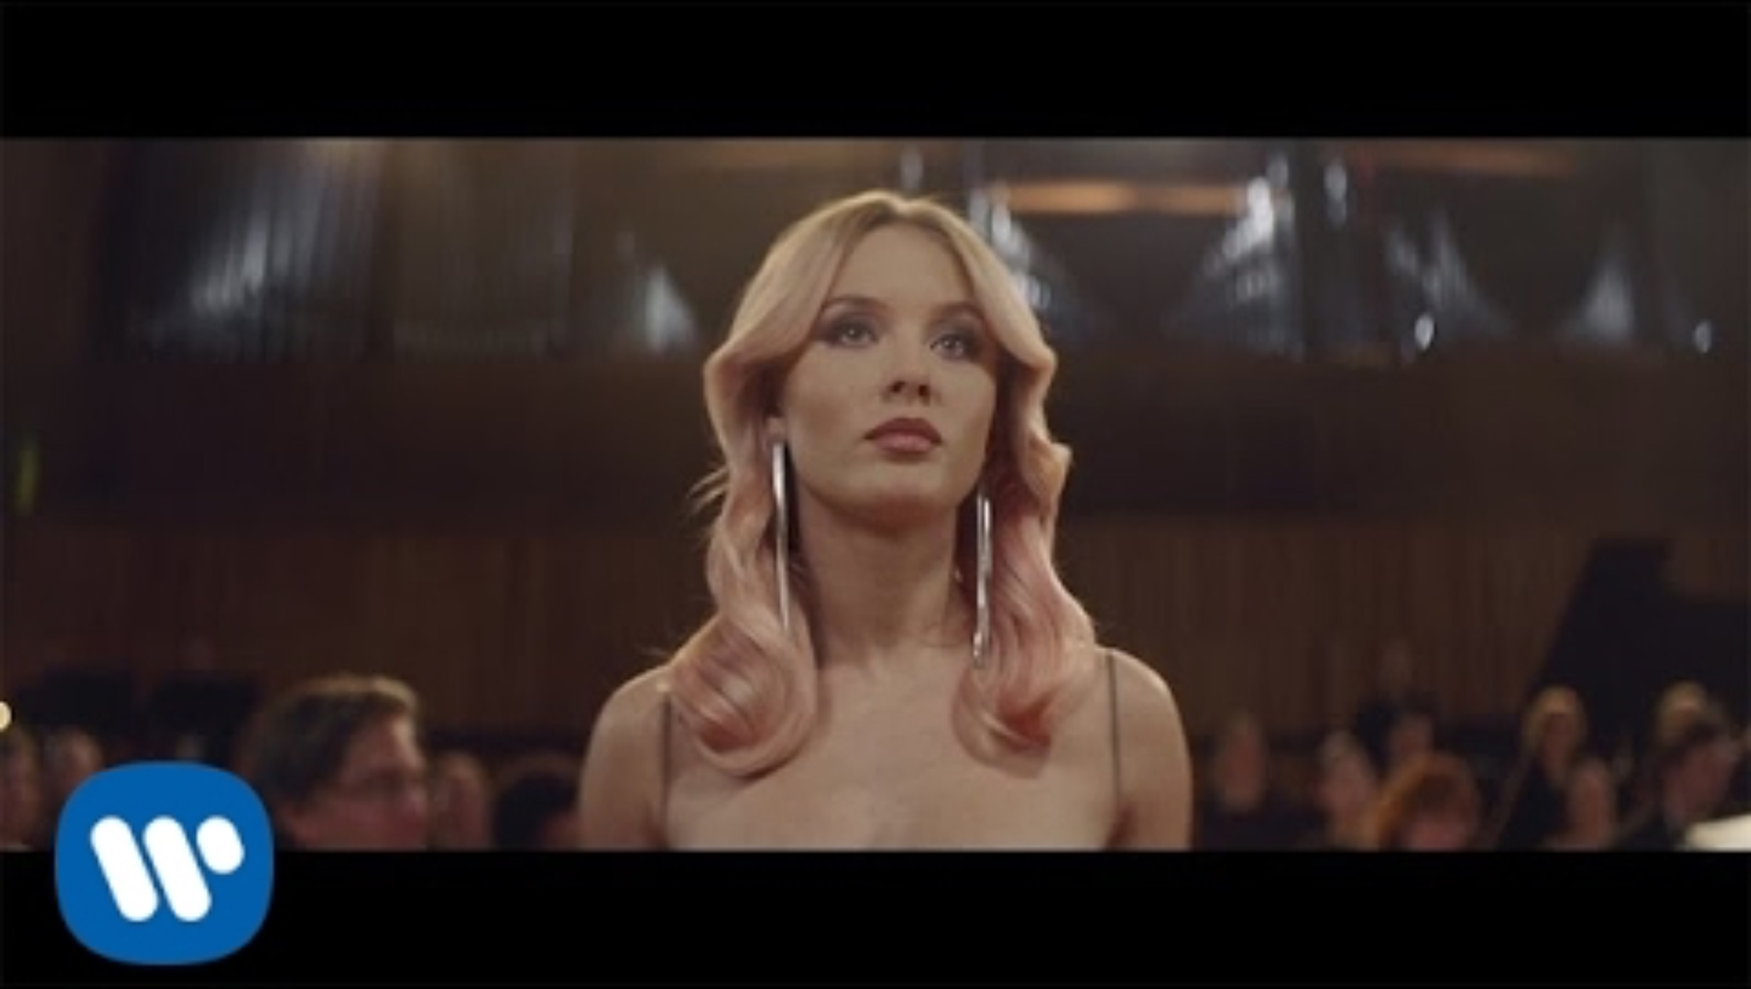

Slide 4
Throughout the lyrics, love is expressed as a “symphony”
The joy of finding love.
Salvation from loneliness.
Gratitude and dependence.

Slide 5


Clean Bandit and Zara Larsson
This song is made by Clean bandit（←）
and sung by
Zara Larsson (→)

Slide 6

Love
Its theme is love.
“I just wanna be part of your symphony”
they expresses their relationship with a loved one using the metaphor of a "symphony“
others...
“Symphony,like a love song on the radio,will you hold me tight and now let go”
“And now your song is on repeat and I’m dancing on to your heartbeat”

Slide 7
Pronunciation focus

Slide 8

Quiz
1. What is the word that is an metaphor for the intersection of life of two in this song?
A.
2. What color dress does Zara(singer) wear in the music video?
A.
symphony
silver

Slide 9

QUIZ
3. What color did the bicycle be painted by the remaining man?
A.
4. How old was Zara when she sang this song?
A.
white
19 years old

Slide 10
QUIZ
5. What is the tempo of this song?
A. The tempo is around 123 beats per minutes.
6. How does the song convey the feelings of love and loss? Give an example of a lyric that highlights these emotions.
A. For example, the lyric "I just wanna be part of your symphony" highlights the yearning to be intertwined with the other person’s life.

Slide 11

Review filler
interview:
-interviewer How did “Symphony” with Clean Bandit come together?
-Zara They wanted to work with me, which I’m super happy about. They heard “Lush Life” in the U.K. and they sent the song to me. I said “yes” immediately because I thought it was so beautiful, then we recorded the song and video, and bam, it was out!

Slide 12
Review filler
"Comments received:
- I felt like I was caught between love and loss.
- The sadness of someone who gave me the most memories in life becoming just a memory.
- Living a life like a symphony.
- I wonder if that person felt the same way.
"Why not explore the symphony you are creating in your own life?"

