Slide 1



Symphony
Clean Bandit

Slide 2
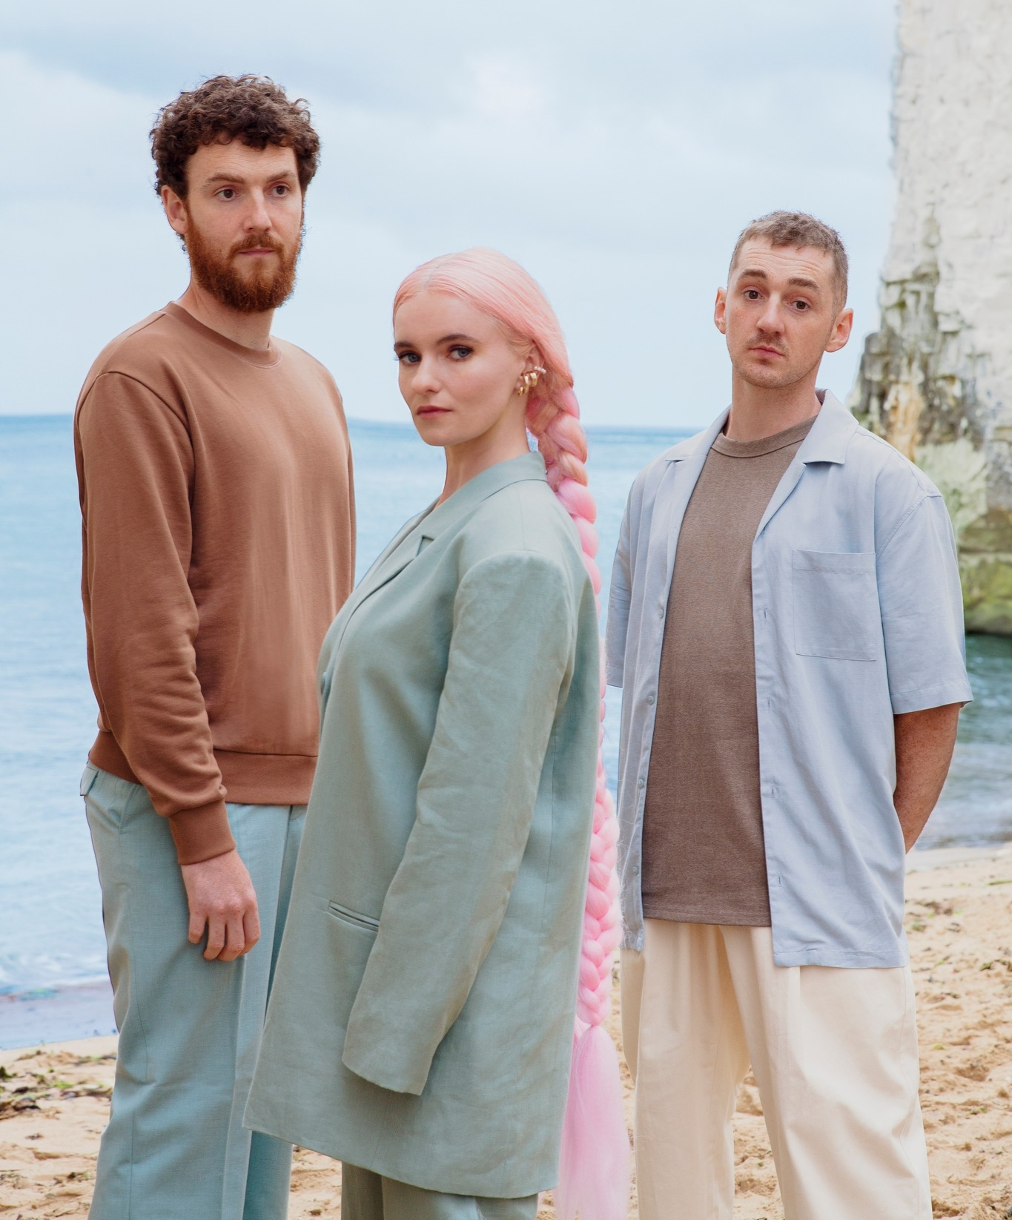
About Clean Bandit
Clean Bandit is a UK electro pop-group, formed in Cambridge in 2008.
It consists of three people , Grace Chatto, and brothers Jack and Luke Patterson.
They have worked with many talented artists, including Zara Larsson, Jess Glynne, and Anne-Marie.

Slide 3
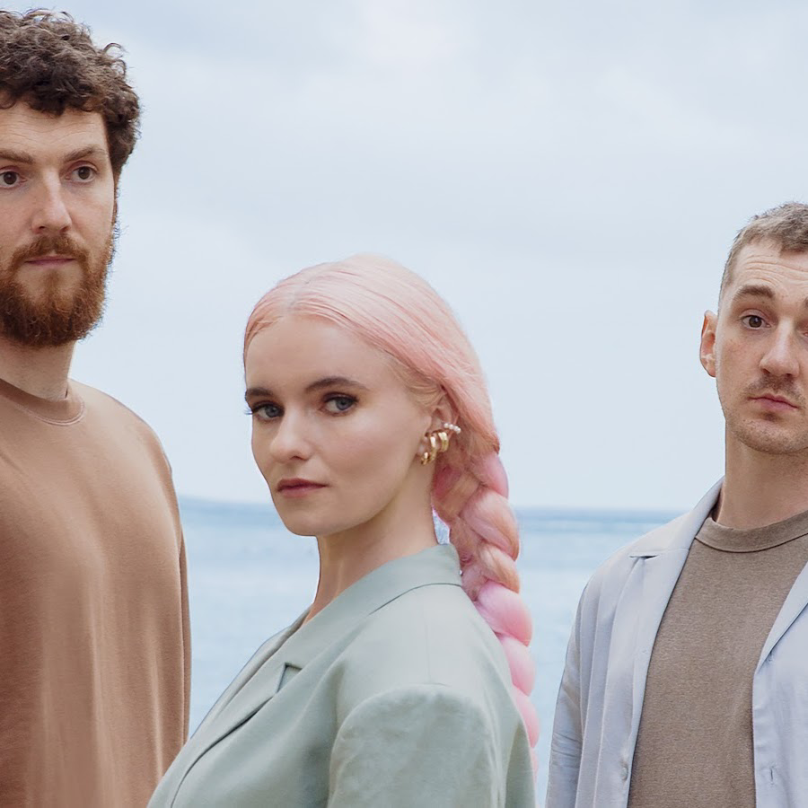
Clean Bandit
3 people in the band
Meet in the University of Cambridge in 2008
Grace Chatto / Jack Patterson / Luke Patterson
Classic+EDM
Origin: Naughty[Russian]
Official Japanese name： 『清潔な盗賊』

Slide 4

Grace：major in Russian
Jack : major in Architecture[study in Russia for 1 year].
→There is no one majoring in Music
singer in the band at all. →feature guest vocals every time they release music
Four times number 1 hits and ten 10 hits on the UK single chart
Most famous song on YouTube [https://youtu.be/papuvlVeZg8]
In 2019, collaborate with SEKAI NO OWARI

Slide 5



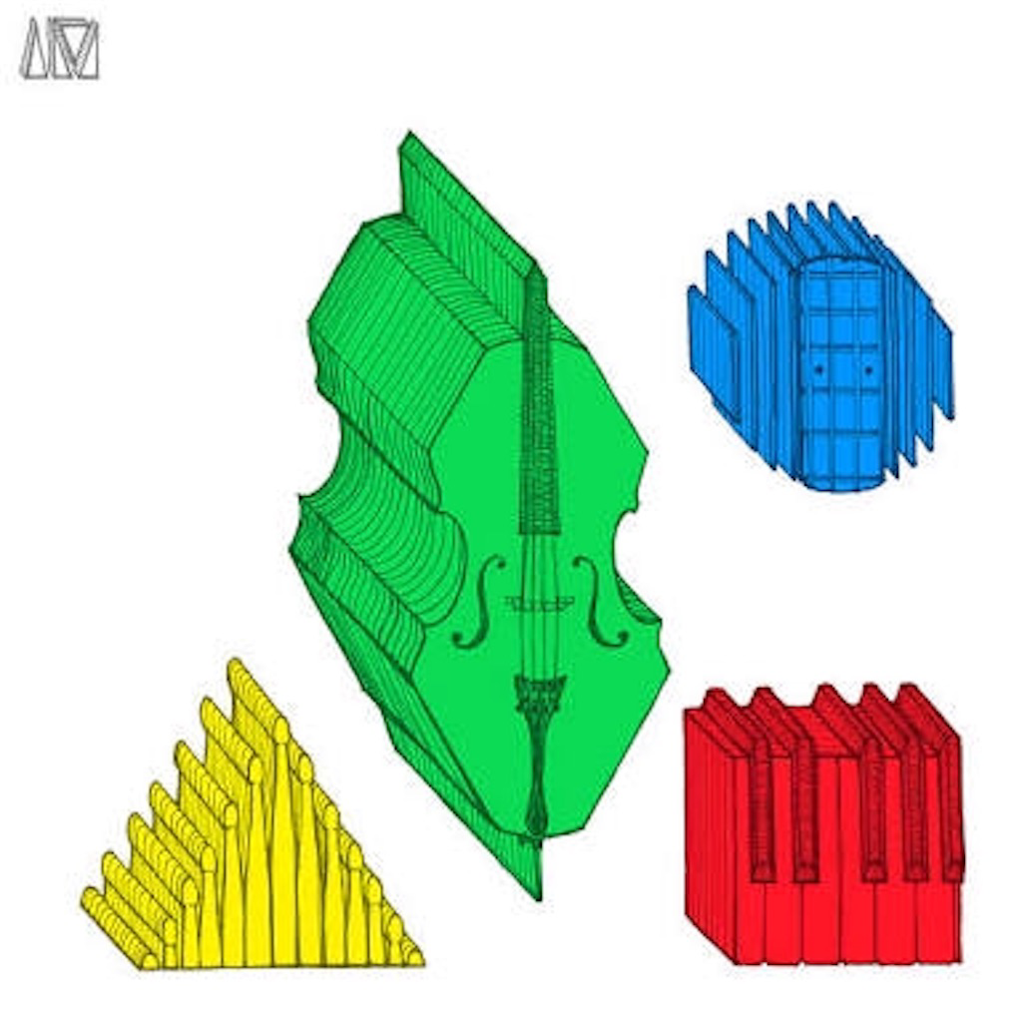

They sometimes use their logo.
Diamond
Circle
Triangle
Square

Slide 6

Zara Larsson
“Symphony” features vocals from Zara Larsson
Sweden Stockholm

Slide 7
Concept
Question!!!!!!!!
Please guess genre of “Symphony”?
“Symphony” is sweet and sad love song.
“I just wanna be part of your symphony.”
People who passed away and people who are alive.

Slide 8
Videos
Music Video divided 2part roughly, like sories.
Black men couple
story part
Orchestra part

Slide 9
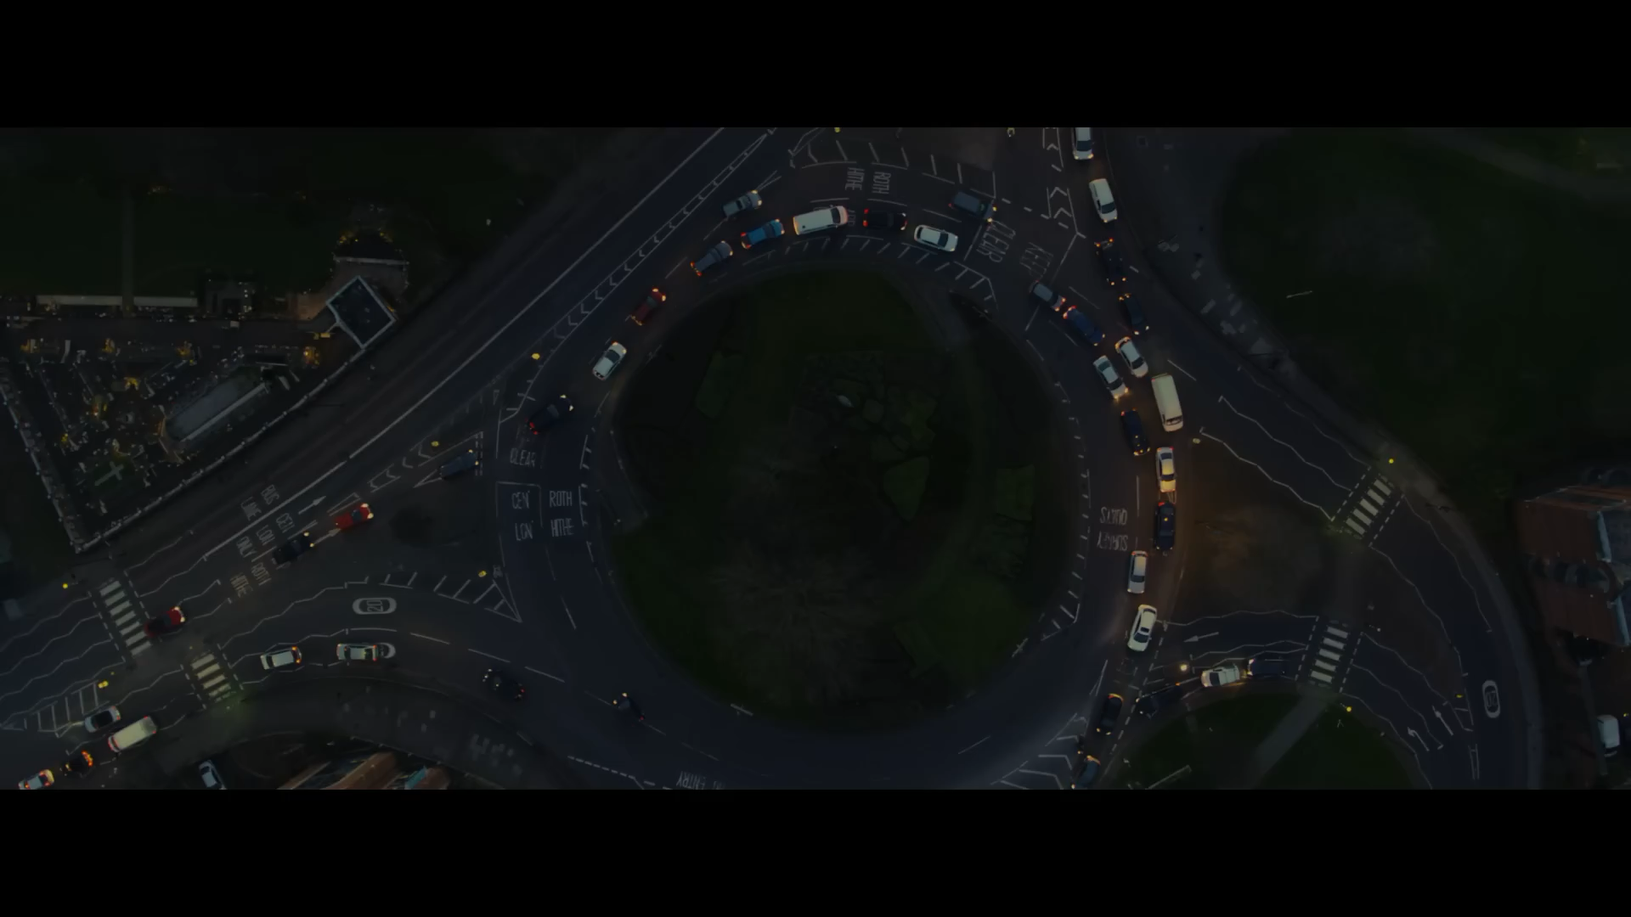

Slide 10

Videos-Orchestra part
An woman is singing “Symphony” front of the orchestra.
The man is couducting.
He is one of the black man who appered in Black men story part.

Slide 11
Videos-Black men story part
Black men gay couple story
One of the man passed away because he had a traffic accident.
The other man was so sad.
He remembers his life with boyfriend.
He conducts and puts on complex feelings on Symphony.

Slide 12
Meaning of lyrics
[Verse 1]
I’ve been hearin’ symphonies
Before, all I heard was silence
A rhapsody for you and me
And every melody is timeless
Life was stringin’ me along
Then you came and you cut me loose
Was solo, singin’ on my own
Now I can’t find the key without you
I heard nothing before I met you
melody is beyond time
I was tied to my life
→thanks to you, I’m free now
You’re necessary for me

Slide 13

[Pre-Chorus]
And now your song is on repeat
And I’m dancing on to your heartbeat
And when you’re gone, I feel incomplete
So, if you want the truth
[Chorus]
I just wanna be part of your symphony
Will you hold me tight and not let go?
Symphony
Like a love song on the radio
Will you hold me tight and not let go?

Slide 14
[Verse 2]
I’m sorry if it’s all too much
Every day you’re here, I’m healin’
And I was runnin’ outta luck
I never thought I’d find this feelin’
‘Cause I’ve been hearin’ symphonies
Before all I heard was silence
A rhapsody for you and me
And every melody is timeless
I’m sorry if my love is too heavy
I’m out of luck
Because we’ve been together

Slide 15

[Pre-Chorus]
And now your song is on repeat
And I’m dancing on to your heartbeat
And when you’re gone, I feel incomplete
So, if you want the truth
[Chorus]
I just wanna be part of your symphony
Will you hold me tight and not let go?
Symphony
Like a love song on the radio
Will you hold me tight and not let go?

Slide 16
Symphony
・Released in 2017
・The top of the UK chart
・Featuring Zara Larsson
Notes:
I’m going to introduce ‘symphony’
This is a one of the most popular songs in clean bandit’s
It was released in 2017
The single peaked at the top of the UK chart
And it Featured Zara Larsson she is swedish singer and has a strong voice

Slide 17
[Verse 1]
I've been hearin' symphonies
Before, all I heard was silence
A rhapsody for you and me
And every melody is timeless
Life was stringin' me along
Then you came and you cut me loose
Was solo, singin' on my own
Now I can't find the key without you
[Pre-Chorus]
And now your song is on repeat
And I'm dancin' on to your heartbeat
And when you're gone, I feel incomplete
So, if you want the truth
[Chorus]
I just wanna be part of your symphony
Will you hold me tight and not let go?
Symphony
Like a love song on the radio
Will you hold me tight and not let go?
[Verse 2]
I'm sorry if it's all too much
Every day you're here, I'm healin’
And I was runnin' outta luck
I never thought I'd find this feelin’
'Cause I've been hearin' symphonies
Before all I heard was silence
A rhapsody for you and me
And every melody is timeless
[Pre-Chorus] [Chorus]
[Interlude]
Ah, ah, ah, ah-ah-ah, ah, ah, ah Ah, ah, ah, ah-ah-ah, ah, ah, ah
[Pre-Chorus] [Chorus]
Like a love song on the radio
Will you hold me tight and not let go?
Notes:
Next, let’s look a lyrics
Please read it

Slide 18
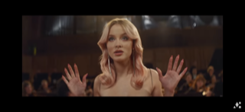
It’s a love song telling love
to a precious person
They express the feeling
by using musical words
Notes:
`Symphony’, It’s a love song telling love to a precious person.
Perhaps you’ve already noticed, They express the feeling
by using musical words . I think it’s interesting

Slide 19
[Verse 1]
I've been hearin' symphonies
Before, all I heard was silence
A rhapsody for you and me
And every melody is timeless
Life was stringin' me along
Then you came and you cut me loose
Was solo, singin' on my own
Now I can't find the key without you
[Pre-Chorus]
And now your song is on repeat
And I'm dancin' on to your heartbeat
And when you're gone, I feel incomplete
So, if you want the truth
[Chorus]
I just wanna be part of your symphony
Will you hold me tight and not let go?
Symphony
Like a love song on the radio
Will you hold me tight and not let go?
[Verse 2]
I'm sorry if it's all too much
Every day you're here, I'm healin’
And I was runnin' outta luck
I never thought I'd find this feelin’
'Cause I've been hearin' symphonies
Before all I heard was silence
A rhapsody for you and me
And every melody is timeless
[Pre-Chorus] [Chorus]
[Interlude]
Ah, ah, ah, ah-ah-ah, ah, ah, ah Ah, ah, ah, ah-ah-ah, ah, ah, ah
[Pre-Chorus] [Chorus]
Like a love song on the radio
Will you hold me tight and not let go?
Notes:
There is a lot of words related to music

Slide 20
[Verse 1]
I've been hearin' symphonies
Before, all I heard was silence
A rhapsody for you and me
And every melody is timeless
Life was stringin' me along
Then you came and you cut me loose
Was solo, singin' on my own
Now I can't find the key without you
[Pre-Chorus]
And now your song is on repeat
And I'm dancin' on to your heartbeat
And when you're gone, I feel incomplete
So, if you want the truth
[Chorus]
I just wanna be part of your symphony
Will you hold me tight and not let go?
Symphony
Like a love song on the radio
Will you hold me tight and not let go?
symphony =
sharing same time
solo = solitude
rhapsody = love
Notes:
We look in detail
I guess …
The words have a lot of possible meanings
As i said, the lyrics are great, but i recommend you to watch music video

Slide 21
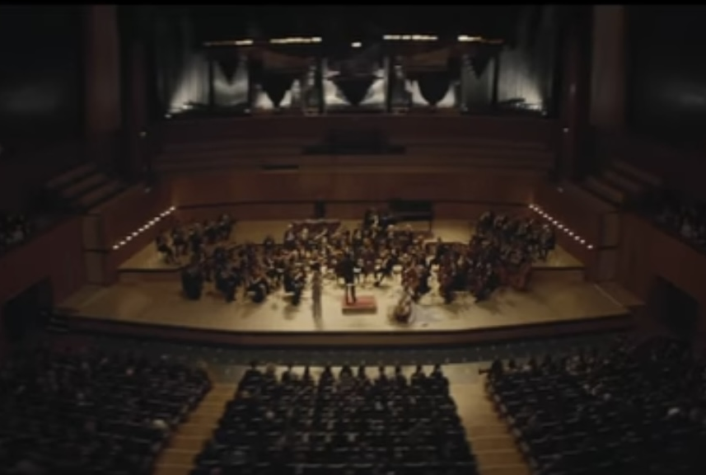
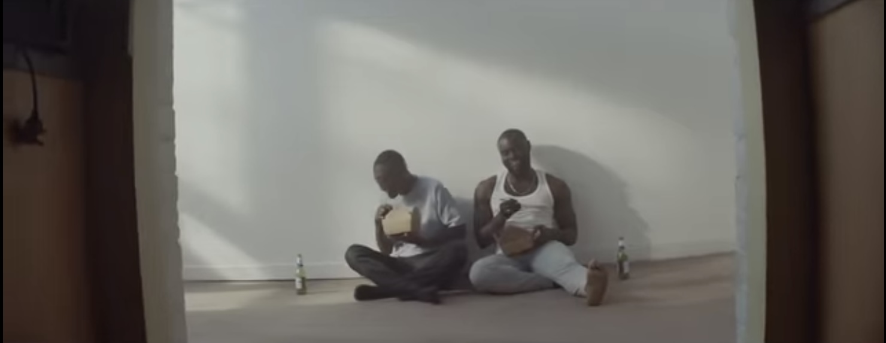
Music Video
Notes:
The story begin with a scene of orchestra and in front of them, zara is singing
Then two men show up. They love to eacy other.

Slide 22

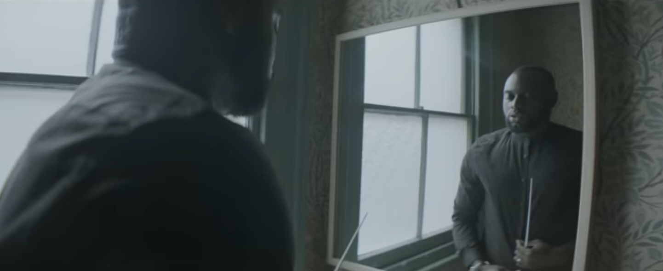
Notes:
But one day one of the men has an accident and died
The left man feel deep sorrow but he continue making effot in order to be a conducter

Slide 23
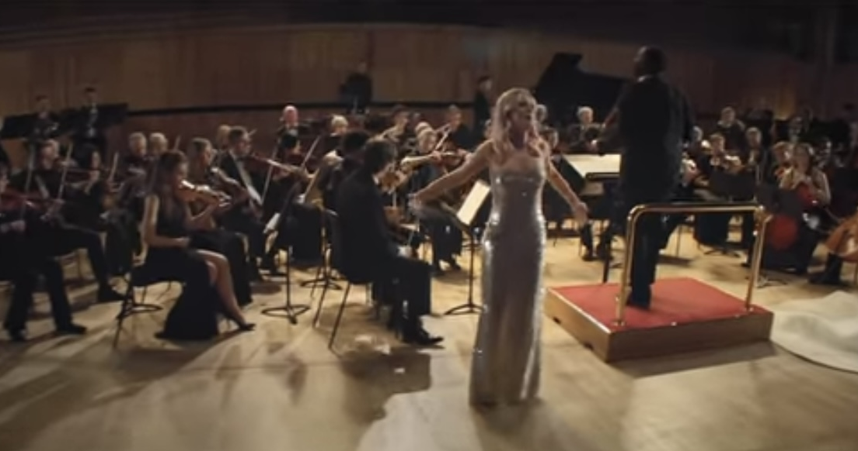
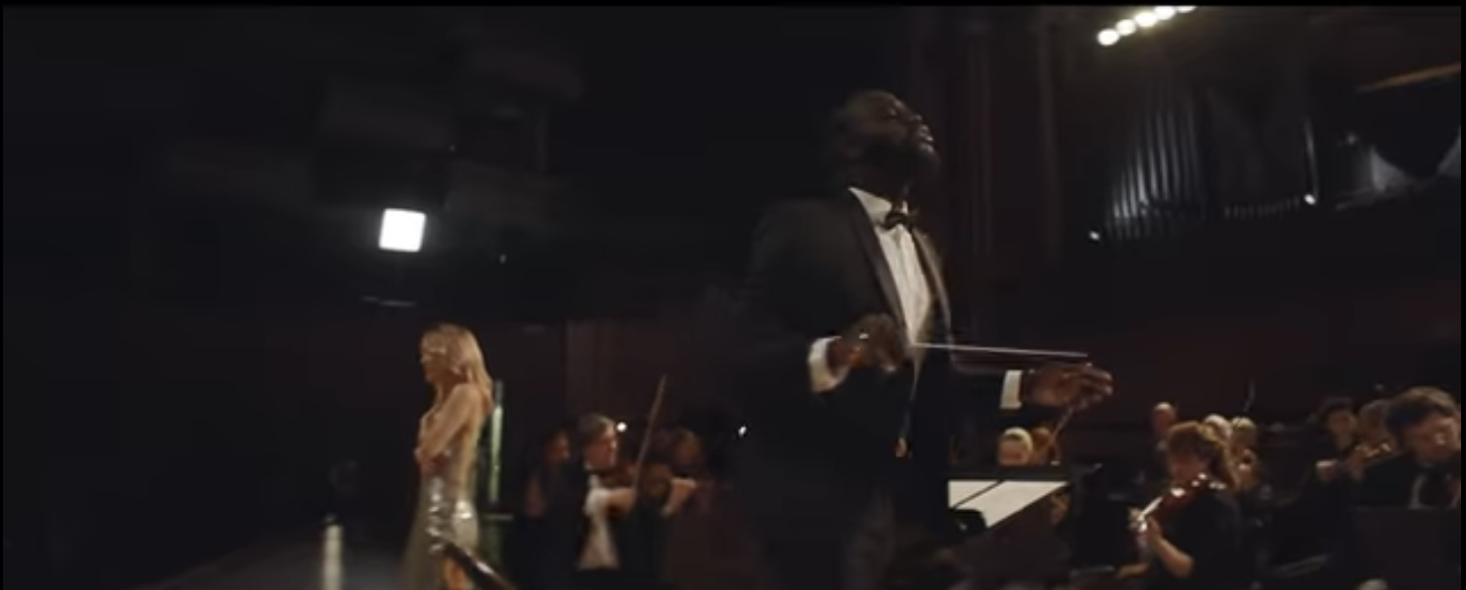
Notes:
Actually the conducter of the orchestra is this man. he conduct the orchestra although he felt painful
When i watched this video, i became sad but i felt the strong power of love

Slide 24

Quiz
Notes:
I think that you can get many information about clean bandit, and Symphny.
So, let’s take a quiz!

Slide 25

Quiz
About the band
・ How many times did they get number 1 hits in the UK Single Chart？
1,once 2, twice 3, four times. 4, seven times
Notes:
First, about the band, clean bandit.
Can you make your answer?
Correct answer is

Slide 26
Quiz
About the band
・ How many times did they get number 1 hits in the UK Single Chart？
1,once 2, twice 3, four times. 4, seven times
Notes:
Four times.
They got number1 four times.
next

Slide 27

Where are they from?
1,France 2, America 3, Canada 4, England
Notes:
You make choice?
Correct answer is

Slide 28
Where are they from?
1,France 2, America 3, Canada 4, England
Notes:
England
I think that your score is great.
Next is last question

Slide 29

About “Symphony”
When was the song released?
1, 2015 2, 2017 3, 2019 4, 2021
Notes:
It’s about Symphony.
We may have told you the answer.
Can you choice?

Slide 30
About “Symphony”
When was the song released?
1, 2015 2, 2017 3, 2019 4, 2021
Notes:
2017
I have finished.
If you had a good time, I’m really happy.

Slide 31
Thank you for listening

Slide 32


Last question
“Symphony” is …
Happy song
sad
song
or

Slide 33


Representative songs
・Rather Be
It was a huge commercial success, debuting at number one on the UK chart.
https://www.youtube.com/watch?v=m-M1AtrxztU
・Rockabye
It is a dancehall song about all of the single and struggling mothers in the world.

Slide 34

Thank you for listening!!

