Slide 1
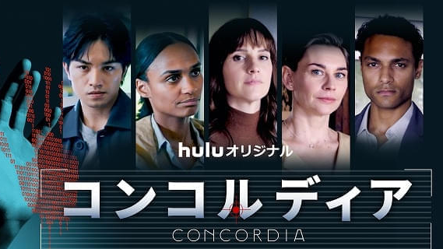
8123103 Rika Narikiyo

Slide 2



CONCORDIA
You can watch all stories of this movie on Hulu .
This is the link of its official page. (written in Japanese)
https://www.hulu.jp/static/concordia/#introduction

Slide 3
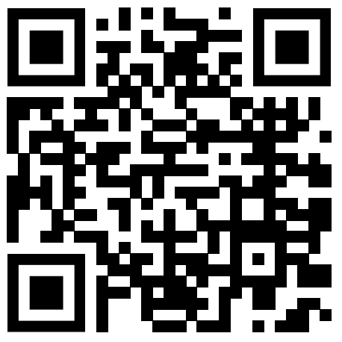
Why I choose this movie (Episode2)
I choose this movie because favorite person is appearing in this movie (Kento Nakajima as A・J).
He can speak English well. I want to tell you that Japanese actor can appear the movie in English.
https://youtube.com/shorts/2fU3CHgjWWg?si=T7IMktcHSbdirICE

Slide 4
Summery of the movie
Concordia is the community which is monitored by camera and AI. This town was made to guarantee free, fare and human society. Here, a murder occurred. After that, people have doubts for the town and the philosophy of Concordia.

Slide 5
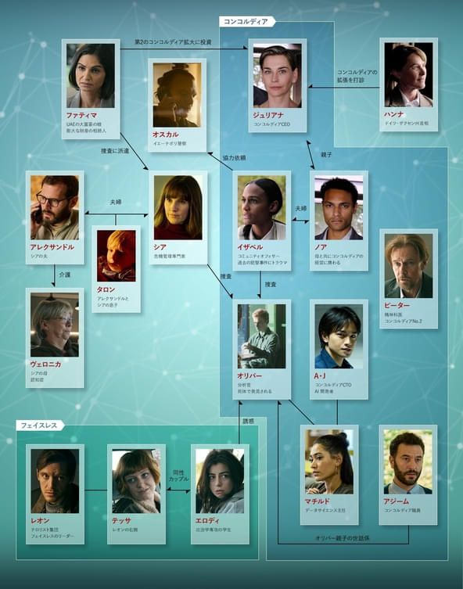
Character

Slide 6
The scene (Episode2)
There is problem with system security and the members of Concordia is discussing whether they inform chief minister and residents of Concordia.

Slide 7
Vocabulary
・under wraps to keep something secret^{※1}
・road maps a detailed plan or explanation to guide you in setting standards or determining a course of action ^{※2}
・breach an act of breaking a law, promise, agreement, or relationship^{※3}
※1 https://www.ldoceonline.com/jp/dictionary/keep-something-under-wraps
※2 https://ejje.weblio.jp/content/road+map,日本語WordNet(英和)
※3 https://dictionary.cambridge.org/ja/dictionary/english/breach

Slide 8
Transcript
https://tufsacjp-my.sharepoint.com/personal/narikiyo_rika_x0_tufs_ac_jp/Documents/8123103%20Rika%20Narikiyo%20AL2%20transcript.docx?web=1

Slide 9
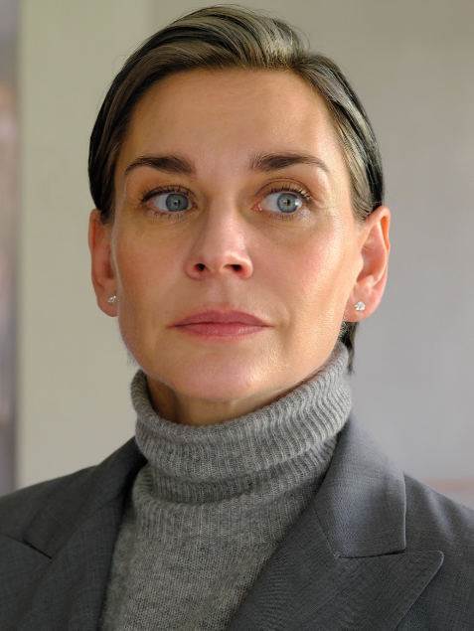
Introduction of characters
(appear in the clip)
JULIANE ERICKSEN
She is the CEO of Concordia. She convince the residents that it is monitoring by camera and AI that can prevent tragedy.

Slide 10
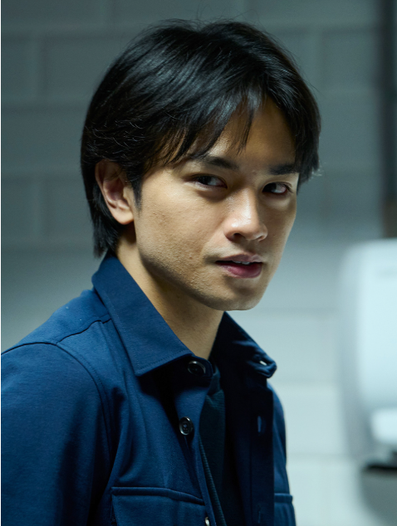
Introduction of characters
(appear in the clip)
A.J.OBA
He is the CTO of Concordia. He is genius in Machine Learning field and made AI of Concordia. He is a confident person.

Slide 11
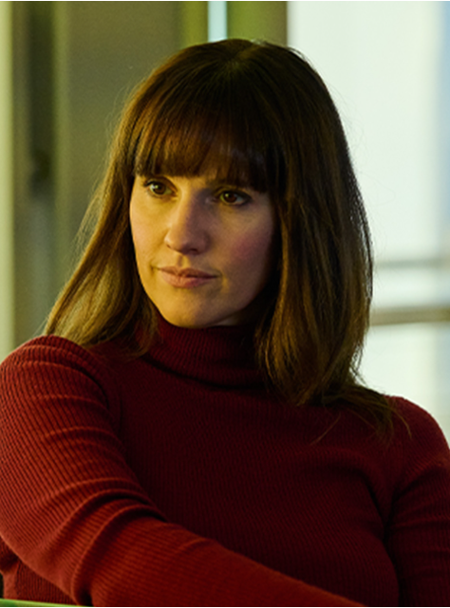
Introduction of characters
(appear in the clip)
THEA RYAN
She is a crisis management specialist from London.
She deal with the accident in Concordia with suspiciousness.

Slide 12
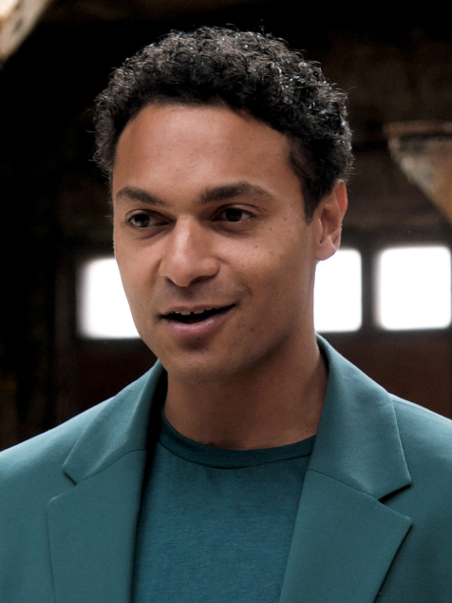
Introduction of characters
(appear in the clip)
NOAH ERICKSEN
He engage in the management of Concordia with his mother. He is gentle and humble. He completely believes the project of Concordia.

Slide 13
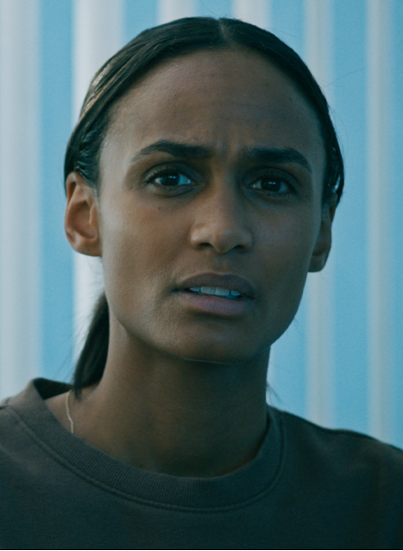
Introduction of characters
(appear in the clip)
ISABBELLE LARSSON
She is community officer of CONCORDIA. She is survivor of school shooting which launch the Concordia project.

Slide 14

Questions
What do you think about A・J’s character?

Slide 15
Questions
2. Who do you think should tell other people about this and don’t think?

Slide 16

Questions
3. What do you think about Japanese subtitles？

Slide 17

Questions
4. What do you think about the community which is monitored by camera and AI?

Slide 18

Fun activity
What do you think about Concordia? Utopia or dystopia?
Let’s think and check the voting result on X(Twitter).
https://x.com/hulu_japan/status/1852153591399936370

Slide 19

What I learned from the scene
A・J has confident in his ability and he get upset due to the accident.
The seamy side of manager
Every characters get upset and they’re opinions are divided.

Slide 20

Thank you
for watching!!

