Slide 1
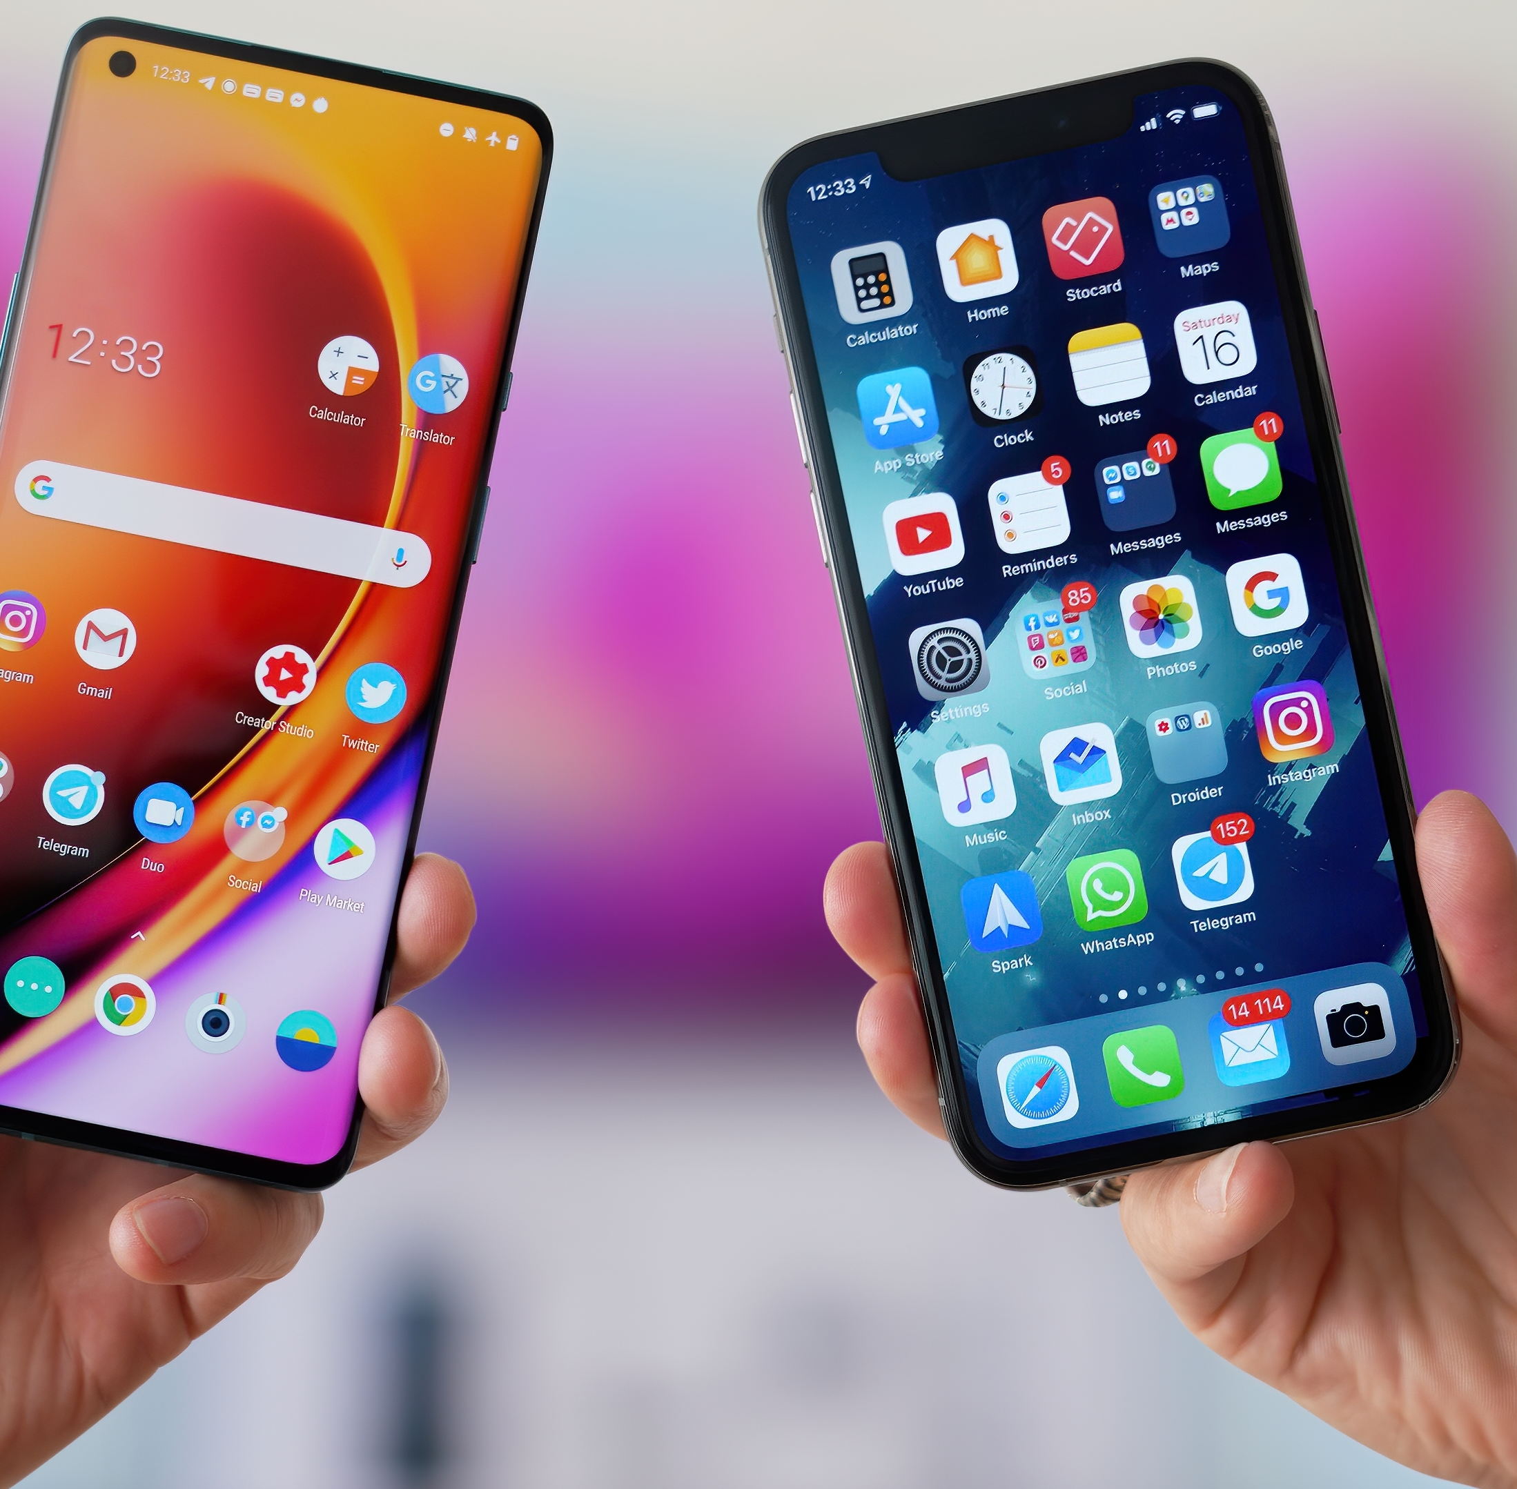
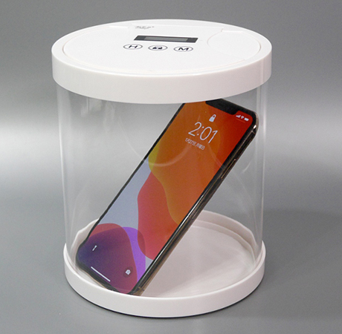
Could you live without a smartphone?

Slide 2
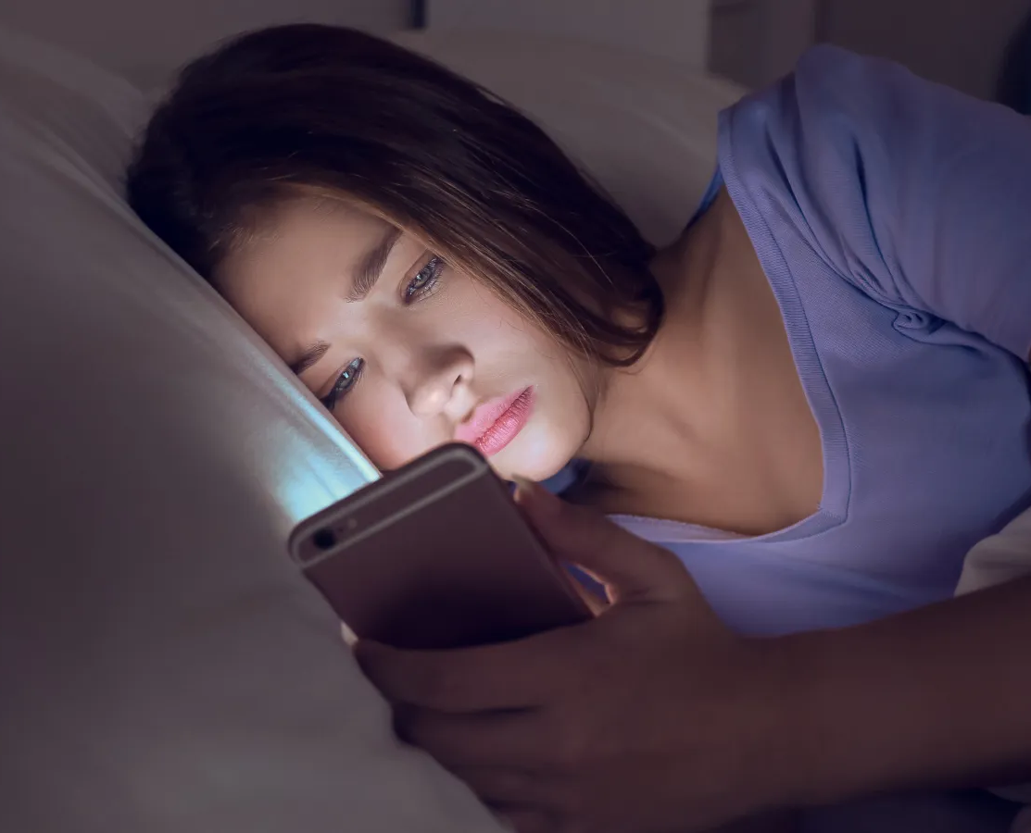

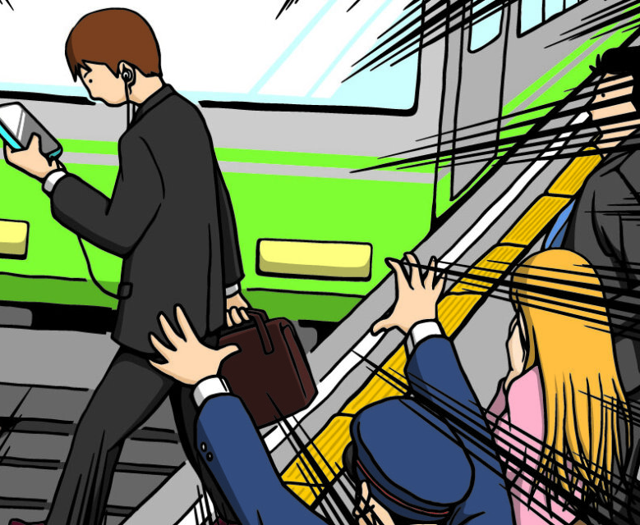
3 reasons Why I chose this topic
① The influence of a certain book
A few months ago, I read a book titled 'Smartphone Brain,' and since then, I have become more aware of how smartphone addiction affects our brains and behaviors
②Personal Experience
I have personally experienced the effects of excessive smartphone use, such as poor sleep quality and increased anxiety regarding face-to-face communication
③Watching news related to "smartphone zombie”
I saw news about accidents where people using their phones while walking got hit by trains or cars and were injured or killed.

Slide 3

Title:Could you live without a smartphone? |
Speaker:Anastasia Dedyukhina
URL:https://www.youtube.com/watch?v=uNQujCwCu88

Slide 4
Vocabulary
・variability
quality of being changeable or having differences.
・neurohormone
a type of hormone produced by nerve cells (neurons) that affects other parts of the body
・neuroscience
the scientific study of the nervous system, including the brain, spinal cord, and nerves
・chunk
a group or unit of something that is treated as a single entity
・disconnect laws
regulations that grant employees the right to disconnect from work communications outside of their working hours.
・dopamine
a neurotransmitter, a chemical messenger in the brain, that plays a key role in regulating mood, motivation, pleasure, and reward
・depressed
a state of feeling very sad, hopeless, or disinterested in life
・cc'ing
the practice of including someone as a "carbon copy" recipient on an email.

Slide 5
comprehension questions
1.How many times do we check our devices daily, according to the speaker?
2.What strategies does the speaker suggest for managing digital habits?
3. According to the speaker, how does multitasking affect our productivity and brain function?
4.What effect does keeping a smartphone near the bed have, according to the speaker?

Slide 6

Let's move on to Discussion Questions

Slide 7
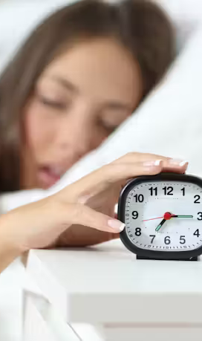
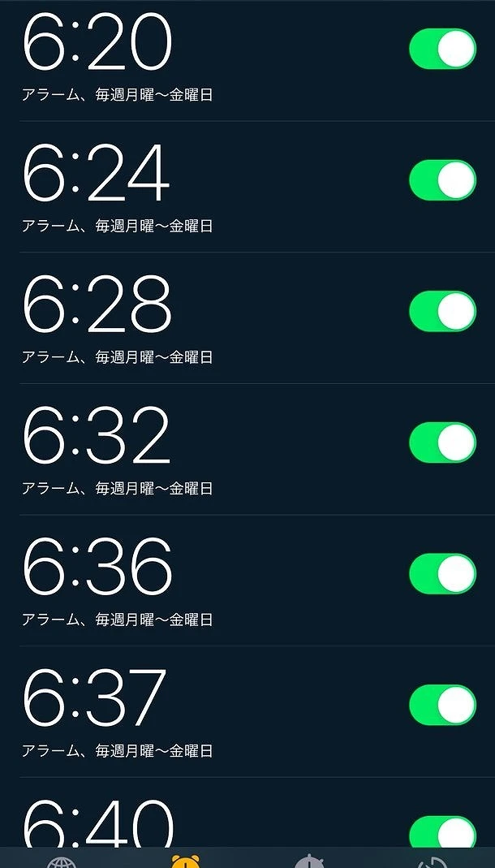
①
The speaker suggests using an alarm clock instead of a phone to wake up. What are your thoughts on this approach, and would you consider making the switch?

Slide 8
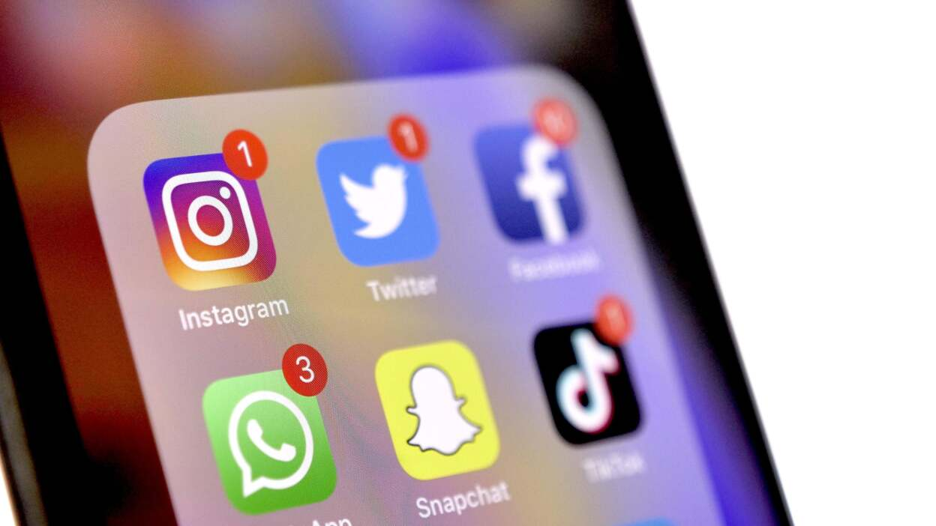
②
The speaker emphasizes the importance of managing notifications and distractions. In what ways do you currently manage your device usage?

Slide 9
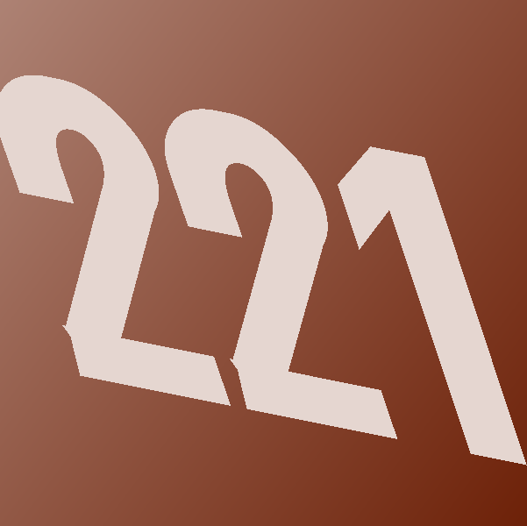
③
The speaker mentions that we check our devices approximately 221 times per day. Do you think this number is accurate for you? Why or why not?
この写真 の作成者 不明な作成者 は CC BY-NC-ND のライセンスを許諾されています

Slide 10

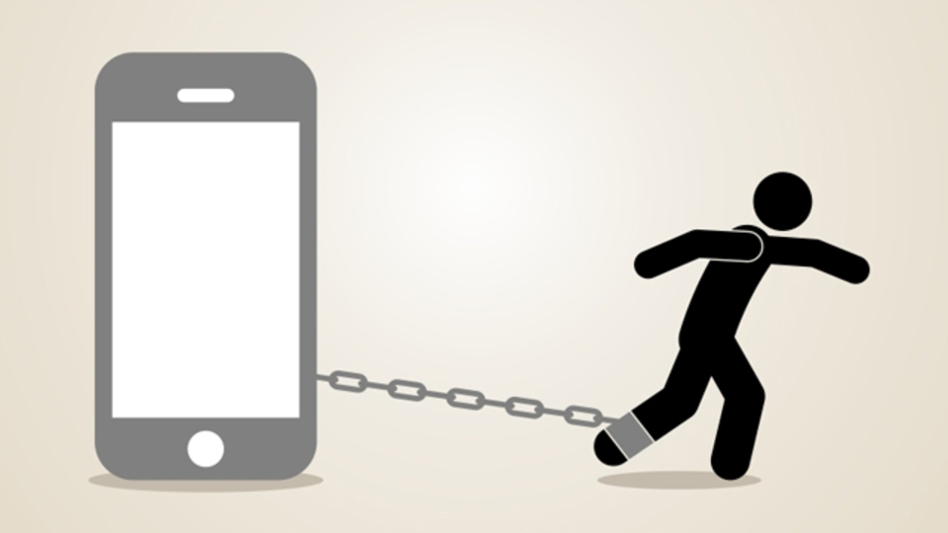
Thank you very much!
I hope you can have a good relationship with your smartphone

Slide 11
Model answers for the comprehension questions
1.
According to the speaker, we check our devices about 221 times per day, which is approximately every 4.3 minutes when we are not sleeping.
2.
The speaker suggests disabling notifications, using delayed email functions, implementing blocking apps, avoiding multitasking, and creating a structured environment to support healthier digital habits.
3.
The speaker notes that multitasking worsens productivity and leads to a decline in the brain's ability to function effectively. A Stanford experiment indicated that the more we multitask, the less proficient we become at it.
4.
Keeping a smartphone near the bed puts the brain in a state of alarm, tempting you to check it first thing in the morning.

Slide 12
Example answers for the Discussion Questions
①
・I think using an alarm clock instead of a phone is a good idea. It helps reduce the temptation to check messages in the morning. I would consider making the switch to have a more peaceful start to my day.
・I believe using a phone as an alarm is more practical than an alarm clock. My phone allows me to customize alarm sounds, set multiple alarms, and even use features like snooze.
②
・I manage my device usage by turning off notifications and setting times to check emails and social media. I also use apps to block distracting websites during work hours and keep my phone away when I'm with family.
③
・I think the number is accurate for me because I often check my phone for messages, social media, and news throughout the day. However, I try to reduce it by limiting my time on certain apps.
・I don't think the number is accurate for me. I usually check my phone less than that because I focus on my work and limit distractions. I prefer to check my messages and social media only a few times a day.

