Slide 1
TED Talk:
Could your language affect your ability to save money?
video
https://www.ted.com/talks/keith_chen_could_your_language_affect_your_ability_to_save_money

Slide 2
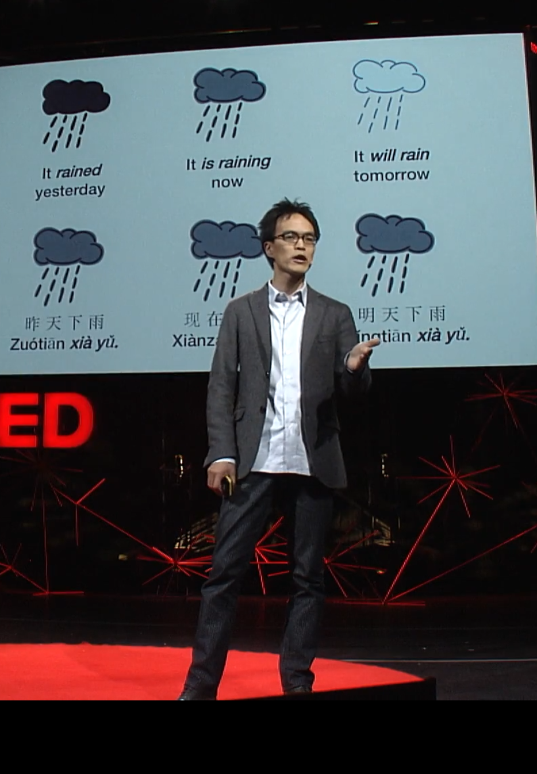
Why did I choose this presentation?
The reason why I chose this presentation is that I am interested in how language affects our way of thinking and behaviors. All students in TUFS speak more than one language, and some of them are interested in linguistics. Therefore, I think many students in TUFS will enjoy and relate to this presentation which talks about the relationship between the language structures we use and our behaviors.

Slide 3
List of vocabulary
Reignite(v) | to start burning again; to make sth start burning again
Headway(n) | To make progress, especially when this is slow or difficult
Propensity(n) | A tendency to a particular kind of behavior
Flank(n) | The side of sth such as a building or mountain
Spectrum(n) | A complete or wide range of related qualities, ideas, etc
Outlier(n) | a person, thing, or fact that is very different from other people, things, or facts, so that it cannot be used to draw general conclusions:

Slide 4
List of vocabulary
Dissociate(v) | Disconnect or separate
Viscerally(adv) | in a way that is based on deep feeling and emotional reactions rather than on reason or thought:
Nudge(v) | To push sb/sth gently or gradually in a particular direction
Fanciful(adj) | Based on imagination and not facts or reason
Granularly(adv) | Having a high level of detail, as in a set of data
Grip(n) | An act of holding sb/sth tightly

Slide 5
Phrasal verbs training match synonyms!
Bring about
Hold down
Split up
Go about
Turn out
Break down
Look back
Cause
Emerge
Keep
Approach
Separate
Review
destroy

Slide 6
Engaging questions!!

Slide 7
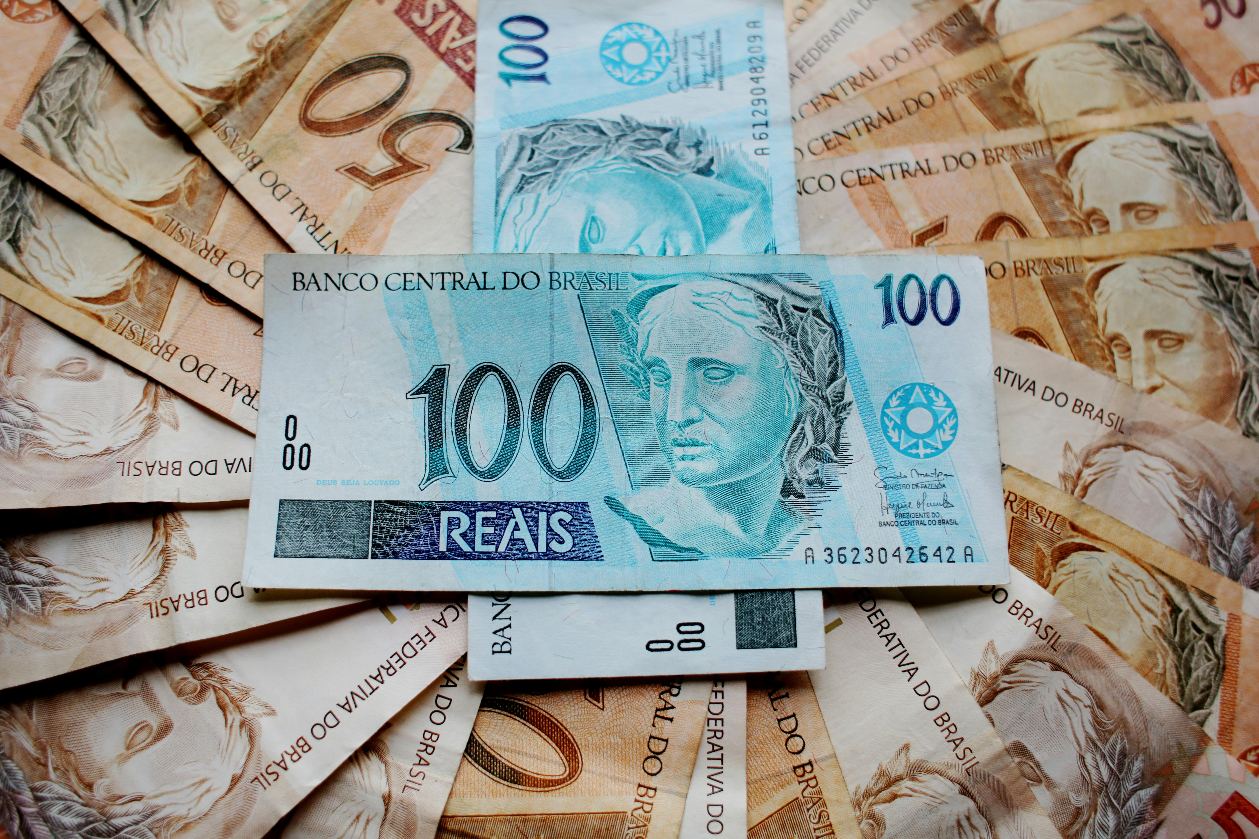
Q1
Do you agree with this presentation?
Why or why not?
Can you give other factors
that affect our saving behavior?

Slide 8
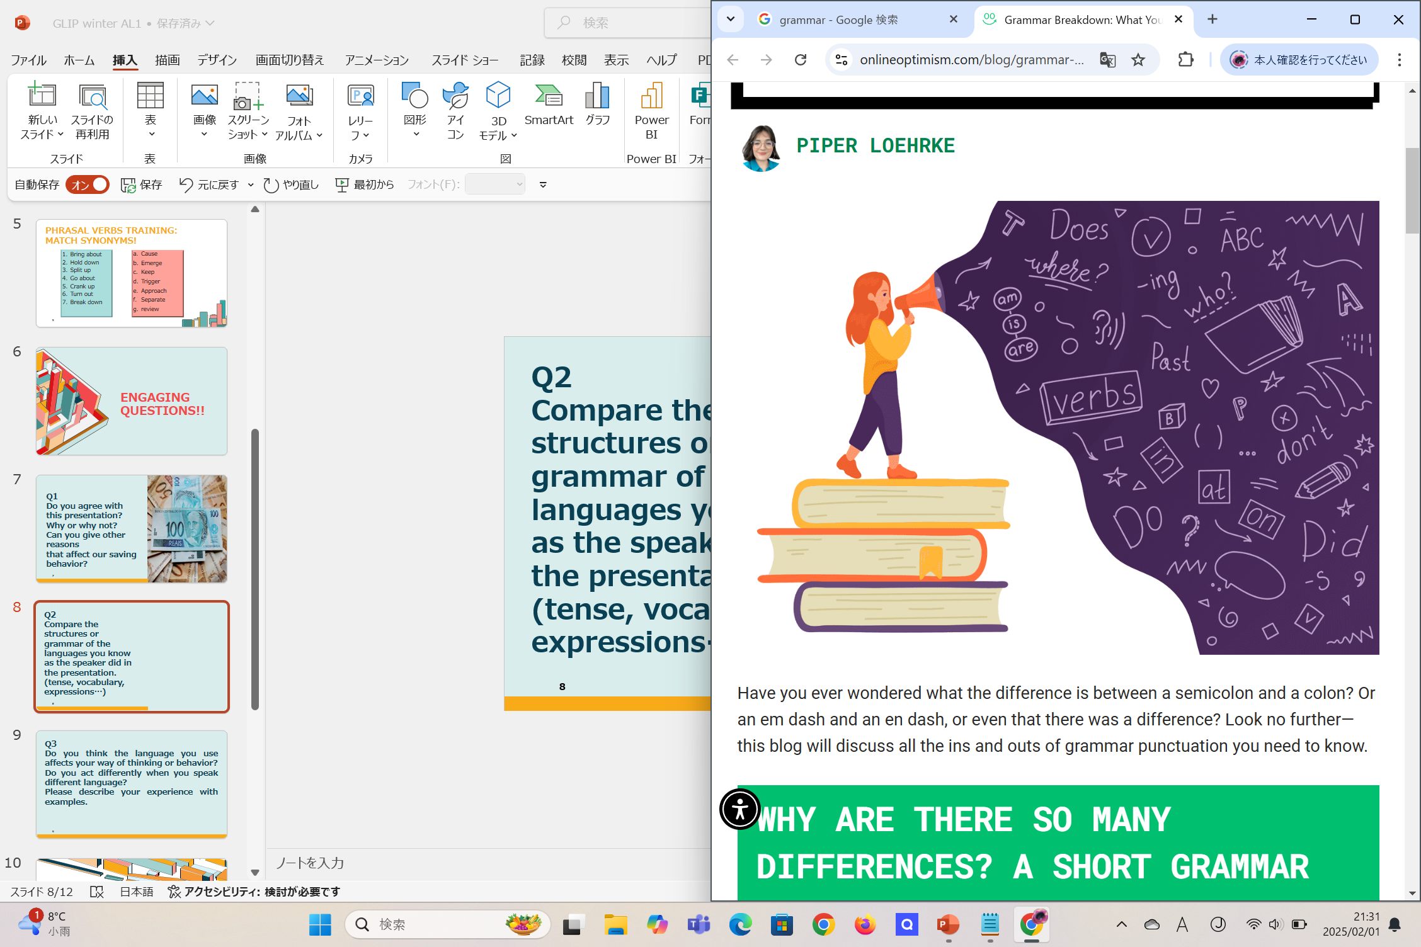
Q2
Compare the structures or grammar of the languages you know and describe the differences between them.
(tense, vocabulary, expressions…)

Slide 9

Q3
Do you act differently when you speak different language?
Please describe your experience with examples.

Slide 10
Fun activity☺

Slide 11
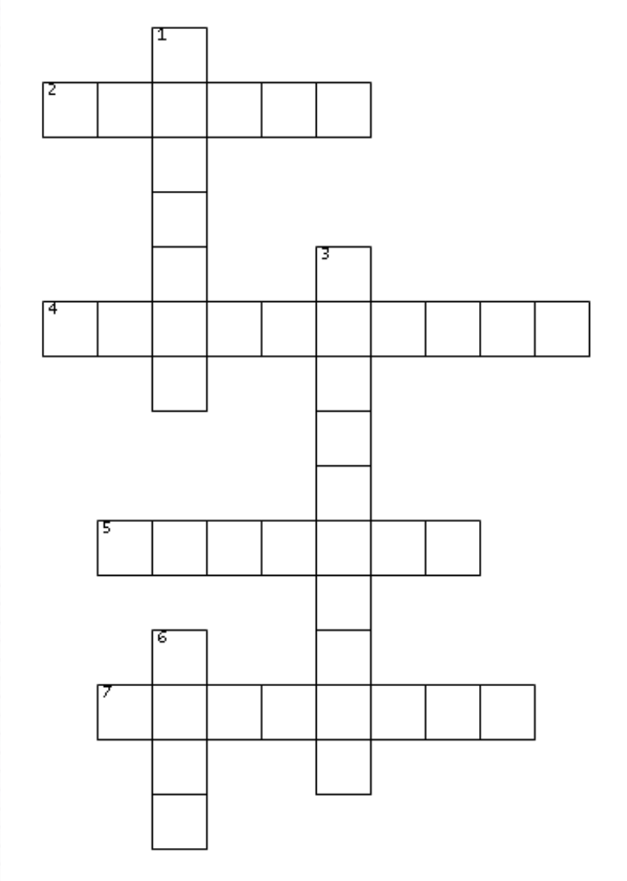
[mini puzzle] watch the video again and complete the puzzle with words used in the presentation!
ACROSS
2. the country whose saving rate is the lowest of all OECD countries.
4. a language which does not have future tense is called X language
5. X is a current pleasure in exchange for future pain.
7. the name of the language family which English belongs to is X language.
DOWN
1. Japan ranks X in the saving rate
3. the speaker is a X scientist.
6. the group of the richest and the most industrialized countries is called X

Slide 12
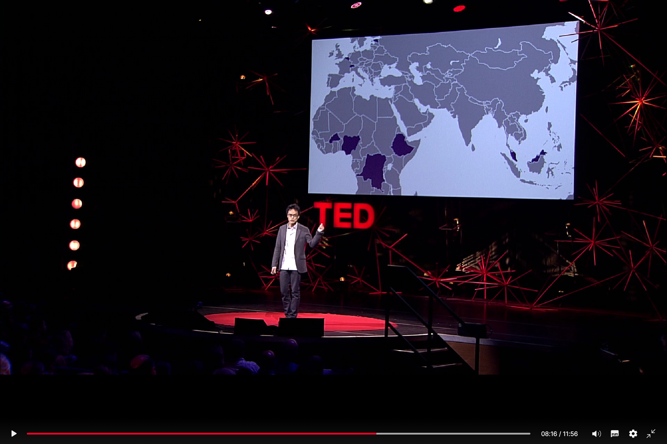
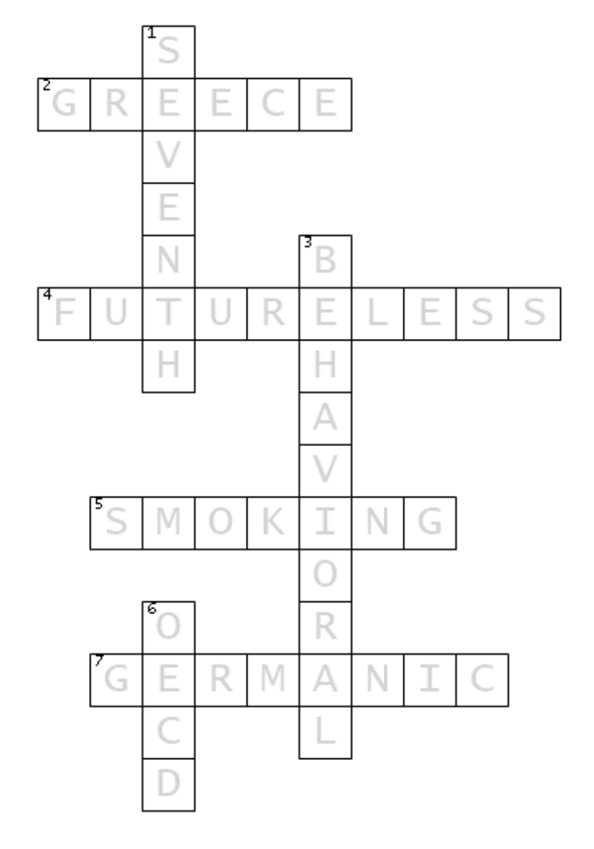
Answers
Phrasal verbs training:
1-a, 2-c, 3-e
4-d, 5-b, 6-g
7-f
Mini puzzle
[Creating mini puzzle]
Discovery EDUCATION. “PUZZLEMAKER CREATE YOUR OWN PUZZLE” . https://puzzlemaker.discoveryeducation.com/ (2025/2/2)

Slide 13
Thank you!

