Slide 1
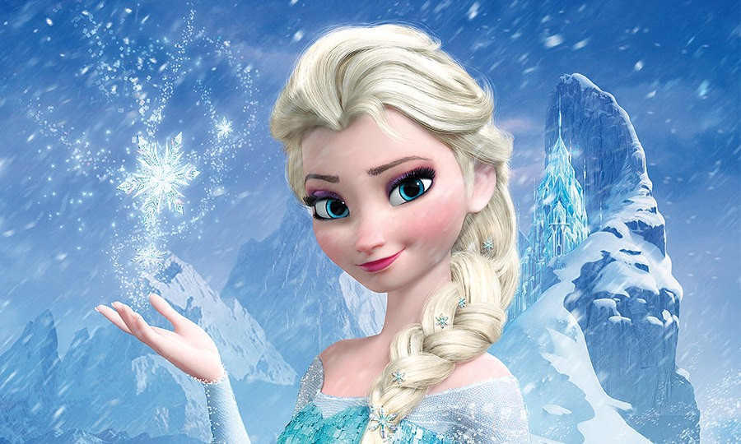
Let It Go

Slide 2
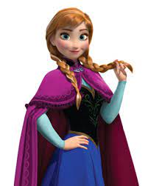
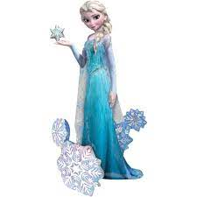
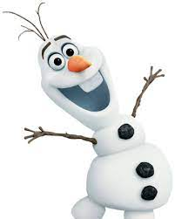
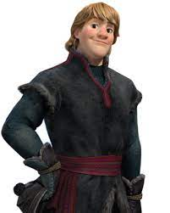
Characters
Main
Sub
Elsa
Ana
Olaf
Kristoff
Sisters
Notes:
Story and Characters
kanon

Slide 3
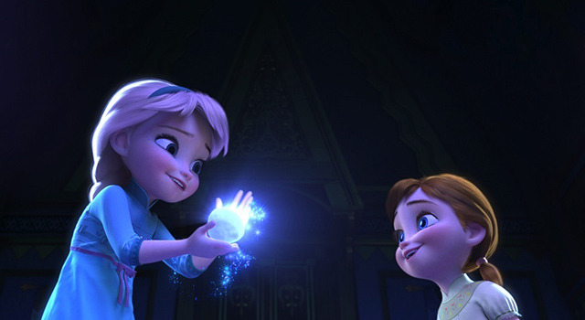
Movie Story
There is sisters that get along well.
Elsa can use snow magic.
Notes:
the scene the song appear
kanon

Slide 4
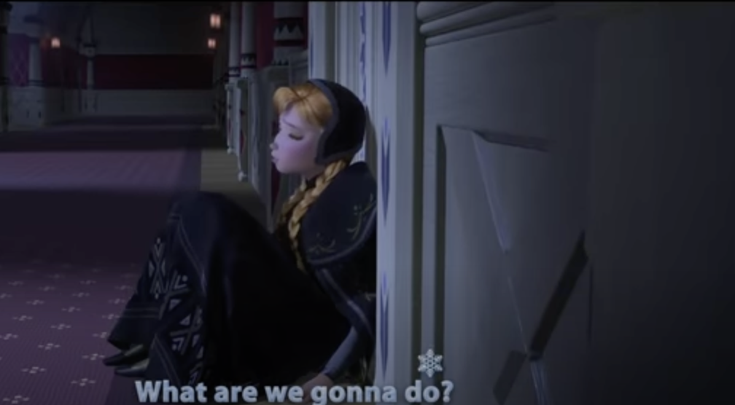
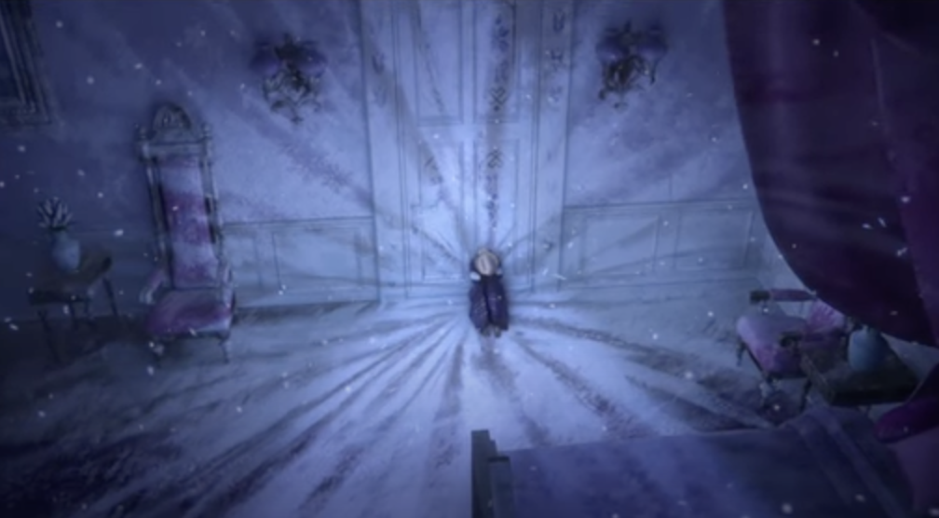
Movie Story
Elsa shuts herself up in her room for fear of her power.

Slide 5
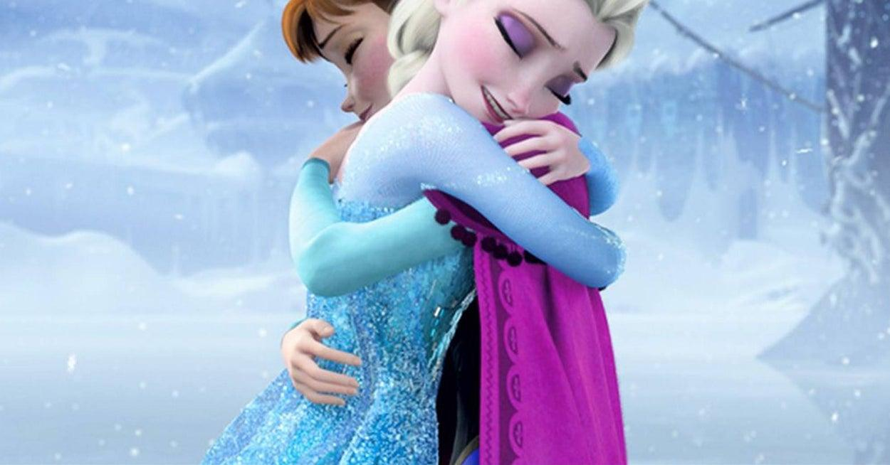
Movie Story
Sisters overcoming various difficulties.
And the bonds between sisters deeped.

Slide 6
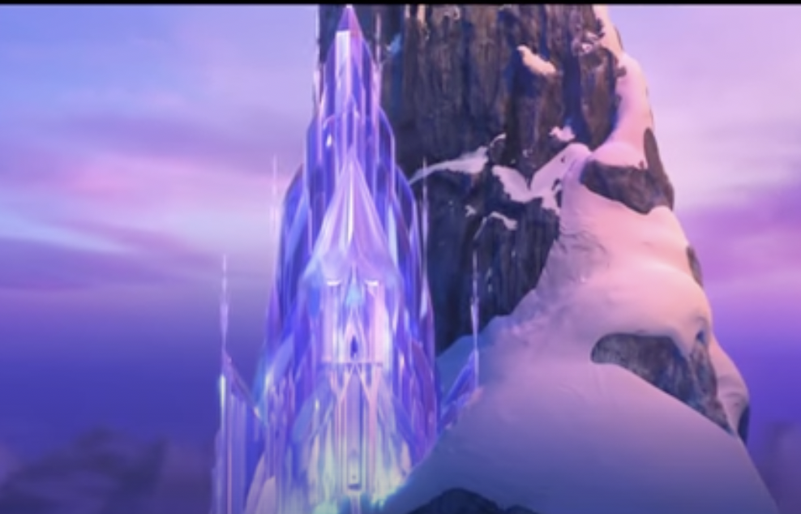
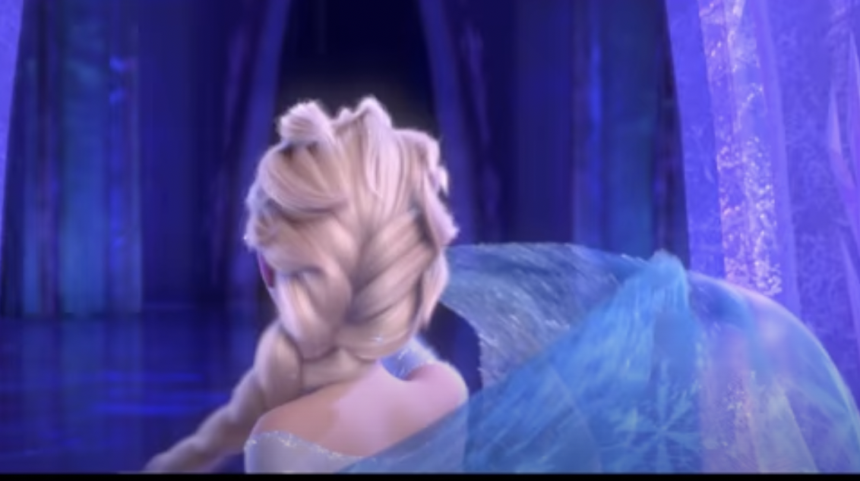

Background of “Let It Go”
In this scene, Elsa builds a magical ice castle on the mountain so as not to hurt others.
At last, she closes her mind.

Slide 7
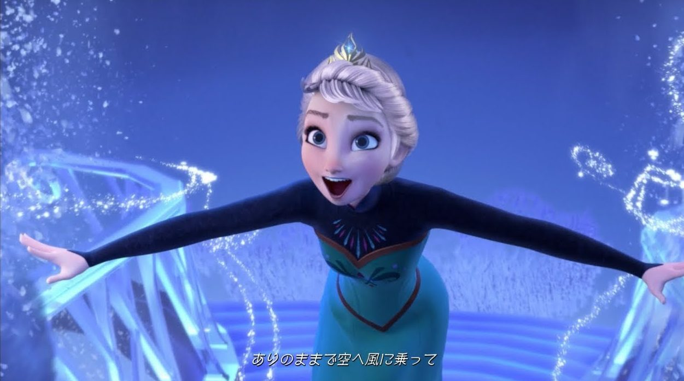
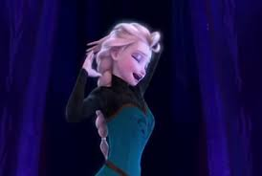
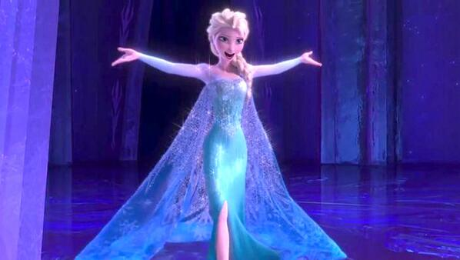
Background of “Let It Go”
“I am not wrong.”
“I don’t have to hide myself.”
“You can be as you are.”
“Be confident! ”

Slide 8

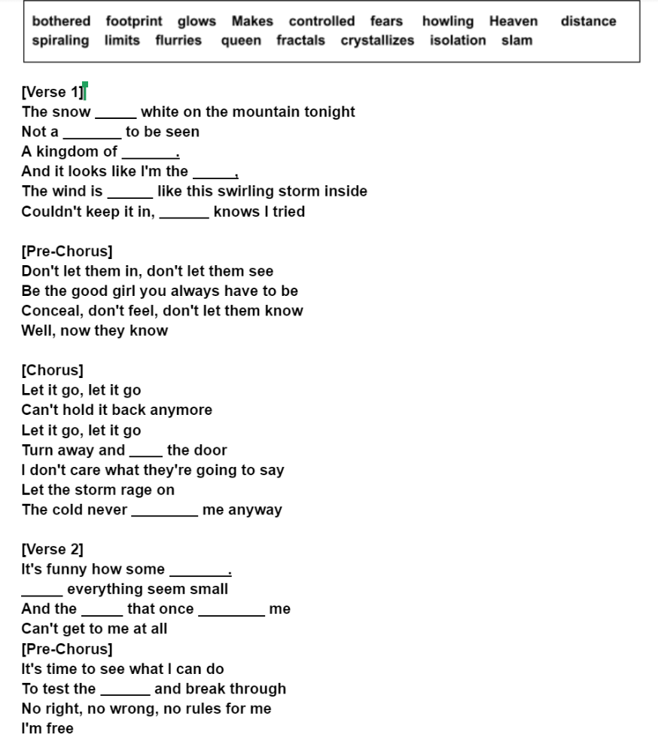
Fill in the gap!
https://docs.google.com/document/d/1NTc1fWLrOiYvRnUyOsfKfcfAf3LqSbkUXq4o_0rxPKM/edit
Notes:
gap fill

Slide 9
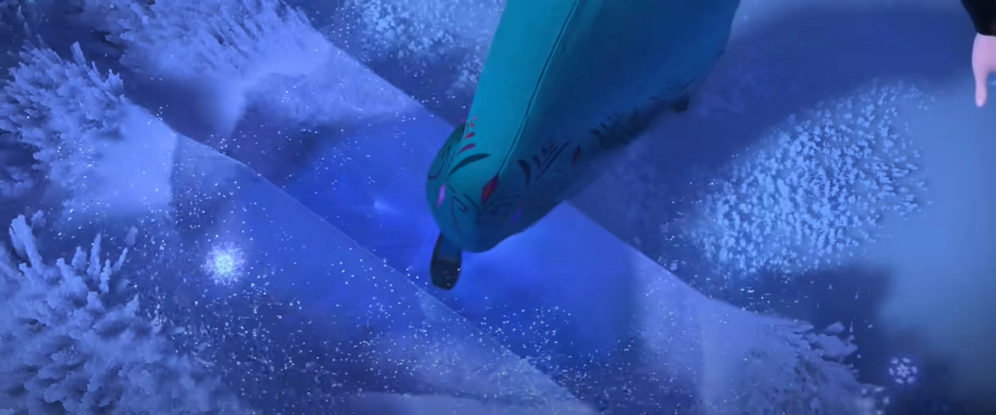
https://youtu.be/moSFlvxnbgk
Notes:
song video]
2:00~2:26

Slide 10
Check the meaning
Can’t hold it back anymore
-to stop someone or something developing or doing as well as they should
Let the storm rage on
-to move or surge with great violence
My power flurries through the air...
-a small swirling mass of something especially snow
Notes:
word meaning

Slide 11
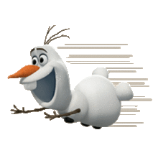
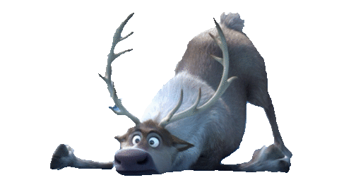
How to sing well -pronunciation
❅Elision-disappearing sounds
ex) And it looks like I’m the queen.
❅Catenation-linking consonant sounds to vowel sounds
ex) The wind is … ⇒ ðə windəz …
❅Assimilation–Changing consonant sounds
ex) Let it go ⇒ leli gou
Notes:
pronuntiation

Slide 12
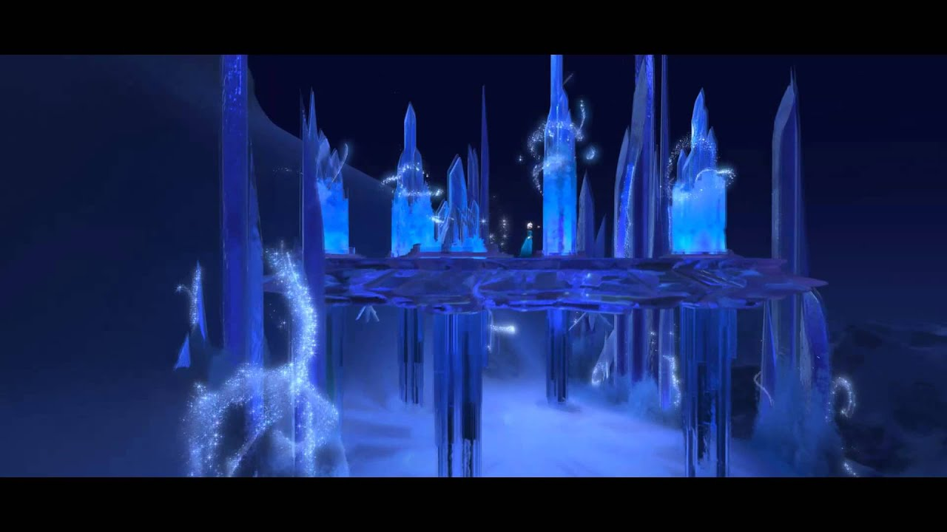
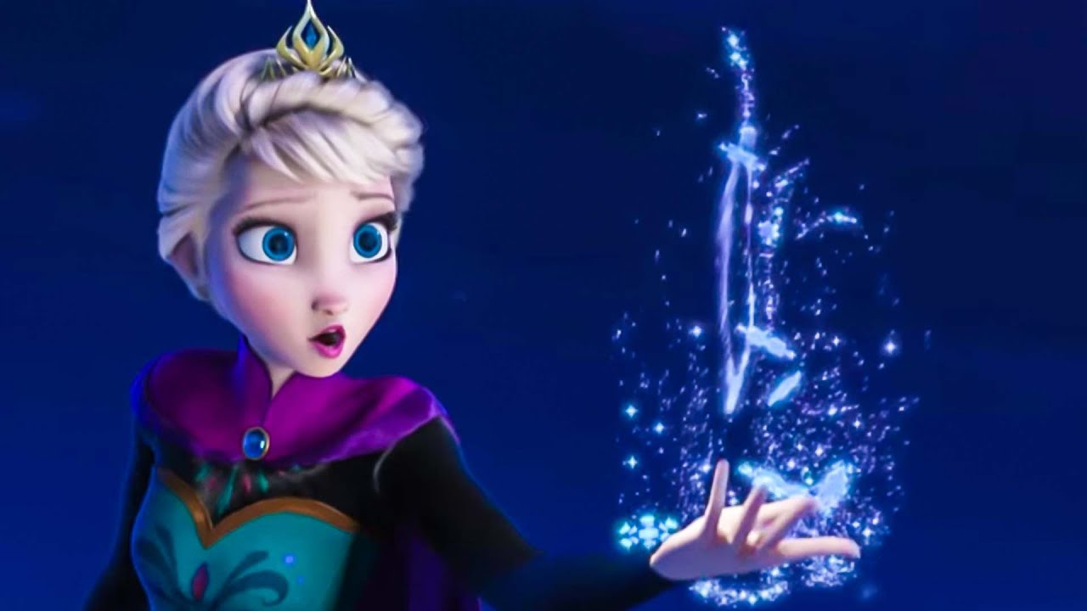
〔Chorus〕
Let’s try anyway!!!
Let it go, let it go Can't hold it back anymore
Let it go, let it go Turn away and slam the door
I don't care what they're going to say
Let the storm rage on
The cold never bothered me anyway

Slide 13
Difference Between English ver. and Japanese ver.
E: Let it go. Let it go. Can't hold it back anymore.
J: Just as I am. Just as I am. Show just the way I am.
E: Let it go. Let it go. Turn away and slam the door.
J: Just as I am. Just as I am. Become just the way I am.
E: I don't care what they are going to say.
J: I’m not afraid of anything.
E: Let the storm rage on.
J: Blow, wind. Blow.

Slide 14
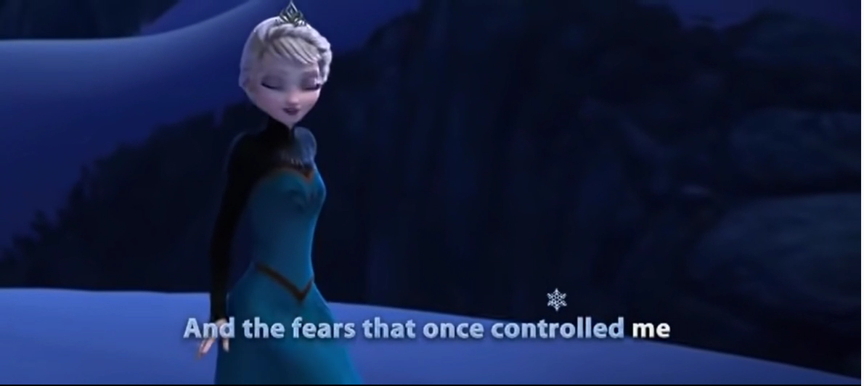
Let’s sing !!!
Notes:
video with lyrics LET’S SING!!!!!!

Slide 15
Thank You for Listening !!!

