Slide 1
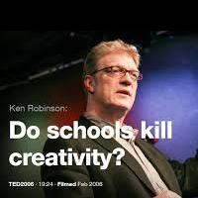
Topic, Why I chose it
Do schools kill creativity?
・I would like to work as a teacher in the future, so I thought this would be helpful for my career.
・I hate the kind of people who don’t respect children’s unique talents/characters/creativities.

Slide 2
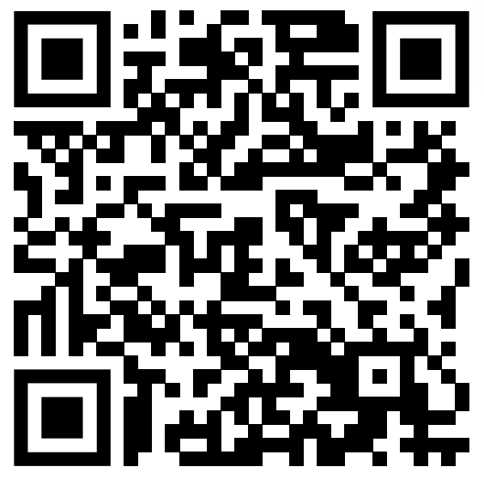
Link
https://www.ted.com/talks/sir_ken_robinson_do_schools_kill_creativity?utm_campaign=tedspread&utm_medium=referral&utm_source=tedcomshare

Slide 3
Vocabulary/Grammar Development
Contention・・・a strong opinion that someone expresses
Sequel・・・a book, film, play etc that continues the story of an earlier one, usually written or made by the same person
Myrrh・・・a substance that comes from trees and is used for making perfume and incense
Discotheque・・・(especially British English) a disco

Slide 4

Engaging questions
Are you prepared to be wrong?
What do you think is intelligence?

Slide 5

Fun activity
If you were a teacher in an elementary school and found that one of your students was making a flip book on their textbook, what would you say to the student?

Slide 6
My Answers
Are you prepared to be wrong?
-Actually, I think I’m not prepared enough. I would choose the majority mostly, but it doesn’t make me creative.
What do you think is intelligence?
-I think people who can think of others and accept varieties are intelligent.

