Slide 1

Do you really need 8 hours of sleep every night?

Slide 2

Do you get enough sleep?
The topic of getting enough sleep hours might be one of the things university students can relate to.
Multitasking has always been required while studying at the university. Such as studying, working on tasks, part-time jobs, club activities, and so on.
As responsibility increases due to age, it is not easy to get "IDEAL Sleep”. The meaning of ”ideal sleep” might depend on some people's sleeping time or the quality of their sleep. When we search on the internet
🔍How to get enough sleep?
You’ll find tons of gadgets to increase the time and quality of your sleep. You might also find an article mentioning about mental health and how your sleep has been wrong.
To get a deeper understanding of this topic, I will be answering the most common question about it.

Slide 3

How can this topic help you?
From my point of view
I have been dealing with sleeping issues due to multitasking for so long that I’ve decided to do some research to get an idea of proper sleep. Thus, when I search for information about the topic, there is too much information that is biased and not logical. Which made me angry about not getting the right information.
I have also experienced the effects of a sleeping shortage several times. It affected brain performance, mood, and communication.
But most importantly, students don’t get enough time to sleep.
That’s why today I will introduce one of the ways to adjust proper sleeping time and quality depending on people.
At the end of the class, I hope everyone gets to know about the topic of “I deal with sleep” and gets to enjoy their university life even more!

Slide 4

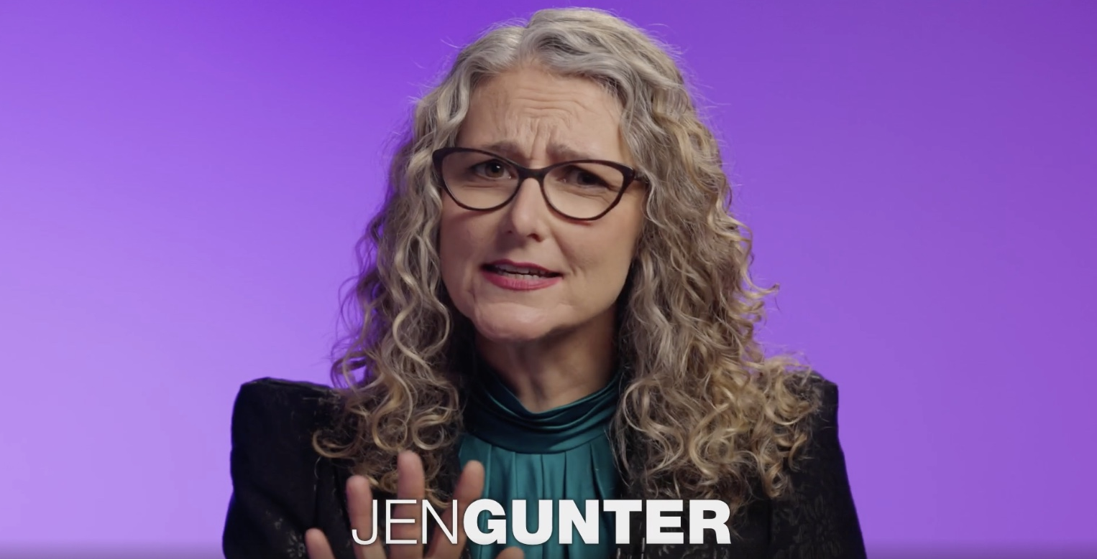
TED BODY STUFF WITH DR. jen Gunter https://www.ted.com/talks/jen_gunter_do_you_really_need_8_hours_of_sleep_every_night
DR. Jen has answered the most common questions about sleep.
1. Is sleeping less than 8 hours bad for our health?
→Not quite right. The specific number of eight is just an average. The range of sleeping hours needed to recover from fatigue depends on the person.
However, extreme short sleeping hours, like 1 or 2 hours, can cause cardiovascular disease, diabetes, and depression.
2.Are devices and services helping us to sleep better?
→It can be counter productive.
In 2019, it was estimated that 21% of adults in the U.S used tracking devices. Knowing your sleeping hours sounds effective. However, obsessing with it so much is leading to condition called ”Orthosomnia”. We you’re getting stressed out to get the perfect sleep.
Unfortunately, this is ironically causing more sleep problems.

Slide 5


WHAT IS ORTHOSOMNIA IN SPECIFIC?
WAYS TO KNOW IF YOU’RE HAVING GOOD SLEEP
According to Dr. Colleen Carney, a psychologist and the head of the Ryerson University Sleep Lab, the basic questions you should ask yourself are:
1.Do I feel reasonably well-rested during the day?
2.Do I generally sleep through the night without disturbances? /if I wake, do I fall back asleep easily?
3.Can I stay awake through the day without involuntarily falling asleep?
If your answers are yes to all three, you probably don't need to worry about your sleep.
→Means being to obsessed with the number of hours.
By fixating on the number of it leads to unrealistic expectations of sleep.
Long sleep hours doesn’t mean good quality of sleep.

Slide 6
Still….If you’re struggling with sleep here‘s what you should do
1. Talk to the doctors to get medical advice.
Sleeping issue can be caused by your environment. By talking to advisers, you can get to consult about the problems you’re having.
→Evidenced- based recommendations
Can help you to get better quality of sleep!
2. Cognitive behavioral therapy for insomnia, or CBT-I
The therapy doesn’t require, and it has a really low failure rate. This works by approaching to your sleeping environmental, mental care and daily diets.
Here’s some examples
Such as trying to adjust time of getting caffeine and finish preparing to go to the bed 2 hours before to feel more relaxed.
This works by 4-8 weeks of trying and measuring your sleep through how you felt after you woke up.
By changing your daily habits and the environment we can know what works well!
➡︎ Trying to get rid of what is bothering you and changing the environment will help you find the best place to sleep without medications. Rather than stressing out a lack of sleep hours, you should measure your sleep quality by how you feel after getting up.

Slide 7
Vocabulary
Here’s important vocabulary that appeared in the video! We will do the exercise on the next page!
WORDS | MEANING | EXAMPLES IN THE TED TALK
Fascination (Noun) | Being greatly interested in | Our fascination with sleep feels as if it's taken on an urgency
Doom (Noun) | Terrible fate | Doomed to bad health
Fixate (Verb) | Obsessive attachment to the thing | Fixating solely on seven to eight hours ignores the fact that there's a range of sleep that people need.
Disturbances (Noun) | A breakdown of peaceful and law-breaking behavior | Do I generally sleep through the night without disturbances?
Cardiovascular (Adjective) | Relating to the heart and blood vessels. | Associated with health problems like cardiovascular disease
Counter productive (Adjective) | Having the opposite of the desired effect. | The second flaw with this kind of doomsday messaging is that it can be counterproductive

Slide 8
Match the synonym with the words given below
Please connect the words and the synonyms
Words
Fascination ・
Cardiovascular ・
Fixate ・
Doom ・
Disturbances ・
Counter productive ・
Synonyms
・ Disaster
・ Ineffective
・ Immersed in
・ Interrupt
・ Attraction
・ Circulatory System

Slide 9
Let’s check your understanding
Write True or False in the sentence given below
1. To know the quality of your sleep, it is effective to try different products and devices to track your sleep. ( )
2. The longer you sleep means you’re getting good quality sleep. ( )
3. ”Orthosomnia” means you’re getting stressed out to get the perfect sleep. ( )
4. You need 8 hours of sleep everyday. ( )
5. To get improve the quality of sleep you should start by changing your environment step by step.( )

Slide 10
Student led discussion
Here are the discussion questions you can use for the discussion!
1. How can we know that we got enough good sleep?
2. How can we improve our sleep?
3. What do you think is the factors of getting good sleep?
4.What do you do when you can’t sleep?
5. Why do people think the time they sleep is important than the actual quality of sleep?

Slide 11

The end
Thank you for learning and do the exercise about “Sleep”. The answers will be given from Mr.Pipe!
I hope you get to learn ways to get good quality of sleep and ways to improve your environment!

Slide 12
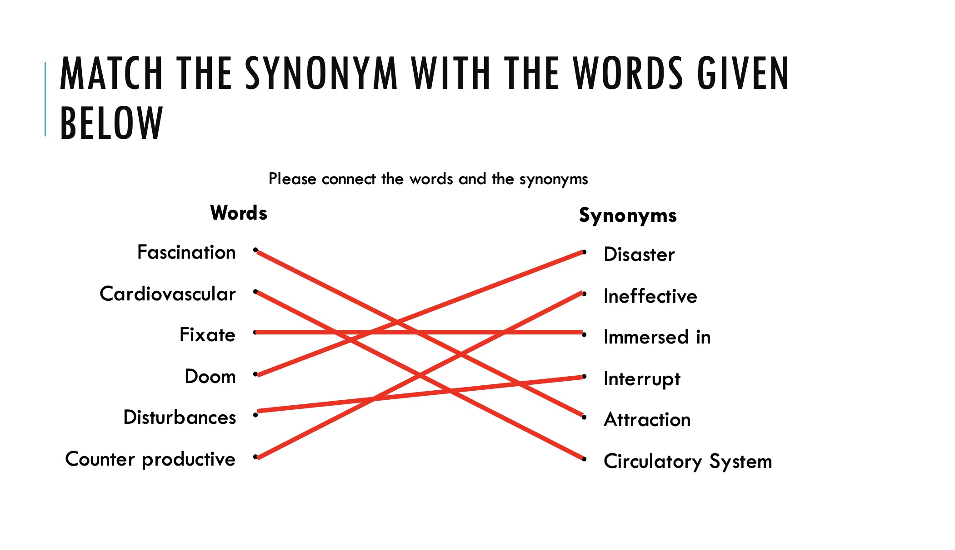
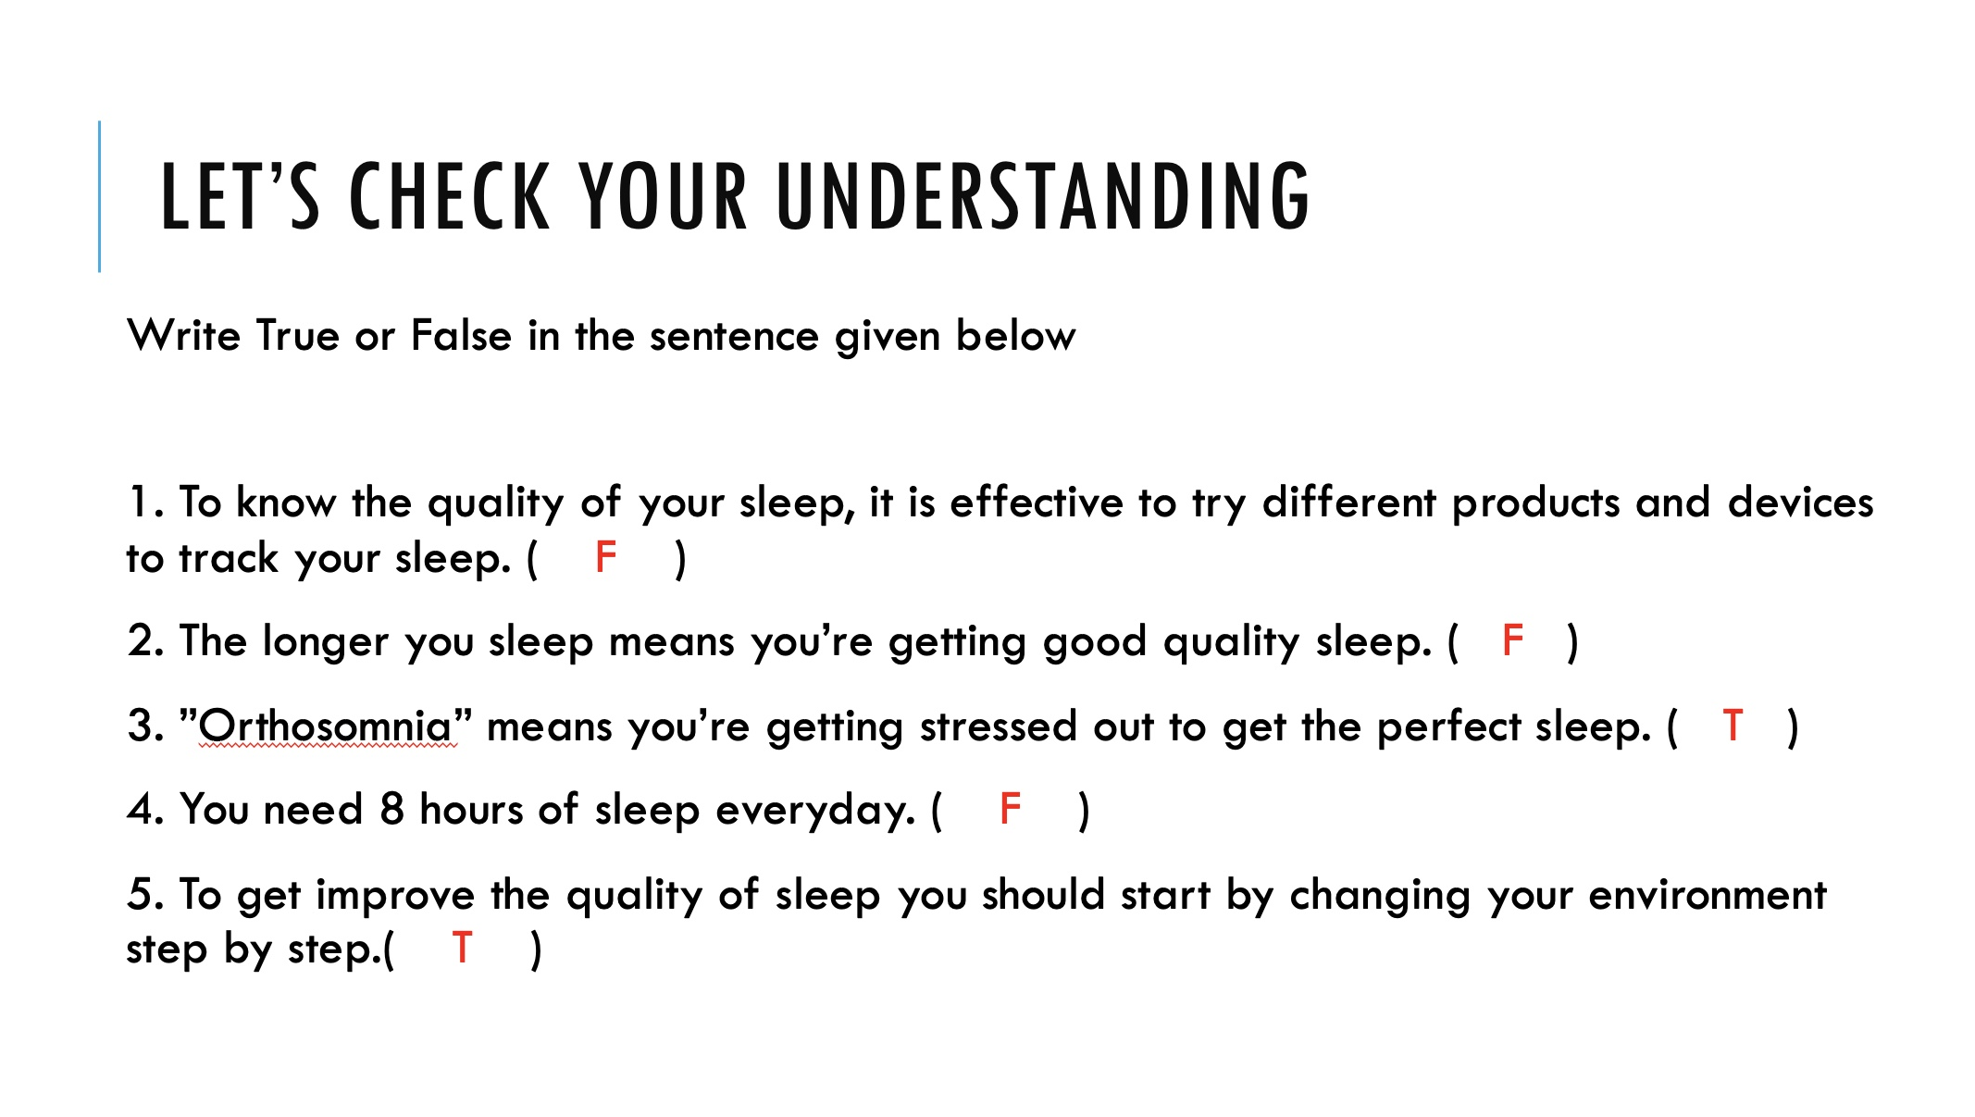
Answers
Slide 9
Slide 8

Slide 13
Citation
・Dr. Jen Gunter (October , 2022) “Do you really need 8 hours of sleep every night?”
[Video]. Ted Talk
https://www.ted.com/talks/jen_gunter_do_you_really_need_8_hours_of_sleep_every_night/transcript
・(2017) In Oxford English Dictionary: Oxford University Press

