Slide 1

Do you talk to yourself?
Here’s how to harness your inner voice

Slide 2
Table of contents
1The reason why I chose this theme
２The vocabulary
３The content of this video
４Engaging questions and Fun activity

Slide 3

1.Do we have several personalities??
We feel different feelings at the sometime.
Now I’m making Power point while thinking about watching YouTube…..

Slide 4
2.Vocabulary
・Harness→Control something, usually in order to use its power
・Negative thought loop→A cycle of repetitive, pessimistic, or self-defeating thoughts that are difficult to escape
・Chatter→Monologue in our minds
・Wear and tear→The damage or deterioration that occurs to objects or minds from ordinary use over time

Slide 5
2.Vocabulary
・Cardiovascular→Relating to the heart and blood vessels
・Distanced self-talk→Technique of talking to yourself
using your own name or "you" instead of "I" to create
psychological distance
・Vent →Forcefully express a negative emotions

Slide 6
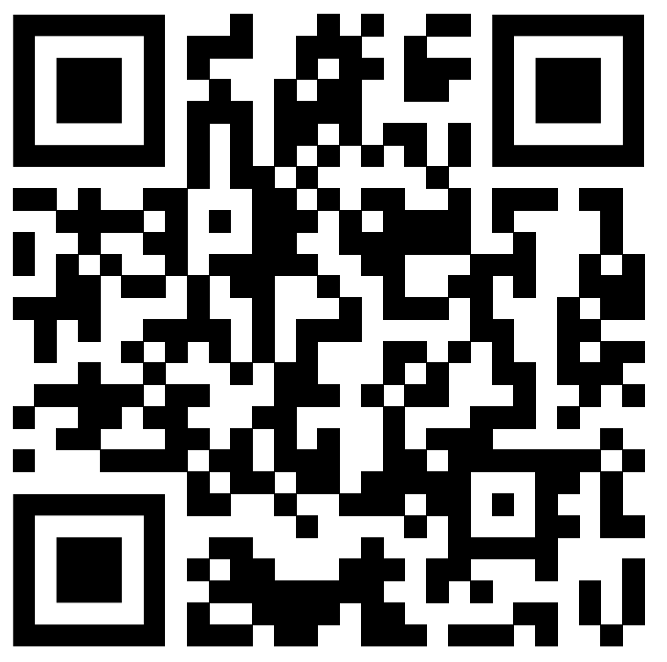
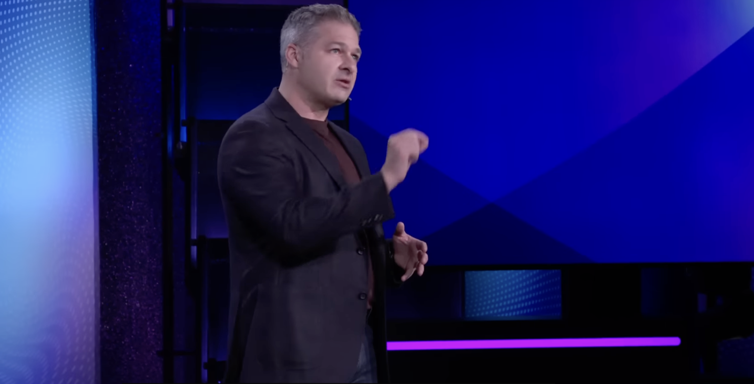

Slide 7
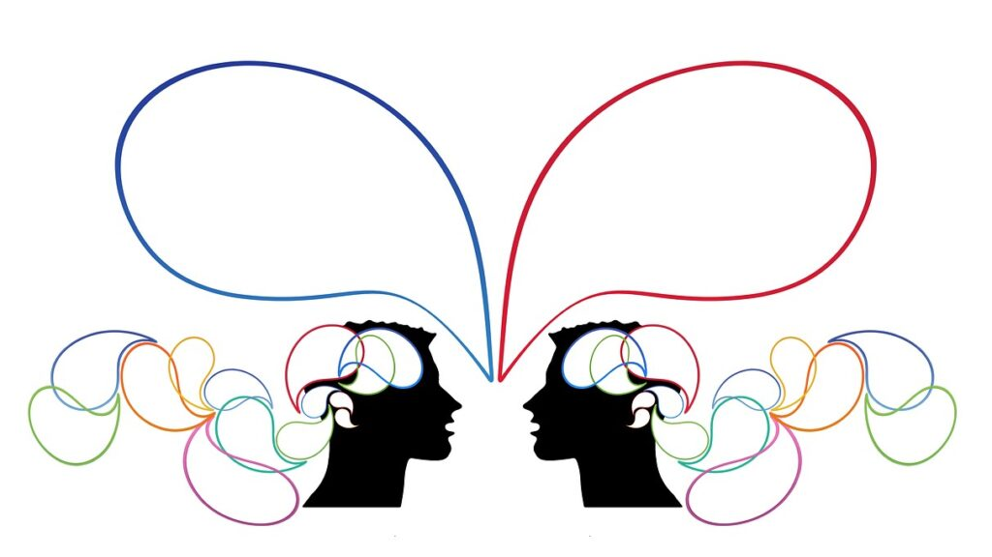
What is inner voice???
Inner voice→we are talking about is our ability to silently use language to reflect on our lives.
We also use our inner voice to simulate and plan.
we use our inner voice to make sense of this messy world that we often live in.
it is a tool that often jams up on us when we need it most. We don’t come up with clear solutions to our problems.

Slide 8
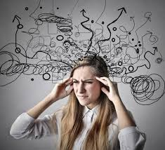
Disadvantages of inner voice “Chatter”
We experience the dark side of our inner voice. “Chatter”
Chatter has negative impacts on us in 3 domains…
1 Attention
2 Relationship
3 Health

Slide 9
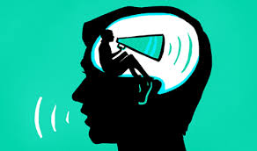
3 ways to solve this problem
Engage with yourself as if offering advice to someone else.
Find someone to vent your feelings to.
Feel a sense of awe.

Slide 10
Engaging questions
What do you do to improve your concentration?
Has “distant self-dialogue” ever improved your situations?

Slide 11
My answers
I make an effort to wake up early! I can concentrate well in the early morning hours, so I do my homework and other tasks during that time.
When I was job hunting and struggling with what I wanted to do in the future, I found a way forward by looking at myself objectively.

Slide 12
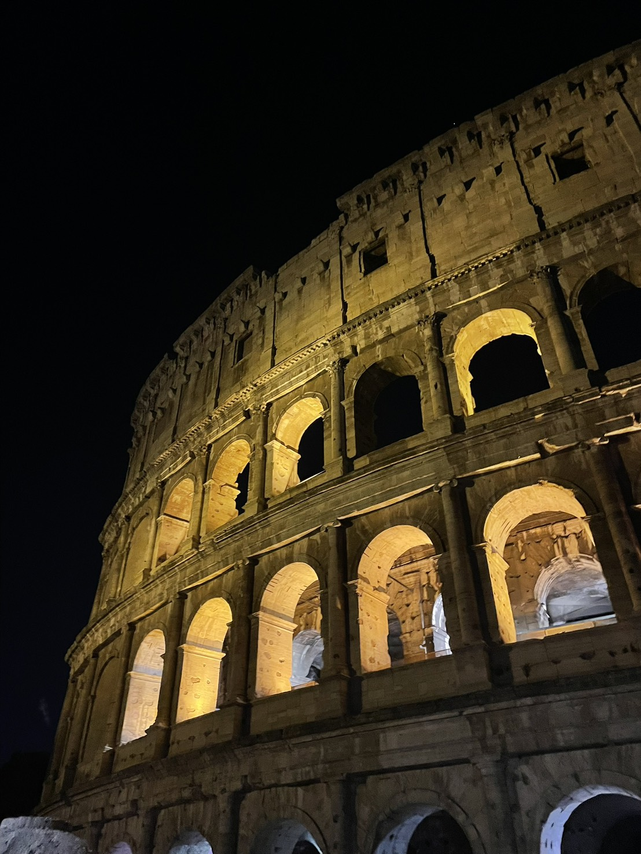
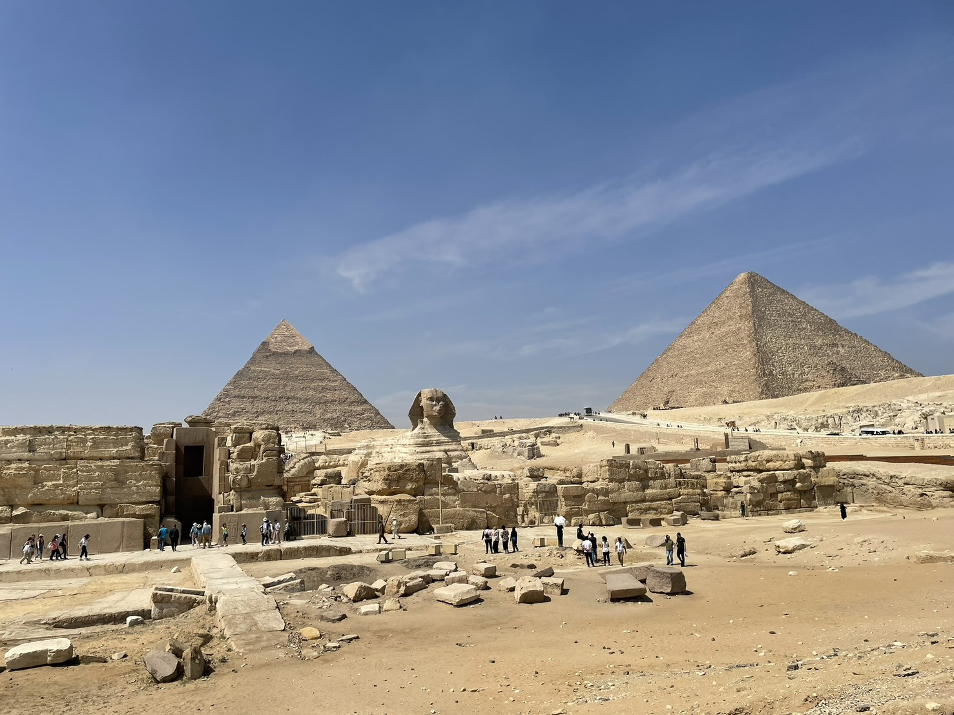
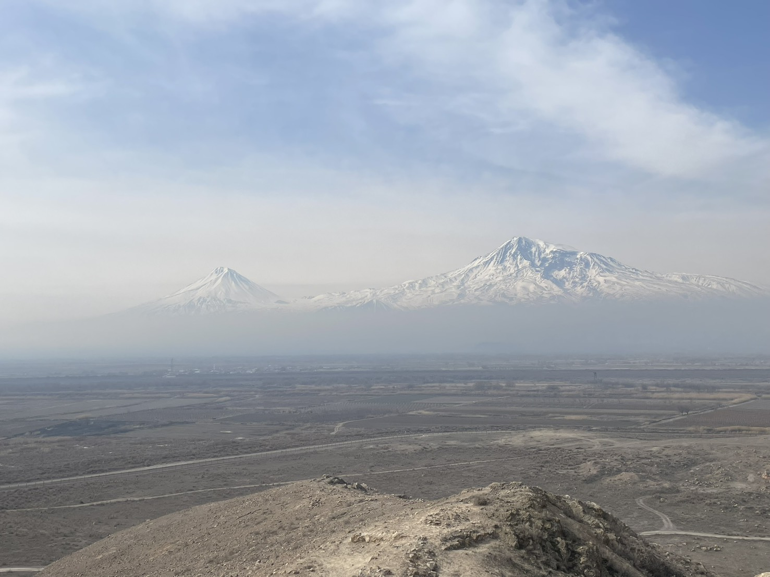
Fun activities
In this video, it said that when you feel awe, chatter can disappear. Many of us major in foreign languages and have traveled abroad! So let's share experiences that moved us during trips overseas or within Japan!!

Slide 13
Thank you for your listening!!

