Slide 1

Dream Scenario
¥

Slide 2
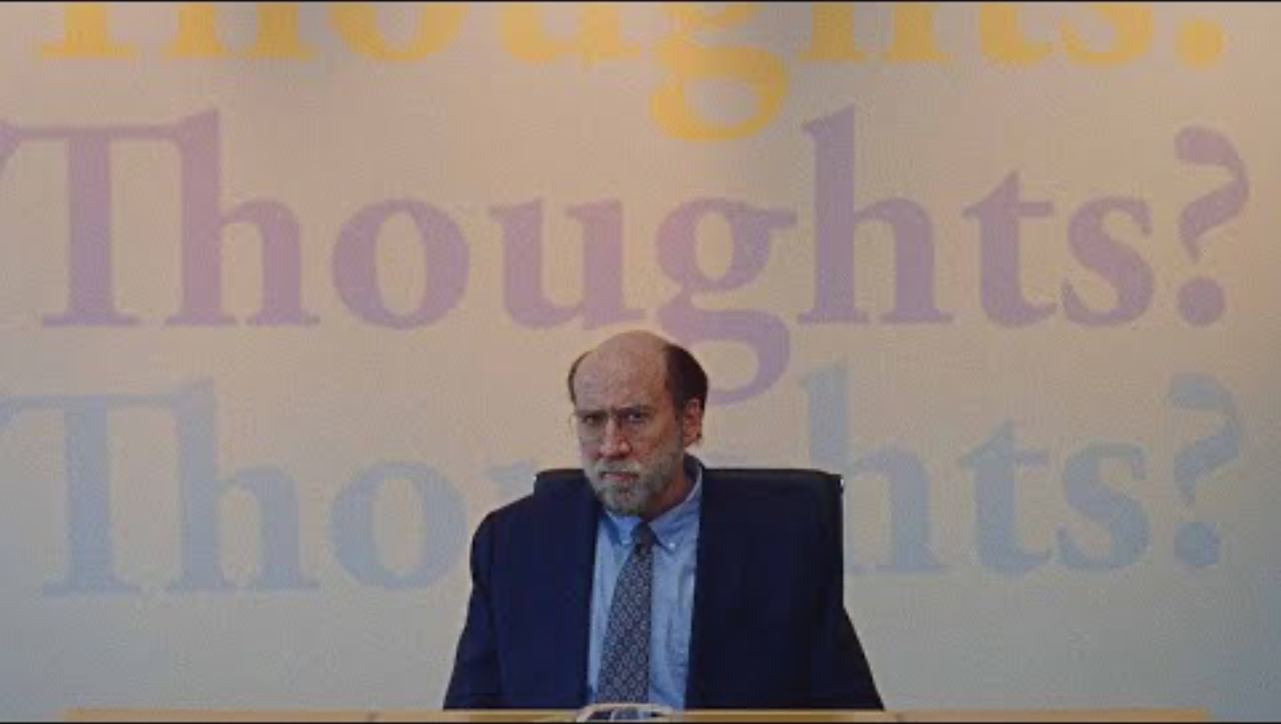
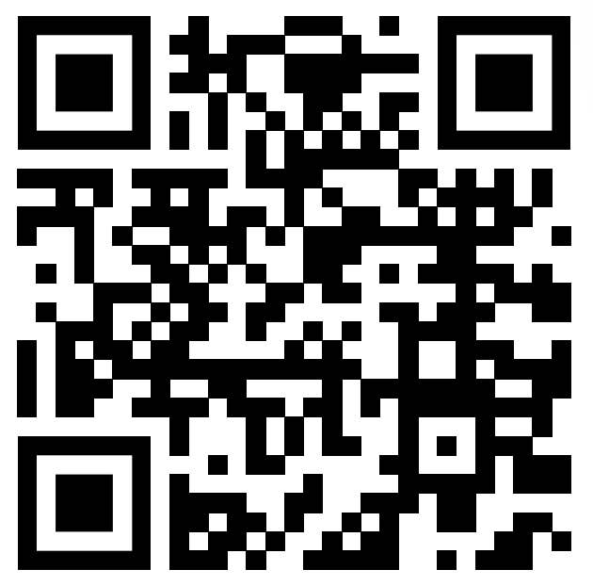
Notes:
https://www.youtube.com/watch?v=NEM47HicIHo

Slide 3
Why I chose this movie clip
Recently, people tend to satisfy their desire for recognition through social media.
This movie is themed on how being recognized on the internet affect our life.
We use social media and internet daily and we shouldn’t forget the impact of them.
The video clip is the scene where the main character become famous on the internet and get an offer for the advertisement. His dream was to publish a book for his study, and he tried to realize his dream by accepting the offer. However, the advertisement company was disinclined for the book publishing idea.

Slide 4
Vocabularies
Throw around –
To mention something frequently
manifest
To show something clearly through signs or actions
alter
To make difference in particular
fire up
To start something with energy and enthusiasm

Slide 5
Questions
Have you ever experienced any dangers when using social media or internet?
Why do you use social media?
Do you feel that social media is a tool to satisfy one’s desire for recognition?
Do you want to be famous through social media?

Slide 6
Vocabulary activity
“we don’t just ____that______. We mean it.”
”Sprite advertisement can _______connection in people’s mind”
“I think I have to ____ my plan.”
“We are really ______ to walk into a room like this”

Slide 7
Answers to the activities
Throw/around
Manifest
Alter
Fired up

Slide 8
transcript
Molly: Yeah, Paul here.
Trent: There you are.
Paul: Here I am.
Trent: Trent, hey, I have been dreaming about this meeting.
Paul: Me too
Trent: Really?
Paul: Oh, you mean literally dreaming
Trent: Yeah you know I’ve literally had dreamed about this very meeting.
I mean I just think there was normal dreams, that is not part of the whole. Who is this weird guy in my dreams.

Slide 9
Paul: Oh, I’m weird?
Trent: No, I mean you are not weird, the whole thing is weird right? Molly’s dreams has been nuts to talk about it here.
This is my colleague Mary Megans.
Mary: Hi.
Paul: Hey.
Mary: Paul. Haha
Trent: Sit down.
Paul: Here?
Trent: wherever you want. Yeah.
How are you? How’s life?
Paul: Well, ah things have been pretty different since you know the dream started.
Trent: How fun is that? I wish I was the one people were dreaming about.

Slide 10
Mary: Me too.
Paul: No it’s something.
Trent: Well, we are so excited to have you here.
Mary: Oh, we are really fired up. Umm it’s probably overwhelming thing right to walk into the room like this, who are these people, What are they doing here. We should back up and talk about what we do?
Trent: Yeah yeah, we started “thoughts” earlier this year, so pretty new agency and we focus mostly online, sort of trying to holistically pair brand and more shall we say unconventional celebrities, if that make sense. And I think of you right now, in this moment, Paul, as the most interesting person in the world.
Paul: hahaha
Trent: I mean it, I mean it. No, we don’t just throw that around.
Mary: No, no we don’t throw that around.
Trent: So I mean the advantage that you have Paul, is that your impact is not just tied to anyone in social arena and you are not just famous on tiktok or for people who read say the NewYorker. You are in people’s minds when they sleep which means that anyone who is dreaming ,you know, could be your audience.

Slide 11
Mary: How amazing is that? Who can say that?
Trent: Isn’t that big in the parties?
You know we’ve been brainstorming a bunch of cool ideas we wanna talk about with you but before we get into any of that I’m curious what you are thinking. Where do you wanna go? What do you wanna achieve? What is your dreams?
Mary: What are your dreams?
Paul: Well, I’ve been needing to write a book for a few years now and I found the time so.
Trent: Ok, so you are a writer. That’s awesome. You know we we talked about selling your life story history or actually.
Mary: Because of all the buzz around this I think we probably gonna six-figure deal.
Paul: Really.
Mary: It’s your life.
Trent: Anyway, here’s somewhere cool, you know, it might be a good place to start. Sprite.
Mary: Sprite.
Paul: Sprite?

Slide 12
Trent: Yeah, they want us to run their social and somebody over who have lost their mind or something? But they are down to go pretty weird so we thought it could be fun like to tweet a new photo of you every night holding a can and in a fun of caption. And it just really manifest that connection in people’s minds to hopefully alter the phenomenon, at least temporarily, to make people dream about you and the products together.

Slide 13
Thank you and enjoy your life with social media!!
Movie title “Dream Scenario”

