Slide 1
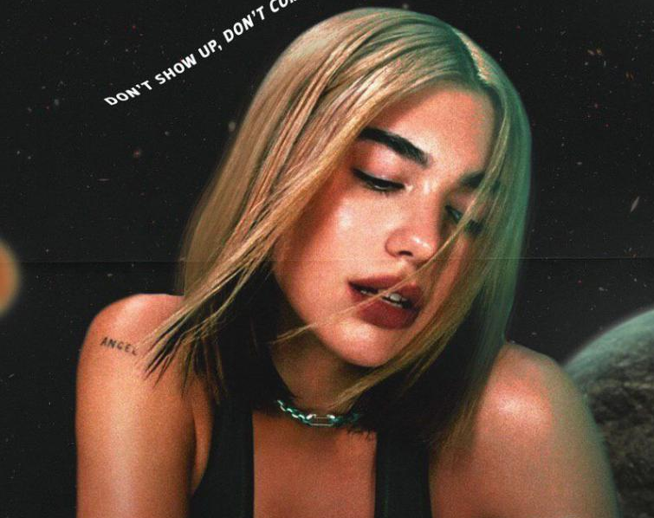

Don't Start Now by Dua Lipa

Slide 2
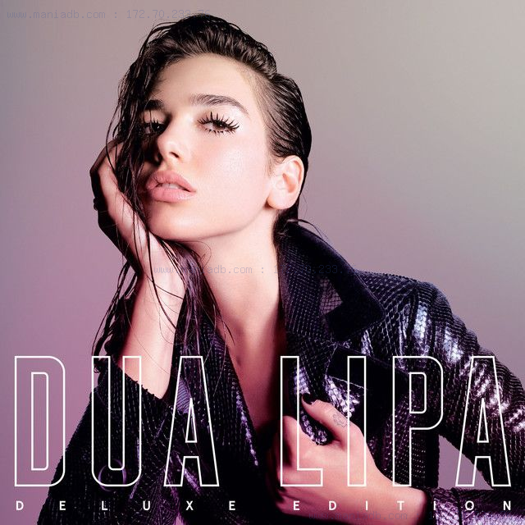
Biography
Dua lipa was born in Lodon in August 1995.
When she was young, she decided to become a singer.
She contract with warnermusic.
She is releasing her first album, New Love.
Her second album is Be The One.
- She raise top 10 in other country such as Australia, Argentina.
- She ranked top of Billboard Dance Club Song Chart.
この写真 (作成者: 不明な作成者) は CC BY-SA-NC に基づいてライセンスが許諾されています。

Slide 3
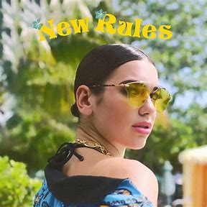

DUA LIPA’s CAREER
14 years old(2009): Christina Maria Aguilera’ s cover on youtube
20 years old(2015): contract with Warner Records !!
(2015.8):released the debut album “New Love”.
(2015.10):released the second album “Be the One”.
It won the first place in Belgium and Poland
the 6th place in Australia
21 years old(2016): nominated Sound of 2016 by BCC

Slide 4
DUA LIP’s CAREER
22 years old (2017): released first album “DUA LIPA”
released new single “New Rules”
“New Rules” won the first place in UK
“New Rules” went viral all over the world!!!!!
23 years old (2018.4): came to Japan and to be solo performance
24 years old (2019.11): released “Don’t Start Now”
won the first place Billboard Hot 100!!!!

Slide 5
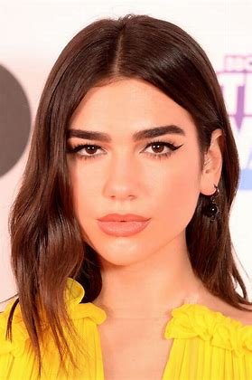
DUA LIPA’s CAREER
25 years old (2020.11): be the global ambassador of “PUMA”
26 years old (2021.3): won the first place the Grammy pop vocal album award

Slide 6
DUA LIPA’s FAVORITE THING
What is Dua Lipa’s favorite thing ?????
Disney
Studio Ghibli
Peanuts (SNOOPY)

Slide 7
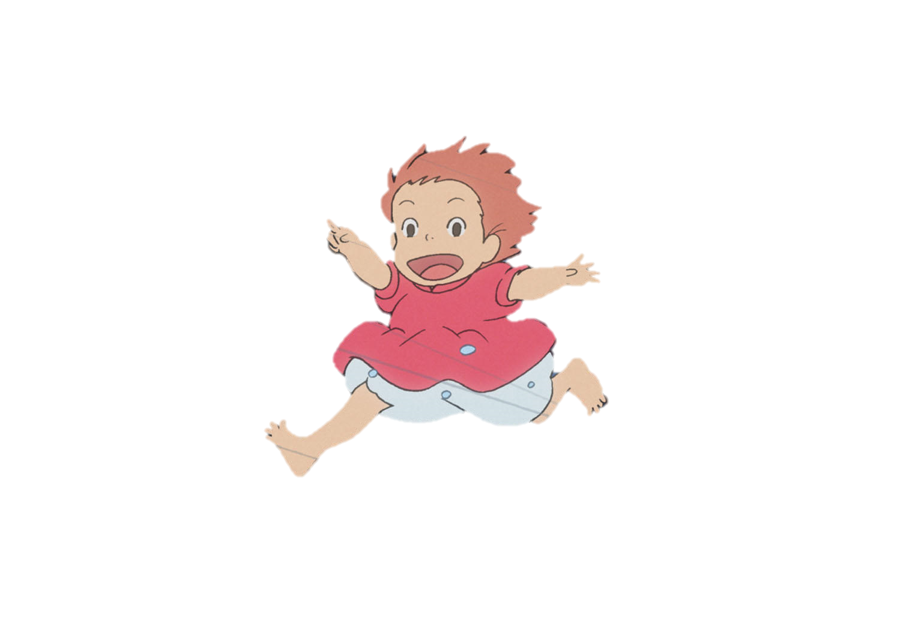
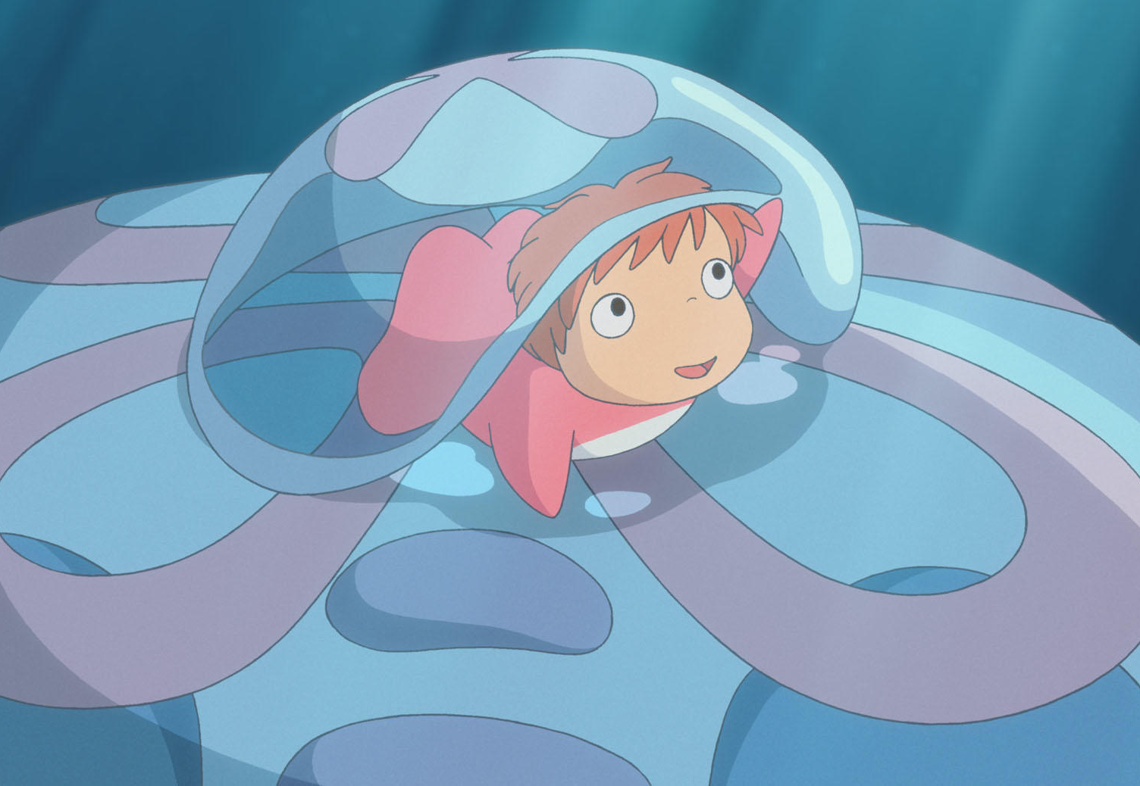
DUA LIPA’s FAVORITE THING
The Answer is………………
Studio Ghibli

Slide 8
Biography
In 2017, she released song of New Rules.
- This is music video hit 1 billion view, she get the youngest female artist with 1 billion views.
Released in 2019, Don't Start Now became the most commercially successful female artist song in the United States.

Slide 9

Song
This song is about "moving on from ex(boy friend)"
After the heartbreak, she is on the way to next love.
You are listening to the music and fill in the blank
We are explaining the meaning of the some words in the lyrics

Slide 10

Lyrics
Did a full one-eighty ← What did??
→ Her emotion changed by 180 degrees
Don't start caring about me ← Why??
→ She want to break off the relationship completely to go next.

Slide 11
Lyrics
Rhyme
One-"eighty" and c"razy"
ch"ange me" and "Maybe"
〜 alrea"dy" and 〜 it's sca"ry"

Slide 12


Slide 13

Don’t Start Now
If you don't wanna see me
Did a full 180, crazy
Thinking 'bout the way I was
Did the 「 1 」 change me? Maybe
But look at where I ended up
I'm all good already
So 「 2 」 on, it's scary
I'm not where you left me at all, so
If you don't wanna see me dancing with somebody
If you wanna believe that anything could stop me
Don’t 「 ３ 」
Don‘t 「 ４ 」
Don't start caring about me now
「 5 」, you know how

Slide 14
Don’t Start Now
Don't start caring about me now
Aren't you the guy who tried to
Hurt me with the word goodbye?
Though it took some time to survive you
I'm better on the other 「 6 」
I'm all 「 7 」 already
So 「 2 」 on, it's scary
I'm not where you left me at all, so
If you don't wanna see me dancing with somebody
If you wanna believe that anything could stop me
(Don't, don't, don't)
Don't 「 3 」
Don't 「 4 」
Don't start caring about me now
「 5 」, you know how
Don't start caring about me now ('bout me now, 'bout me)

Slide 15
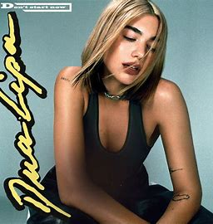




VOCABULARY
Heartbreak
Moved
Show up
Come up
Walk away
side
Good
Don’t Start Now
━━━━
Dua Lipa

Slide 16
Moving onto Kahoot,
https://kahoot.it/challenge/09869844?challenge-id=fb0f0a98-b751-43ec-9b60-049f96222f66_1693464715535

