Slide 1

WHO is
Dua Lipa ??

Slide 2
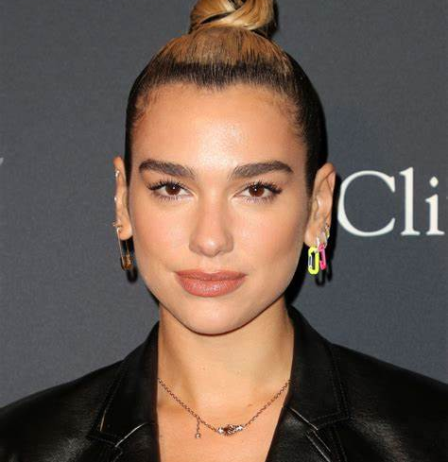

INFORMATION ABOUT DUA LIPA
Birth: 1995.8.22
From: London
Siblings: younger sister& younger brother
Parents: Refgee (Albanians)
“DUA” means LOVE in Albania

Slide 3

DUA LIPA’s CAREER
14 years old(2009): Christina Maria Aguilera’ s cover on youtube
20 years old(2015): contract with Warner Records !!
(2015.8):released the debut album “New Love”.
(2015.10):released the second album “Be the One”.
It won the first place in Belgium and Poland
the 6th place in Australia
21 years old(2016): nominated Sound of 2016 by BCC

Slide 4
DUA LIP’s CAREER
22 years old (2017): released first album “DUA LIPA”
released new single “New Rules”
“New Rules” won the first place in UK
“New Rules” went viral all over the world!!!!!
23 years old (2018.4): came to Japan and to be solo performance
24 years old (2019.11): released “Don’t Start Now”
won the first place Billboard Hot 100!!!!

Slide 5
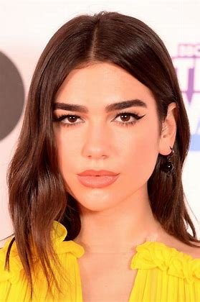
DUA LIPA’s CAREER
25 years old (2020.11): be the global ambassador of “PUMA”
26 years old (2021.3): won the first place the Grammy pop vocal album award

Slide 6
DUA LIPA’s FAVORITE THING
What is Dua Lipa’s favorite thing ?????
Disney
Studio Ghibli
Peanuts (SNOOPY)

Slide 7
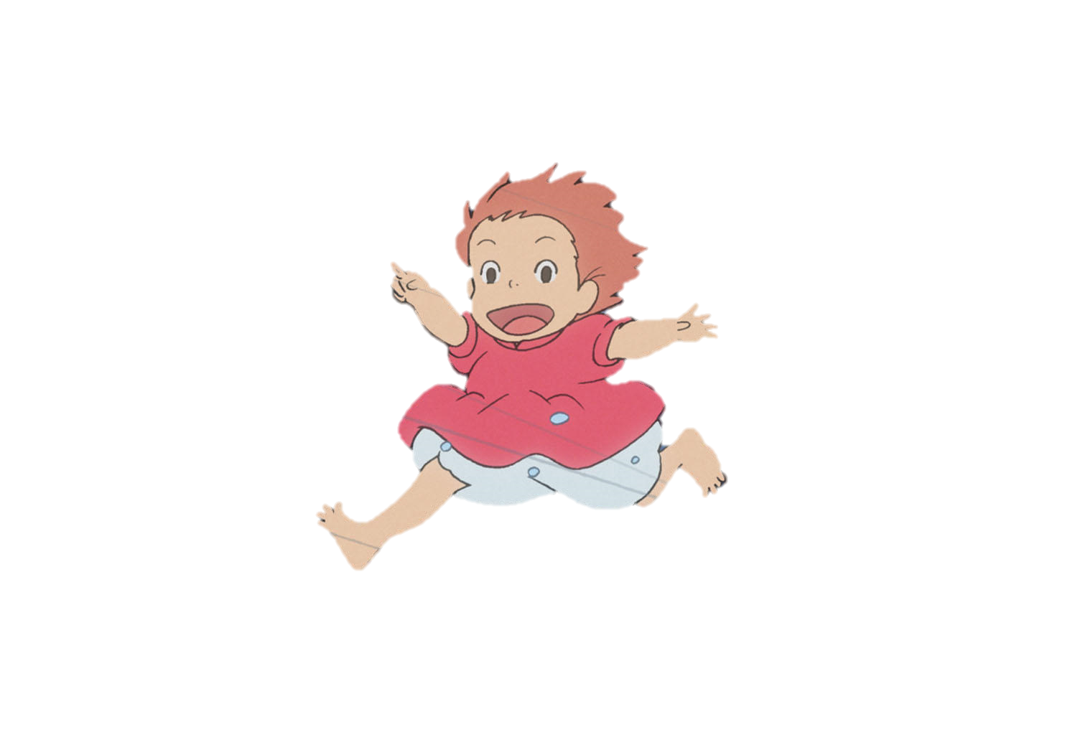
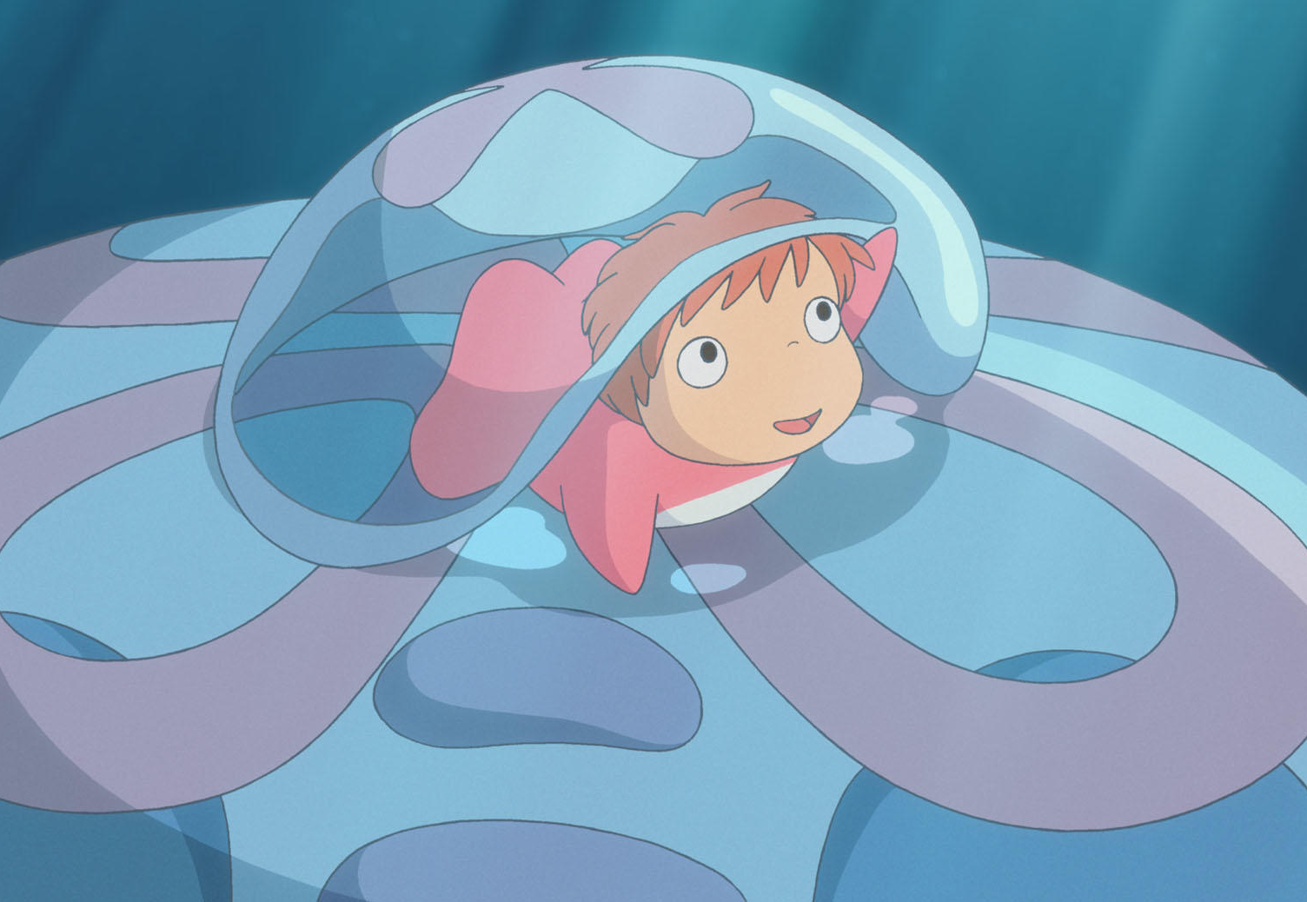
DUA LIPA’s FAVORITE THING
The Answer is………………
Studio Ghibli

Slide 8
Don’t Start Now
Lyrics summary...
A woman heartbreak but she reborn. She became a strong woman.
https://www.youtube.com/watch?v=oygrmJFKYZY

Slide 9

Don’t Start Now
If you don't wanna see me
Did a full 180, crazy
Thinking 'bout the way I was
Did the 「 1 」 change me? Maybe
But look at where I ended up
I'm all good already
So 「 2 」 on, it's scary
I'm not where you left me at all, so
If you don't wanna see me dancing with somebody
If you wanna believe that anything could stop me
Don’t 「 ３ 」
Don‘t 「 ４ 」
Don't start caring about me now
「 5 」, you know how

Slide 10
Don’t Start Now
Don't start caring about me now
Aren't you the guy who tried to
Hurt me with the word goodbye?
Though it took some time to survive you
I'm better on the other 「 6 」
I'm all 「 7 」 already
So 「 2 」 on, it's scary
I'm not where you left me at all, so
If you don't wanna see me dancing with somebody
If you wanna believe that anything could stop me
(Don't, don't, don't)
Don't 「 3 」
Don't 「 4 」
Don't start caring about me now
「 5 」, you know how
Don't start caring about me now ('bout me now, 'bout me)

Slide 11





VOCABULARY
Heartbreak
Moved
Show up
Come up
Walk away
side
Good
Don’t Start Now
━━━━
Dua Lipa

