Slide 1
Levitating
by Dua lipa
Team 4 u
Notes:
We are Team 4u ,and we choose Levitating by Dua Lipa

Slide 3
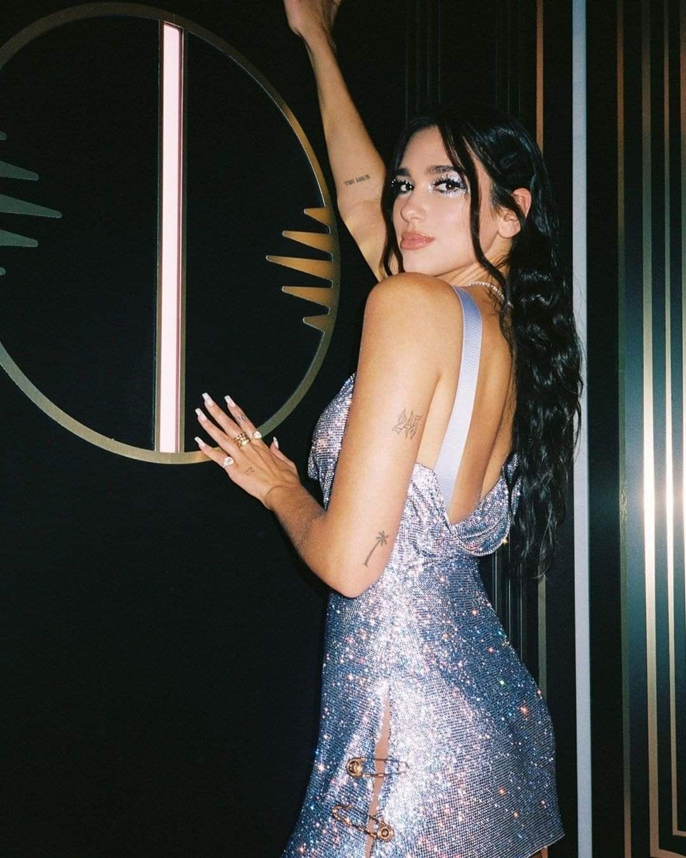
Dua Lipa https://genius.com/artists/Dua-lipa
☾British singer-songwriter
☾10th place on Billboard artist 100 (9/9/2021)
☾Awards she has recieved
61st GRAMMY Awards: Best New Artist, Best Dance Recording - Electricity (Dua Lipa & Silk City)
48th Annual American Music Awards - Favourite Song Award - Pop/Rock - "Don't Start Now
63rd GRAMMY Awards - Best Pop Vocal Album, Future Nostalgia
Notes:
In my part, I gonna explain about artist and this song Levitating.
at first, I want to talk about Dua Lipa
she is a British singer songwriter, and she is in 10th place on Bilboard aritist 100 now.
She has recieved many awards,
for example grammy awards, American music awards, Brit awards, Mnet Asian music awards and so on.

Slide 4
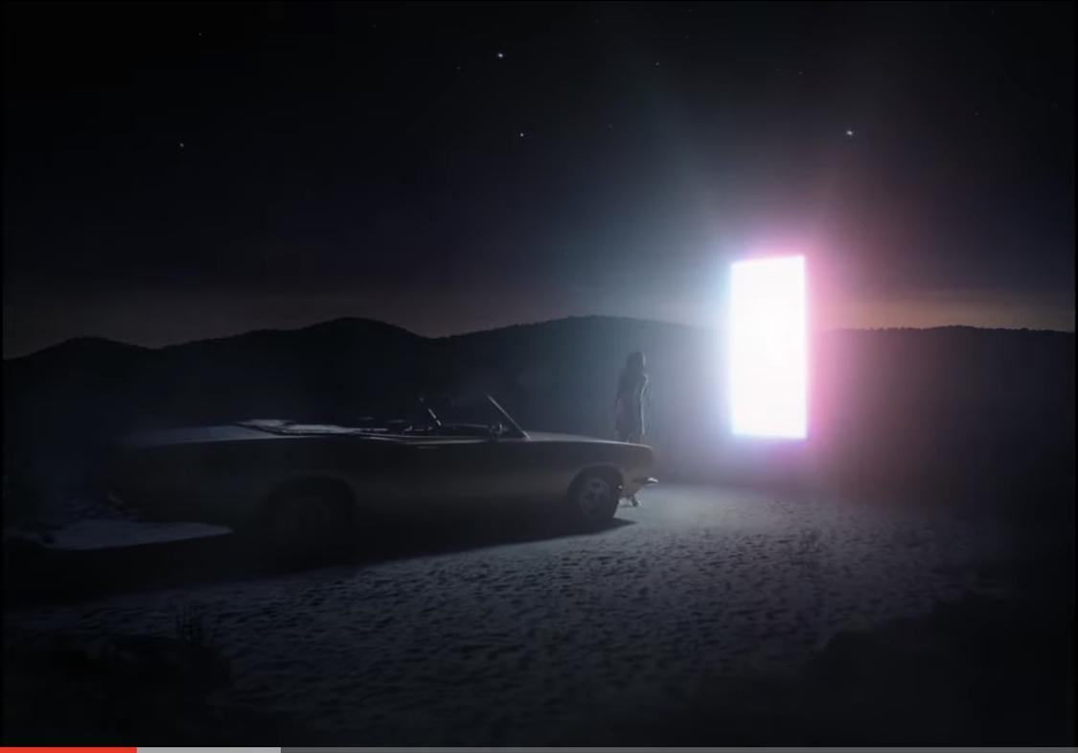
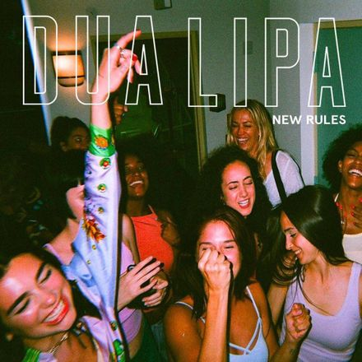

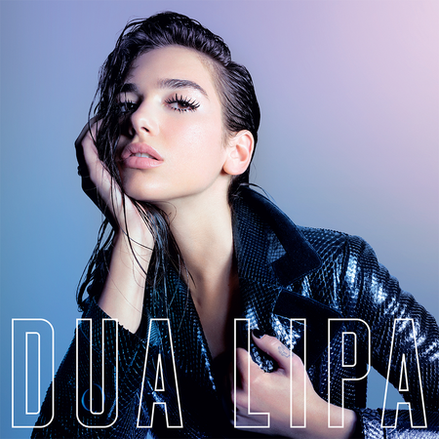

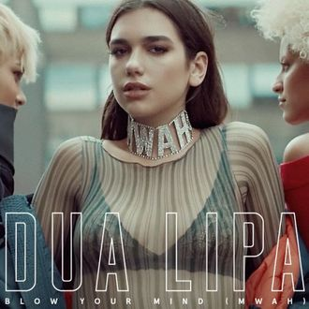
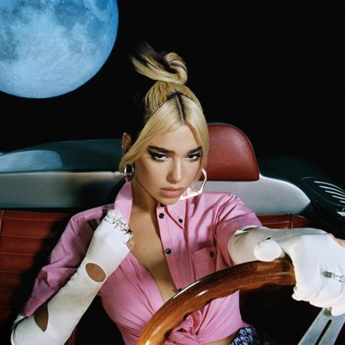
Her Popular
Songs
&
Albums
New Rules (2017)
Don’t Start Now(2019)
DUA LIPA (2017)
Blow Your Mind (Mwah) (2016)
Future Nostalgia (2020)
IDGAF (2018)
Notes:
there are her popular songs.
“New Rules,” became a worldwide hit, topping the charts in the UK and remaining in the top 5 for 10 consecutive（こんせｋてぃぶ） weeks.
Future Nostalgia won the 61st Grammy Award.

Slide 5

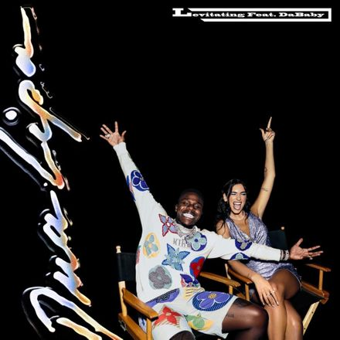
about song
Levitating
March 27, 2020
https://genius.com/Dua-lipa-levitating-lyrics
“Levitating” was released
as part of her second album,
Future Nostalgia.
A remix version of the song in collaboration with Dababy increased the song's popularity.
This song is now ranked
#8 on the Billboard HOT 100.
Levitating(Remix)
October 2, 2020
https://genius.com/Dua-lipa-levitating-remix-lyrics
Notes:
Next, I talk about Levitating.
“Levitating” was released
as part of her second album,
Future Nostalgia.
A remix version of the song in collaboration with Dababy increased the song's popularity.
This song is now ranked
#8 on the Billboard HOT 100 chart.

Slide 6
The theme of this song is …
space travel and excitement
Notes:
the theme(Thーむ) is this song is space travel and excitement.
This theme is shown in the lyrics and music video.

Slide 7
This song expresses…
The process of falling in love
Dua Lipa explained this song...
It’s about meeting someone and falling in love and thinking, “You’ve probably met me at the perfect time, let’s just go for it.”
It’s the feeling when love makes you feel like you’re levitating.
Notes:
and, this song express the process of falling in love.
Dua Lipa explained this song...
It’s the feeling when love makes you feel like you’re levitating.

Slide 8
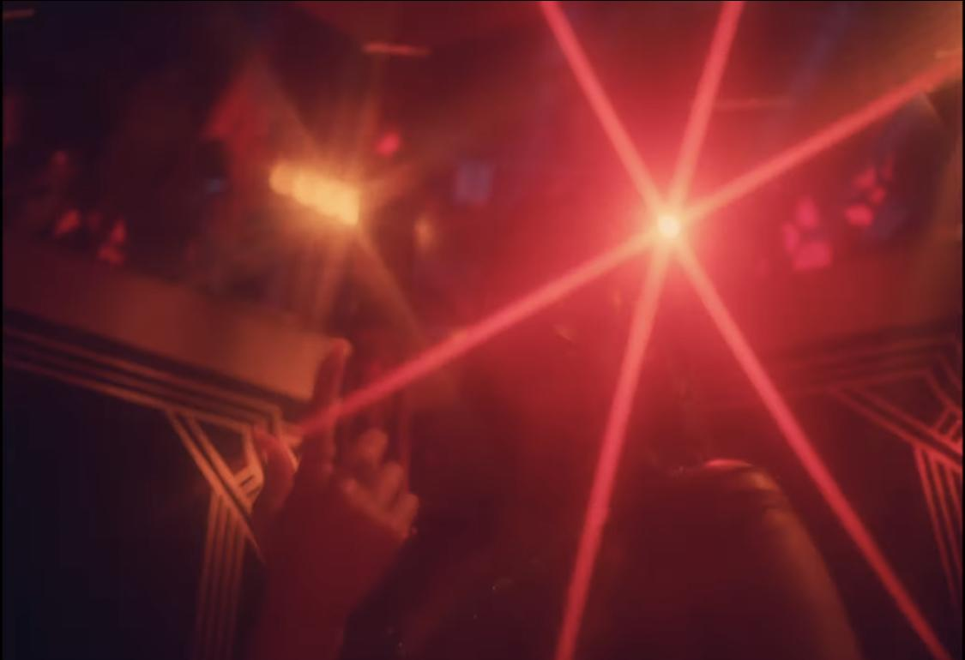
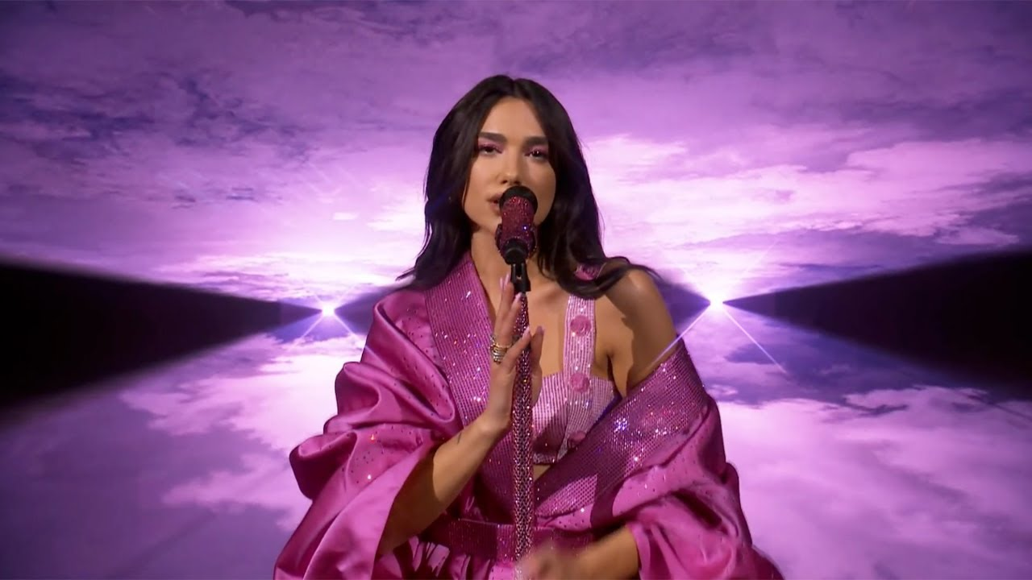
This song (album”Future Nostalgia ”)
and Covid-19
The album ”Future Nostalgia” was released ahead of schedule.
The reason why Lipa said…
I was a little conflicted about whether it was right to do this at this time when so many people are suffering.
But I decided to do it because
"we need joy and we need to try to see the light.”
Notes:
Finally, I'll talk about the relationship between this song and Covid-19.
The album ”Future Nostalgia” was released ahead of schedule.
She explained
the reason why ,she thought we need joy and we need to try to see the light.”

Slide 9
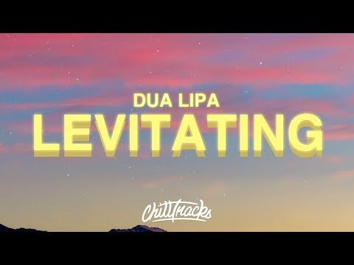

Slide 10


Slide 11
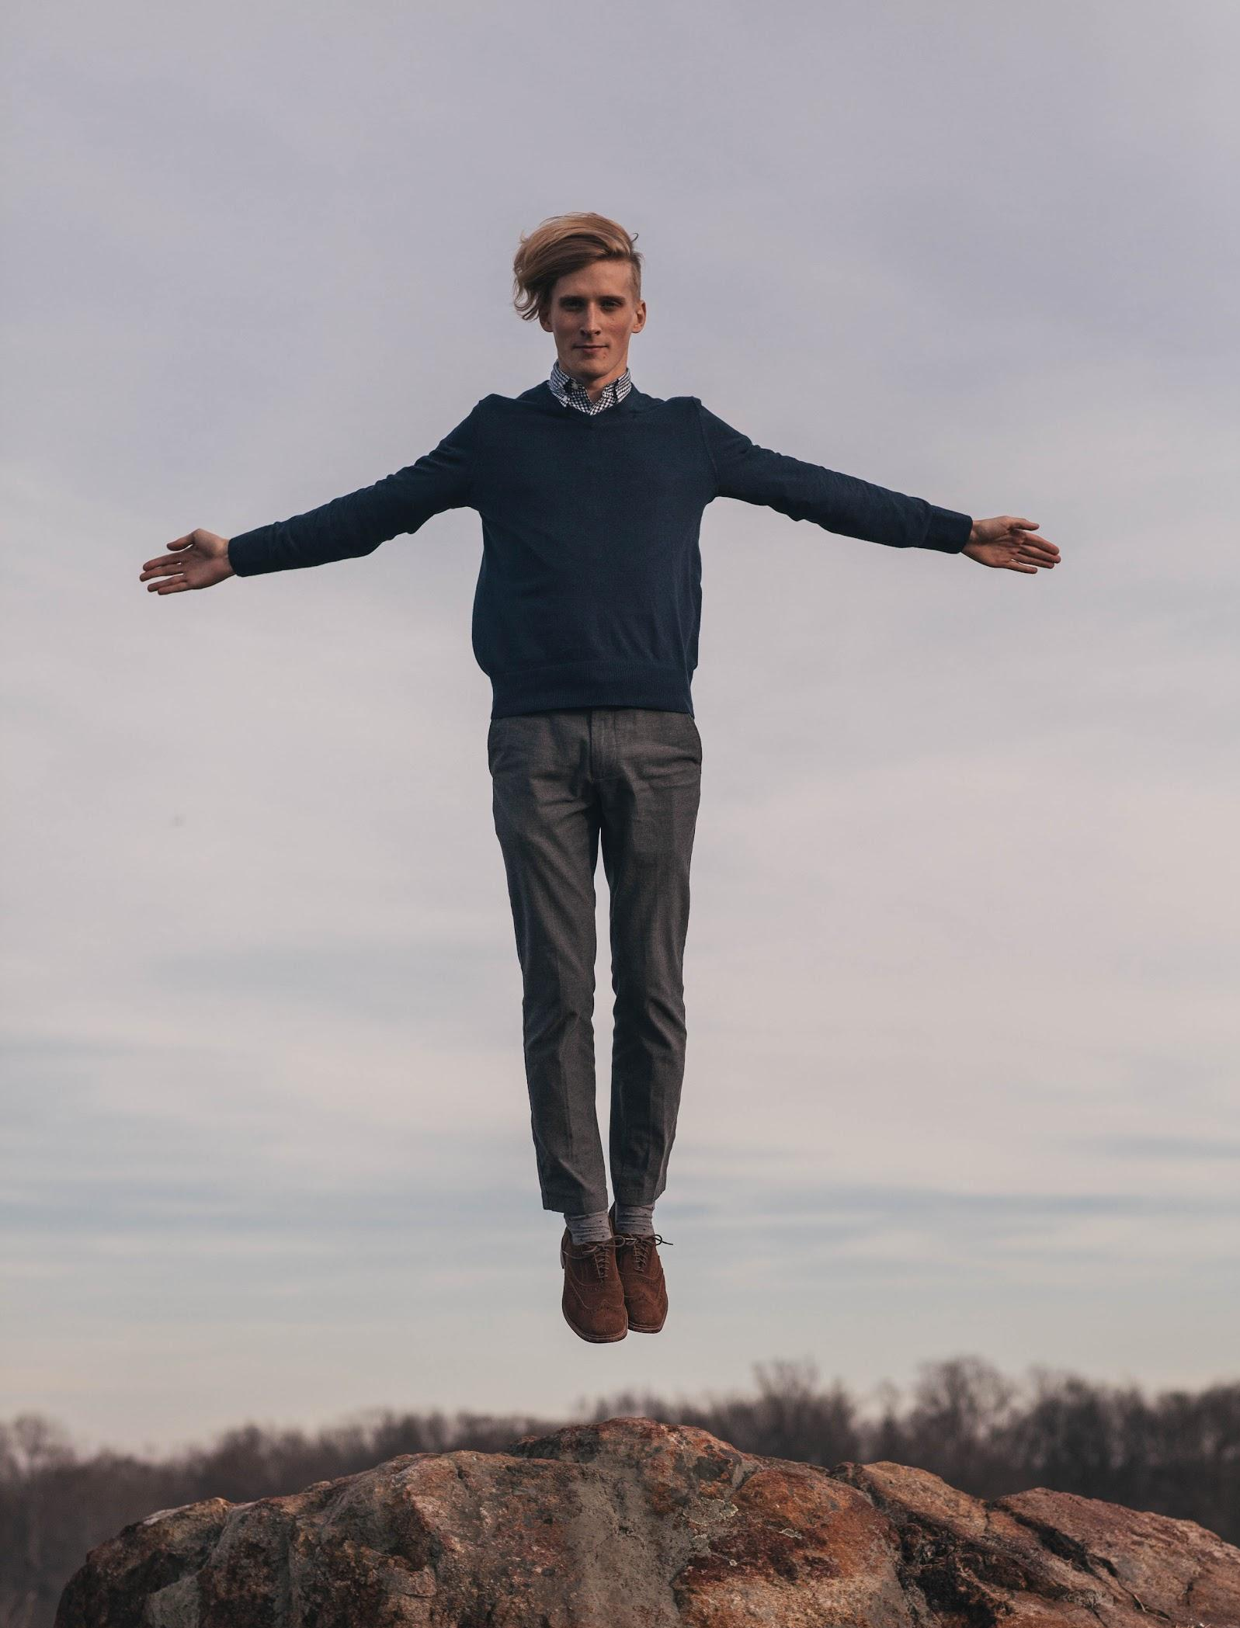
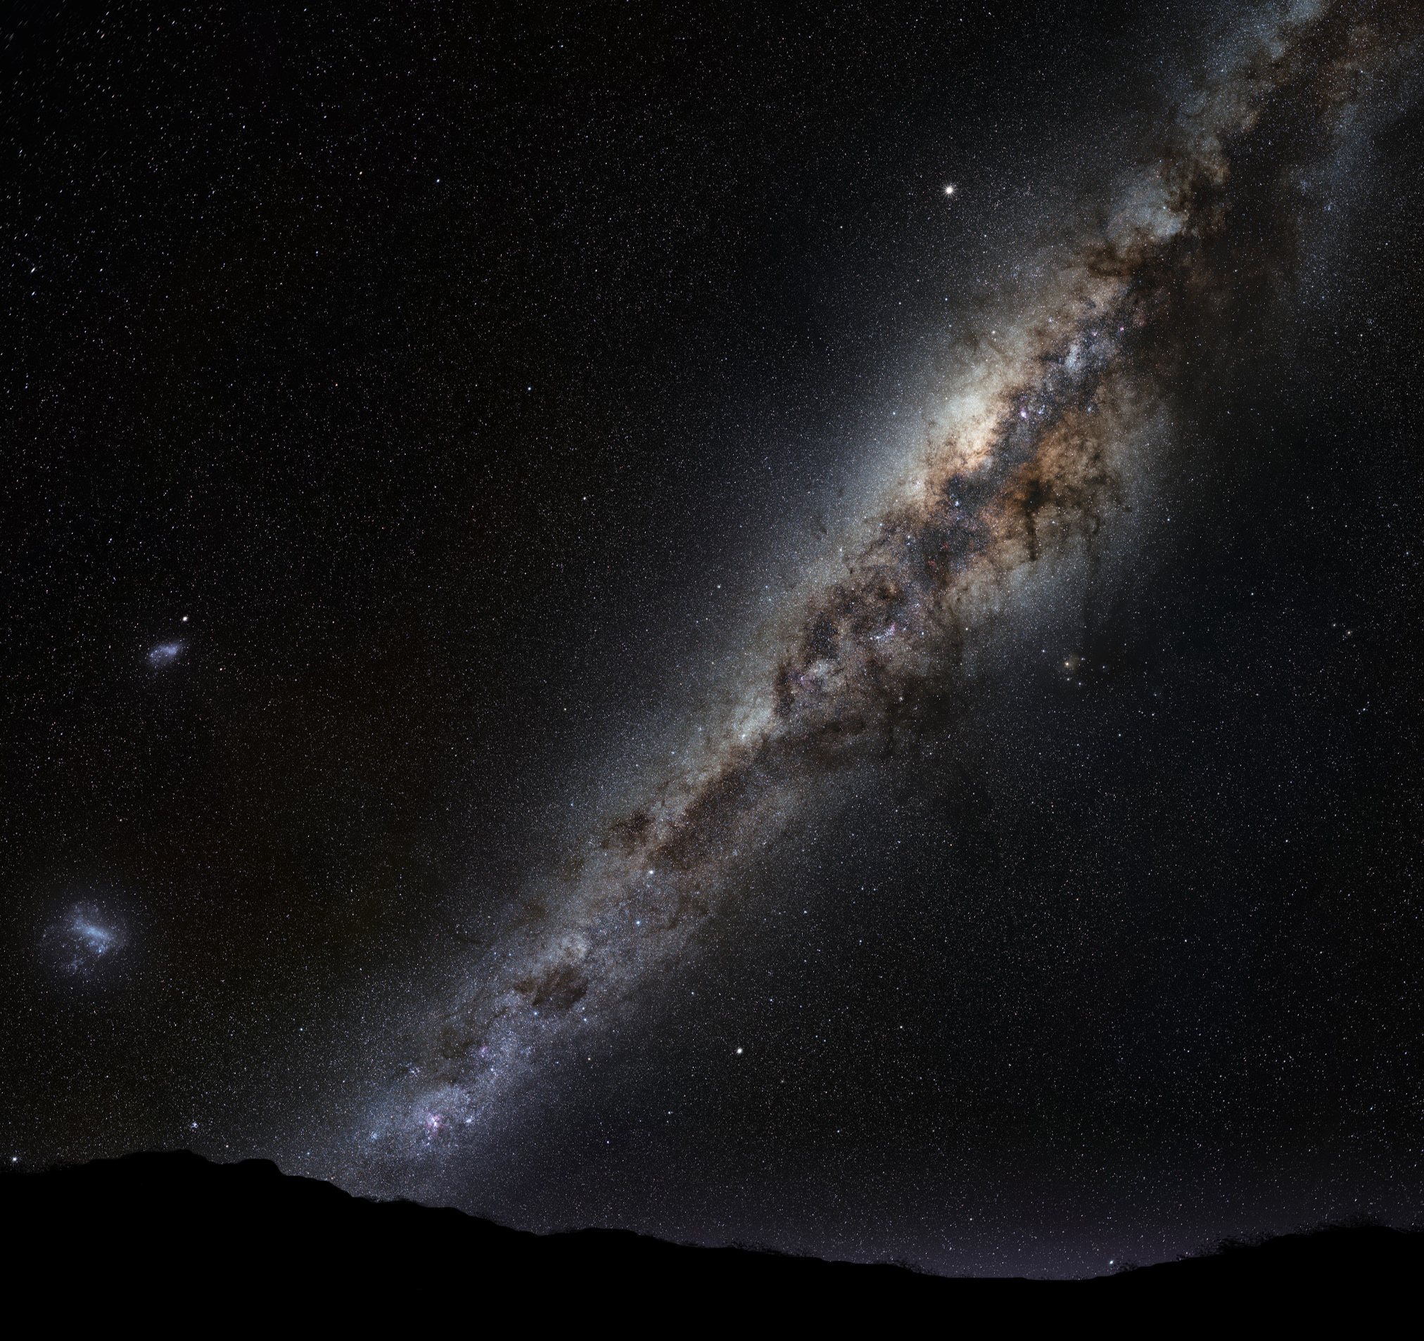
Important Words
Levitating: fly away
Sugarboo: sweet situation
Milky way: star road especially you can see in July
Renegading: fight against somethings

Slide 12
［Pre-Chorus]
You want me, I want you, baby
My , I'm levitating
The Milky Way, we're ,
Yeah, yeah, yeah, yeah, yeah
[Chorus]
I got you, , you're my ,
I need you all night, come on, ,
I'm levitating
You, , you're my (You're the moonlight)
I need you all night, come on, ,
I'm levitating

Slide 13
［Pre-Chorus]
You want me, I want you, baby
My sugarboo, I'm levitating
The Milky Way, we're renegading
Yeah, yeah, yeah, yeah, yeah
[Chorus]
I got you, moonlight, you're my starlight
I need you all night, come on, dance with me
I'm levitating
You, moonlight, you're my starlight (You're the moonlight)
I need you all night, come on, dance with me
I'm levitating

Slide 14
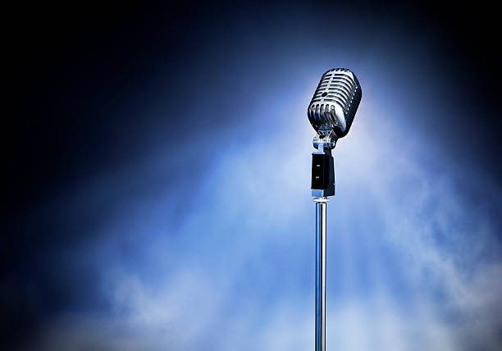
♪
How to sing well ♪
~ Let’s sing Pre and Chorus together!! ~
♫
♪
♫
♪
♫
♪

Slide 16
Points
1. Using pronunciation rule as linking, reduction and assimilation
ex) You want me, I want you, baby
2. Rising and falling of tone like emphasis or not…. Keep the rhythm
3. The same letter is followed by a letter, pronounce it together.
ex) we’re renegading
4. Pronunciation focus ex) hand-drum, to work on the beats and practice
5. When you find some same or similar pronunciation, you try to keep the rhythm

Slide 17
Let’s sing :)
【Pre-Chorus】
You want me, I want you, baby
My sugarboo, I’m levitating
The Milky Way, we’re renegading
Yeah, yeah, yeah, yeah, yeah

Slide 18
【Chorus】Pronunciation Focus
I got you, moonlight, you’re my starlight
I need you all night, come on, dance with me
I’m levitating
You moonlight, you’re my starlight
I need you all night, come on, dance with me
I’m levitating

