Slide 1


Slide 2
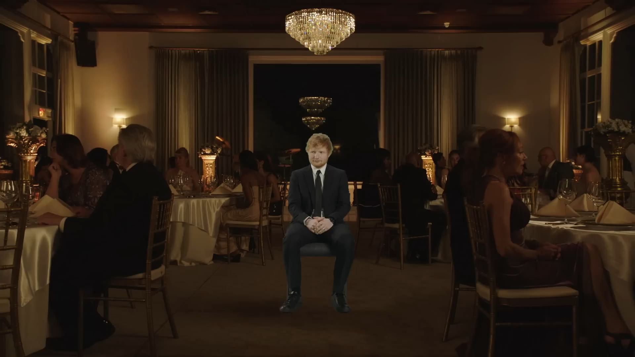

Slide 3

I Don’t Care
Ed Sheeran & Justin Bieber
https://www.youtube.com/watch?v=y83x7MgzWOA
[Verse 1: Ed Sheeran]
I'm at a party I don't wanna be at
And I don't ever wear , yeah
Wonderin' if I could the back
Nobody's even lookin' me in my eyes
Then you ,
Finish my drink , say, "Shall we dance?" (Hell, yeah)
You know I love ya, did I ya?
You make it better like that

Slide 4
[Pre-Chorus: Ed Sheeran]
Don't think I fit in at this party
Everyone's got so much to say (Yeah)
I always feel like I'm , mmm
Who wants to fit in anyway?
[Chorus: Ed Sheeran]
'Cause I don't care when I'm with my baby, yeah
All the bad things disappear
And you're making me feel like maybe I am ,
I can deal with the bad nights
When I'm with my baby, yeah

Slide 5
Ooh, ooh, ooh, ooh, ooh, ooh
'Cause I don't care as long as you just ,
You can take me anywhere
And you're making me feel like I'm loved by somebody
I can deal with the bad nights
When I'm with my baby, yeah
Ooh, ooh, ooh, ooh, ooh, ooh
[Verse 2: Justin Bieber]
We at a party we don't wanna be at
Tryna talk, but we can't hear ourselves
Read your lips, I'd rather kiss 'em right back
With all these people all around
I'm crippled with ,
But I'm told it's where I'm s'posed to be

Slide 6
You know what? It's kinda crazy 'cause I really don't mind
When you like that
[Pre-Chorus: Justin Bieber] [Chorus: Ed Sheeran & Justin Bieber]
[Bridge: Justin Bieber & Ed Sheeran]
I don't like nobody but you, it's like you're the only one here
I don't like nobody but you, baby, I don't care
I don't like nobody but you, I hate everyone here
I don't like nobody but you, baby, yeah
[Chorus: Ed Sheeran & Justin Bieber]

Slide 7
Answer
I'm at a party I don't wanna be at
And I don't ever wear a suit and tie, yeah
Wonderin' if I could sneak out the back
Nobody's even lookin' me in my eyes
Then you take my hand
Finish my drink, say, "Shall we dance?" (Hell, yeah)
You know I love ya, did I ever tell ya?
You make it better like that
[Pre-Chorus: Ed Sheeran]
Don't think I fit in at this party
Everyone's got so much to say (Yeah)
I always feel like I'm nobody, mmm
Who wants to fit in anyway?

Slide 8
[Chorus: Ed Sheeran]
'Cause I don't care when I'm with my baby, yeah
All the bad things disappear
And you're making me feel like maybe I am somebody
I can deal with the bad nights
When I'm with my baby, yeah
Ooh, ooh, ooh, ooh, ooh, ooh
'Cause I don't care as long as you just hold me near
You can take me anywhere
And you're making me feel like I'm loved by somebody
I can deal with the bad nights
When I'm with my baby, yeah
Ooh, ooh, ooh, ooh, ooh, ooh
[Verse 2: Justin Bieber]
We at a party we don't wanna be at
Tryna talk, but we can't hear ourselves

Slide 9
Read your lips, I'd rather kiss 'em right back
With all these people all around
I'm crippled with anxiety
But I'm told it's where I'm s'posed to be
You know what? It's kinda crazy 'cause I really don't mind
When you make it better like that
[Pre-Chorus: Justin Bieber] [Chorus: Ed Sheeran & Justin Bieber]
[Bridge: Justin Bieber & Ed Sheeran]
I don't like nobody but you, it's like you're the only one here
I don't like nobody but you, baby, I don't care
I don't like nobody but you, I hate everyone here
I don't like nobody but you, baby, yeah
[Chorus: Ed Sheeran & Justin Bieber]

Slide 10
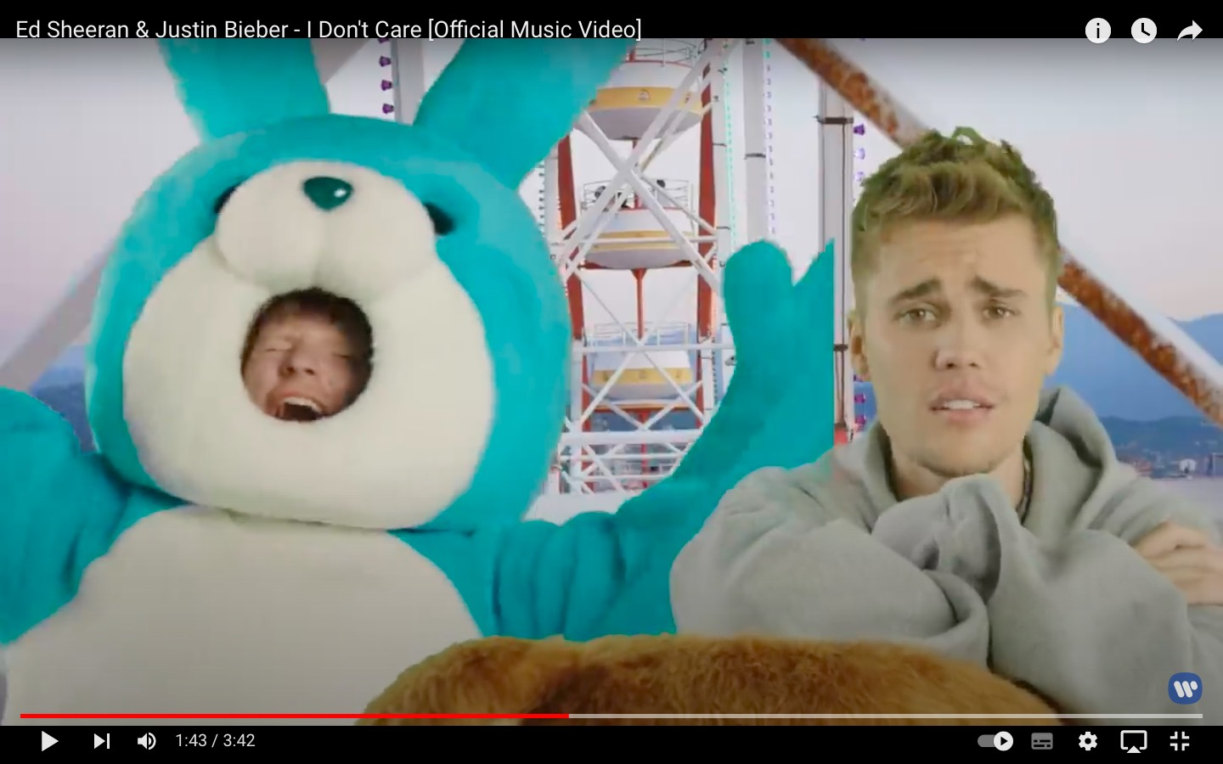
Quiz

Slide 11
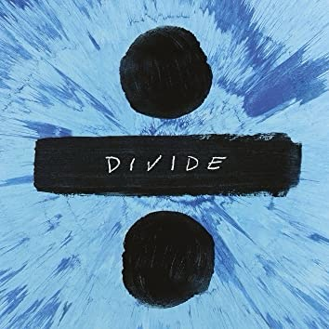
Was Ed Sheeran’s first album “÷” ?

Slide 12
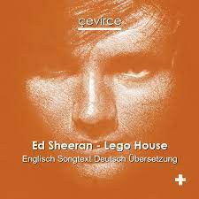
The answer is ……
×
His first album is “+”.

Slide 13
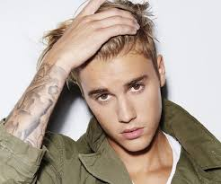
When Justin Bieber entered big-time record, who trained him?
1, His mother
2, His music teacher
3, One of his friends
4, He wasn’t trained by anyone.

Slide 14
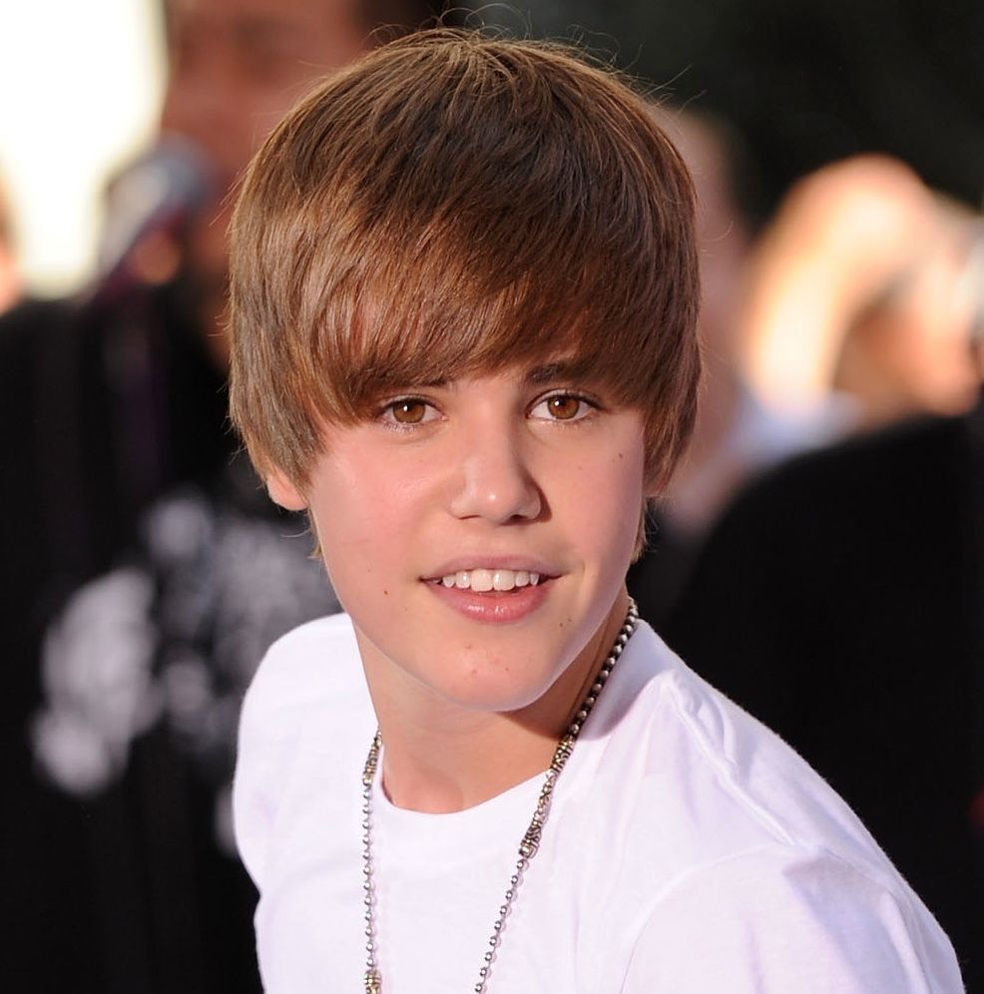
The answer is ……
4

Slide 15
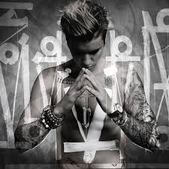
Justin Bieber is crippled with what?
1, Fear
2, Injury
3, Anxiety
4, Heart broken

Slide 16
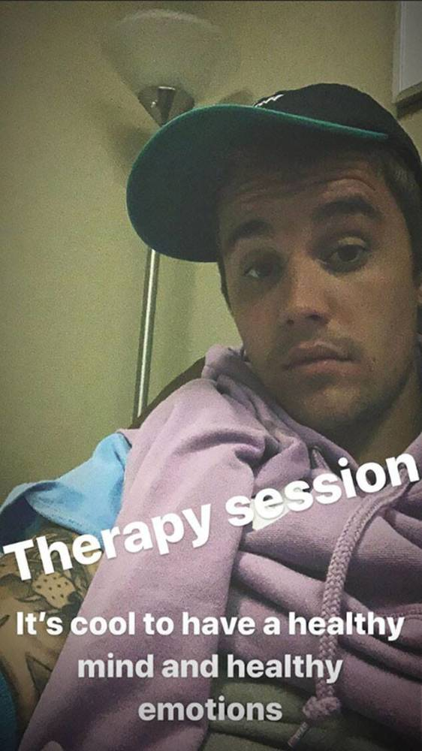
The answer is ……
3

