Slide 1

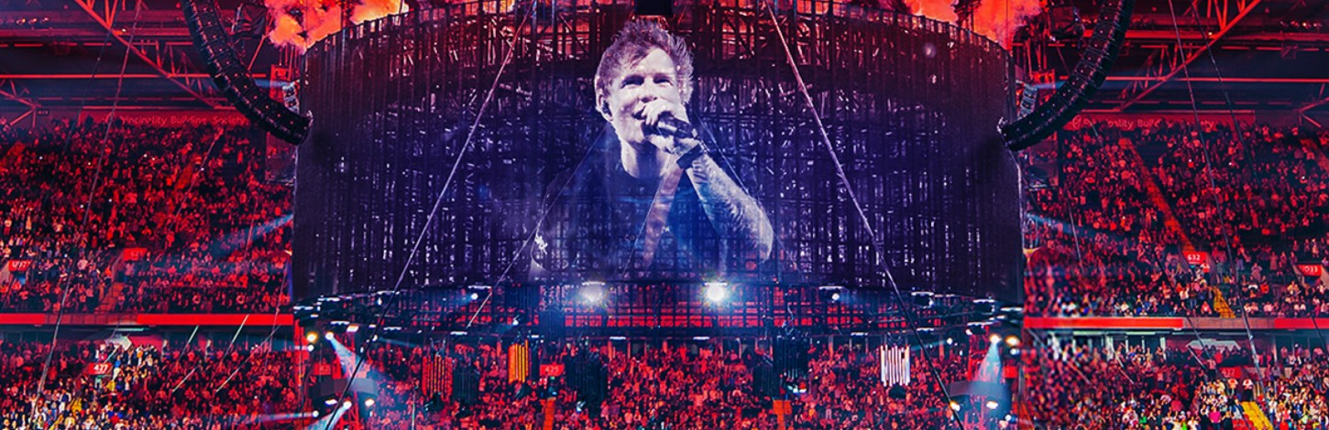
Yuri,Tesshu,Yuki
Ed Sheeran
Shivers

Slide 2

CONTENTS
01 Ed Sheeran
02 His Career
03 This song about...
04 pronunciation
05 Quiz

Slide 3
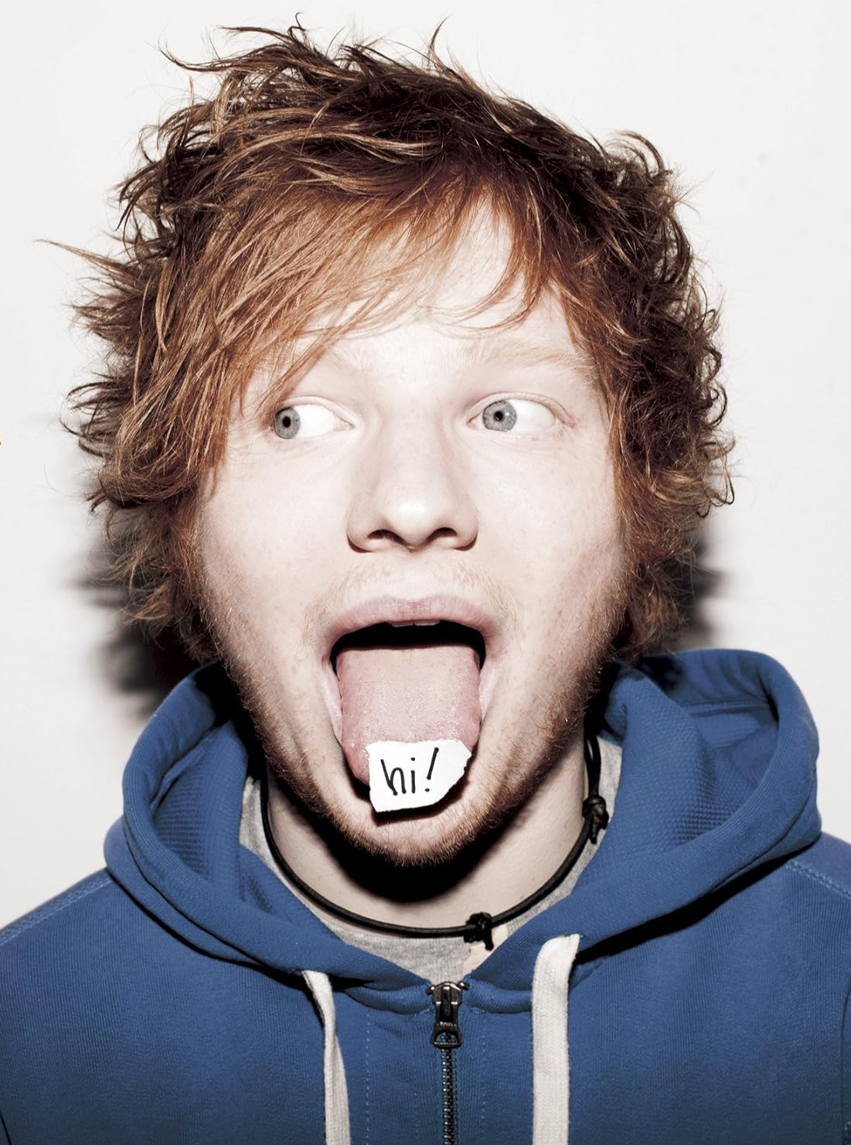
He was born with a hearing impairment in 1991 , Feblary , 17th.
His family is known as artistic family . His father is art curater , his mother is jewely designer and his brother is composer.
Ed Sheeran

Slide 4
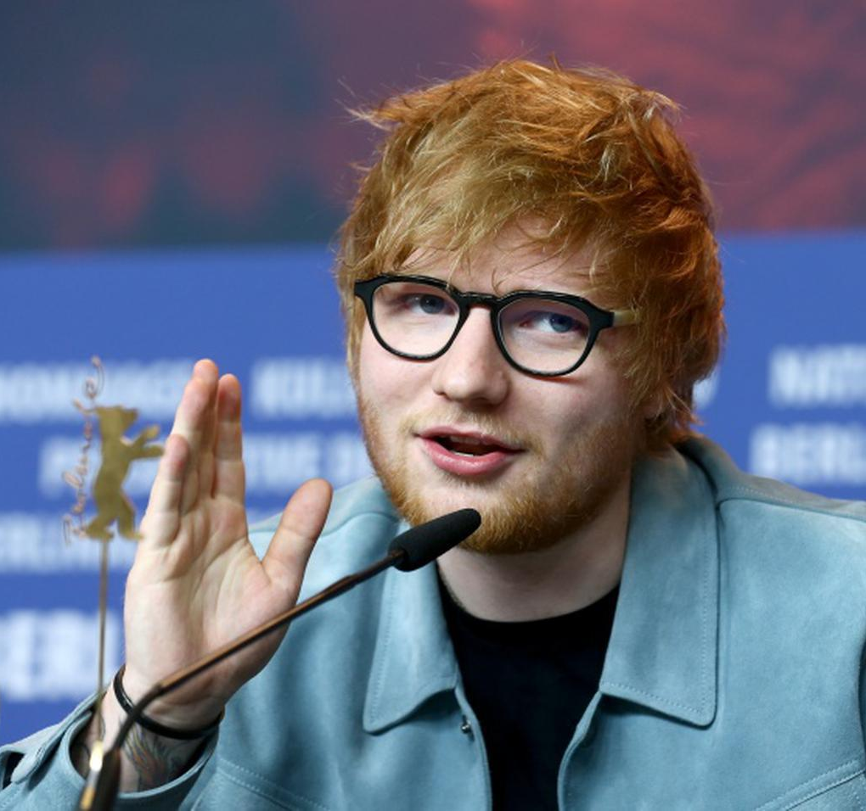
His Career
He started to learn the guiter , to compose in 11 , and at the age of 16 , he moved to London ,where he does live performance in studio and on the load.
+-=÷× Tour is his 4th concert tour , which was started at dublin,Ireland in 2022.He is scheduled to put on 141 shows with a japan tour scheduled for january 2024.
He has sold more than 150 million records and is chosen as one of the best selling music artist in the world.

Slide 5
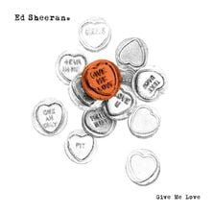
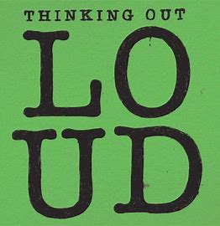

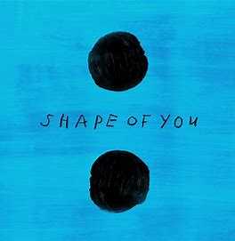

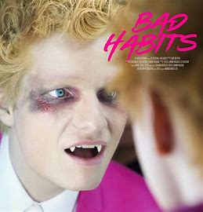
HIT SONGS
2011
Give me love
2014
Thinking out loud
2014
Photograph
2017
Shape of you
2017
Perfect
2021
Bad habits

Slide 6
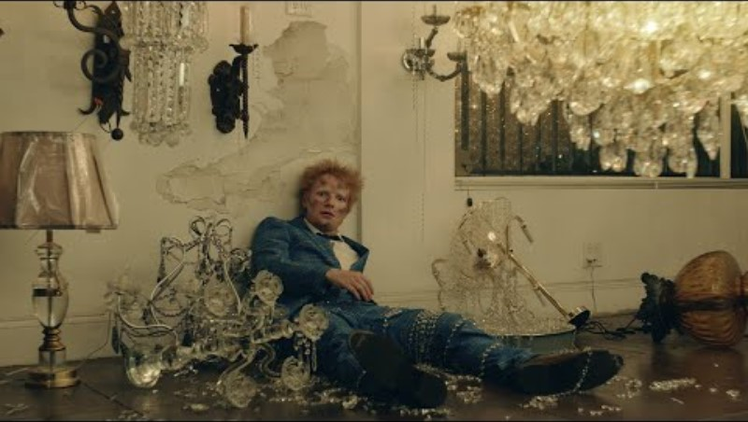
It’s really ***

Slide 7
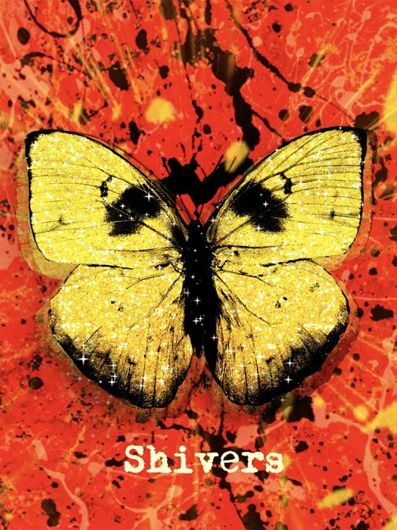
This song about
This song was released on 2021.10.29
it's a pretty sexy song.
for instance.....
"I never kissed a mouth that taste like yours"
"lipstick on my guiter"
"I love it when you do it like that"
I leave the meaning of these to your imagination!

Slide 8
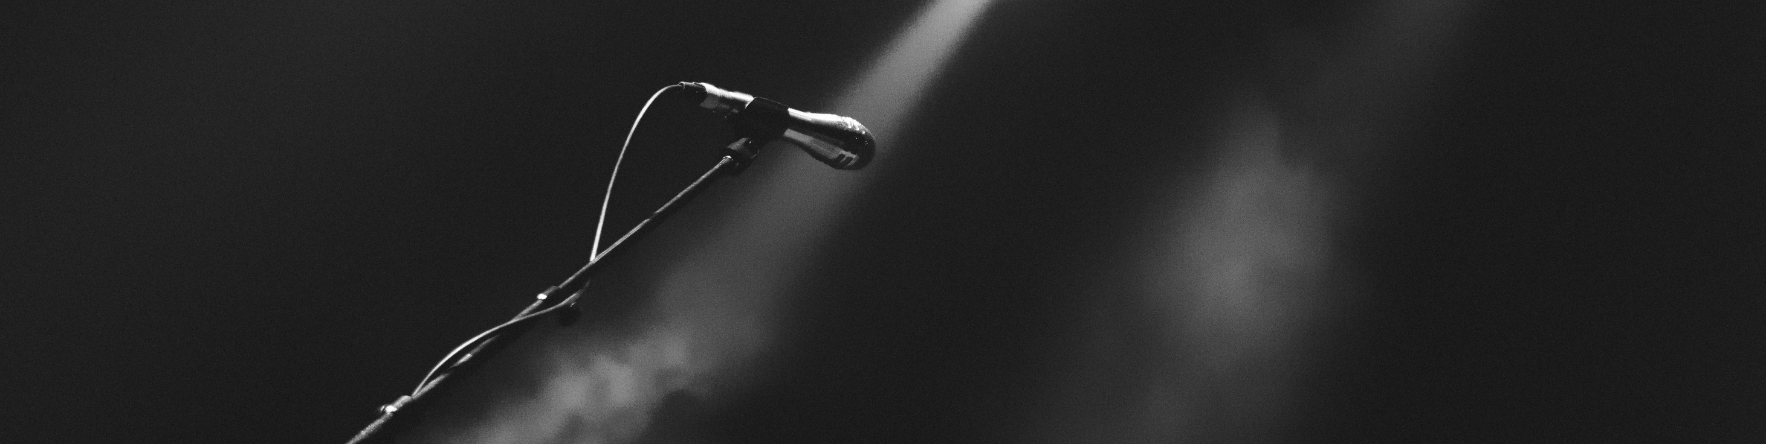
pronunciation
there are a lot of linking sounds in this Song
So prepared two steps to practice
Let's try together

Slide 9
first step
elision
lyric
Real pronunciation
I want it
i wan' it

Slide 10
second step
elision &intrusion
lyric
Real pronunciation
Stay up all day and all night
Stay Rup a' day
an' a' nigh’

Slide 11
GAP-FILL LISTENING TEST

Slide 12
ANSWER
[Verse 1]
I took an arrow to the heart
I never kissed a mouth that tastes like yours
Strawberries and then somethin' more
Ooh, yeah, I want it all
Lipstick on my guitar
Fill up the engine, we can drive real far
Go dancin' underneath the stars
Ooh, yeah, I want it all
Mmm, you got me feelin' like
[Pre-Chorus]
I wanna be that guy, I wanna kiss your eyes
I wanna drink that smile, I wanna feel like I'm
Like my soul's on fire,
I wanna stay up all day and all night
Yeah, you got me singin' like
[Chorus]
Ooh, I love it when you do it like that
And when you're close up, give mе the shivers
Oh, baby, you wanna dance 'til thе sunlight cracks
And when they say the party's over,
then we'll bring it right back
And we'll say,
"Ooh, I love it when you do it like that"
And when you're close up, give me the shivers
Oh, baby, you wanna dance 'til the sunlight cracks
And when they say the party's over,
then we'll bring it right back

Slide 13
When was this song released?
01. 2020.10.27
02. 2021.10.27
03. 2020.20.29
04. 2021.10.29

Slide 14
Which season in japan he was born?
01. Spring
02. Summer
03. Fall
04. Winter

Slide 15
When has +-=÷× Tour started?
01. 2020
02. 2021
03. 2022
04. 2023

Slide 16
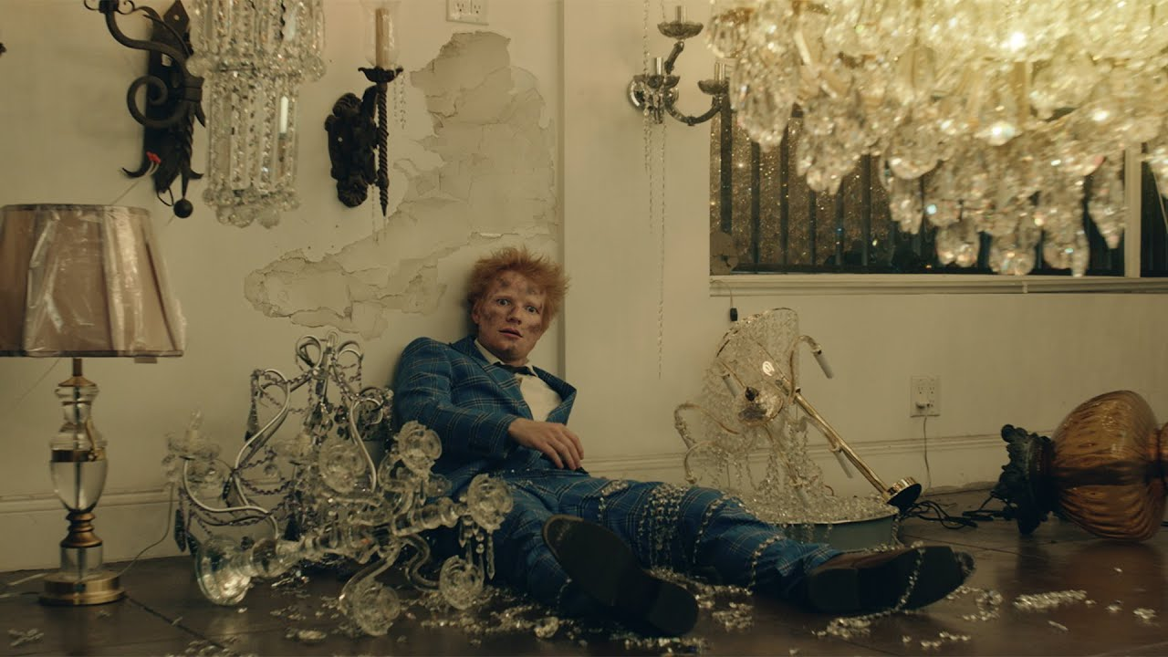

THANKS

