Slide 1
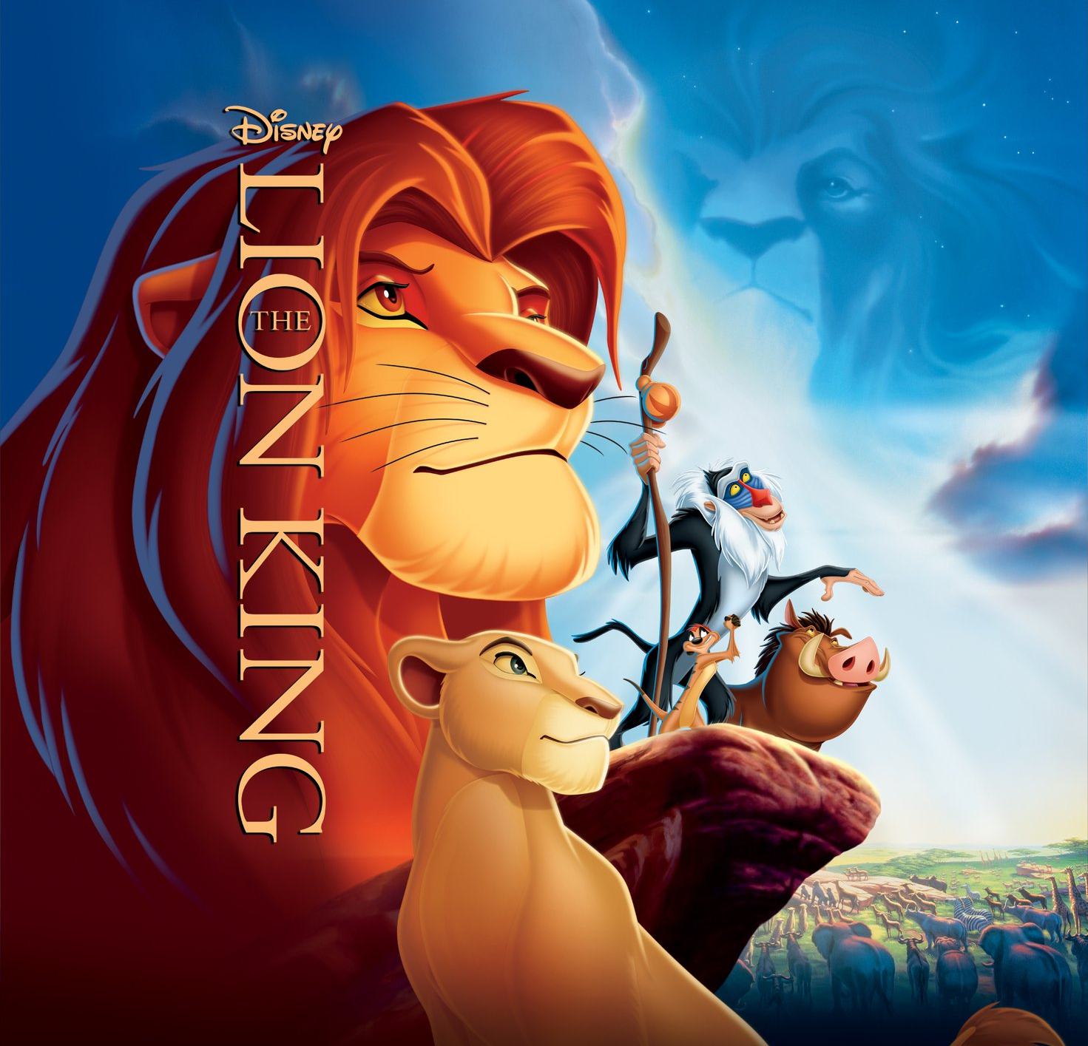
Can You Feel Love Tonight
Elton John

Slide 2

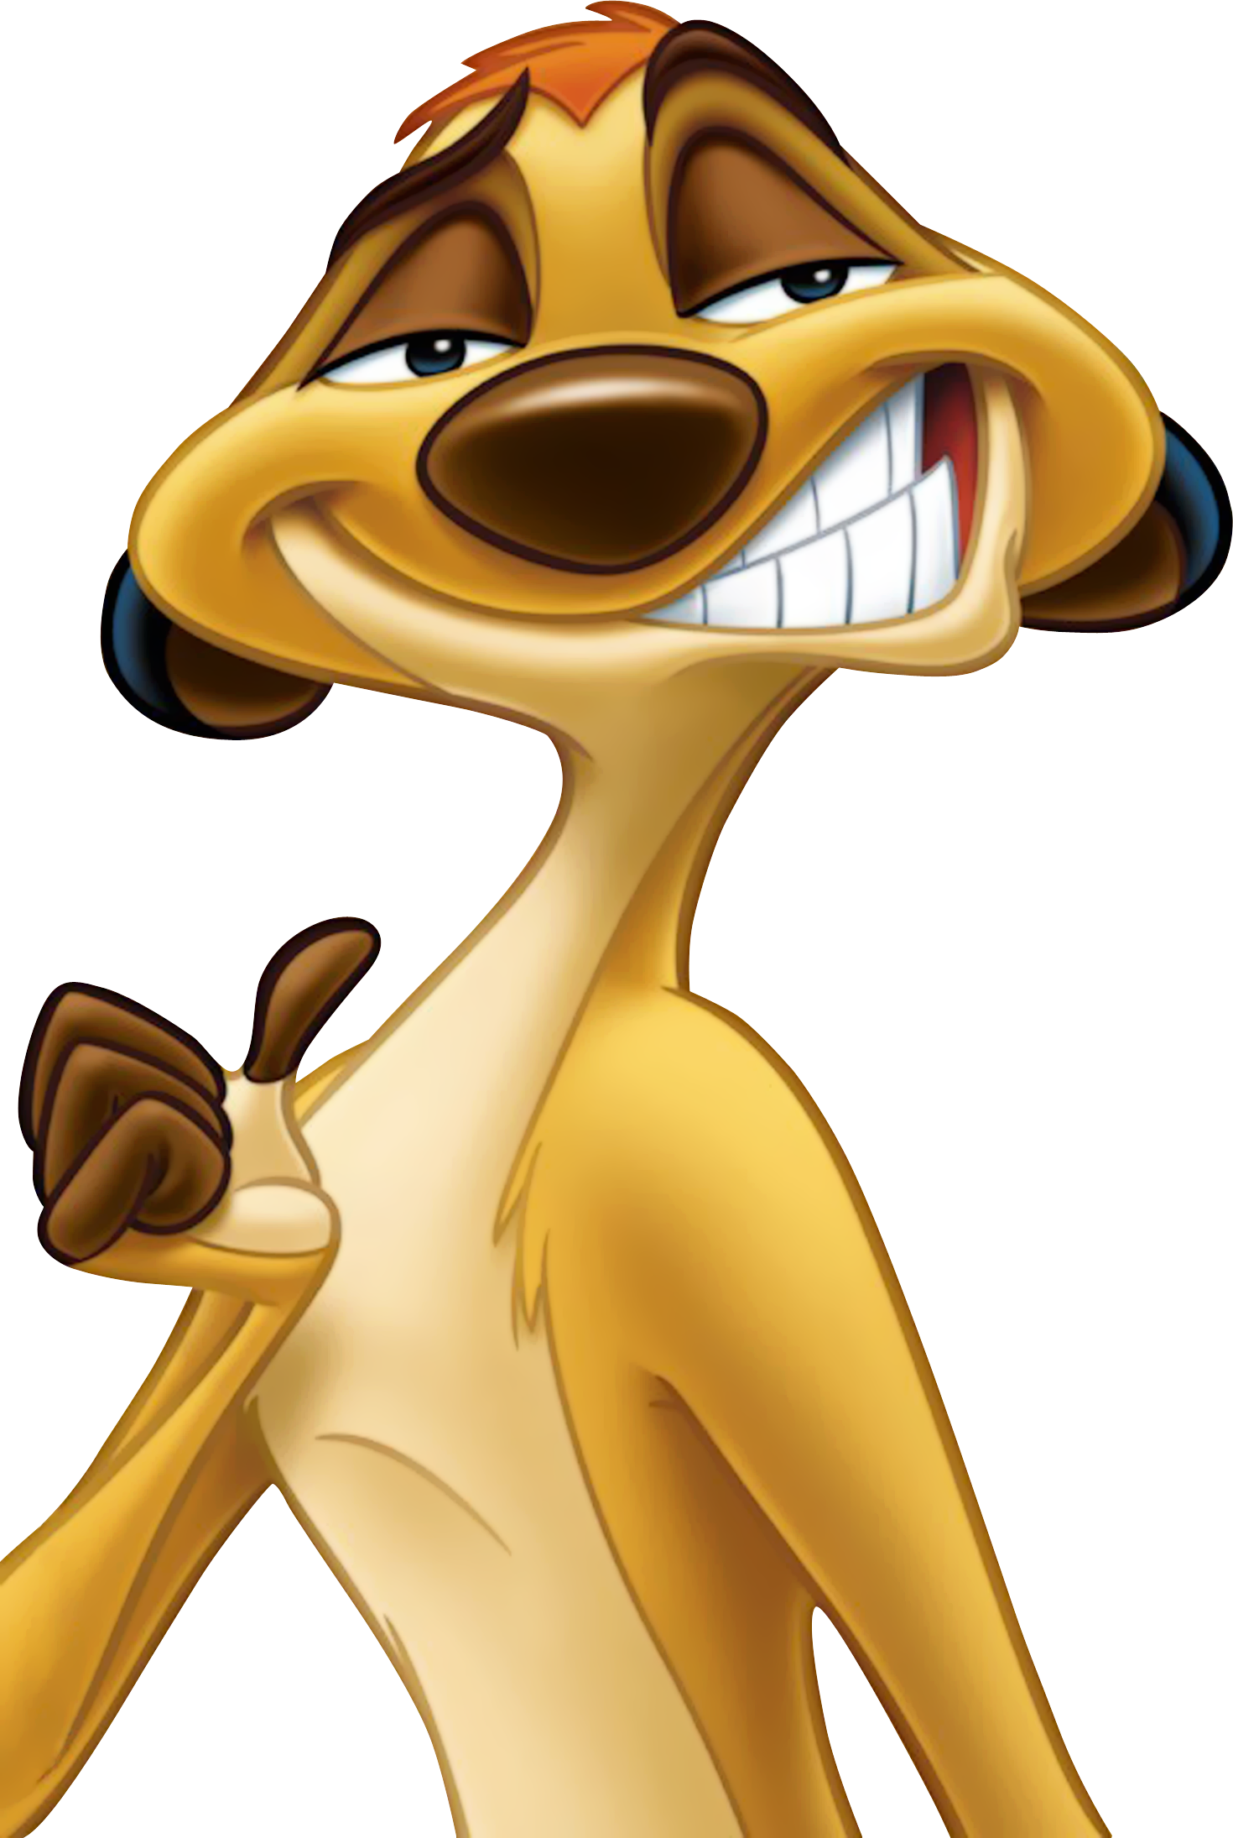
Listen to the whole song and try to fill the gaps!!
Elton John - Can You Feel the Love Tonight (From "The Lion King"/Official Video) - YouTube
Check your answers with an answer sheet

Slide 3


Slide 4
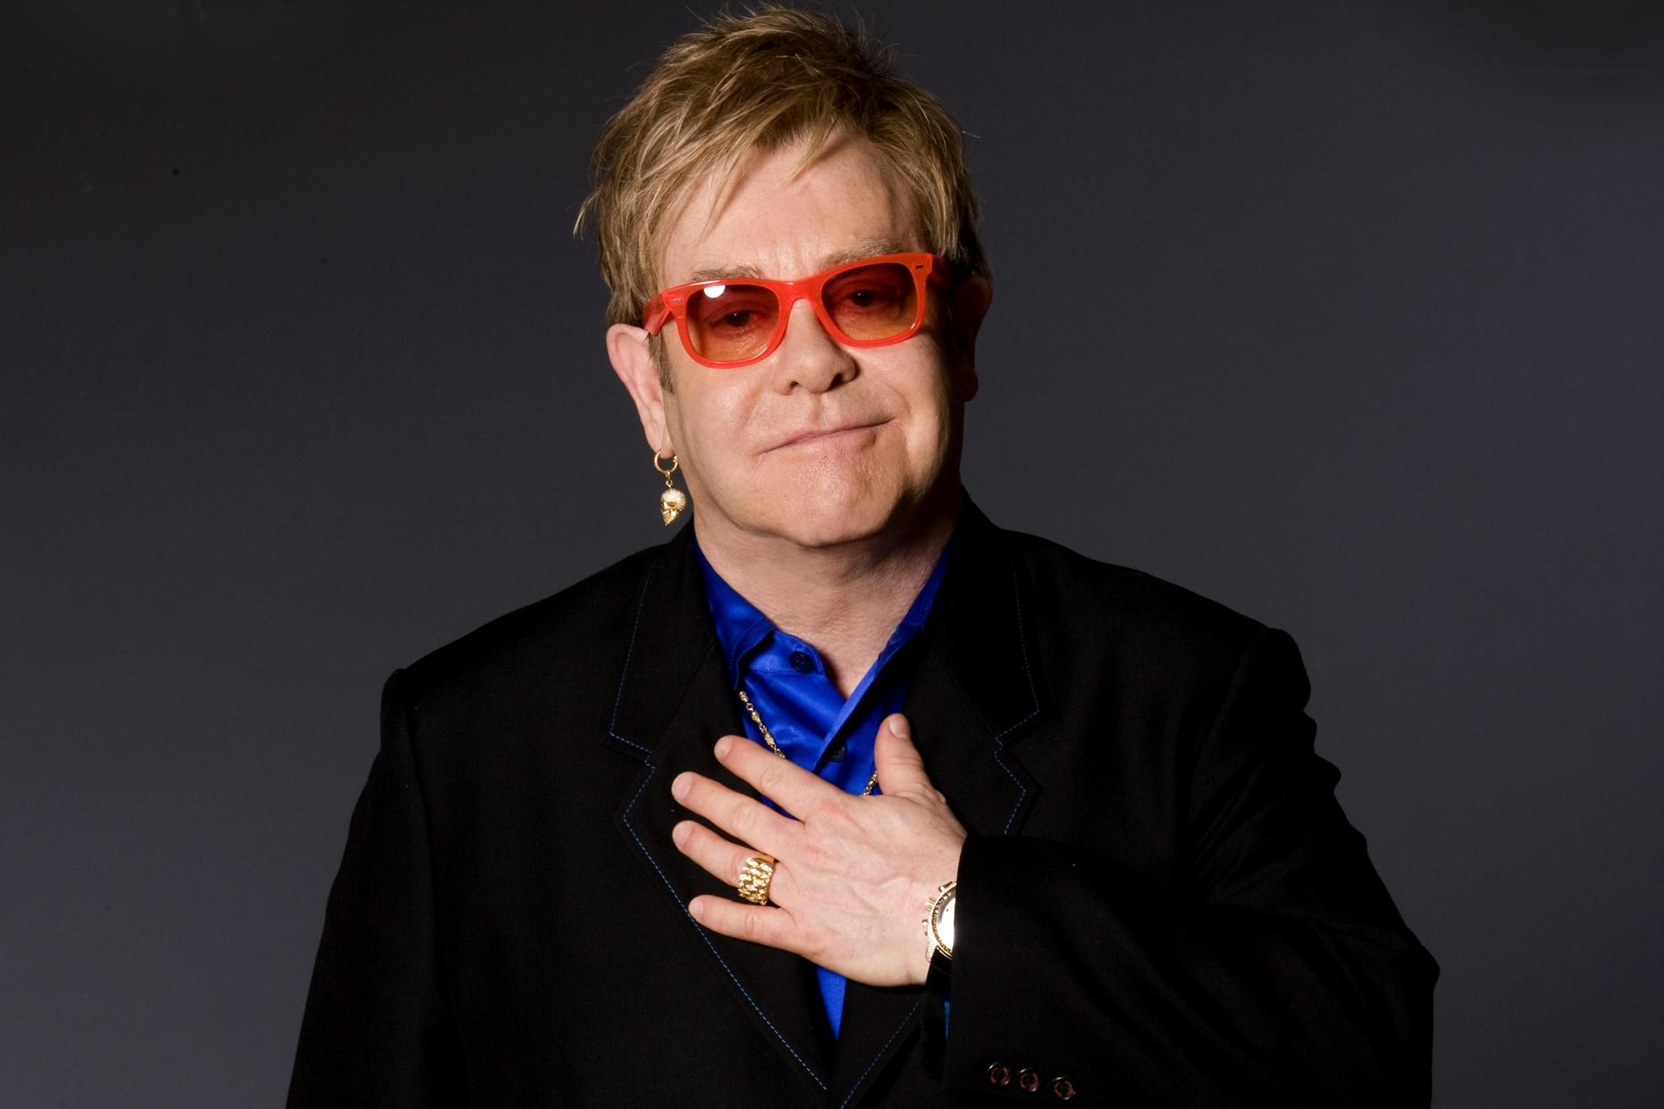

Elton John
British singer
Q. What genre of music does he sing?
A. rock / pop music / piano rock /
pop rock / soft rock / glam rock / rhythm and blues

Slide 5
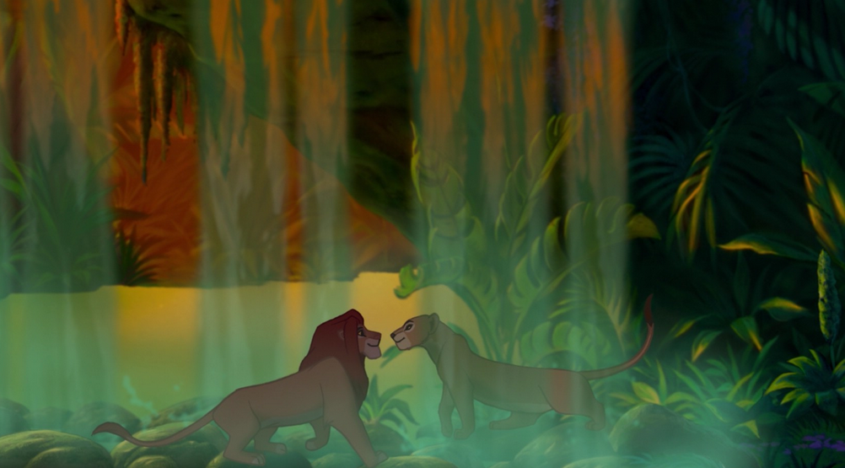
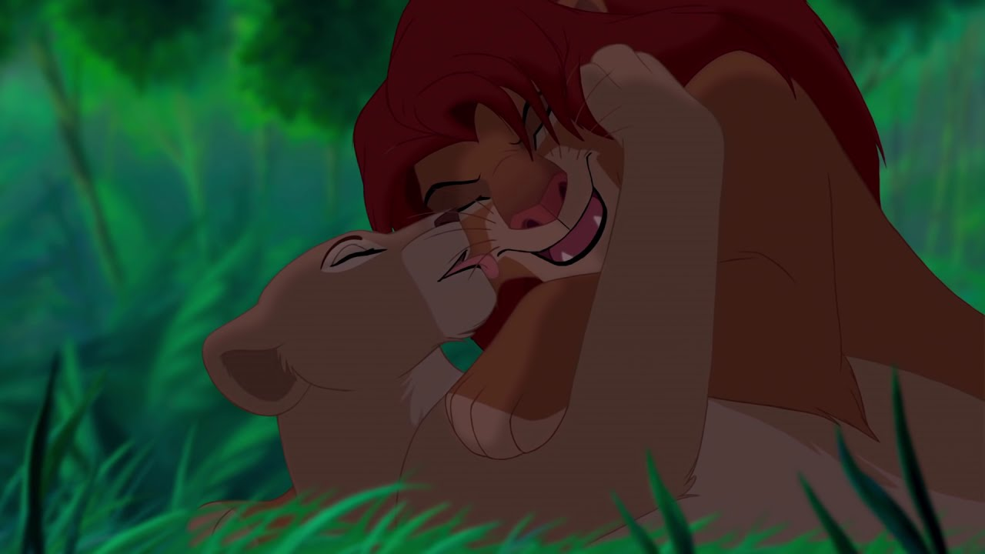
scene
Simba
Nala

Slide 6
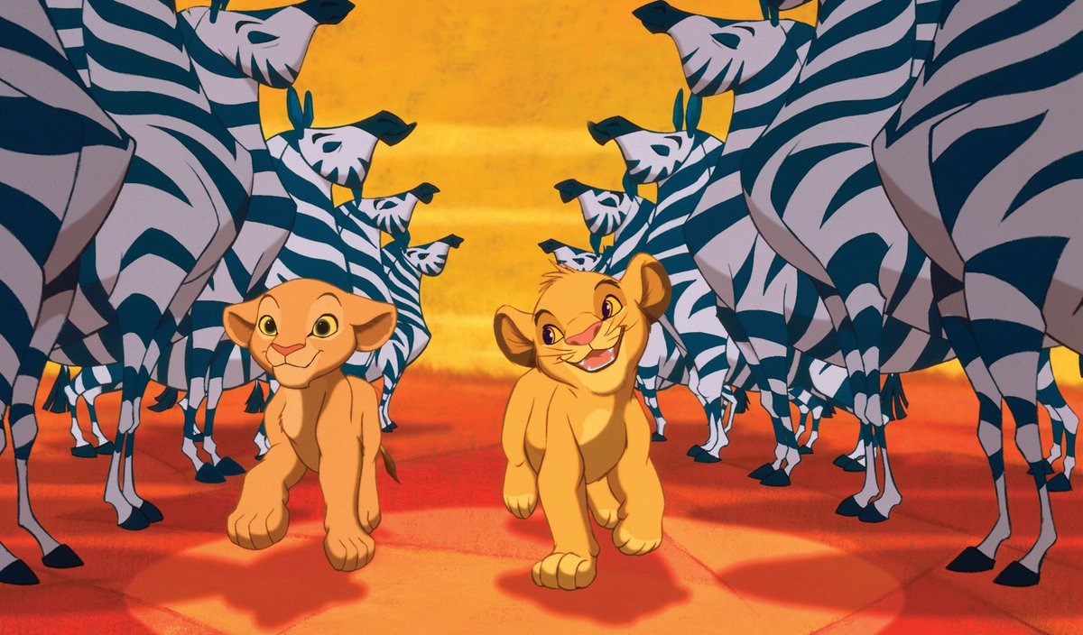
Story

Slide 7
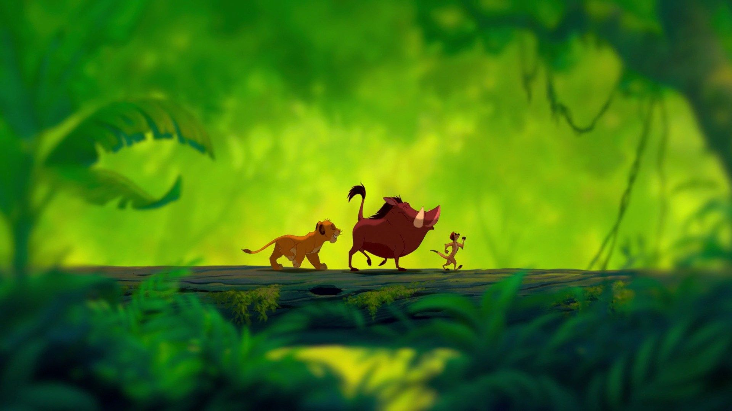
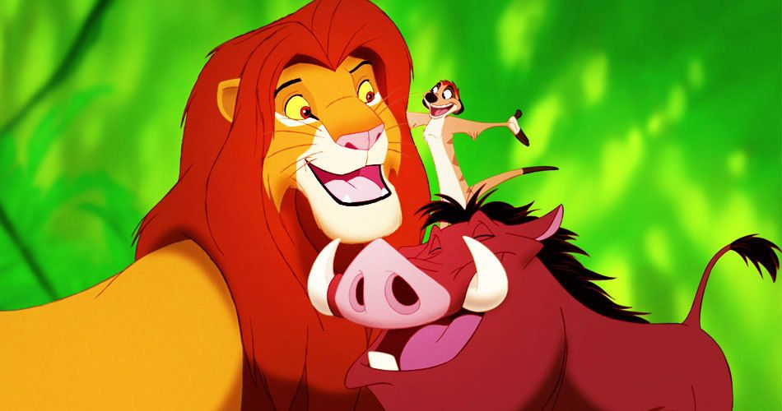
Story

Slide 8
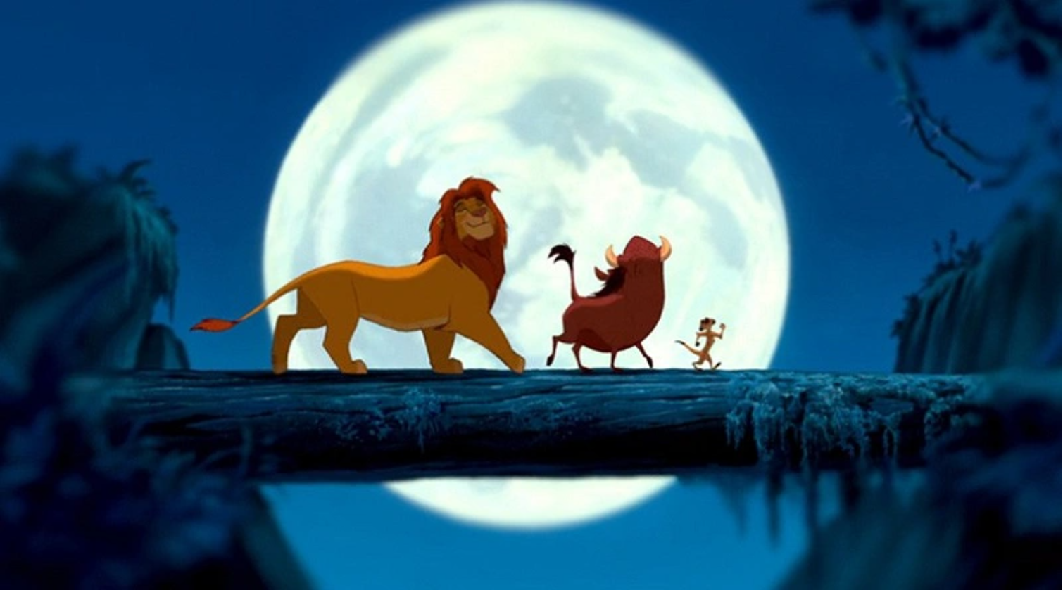
LET’S SING THIS SONG!!

Slide 9

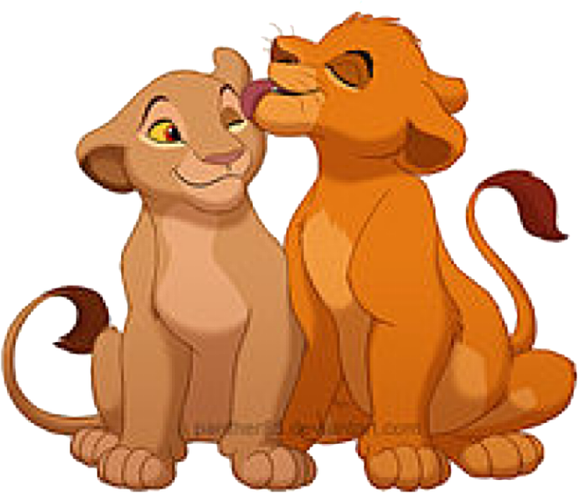
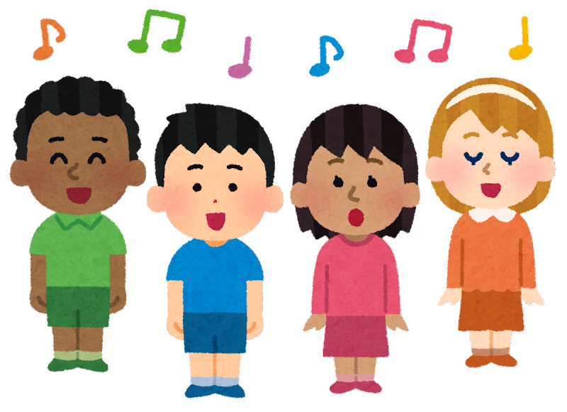
LET’S PRACTICE THIS PART ‼
v
and
Can
yu
Fe-el
the
Lo-ve
TO-Nigh-t

Slide 10
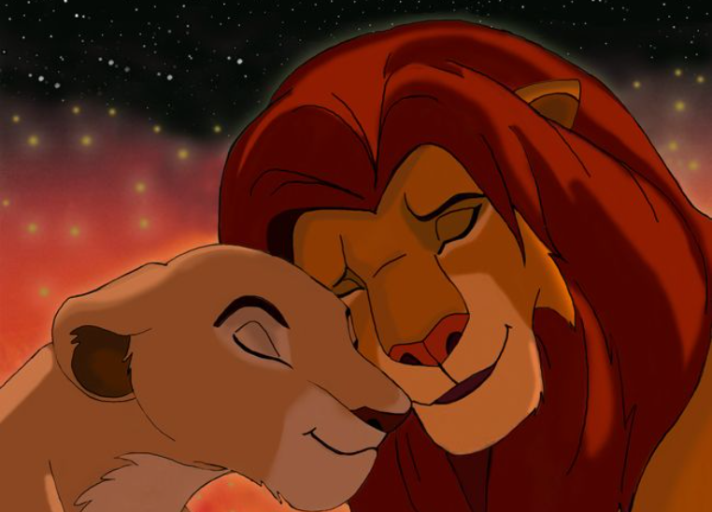
LET’S SING
WITH MUSIC
Click Here
https://www.youtube.com/watch?v=Ja5aE7rl2p8

Slide 11
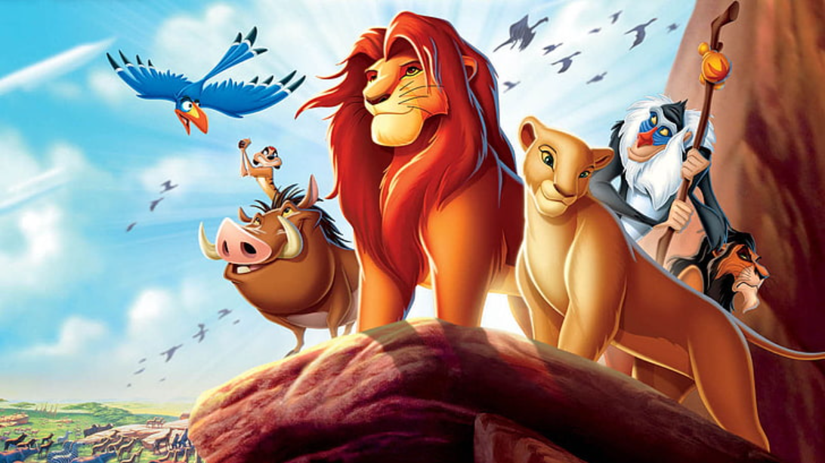
Thank You For Listening

