Slide 1


I’m still standing
By Elton john

Slide 2
Today’s agenda
About main meaning
About the singer
About the theme
Pronunciation Challenge
Quiz
About the music video

Slide 3

Main meaning
Overcome his difficult situation!!!

Slide 4
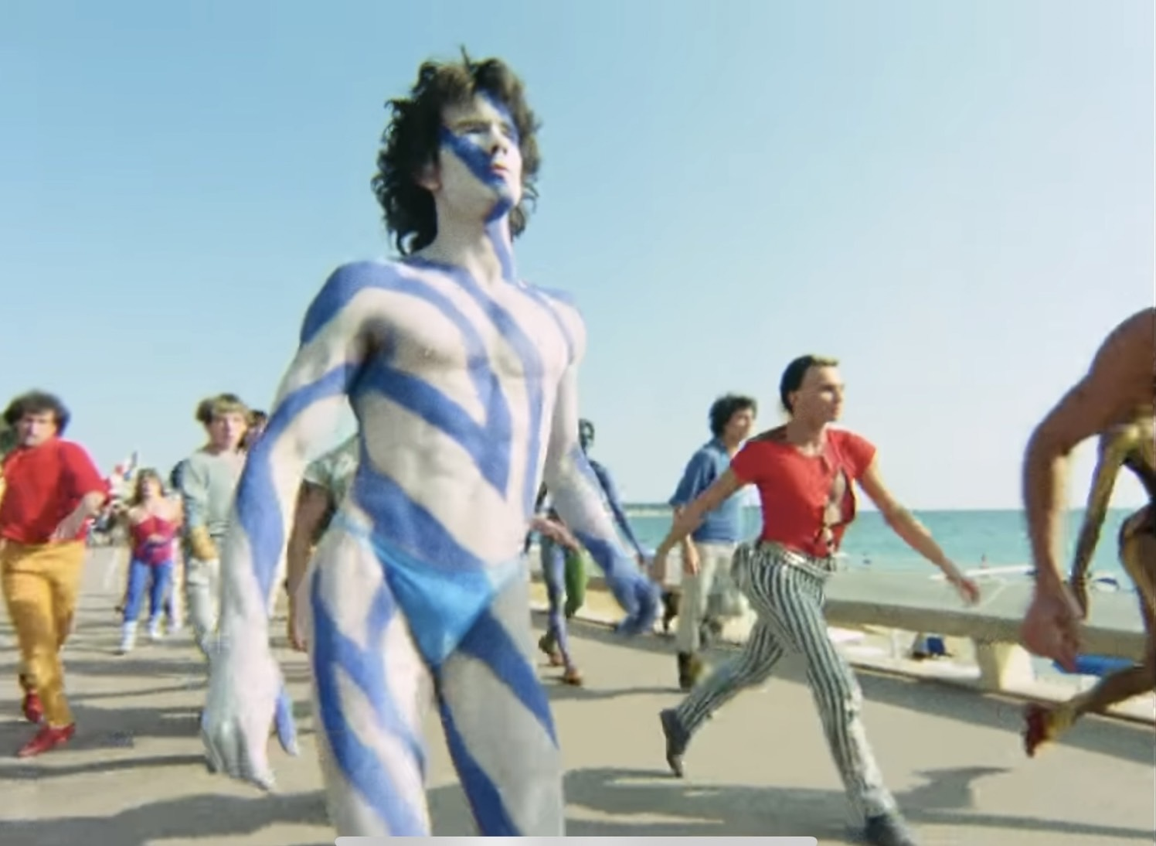
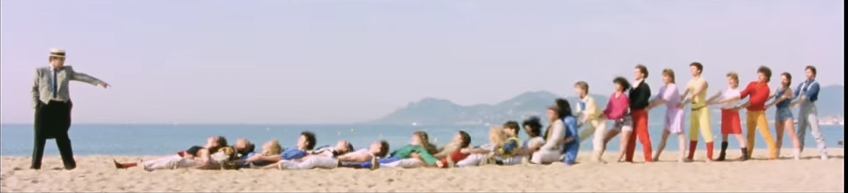
About the music video
The concept of this music video
・Gender free
-He expressed through dance and colorful costumes.

Slide 5
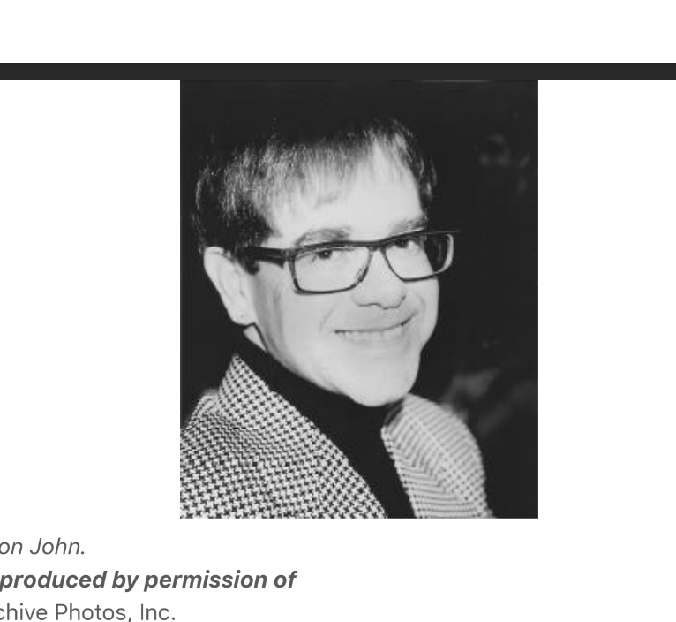
about the singer
Name: Elton John
Birthday: 1947,March 25
From: Pinner town in England
Appealing feature: glasses

Slide 6
about the singer
【his life】
He studied in London Academy of Music, but dropped out two weeks before graduation.
He worked for a music publishing company and also played the piano in bars, later joining a band.
In 1968 John met Bernie Taupin who became his business partner.
His second album contained "Your Song," a hit. Moreover his songs became hit all over the world.
He went on a two-year hiatus and dissolved his partnership with Taupin. During his hiatus, he came out as gay.
He then resumed his activities and had a hit with “I'm still standing”.

Slide 7
The theme
The main concept of this song is...
to inspire yourself to say “I haven't lost, I haven't been beaten yet” to a lost love.
The real message in the song that we thought is...
to convey that he would not give up, even in the face of hardship.

Slide 8
Pronunciation Challenge
1) And there's a cold, lonely light that shines
th sh
2) You'll wind-up like the wreck-you hide

Slide 9
Quiz
How many kind of glasses in this music video?
1) 5
2) 7
3) 12

Slide 10
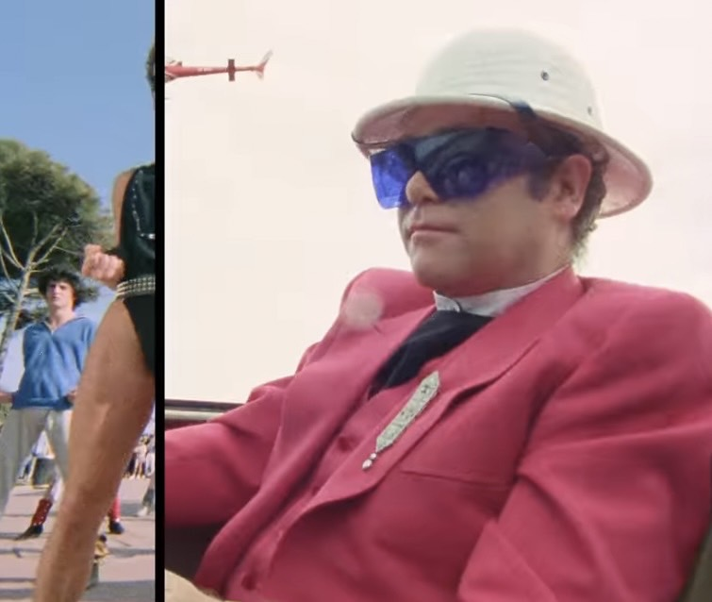
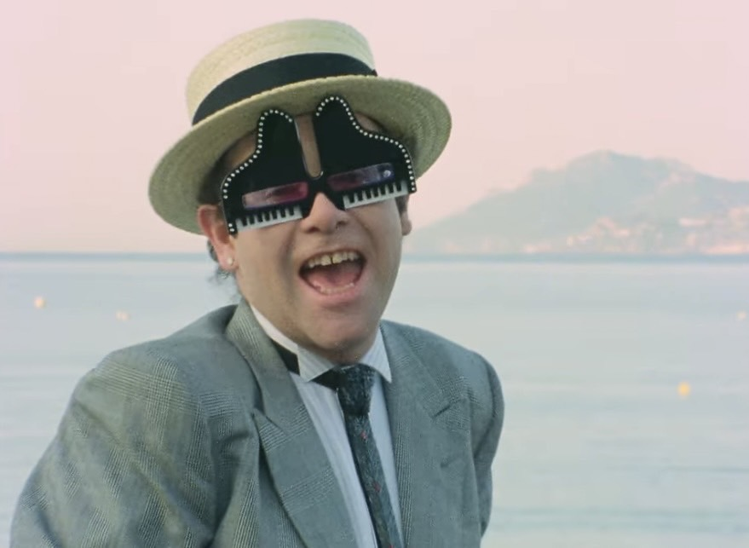
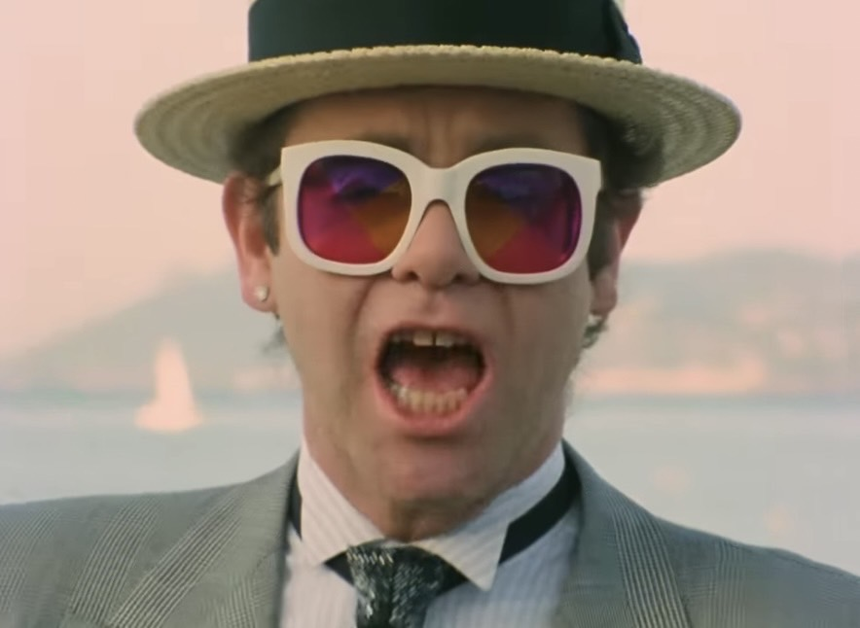
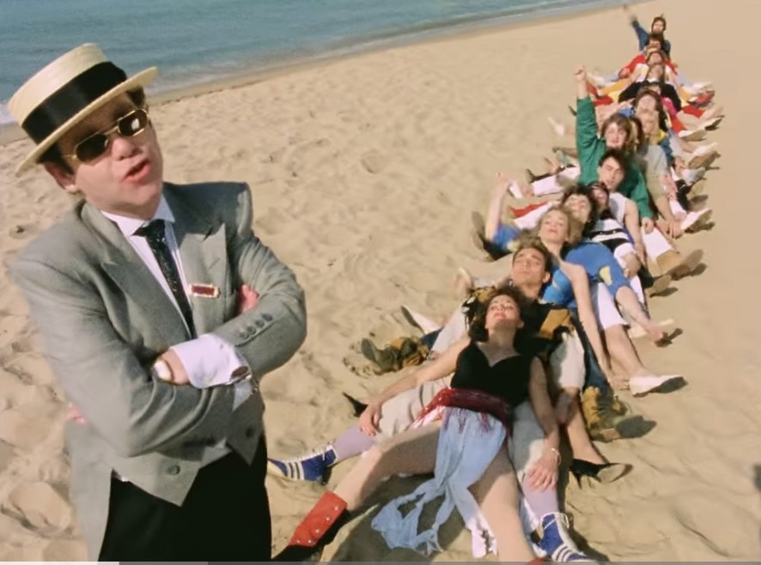
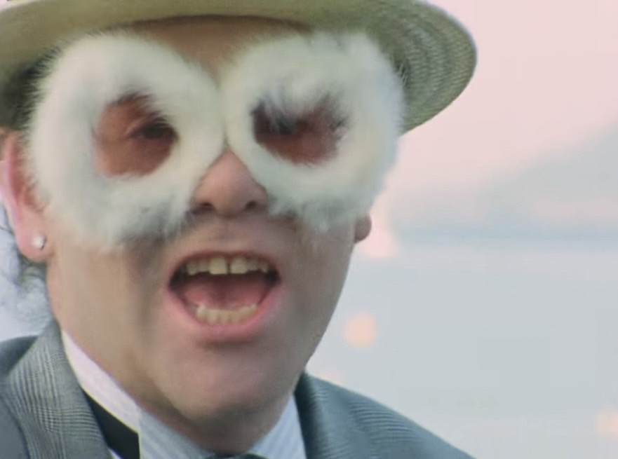
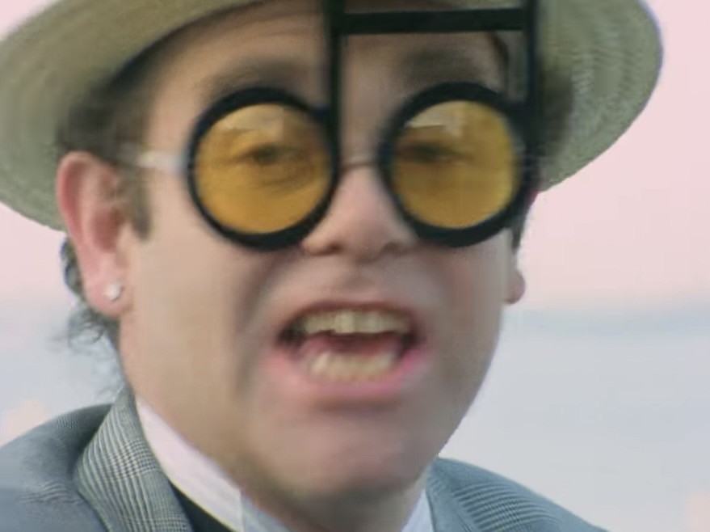
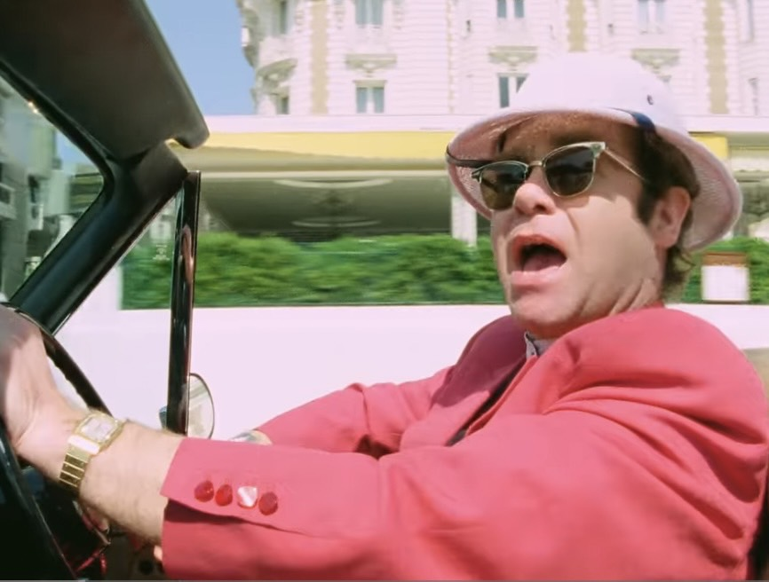
Quiz
How many kind of glasses in this music video?
1) 5
2) 7
3) 12

Slide 11

Thank you for listening

