Slide 1
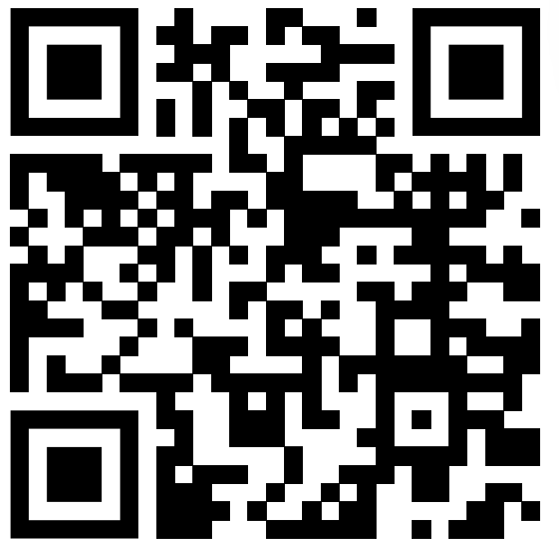
Everything you think you know about addiction is wrong - Johann Hari
I chose this TED TALK, because of two reasons.
Showing a unique perspective toward addictions
Giving you an opportunity how privileged it is to be bound with others

Slide 2
Expressions of “many”
loads of
a lot of
hundreds of thousands of
(massively)
(significantly)

Slide 3

What is addiction
Have you ever “addicted” to something?
And what do you think caused addiction?
It’s horse race for me.
©JRA

Slide 4

What happened in Portugal, where drugs were decriminalized in 2000
Portugal stop spending money on cutting addictions off. Started using it on make addicts reconnected to society.
1% of population was addicted to drugs→
①10％ ↑ ④no change
②30％ ↑ ⑤10% ↓
③50％ ↑ ⑥30% ↓ ⑦50%↓

Slide 5
The last words of presentation
For 100 years now, we've been singing war songs about addicts. I think all along we should have been singing love songs to them, because
the opposite of addiction is not sobriety. The opposite of addiction is connection.

