Slide 1





Everything You Think You Know About Addiction Is Wrong
Johann Hari
2025 . 11 . 09
https://www. ted. com/talks/johann_hari_everything_you_think_you_know_about_
addiction_is_wrong

Slide 2
Table of contents
01 The Reasons Why I Chose this Topic
02
Vocabulary ＆ the Grammar Development
03
Engaging Questions
04
Fun Activity

Slide 3
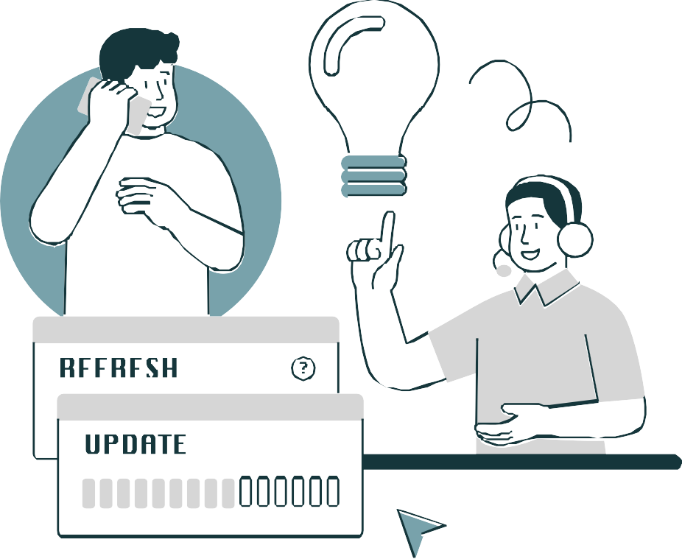
1
The Reasons Why I Chose this Topic
3

Slide 4

The reasons
Infographic Sample
The reason I chose this topic is that I’m aware that I also live with some bad addictions. By learning about the theme of addiction, I wanted to better understand my own addictions. In this TED Talk, drug addiction is discussed, but I can think of many things I’m personally addicted to, such as smartphones, junk food, and caffeine. I believe many other students can also relate to this.
Why do we reach out for “bad addictions” even when we know they are harmful? I would like us to think together about the thoughts that lead us to addiction, and how we can face ourselves when we are harmed by it.
4

Slide 5
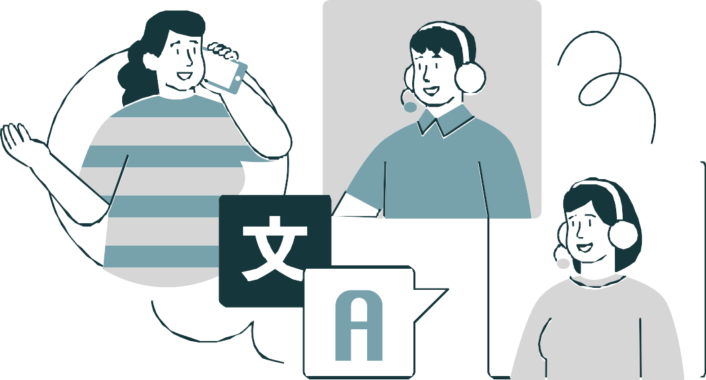
Vocabulary ＆ the
Grammar Development
2
5

Slide 6


Vocabulary ＆ the Grammar Development
<Vocabulary>
Junkie: A
person who is addicted to drugs,
especially illegal drugs such as heroin, cocaine, or
marijuana.
Get drunk: To become intoxicated by alcohol and be unable to stay sober.
Shape up: To improve behavior, performance, or attitude and begin to do good things.
6

Slide 7

Vocabulary ＆ the Grammar Development
<Expression> <Grammar>
“ Because the addicts were s inging love songs to
“The opposite of addiction is not sobriety. The
opposite of addiction is connection.”
them, not war songs against them.”
Metaphor:
Syntax:
Singing f ight songs: A metaphor for punishing,
The opposite of A is not B. The opposite of A is C.
attacking, and criticizing.
Singing love songs: A metaphor for accepting people and offering warm support.
The nuance: " Treat addicts with love, not hostility.

Slide 8
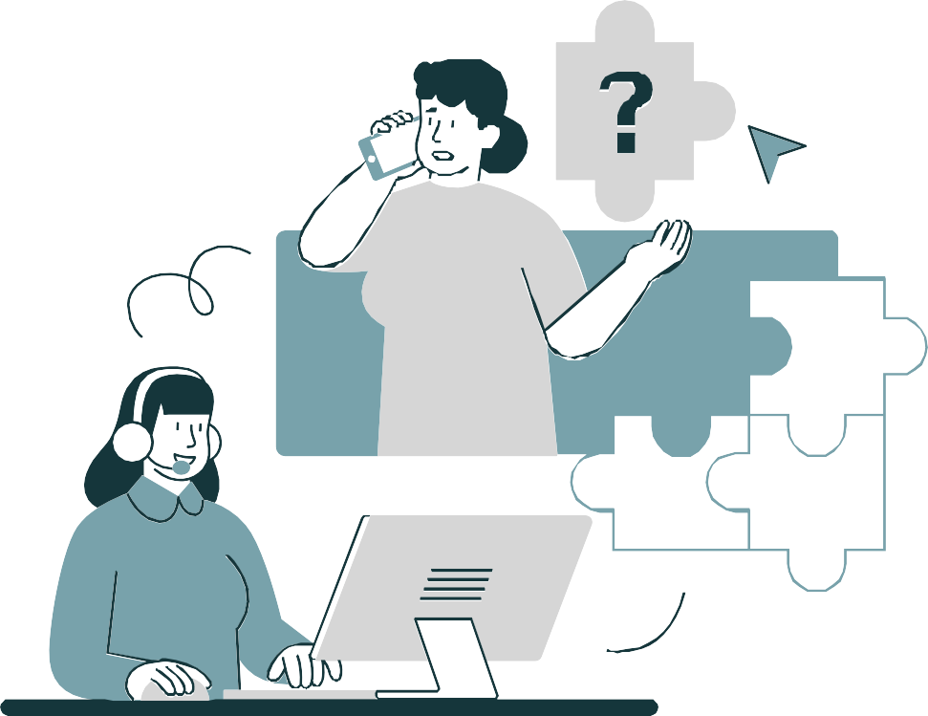
3
Engaging Questions

Slide 9


Engaging Questions
Q1. What causes people to become addicted to bad things (drugs, etc.)?
Q2. What solutions are needed to break free from bad addictions?
Q3. Has the problem of bad addiction surfaced in Japan?
9

Slide 10
My Answer
A1. I believe that the main cause of harmful addiction is the environment in which a person grows up. For example, in a poor family, drugs might be used as a way to ease hunger. Some people may have relatives who are already addicted, which makes them feel less resistance toward drugs. Others may have access to drugs through friends from an early age.
A2. To overcome addiction, I think it’s important to spend more time reflecting on yourself and learn to see your own dependence objectively. However, this is not something that can be done alone. That’s why we need people who can notice when we are going off track and help us return to the right path. Building trusting relationships with people you can rely on
—and who can rely on you—is essential.
A3. In Japan, the problem of harmful addiction has also become more visible, especially among young people. For instance, since around 2020, a group of minors in Shinjuku’s Kabukicho area known as “Toyoko Kids” has drawn media attention for drug-related issues. I believe Japan, too, needs to address the problem of drug addiction as a national issue.

Slide 11

Fun Activity
4
What are you addicted to?
Check your addiction risk level with the f lowchart!

Slide 12
Risk of addiction
Level 1 Level 2 Level 3
Level 4
・Alcohol
・Games
・Smartphones
・Nicotine
・Stimulants (cocaine,
・Fast food
・Caffeine (coffee,
・Gambling
marijuana)
・Supplements
energy drinks)
・Pornography
・Self-harm
・Romance
・Shopping
・Medications (sleeping
・Domestic violence
・Stock and currency
・Snacks
pills, painkillers)
・Parental abuse
investments
・Drug dealing

Slide 13
Fun Activity
Which was your result?
Final Checklist
□Level 1
This is the stage where daily life is slightly affected, but can be controlled with conscious effort.
□Level 2
This is the stage where it becomes difficult to stop on one's own will, and lifestyle habits and relationships begin to be affected.
□Level 3
This is the stage where behavior cannot be controlled, and work, studies, and relationships begin to suffer.
□Level 4
This is the stage where recovery is difficult without medical intervention and support from those around you.

Slide 14


Reference
Information Clarity
Title
Everything You Think You Know About Addiction Is Wrong
Speaker
Johann Hari
  Link
https://www.ted.com/talks/johann_hari_everything_you_think_ you_know_about_addiction_is_wrong
14

Slide 15
THANK YOU!
https://www. ted. com/talks/johann_hari_everything_you_think_you_know_about_addiction_is_wrong
2025 . 11 . 09
6525801 Yo Sato
15

