Slide 1
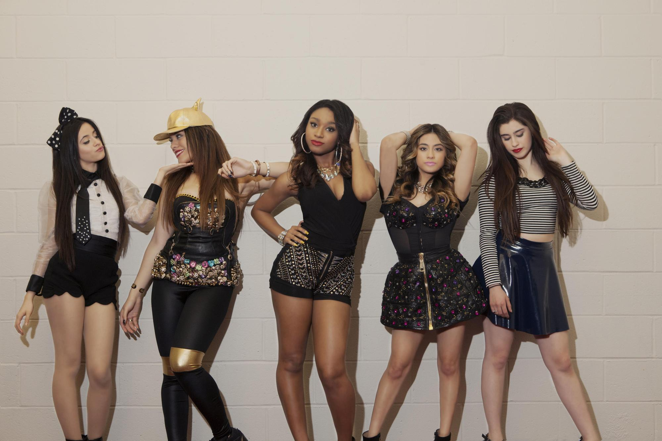

All Female Group2
FASHION COLLECTION
Yuiko
Mami
Futuki
That's My Girl
By Fifth Harmony

Slide 2
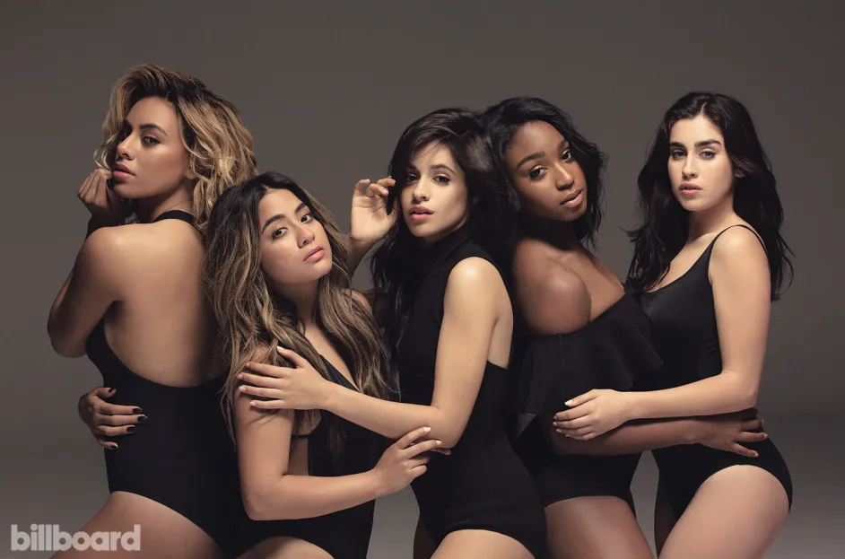
Contents
1.About artist
2.About music
3.Important vocabulary
4. Pronunciation challenge
5.Watching music video ＆ Gap fill quiz
6.Singing challenge
7.Quiz
8.Lyrics scramble

Slide 3
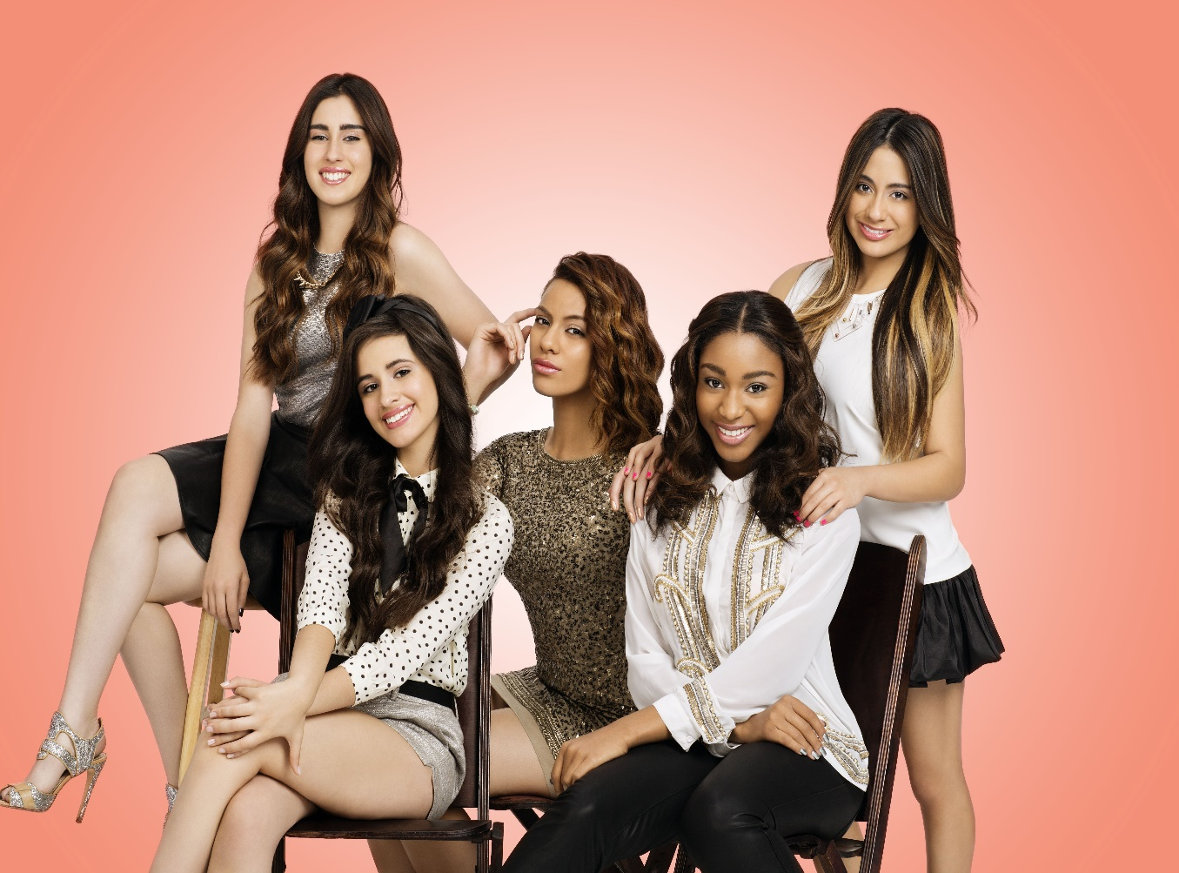
“Fifth Harmony”
★ Formation Year : 2012
★ Member’s Name : Ally Brooke
Normani Kordei
Lauren Jauregui
Dinah Jane
Camila Cabello
★ Genre : Pop , R＆B
★ Hometown : Miami, Florida, U.S.A.

Slide 4
“Fifth Harmony”
Fifth Harmony was born out of Season 2 of the American version of the audition show “The X Factor.
Fifth Harmony is influenced primarily by Demi Lovato, Mariah Carey, Whitney Houston, Spice Girls, and Destiny's Child.
From their debut song, “Miss Movin' On,” they kept on having hits.
We can say that their heyday is 2015~2016.
Their big hits “Worth It” and “Work From Home” are very famous.

Slide 5
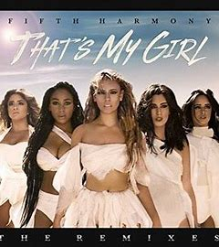
About “That’s My Girl”
Release: 2016
Genre: Pop
Album: sophomore album “7/27”
More Information:
It’s being used for the Olympics or the commercials
or whatever. It’s so female-empowering song.
The biggest attraction of this song is the power of
its lyrics and voice. You can picture of them leading
the way forward strongly .

Slide 6
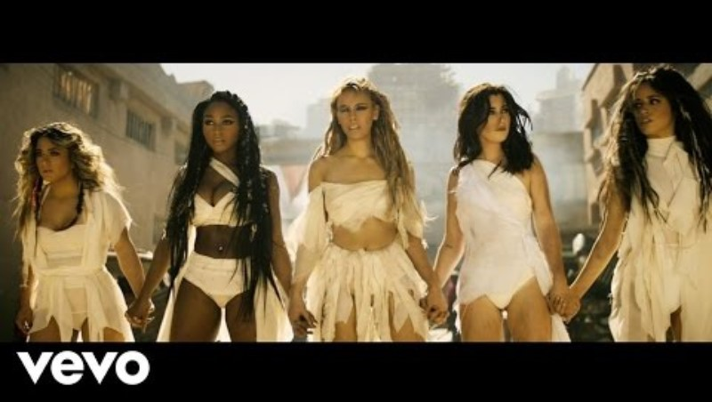
Let’s watch the MV!
https://www.youtube.com/watch?v=sY3rIlrTTh8

Slide 7
Let’s watch the MV!
・There are five woman in the MV.
・They walked through a devastated town; they look like fully confident.
・A woman singing in a cave.
・Five women dancing and singing with a white flag.
・Five woman help people who are injured.
・A woman singing powerfully in a dark and dirty building.
Feel the power!!

Slide 8

Main Concept is …
to cheer someone up
“Cheer someone up” is main concept of this song.
“That's my girl” is often used by parents to children. For example, when your daughter won the first prize at a sports day, you thought "That's my child!" and said "That's my girl!" (That's my boy, of course). In other words, through this song, Fifth Harmony is encouraging women all over the world.

Slide 9
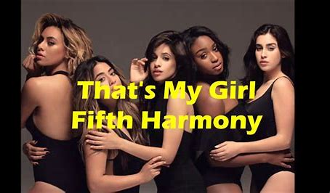
Important Vocabulary
〈who's been working so damn hard〉
In today's society, women spend their days working just as hard as men.
〈That’s my girl〉
That's my girl is an idiomatic expression.
Fifth Harmony sings on behalf of all women in the world in this song.
In other words, women all over the world are like Fifth Harmony's children.
That's why you're you! That's who you are!
This is the meaning of the short phrase “that's my girl” in the song.

Slide 10
Pronunciation challenge
Who’s been working so damn hard you
got that head on overload
Got yourself this flawless body aching now from head to toe

Slide 11
Watch the MV with Gap fill quiz
https://www.youtube.com/watch?v=sY3rIlrTTh8

Slide 12


Gap fill quiz answer
[Intro: Camila]
That's my girl
[Verse 1: Ally, Ally & Camila]
Yeah, who's been working so damn hard?
You got that overload?
this flawless body
Achin' now from head to toe
[Refrain: Normani, Ally, Dinah & All]
Ain't nothin', ain't nothin' (Ooh, ah)
All my ladies 'round the world
Ain't nothin', ain't nothin' (Ooh, ah)
Good girls better get bad
[Pre-Chorus: Lauren & Camila]
You've been down before
You've been hurt before
You --- -- before
You'll be good to go, good to go
[Chorus: Normani & Lauren]
Destiny said it, you got to --- -- and ---- --
Get mad independent and don’t you ever forget it
Got some dirt on your shoulder, then let me brush it off for ya
If you're feeling me, --- ---- five high
That's my girl
[Post-Chorus: All, Ally, Camila & Lauren]
That's my girl
That's my girl
That's my girl (Get up)
What you ------- for?
That's my girl
That's my girl (That's my girl)
That's my girl (My girl)
[Interlude: Camila]
That's my girl
Nah
[Verse 2: Dinah, Dinah & Camila, Lauren, Camila]
Nod if you've been played by every boo
Just tryna ---- --- off (Yeah)
Thought he was the best you ever had
Until he --- --- off
[Refrain: Normani, Ally, Dinah & All]
Ain't nothin', ain't nothin' (Ooh, ah)
--- ---, --- --- know your worth
Ain't nothin', ain't nothin' (Ooh, ah)
Good girls better get bad
[Pre-Chorus: Lauren & Camila, Dinah]
You've been down before (Oh)
You've been hurt before (Oh)
You --- -- before
You'll be good to go, good to go
[Chorus: Normani, Camila & Lauren]
Destiny ---- --, you got to get up and get it (Get up and get it)
Get mad independent and don't you ever forget it (Don't you ever forget it)
Got some ---- -- your shoulder, then let me brush it off for ya
If you're feeling me, put your five high (If you're feeling me, put your five high)
That's my girl (That's my girl)
[Post-Chorus: All & Camila]
That's my girl
That's my girl
That's my girl
What you ----, what you ----, what you ------- for? (For, for)
That's my girl (For, for; Woah)
That's my girl (For, for; That's my girl)
That's my girl (No-oh)
[Pre-Chorus: Lauren & Camila]
You've been down before
You've been hurt before
You got up before
You'll be good to go, good to go
(Baby, get up, no, no, oh)
[Chorus: Dinah & Lauren, Camila, Dinah & Ally, Dinah]
Destiny said it, you got to get up and get it
Get mad independent and ----- --- ever forget it (Don't you ever forget it)
Got some dirt on your shoulder, let me ----- -- off for ya
If you're feeling me, put your five high
That's my girl, woah, woah
[Post-Chorus: All, Camila, Lauren & Dinah]
That's my girl
That's my girl (That's my girl)
That's my girl
What you wait, what you wait, what you waitin' for? (For, for)
That's my girl (For, for)
That's my girl (For, for)
That's my girl
(That's my girl, that's my girl, that's my girl)
[Bridge: Normani, Lauren & Camila]
Ain't nothin', ain't nothin'
Ain't nothin', put your heart and your soul -- --
Ain't nothin', ain't nothin' (Ain't nothin')
Ain't nothin', put your heart and your soul -- -- (Yeah, yeah)
[Post-Bridge: All & Camila]
(For, for)
That's my girl (For, for)
head on
Got yourself

Slide 13

Gap fill quiz answer
[Pre-Chorus: Lauren & Camila]
You've been down before
You've been hurt before
You before
You'll be good to go, good to go
[Chorus: Normani & Lauren]
Destiny said it, you got to and
Get mad independent and don’t you ever forget it
Got some dirt on your shoulder, then let me brush it off for ya
If you're feeling me, five high
That's my girl
[Post-Chorus: All, Ally, Camila & Lauren]
That's my girl
That's my girl
That's my girl (Get up)
What you ------- for?
That's my girl
That's my girl (That's my girl)
That's my girl (My girl)
[Interlude: Camila]
That's my girl
Nah
[Verse 2: Dinah, Dinah & Camila, Lauren, Camila]
Nod if you've been played by every boo
Just tryna ---- --- off (Yeah)
Thought he was the best you ever had
Until he --- --- off
[Refrain: Normani, Ally, Dinah & All]
Ain't nothin', ain't nothin' (Ooh, ah)
--- ---, --- --- know your worth
Ain't nothin', ain't nothin' (Ooh, ah)
Good girls better get bad
[Pre-Chorus: Lauren & Camila, Dinah]
You've been down before (Oh)
You've been hurt before (Oh)
You --- -- before
You'll be good to go, good to go
[Chorus: Normani, Camila & Lauren]
Destiny ---- --, you got to get up and get it (Get up and get it)
Get mad independent and don't you ever forget it (Don't you ever forget it)
Got some ---- -- your shoulder, then let me brush it off for ya
If you're feeling me, put your five high (If you're feeling me, put your five high)
That's my girl (That's my girl)
[Post-Chorus: All & Camila]
That's my girl
That's my girl
That's my girl
What you ----, what you ----, what you ------- for? (For, for)
That's my girl (For, for; Woah)
That's my girl (For, for; That's my girl)
That's my girl (No-oh)
[Pre-Chorus: Lauren & Camila]
You've been down before
You've been hurt before
You got up before
You'll be good to go, good to go
(Baby, get up, no, no, oh)
[Chorus: Dinah & Lauren, Camila, Dinah & Ally, Dinah]
Destiny said it, you got to get up and get it
Get mad independent and ----- --- ever forget it (Don't you ever forget it)
Got some dirt on your shoulder, let me ----- -- off for ya
If you're feeling me, put your five high
That's my girl, woah, woah
[Post-Chorus: All, Camila, Lauren & Dinah]
That's my girl
That's my girl (That's my girl)
That's my girl
What you wait, what you wait, what you waitin' for? (For, for)
That's my girl (For, for)
That's my girl (For, for)
That's my girl
(That's my girl, that's my girl, that's my girl)
[Bridge: Normani, Lauren & Camila]
Ain't nothin', ain't nothin'
Ain't nothin', put your heart and your soul -- --
Ain't nothin', ain't nothin' (Ain't nothin')
Ain't nothin', put your heart and your soul -- -- (Yeah, yeah)
[Post-Bridge: All & Camila]
(For, for)
That's my girl (For, for)
got up
get up
get it
put your

Slide 14
Gap fill quiz answer
[Post-Chorus: All, Ally, Camila & Lauren]
That's my girl
That's my girl
That's my girl (Get up)
What you for?
That's my girl
That's my girl (That's my girl)
That's my girl (My girl)
[Interlude: Camila]
That's my girl
Nah
[Verse 2: Dinah, Dinah & Camila, Lauren, Camila]
Nod if you've been played by every boo
Just tryna ---- --- off (Yeah)
Thought he was the best you ever had
Until he --- --- off
[Refrain: Normani, Ally, Dinah & All]
Ain't nothin', ain't nothin' (Ooh, ah)
--- ---, --- --- know your worth
Ain't nothin', ain't nothin' (Ooh, ah)
Good girls better get bad
[Pre-Chorus: Lauren & Camila, Dinah]
You've been down before (Oh)
You've been hurt before (Oh)
You --- -- before
You'll be good to go, good to go
[Chorus: Normani, Camila & Lauren]
Destiny ---- --, you got to get up and get it (Get up and get it)
Get mad independent and don't you ever forget it (Don't you ever forget it)
Got some ---- -- your shoulder, then let me brush it off for ya
If you're feeling me, put your five high (If you're feeling me, put your five high)
That's my girl (That's my girl)
[Post-Chorus: All & Camila]
That's my girl
That's my girl
That's my girl
What you ----, what you ----, what you ------- for? (For, for)
That's my girl (For, for; Woah)
That's my girl (For, for; That's my girl)
That's my girl (No-oh)
[Pre-Chorus: Lauren & Camila]
You've been down before
You've been hurt before
You got up before
You'll be good to go, good to go
(Baby, get up, no, no, oh)
[Chorus: Dinah & Lauren, Camila, Dinah & Ally, Dinah]
Destiny said it, you got to get up and get it
Get mad independent and ----- --- ever forget it (Don't you ever forget it)
Got some dirt on your shoulder, let me ----- -- off for ya
If you're feeling me, put your five high
That's my girl, woah, woah
[Post-Chorus: All, Camila, Lauren & Dinah]
That's my girl
That's my girl (That's my girl)
That's my girl
What you wait, what you wait, what you waitin' for? (For, for)
That's my girl (For, for)
That's my girl (For, for)
That's my girl
(That's my girl, that's my girl, that's my girl)
[Bridge: Normani, Lauren & Camila]
Ain't nothin', ain't nothin'
Ain't nothin', put your heart and your soul -- --
Ain't nothin', ain't nothin' (Ain't nothin')
Ain't nothin', put your heart and your soul -- -- (Yeah, yeah)
[Post-Bridge: All & Camila]
(For, for)
That's my girl (For, for)
Waitin’

Slide 15
Gap fill quiz answer
Verse 2: Dinah, Dinah & Camila, Lauren, Camila]
Nod if you've been played by every boo
Just trying off (Yeah)
Thought he was the best you ever had
Until he off
[Refrain: Normani, Ally, Dinah & All]
Ain't nothin', ain't nothin' (Ooh, ah)
, know your worth
Ain't nothin', ain't nothin' (Ooh, ah)
Good girls better get bad
[Pre-Chorus: Lauren & Camila, Dinah]
You've been down before (Oh)
You've been hurt before (Oh)
You before
You'll be good to go, good to go
[Chorus: Normani, Camila & Lauren]
Destiny ---- --, you got to get up and get it (Get up and get it)
Get mad independent and don't you ever forget it (Don't you ever forget it)
Got some ---- -- your shoulder, then let me brush it off for ya
If you're feeling me, put your five high (If you're feeling me, put your five high)
That's my girl (That's my girl)
[Post-Chorus: All & Camila]
That's my girl
That's my girl
That's my girl
What you ----, what you ----, what you ------- for? (For, for)
That's my girl (For, for; Woah)
That's my girl (For, for; That's my girl)
That's my girl (No-oh)
[Pre-Chorus: Lauren & Camila]
You've been down before
You've been hurt before
You got up before
You'll be good to go, good to go
(Baby, get up, no, no, oh)
[Chorus: Dinah & Lauren, Camila, Dinah & Ally, Dinah]
Destiny said it, you got to get up and get it
Get mad independent and ----- --- ever forget it (Don't you ever forget it)
Got some dirt on your shoulder, let me ----- -- off for ya
If you're feeling me, put your five high
That's my girl, woah, woah
[Post-Chorus: All, Camila, Lauren & Dinah]
That's my girl
That's my girl (That's my girl)
That's my girl
What you wait, what you wait, what you waitin' for? (For, for)
That's my girl (For, for)
That's my girl (For, for)
That's my girl
(That's my girl, that's my girl, that's my girl)
[Bridge: Normani, Lauren & Camila]
Ain't nothin', ain't nothin'
Ain't nothin', put your heart and your soul -- --
Ain't nothin', ain't nothin' (Ain't nothin')
Ain't nothin', put your heart and your soul -- -- (Yeah, yeah)
[Post-Bridge: All & Camila]
(For, for)
That's my girl (For, for)
to show
cut you
Bet you
bet you
got up

Slide 16
Gap fill quiz answer
[Chorus: Normani, Camila & Lauren]
Destiny , you got to get up and get it (Get up and get it)
Get mad independent and don't you ever forget it (Don't you ever forget it)
Got some your shoulder, then let me brush it off for ya
If you're feeling me, put your five high (If you're feeling me, put your five high)
That's my girl (That's my girl)
[Post-Chorus: All & Camila]
That's my girl
That's my girl
That‘s my girl
What you , what you , what you for? (For, for)
That's my girl (For, for; Woah)
That's my girl (For, for; That's my girl)
That's my girl (No-oh)
[Pre-Chorus: Lauren & Camila]
You've been down before
You've been hurt before
You got up before
You'll be good to go, good to go
(Baby, get up, no, no, oh)
[Chorus: Dinah & Lauren, Camila, Dinah & Ally, Dinah]
Destiny said it, you got to get up and get it
Get mad independent and ----- --- ever forget it (Don't you ever forget it)
Got some dirt on your shoulder, let me ----- -- off for ya
If you're feeling me, put your five high
That's my girl, woah, woah
[Post-Chorus: All, Camila, Lauren & Dinah]
That's my girl
That's my girl (That's my girl)
That's my girl
What you wait, what you wait, what you waitin' for? (For, for)
That's my girl (For, for)
That's my girl (For, for)
That's my girl
(That's my girl, that's my girl, that's my girl)
[Bridge: Normani, Lauren & Camila]
Ain't nothin', ain't nothin'
Ain't nothin', put your heart and your soul -- --
Ain't nothin', ain't nothin' (Ain't nothin')
Ain't nothin', put your heart and your soul -- -- (Yeah, yeah)
[Post-Bridge: All & Camila]
(For, for)
That's my girl (For, for)
said it
dirt on
wait
wait
waiting

Slide 17
Gap fill quiz answer
[Pre-Chorus: Lauren & Camila]
You've been down before
You've been hurt before
You got up before
You'll be good to go, good to go
(Baby, get up, no, no, oh)
[Chorus: Dinah & Lauren, Camila, Dinah & Ally, Dinah]
Destiny said it, you got to get up and get it
Get mad independent and ever forget it (Don't you ever forget it)
Got some dirt on your shoulder, let me off for ya
If you're feeling me, put your five high
That's my girl, woah, woah
[Post-Chorus: All, Camila, Lauren & Dinah]
That's my girl
That's my girl (That's my girl)
That's my girl
What you wait, what you wait, what you waitin' for? (For, for)
That's my girl (For, for)
That's my girl (For, for)
That's my girl
(That's my girl, that's my girl, that's my girl)
[Bridge: Normani, Lauren & Camila]
Ain't nothin', ain't nothin'
Ain't nothin', put your heart and your soul -- --
Ain't nothin', ain't nothin' (Ain't nothin')
Ain't nothin', put your heart and your soul -- -- (Yeah, yeah)
[Post-Bridge: All & Camila]
(For, for)
That's my girl (For, for)
Don’t you
brush it

Slide 18

Gap fill quiz answer
[Post-Chorus: All, Camila, Lauren & Dinah]
That's my girl
That's my girl (That's my girl)
That's my girl
What you wait, what you wait, what you waitin' for? (For, for)
That's my girl (For, for)
That's my girl (For, for)
That's my girl
(That's my girl, that's my girl, that's my girl)
[Bridge: Normani, Lauren & Camila]
Ain't nothin', ain't nothin'
Ain't nothin', put your heart and your soul
Ain't nothin', ain't nothin' (Ain't nothin')
Ain't nothin', put your heart and your soul (Yeah, yeah)
[Post-Bridge: All & Camila]
(For, for)
That's my girl (For, for)
in it
in it

Slide 19
Singing challenge
Destiny said it, you got to get up and get it
Get mad independent ,and don’t you ever forget it
Got some dirt on your shoulder, then let me brush it off for ya
If you’(re) feeling me, put your five high
That's my girl
y

Slide 20
Quiz 1
What is their debut song?
1
2
Work from Home
Miss Movin’ On
3
4
That’s My Girl
Worth it
Notes:
Miss Movin' On

Slide 21
Quiz 1
What is their debut song?
1
2
Work from Home
Miss Movin’ On
3
4
That’s My Girl
Worth it
Notes:
Miss Movin' On

Slide 22
Quiz 2
What is Main concept of this song?
1
2
To go to trip
To be a famous
3
4
To do exercise
To cheer someone up

Slide 23
Quiz 2
What is Main concept of this song?
1
2
To go to trip
To be a famous
3
4
To do exercise
To cheer someone up

Slide 24
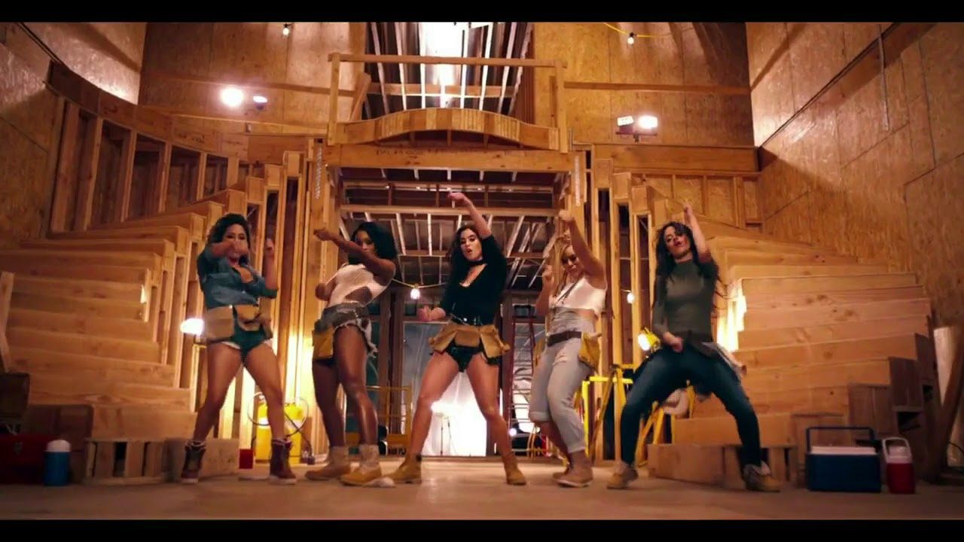
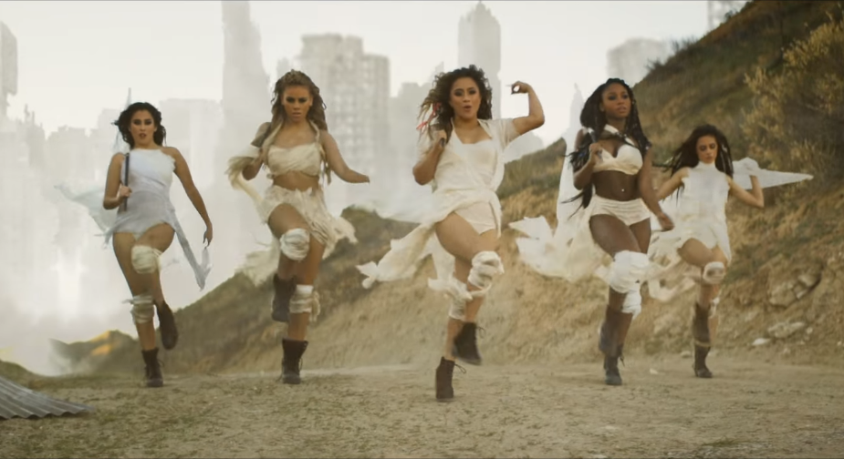
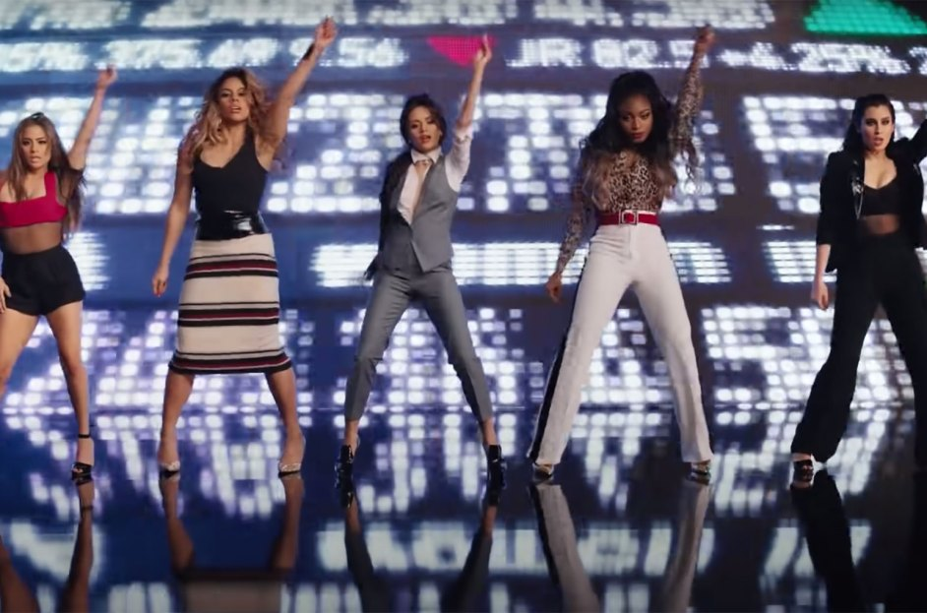
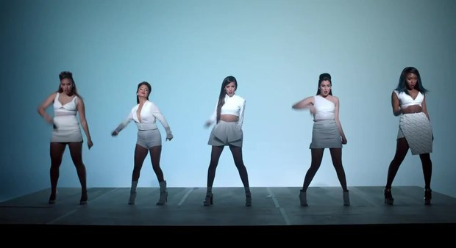
Quiz 3
Which is the music video for this song?
1
2
3
4

Slide 25
Quiz 3
Which is the music video for this song?
1
2
3
4

Slide 26
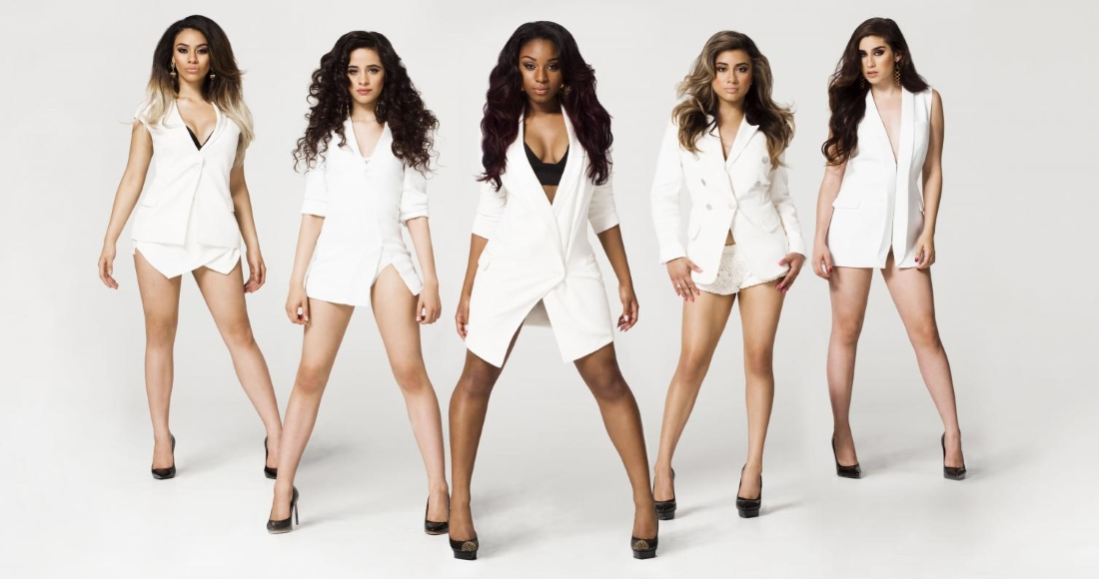
Quiz scramble
Q1.（some,your,me,it,on,got,shoulder,then,dirt,let,brush,off）
Q2.(said,up,you,it, it,destiny,to,get,got,get,and)
Q3. (If,are,you,your,me,put,feeling,five,high )

Slide 27
Quiz scramble
Q1.Got some dirt on your shoulder, then let me brush it off
Q2.Destiny said it, you got to get up and get it
Q3. If you are feeling me, put your five high

Slide 28


Review Filler
We’ll give 5 stars for this song!! We definitely want you to listen to this song!
As for the music video...it's like a movie.
It is a very American music video with overwhelming visual beauty and power.
And the lyrical content is very encouraging, especially for women!

Slide 29
Thank you
for lisning!!

