Slide 1

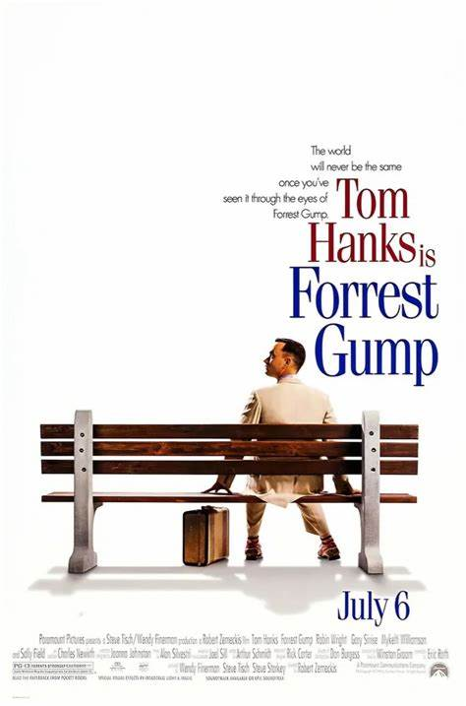
https://www.youtube.com/watch?v=LZK5VRuUfEY

Slide 2
The two reasons I chose that video are…
The movie let you understand American history through Gump’s life.
His simple English helps our understanding of the content

Slide 3
CONTEXT
Gump is a simple-minded man. He experienced death of his friends, war, shrimping, etc.
The clip is a scene that he has almost experienced above and has fortune.
What he does all comes down to doing his best and giving his energy to other people.

Slide 4
Match the words
Lieutenant
The Lieutenant Dan said I was nuts.
I was a gazillionaire
only so much fortune a man really needs
A large amount of money or wealth.
A junior commissioned officer rank in the armed forces of many nations. (military rank)
Crazy
A humorous way of saying sb is extremely rich.

Slide 5
Questions on the content
Why the speaker(Forrest Gump) give away a large portion of their wealth?
How did Lieutenant Dan react to the Gump’s actions?

Slide 6
Questions for your further discussions
Do you think wealth should be shared with others as the Gump did?
What are other examples to show their generosity to people in real?

Slide 7
Activities
If you were a billionaire, what would you spend your money on?
What impacts could you have if you do that?

Slide 8
Thank you!

Slide 9
Answers 1
Match the words
  1, b
  2, c
  3, d
  4, a

Slide 10
Answers 2
Why the speaker(Forrest Gump) give away a large portion of their wealth?
  Because he believes a man needs a certain amount of fortune. Using the rest of money, he donated to the church, a hospital.
How did Lieutenant Dan react to the Gump’s actions?
  Gump was nuts

Slide 11
Script
Company, and then I got a call from him saying, "We don't have to worry about money no more." And I said, "That's good, one last thing.“
Now, Mama said there's only so much fortune a man really needs, and the rest is just for showing off. So, I gave a whole bunch of it to the Foursquare Gospel Church, and I gave a whole bunch to the Bayou La Batre fishing hospital.
And even though Bubba was dead, and Lieutenant Dan said I was nuts, I gave Bubba's mama Bubba's share… You know what? She didn't have to work nobody's catching shrimp no more.
And 'cause I was a gazillionaire, and I liked doing it, so…

