Slide 1



Take me out
Franz ferdinand

Slide 2

Now please fill in the blanks

Slide 3
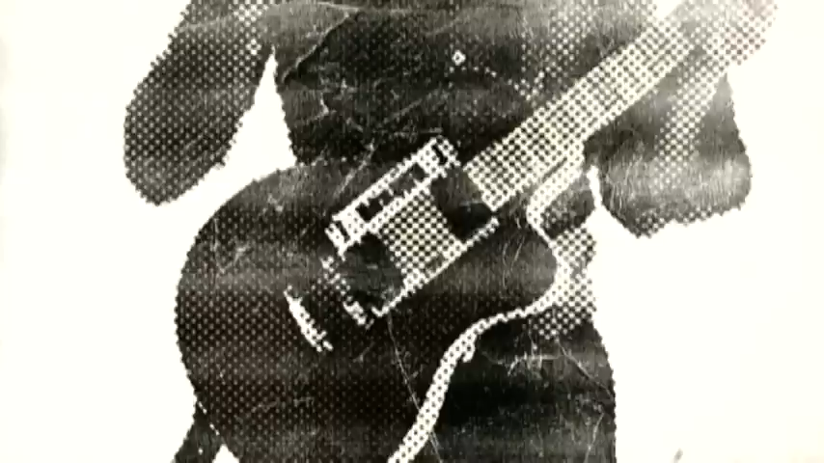

Slide 4











https://www.youtube.com/watch?v=Ijk4j-r7qPA
[INTRO]
So if you’re _________, you know I’m here waiting for you
I’m just a _____________, I’m just a _____________ from you
And if you leave here, you leave me broken, __________ I lie
I’m just a ______________, I’m just a shot, then we can die
Oh, Oh, Oh
I know I _______ be leaving here with you
[Instrumental break]
[Verse 1]
I say, don’t you know?
You say you don’t know
I say: take me out
I say you _________________
Don’t move, time is ________
I say: take me out

Slide 5




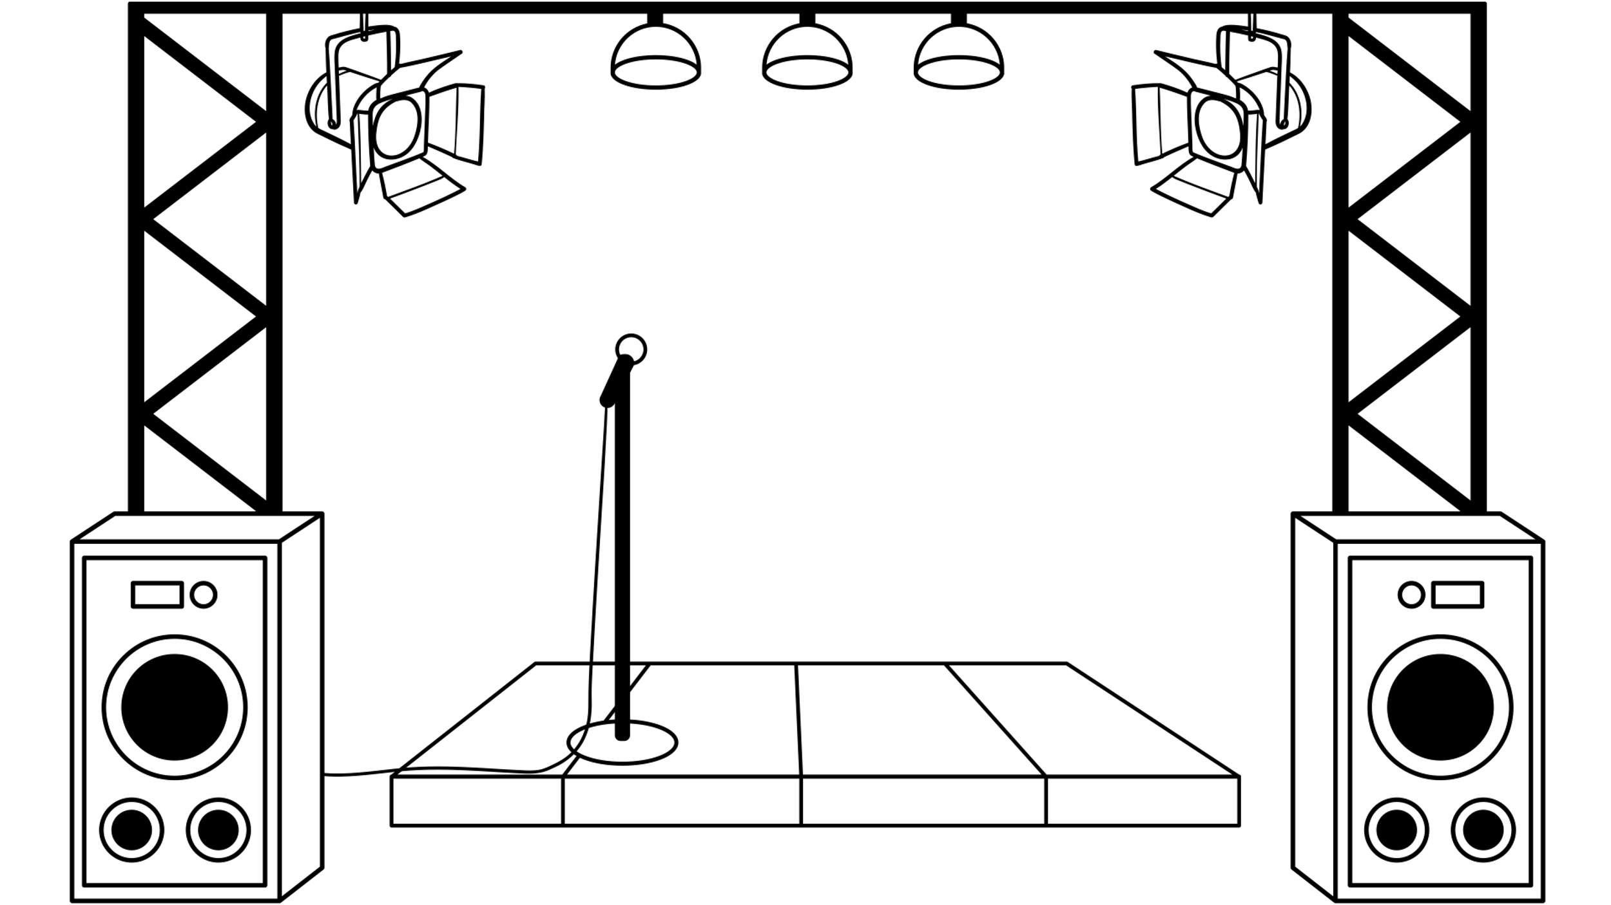




[Verse 2]
Well, I say you don’t know
You say you don’t know
I say: take me out
If I ____________, this could die
I want you to take me out
[Chorus]
I know I won’t be leaving here (With you)
I know I won’t be leaving here
I know I won’t be leaving here (With you)
I know I won’t be leaving here with you

Slide 6






[Verse 3]
I say, don’t you know?
You say you don’t know
I say: take me out
If I _______, this could be die
If I _______, this could be die
I want you to take me out
If I _______, this could be die
_____________, this can die
Come on, take me out
[Chorus]
Words
Take me out-double meanings
1. dating with me 2. killing me
Cross-hair target
Wane weaken

Slide 7
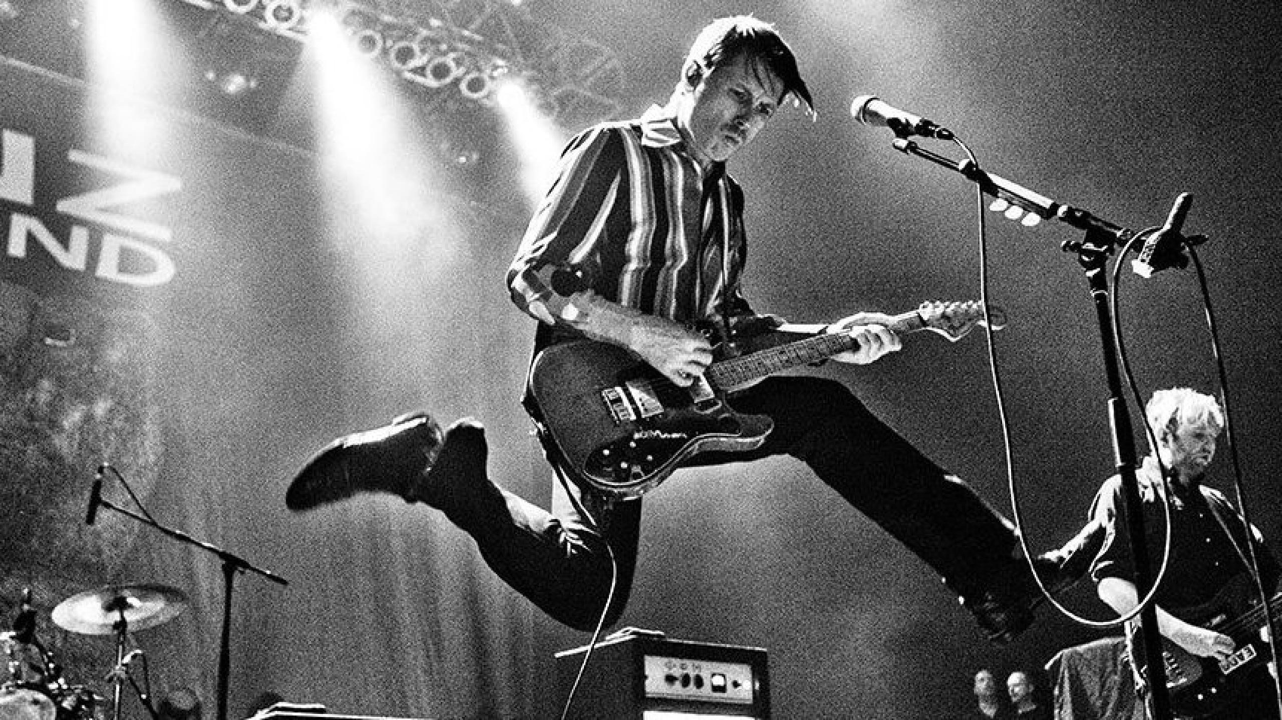
https://www.youtube.com/watch?v=svDU32rmnRo

Slide 8
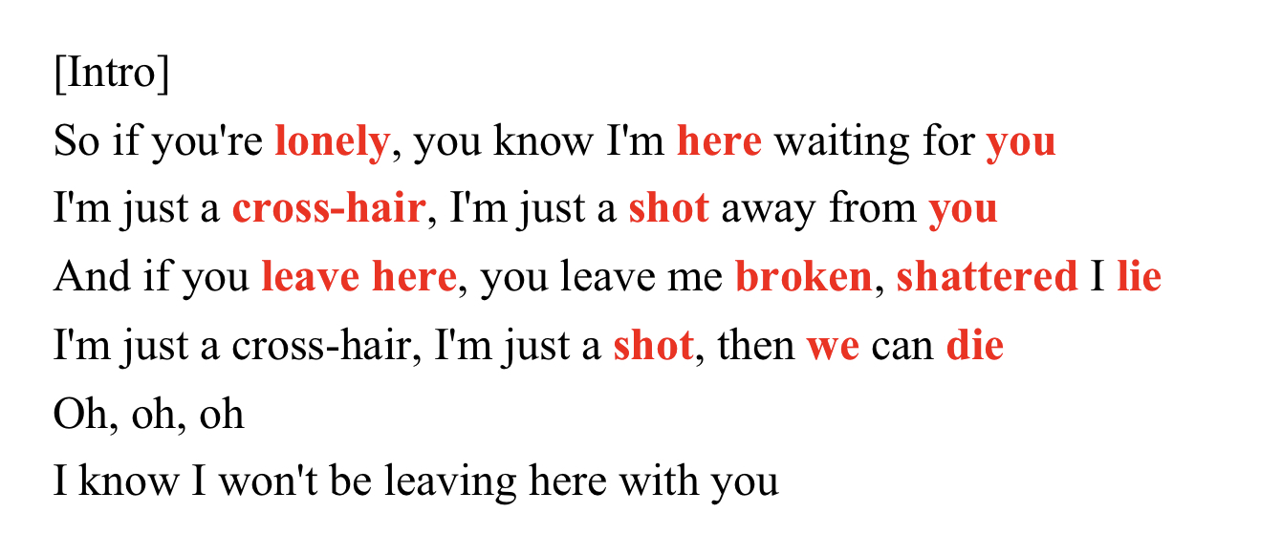

Slide 9
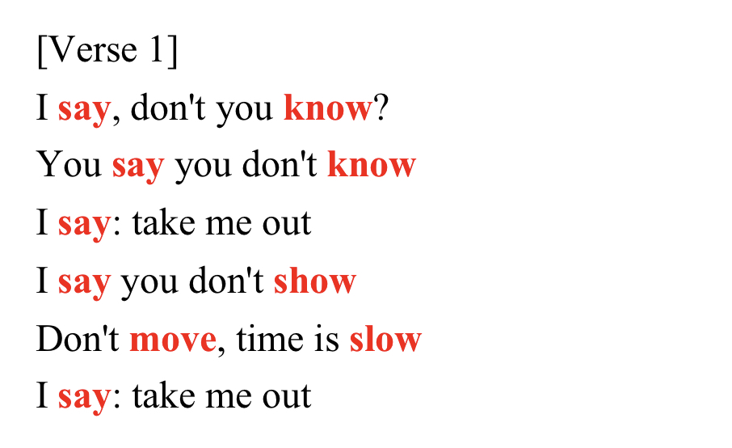


Slide 10
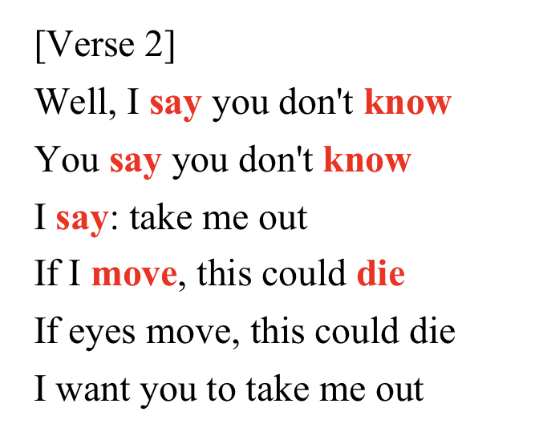
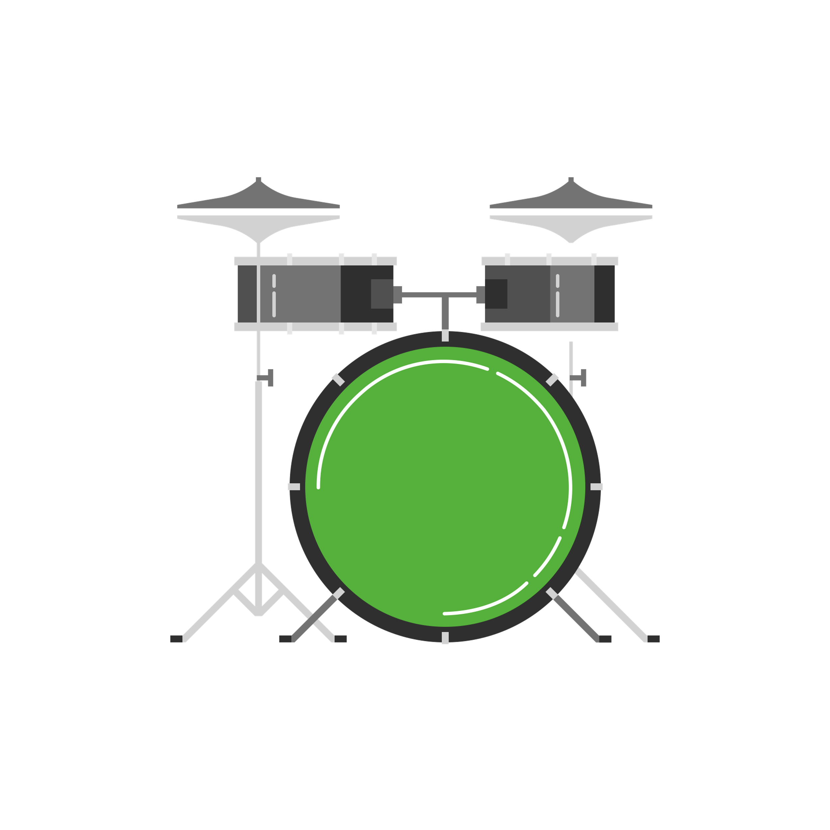

Slide 11
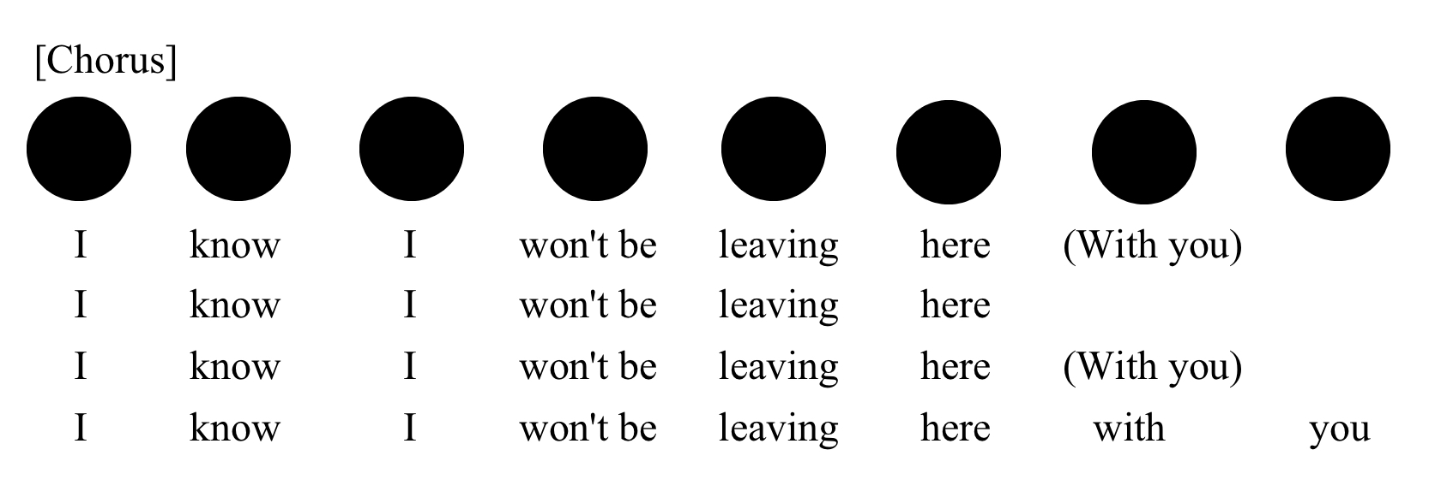


Slide 12
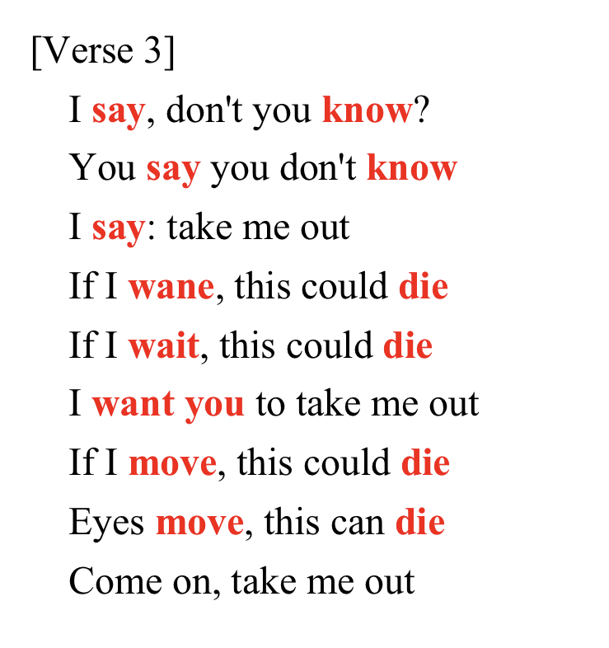


Slide 13
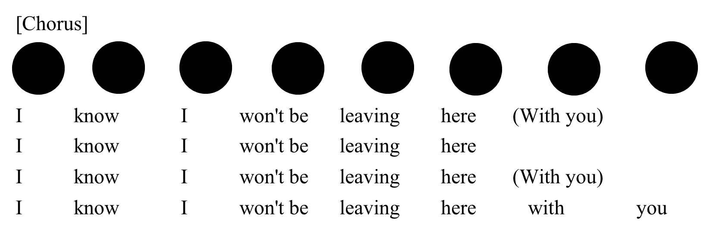


Slide 14

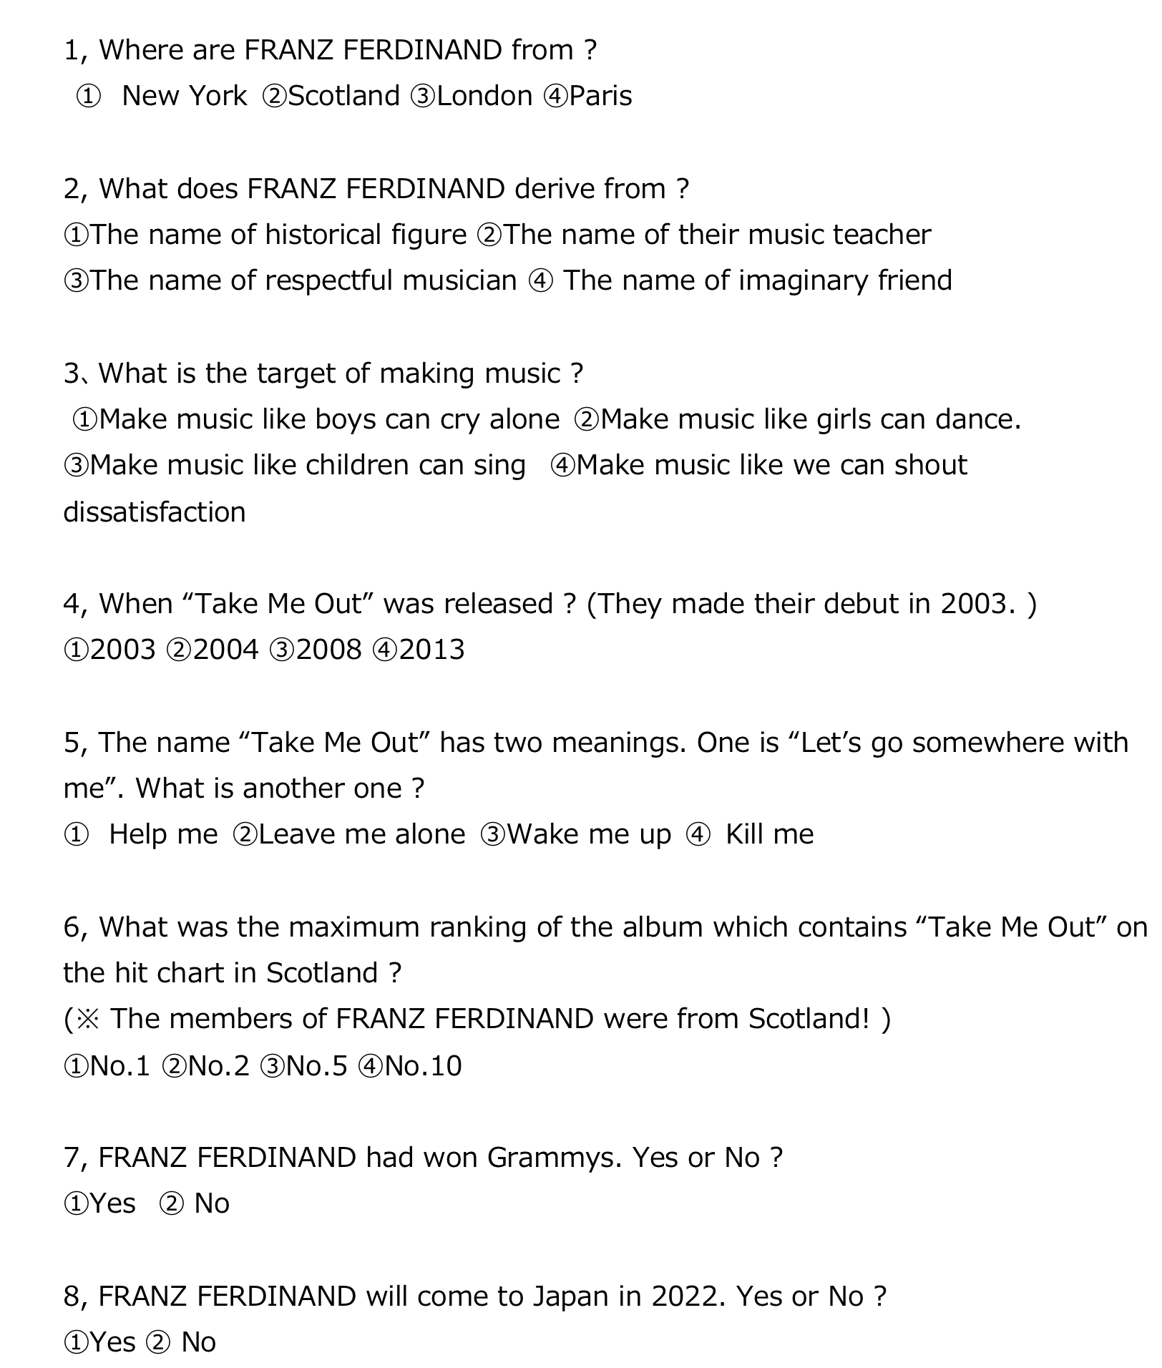

Slide 16
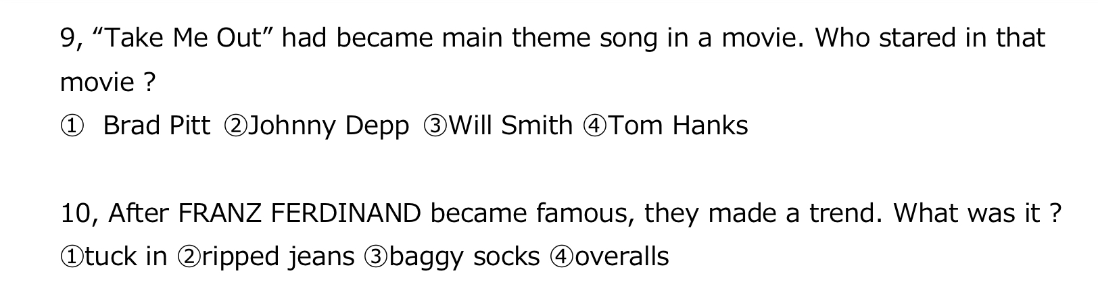

Slide 17



