Slide 1


TAKE ME OUT
SOUTA CHOUNAN
MAMI ENDO
WU JINGYAO

Slide 2
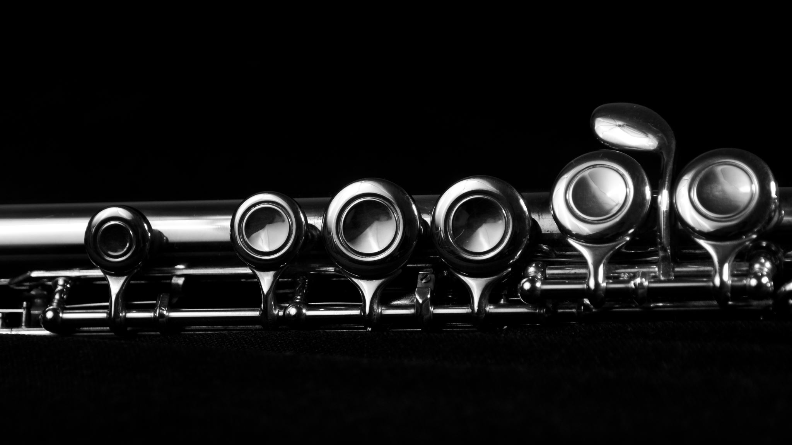
Band’s details

Slide 3
Country: Scotland
Origin Glasgow, Scotland
Genres Rock
Years active 2002–present

Slide 4

TAKE ME OUT

Slide 5
Background of music
At the party, a nice guy is waiting for a lonely girl.The guy can’t act her, but she doesn‘t move him.This song refers to the pride of this boy.
Take Me Out" expresses a strong desire to escape a current situation, with an urgent need to break free, underscored by the song's intense rhythm and structure.

Slide 6
Pronunciation challenge
If I move this could die / Eyes move this can die
[If] skipped
[could die] each “d” is joined
[eyes move] Because of high tempo, two words are packed

Slide 7
Quiz Questions 1
What is genre？
1. Soul
2. Rock
3. Country
4. Funk

Slide 8
Answer
2. Rock

Slide 9
Quiz Questions 2
I ____ don’t you know
Say
Tell
Hear
listen

Slide 10
Answer
1. Say

Slide 11
Quiz Questions 3
When is this song released?
1994
1999
2006
2004

Slide 12
Answer
4. 2004

Slide 13
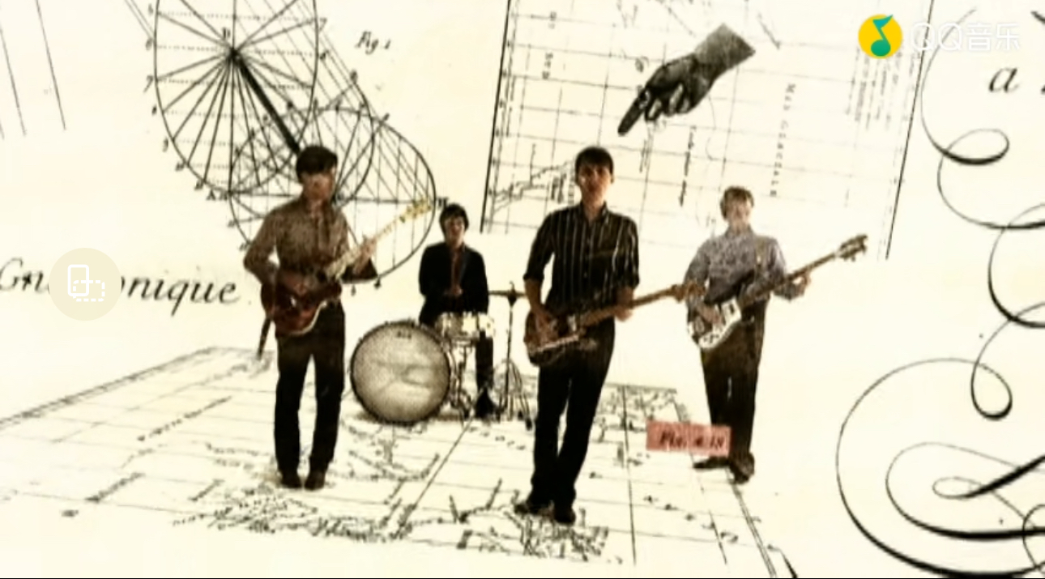
https://www.youtube.com/watch?v=Ijk4j-r7qPA

