Slide 1
Gilmore girls

Slide 2


Why this video?
This is so long TV series and I watch it for improving my listening skill
Their vocabulary level is good for studying
Stories are interesting and they mainly about family love so good to see
Link: https://youtu.be/HnMtWxq997Q?feature=shared
(-2:14)

Slide 3
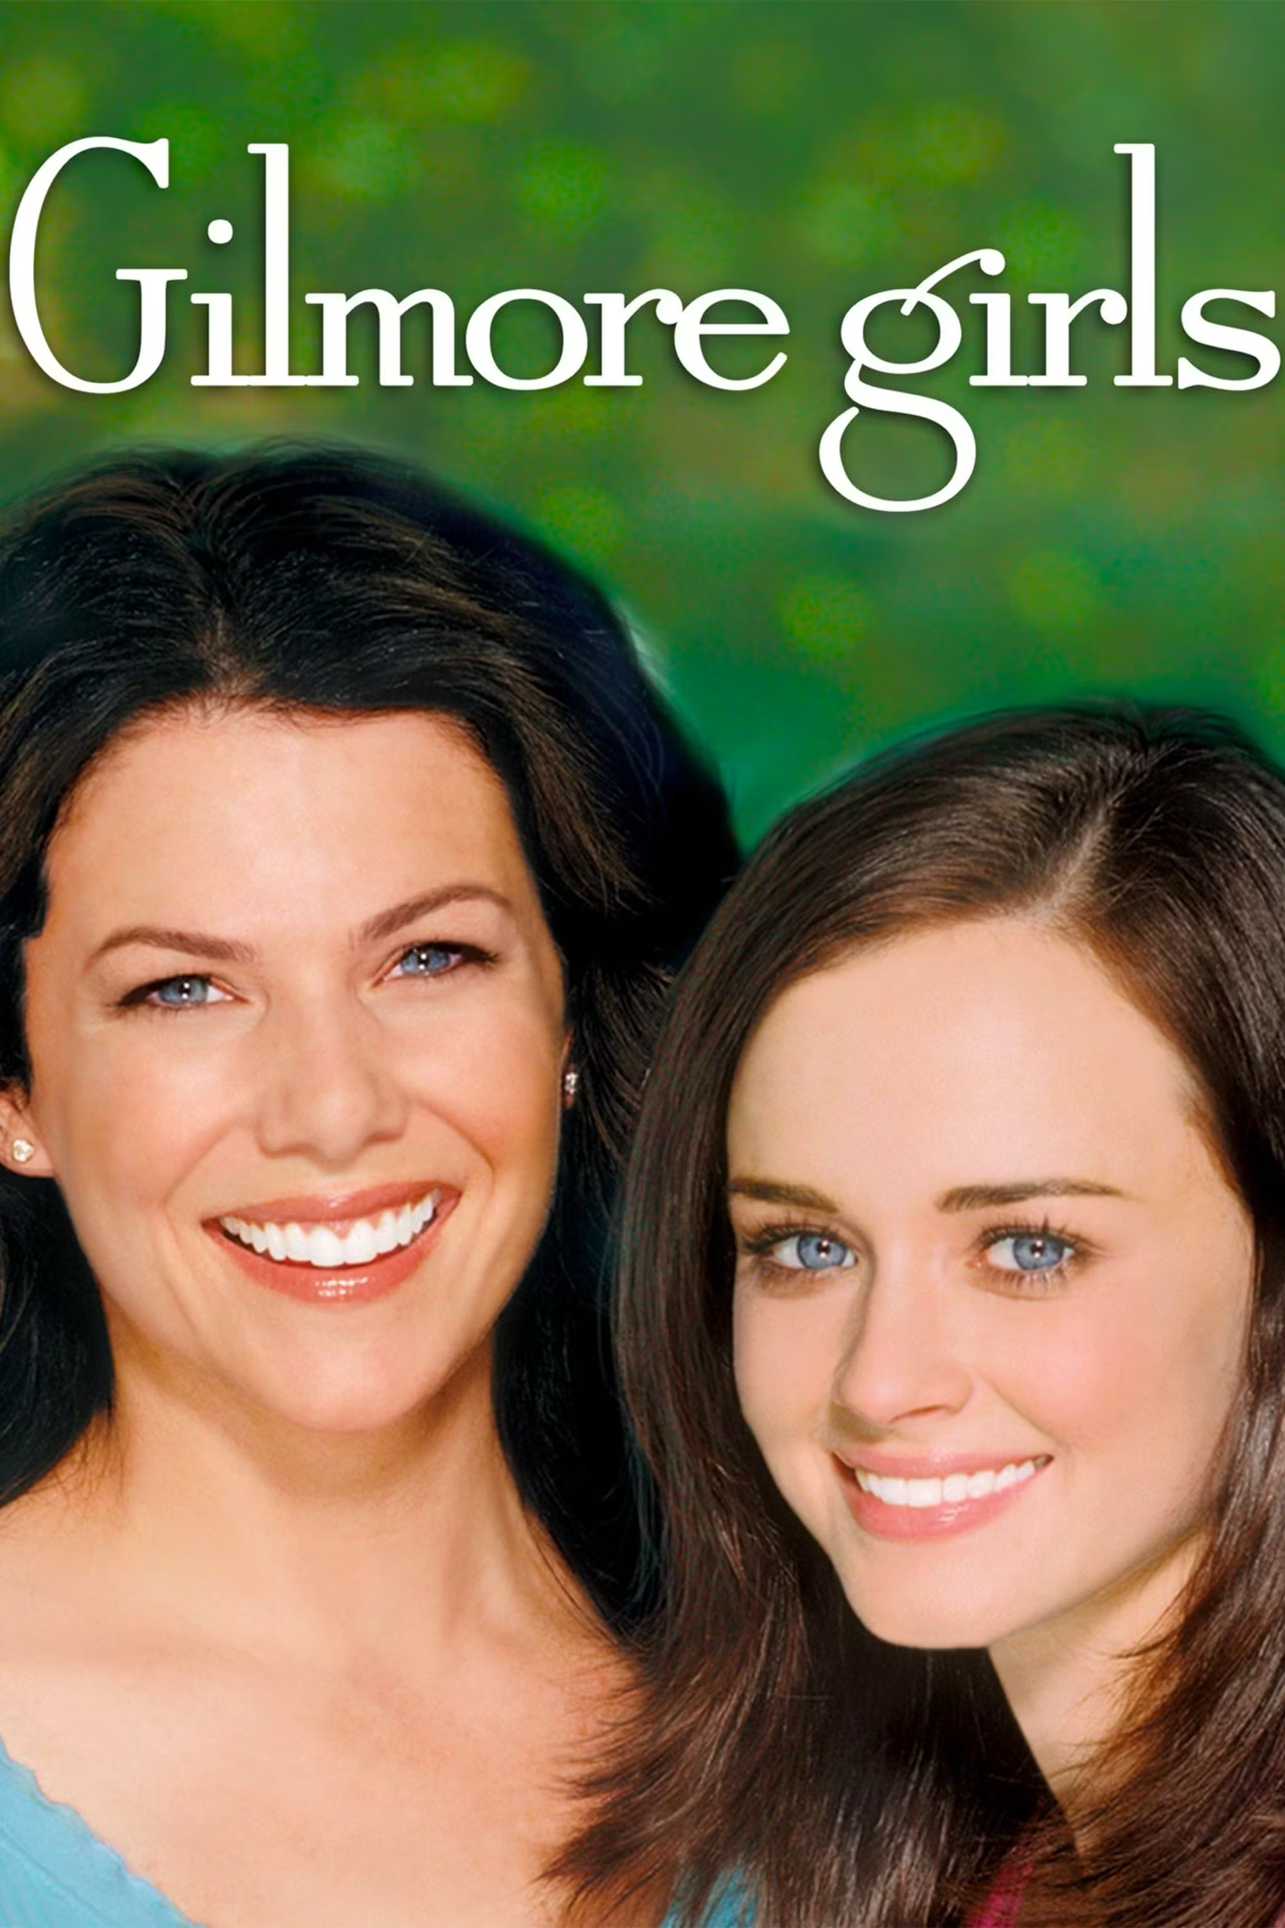
Explanation the drama
Gilmore Girls is a heartwarming drama that follows the close-knit relationship between Lorelai Gilmore and her daughter Rory. Lorelai, a single mother, raised Rory on her own in the small town of Stars Hollow. The series explores their lives as they navigate personal, professional, and familial challenges. Lorelai works as the manager of an inn, while Rory dreams of becoming a journalist. The show also delves into their interactions with quirky town residents, Lorelai's wealthy but distant parents, and Rory’s academic journey at the prestigious Yale University. At its core, "Gilmore Girls" is about family, friendship, and the complexities of growing up.

Slide 4
Engaging questions
Why people are gathered to see Rory and Lorelai?
How was the reaction of Luke?
Do you think Lorelai will get marry with Max?

Slide 5
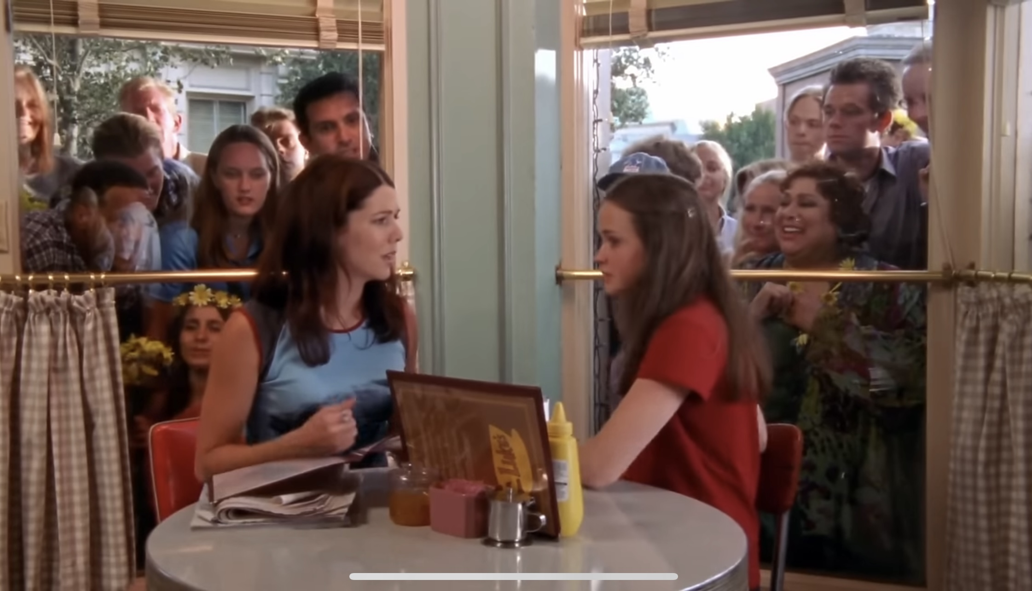
Script
Lorelai : Hmm, let‘s see, What looks good? I’m so hungry, I’m gonna have to order breakfast and lunch.
Rory: Mom,go to tell him.
Lorelai : I will.
Rory: Now.
Lorelai :Why?
Rory: Because in 5 minutes,someone’about be pushed through that window.
Lorelai : This is crazy.Why is everybody making such a big deal about this?
Rory: Because everyone knows that Luke has a thing for you.
Lorelai : Luke does not have a thing for me.We can barely get through a single conversation without biting each other’s heads off.Everything about me repulses that man my coffee-drinking,my eating haits. Remember when I called him ’Ranger Bob’ last week? He hated that!
Rory: Will you get me a muffin?
Lorelai : Okay. God. Fine.

Slide 6
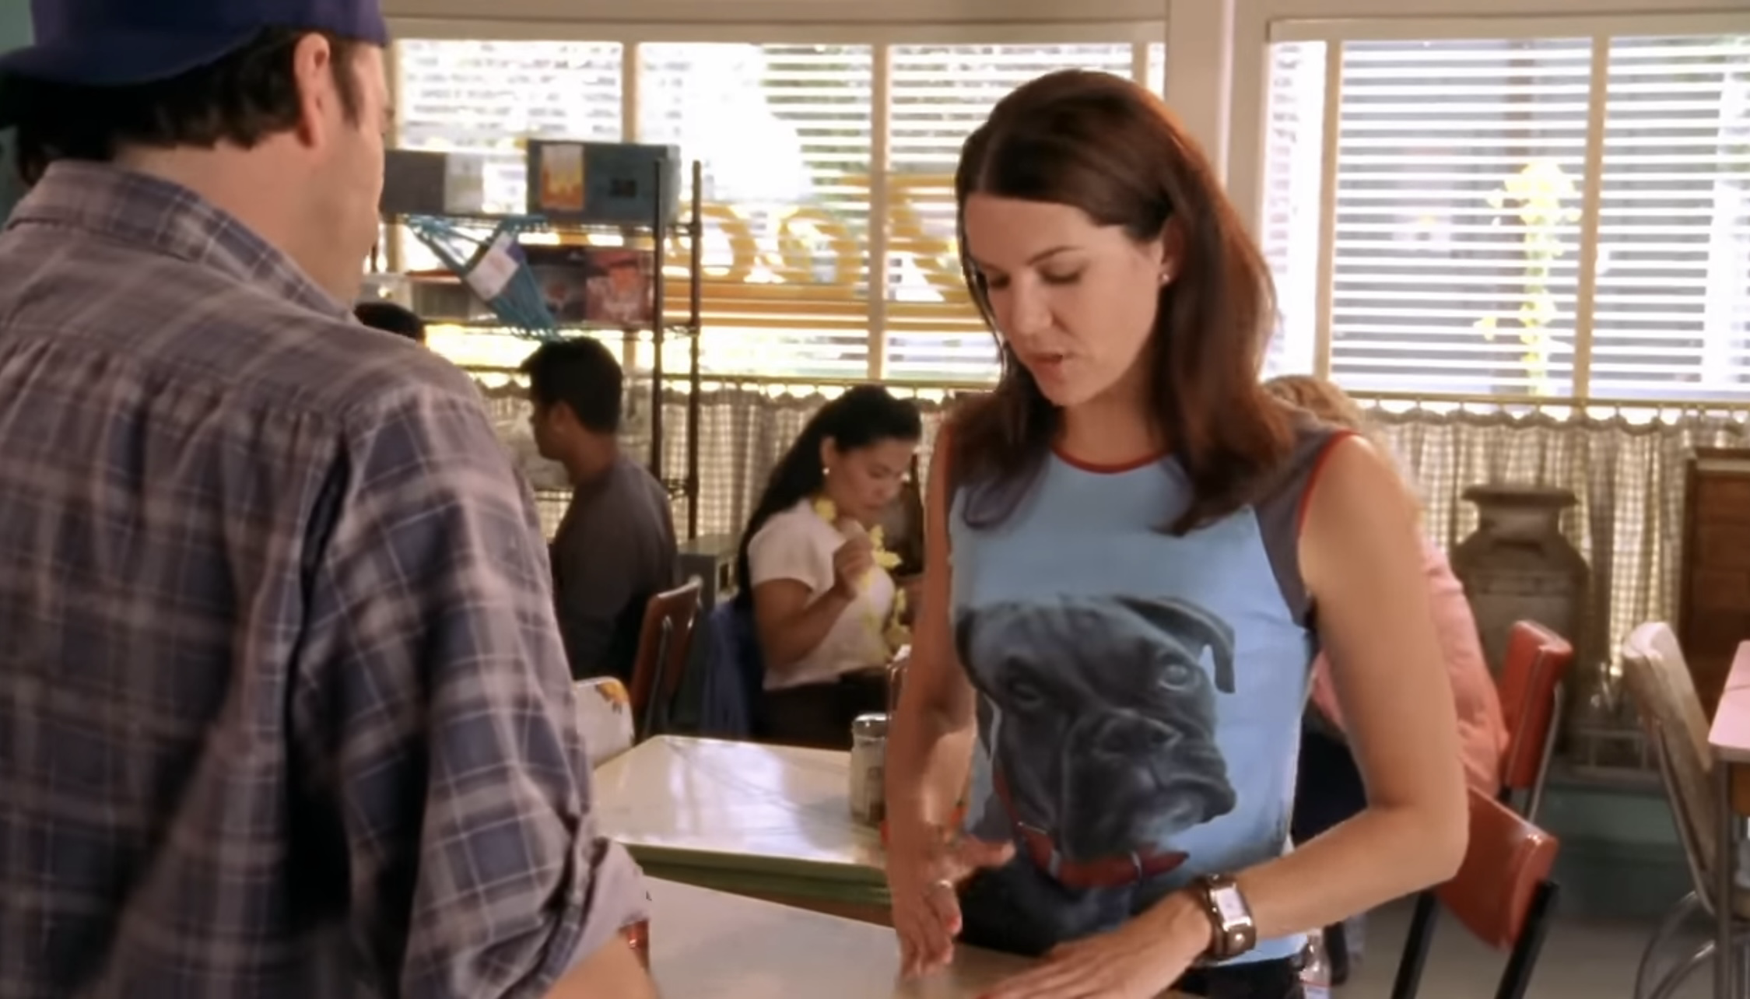
Lorelai : Hey.
Luke: Coffee will be ready soon unless you want to just roll up a dollar bill and go nuts.
Lorelai :No tahnks, I can wait.
Luke: What the hell is going on with them?
Lorelai : Oh, I don’t know
Luke: The whole town should be medicated and put in a rec room with ping-pong tables and hand puppets…..What?
Lorelai : Nothing..well…. I have something to tell you,something to share with you,actually.When exiting things happen,you want to share them with people who you think will find them exciting.
Luke: What is it?
Lorelai :It’s um…It’s very..exiting.
Luke: I’m prepared to jump up and down if necessary.
Lorelai : Okay then,uh, Here it is. Um….Max has asked me to marry him.
Luke:Yeah,I figured.
Lorelai : You did?
Luke: Well,It was obvious.You two were getting kind of close,he was around a lot. Then last night with that ‘life changing ‘moment,I put two together and figured it out. Congratulations ,by the way.

Slide 7
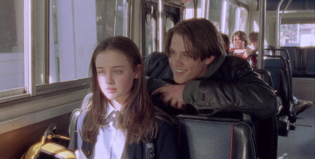
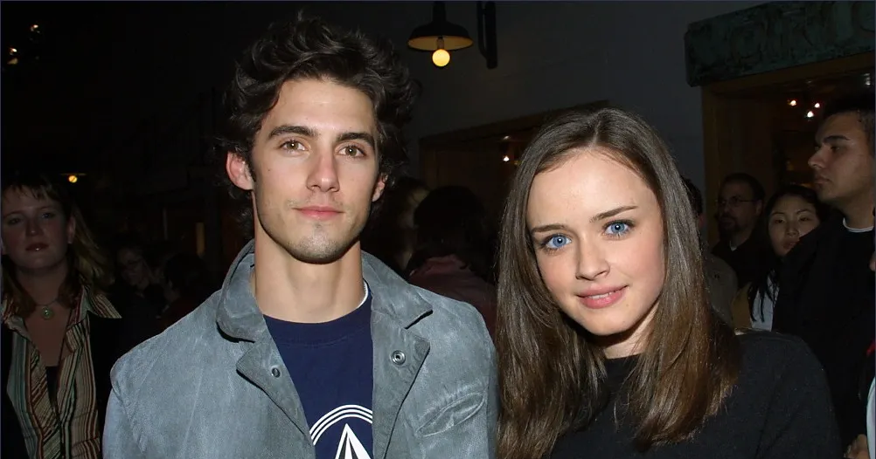
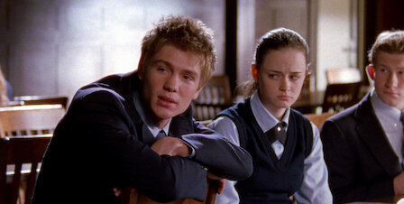
Activity
These boys are boyfriends of Rory in the story
Who is your favorite?☺
Dean Forester
  Dean was Rory's first boyfriend, and they started dating during her high school years. Their relationship was sweet, innocent, and very much focused on first love.
Jess Mariano
  Jess came next. He was more rebellious and independent, and he challenged Rory in new ways. Their relationship marked a period of growth and maturity for Rory, although it ended due to their differences.
Logan Huntzberger
  Logan entered Rory's life when she was in college. He came from a wealthy family and had a more carefree, sometimes reckless personality. Their relationship evolved into a more mature, complex romance, and while they broke up at one point, their connection remained significant.

Slide 8
New vocabularies
Make a big deal
ある出来事や事柄を過剰に重要視したり、騒ぎ立てたりすることを意味します。通常、この表現はあまり大したことではないことを大げさに扱う場合に使われます。
Barely
ほとんど～ない、かろうじて
「barely」は、何かがほとんど達成されていない、またはぎりぎりの状態であることを示します。何かがわずかに、または限界に近い状態で起こったり、存在したりする場合に使います。
Repulse
拒絶する、追い払う
何かまたは誰かを強く拒絶したり、攻撃的な行動や接近を防ぐために遠ざけることを意味します。
嫌悪感を与える、反発させる
何かが非常に不快で、嫌悪感を引き起こす場合にも使います。
go nuts
興奮する、熱狂する
何かに非常に興奮したり、喜んだりすることを意味します。
be medicated
「薬を服用している」「薬で治療されている」という意味です。この表現は、薬を使って体調を治療したり、症状を軽減したりしている状態を指します。

Slide 9
What did I learn from this video
The difference between the countryside and the city
I have learned once again that the level of interference in people's private lives differs between the countryside and the city. In the city, people don't interfere with each other's privacy, but in small towns, like the one depicted in this drama, people tend to get involved in others' personal matters, including their relationships. Lorelai, the mother, has a very close, almost inseparable relationship with Luke, the cafe owner. Everyone in the town knows that Luke likes Lorelai, so when she was proposed to by someone else, the townspeople gathered to watch Luke's reaction. I found their exaggerated reactions amusing. I think this warm, homey atmosphere of the countryside is wonderful.

Slide 10
Answers
Why people are gathered to see Rory and Lorelai?
Because they want to see the reaction of Luke
How was the reaction of Luke?
He pretended to be okay
Do you think Lorelai will get marry with Max?
(She will marry Luke in the end)

