Slide 1

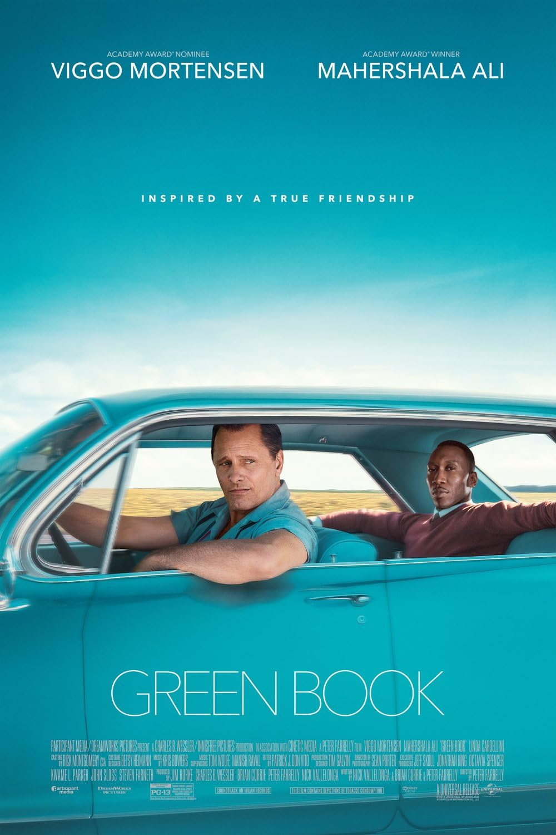
GREEN BOOK
: the comedy of highlighting distinctions of class

Slide 2
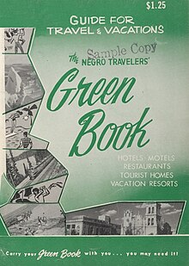
Before you watch…
What is a green book ?
A guidebook for African American road trippers which showed hotels and restaurants that they were allowed to use.
What is the movie about?
This story is about an unexpected friendship between a rough, working-class Italian-American, and a refined African-American pianist.
They encounter prejudice and hardship, but despite initial differences and biases, they grow closer, learning from each other and forming a deep bond.

Slide 3
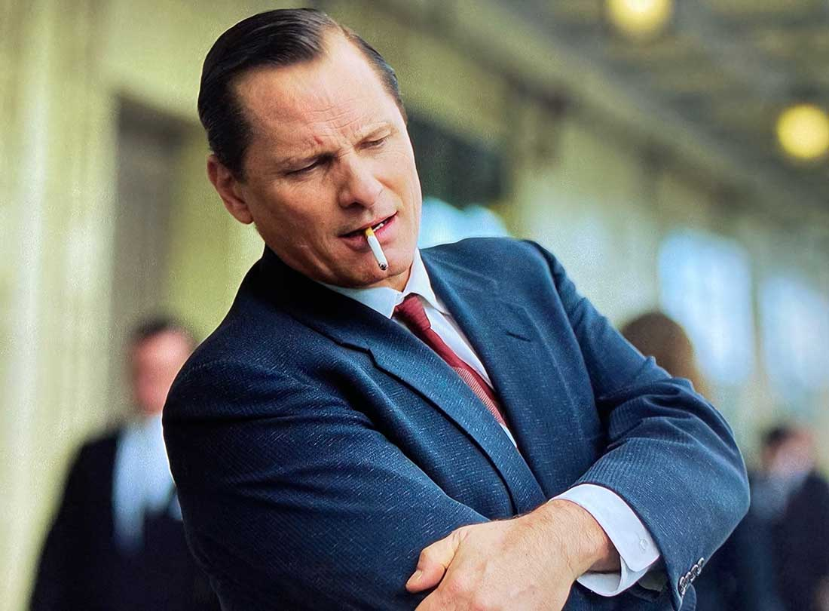
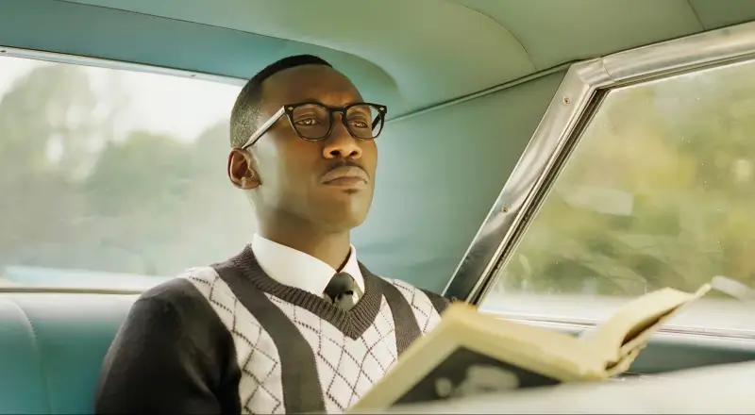
Before you watch…
Institutionalized segregation and racial discrimination were still prevalent around 1962.
The two main characters :
Tony Lip
・An Italian American bouncer.
・Street-smart, with a low educational background.
Dr. Don Shirley
・An African American pianist.
・Highly educated, refined and professional.
・Hires Tony as a driver for his concert tour
through the Midwest and Deep South.

Slide 4
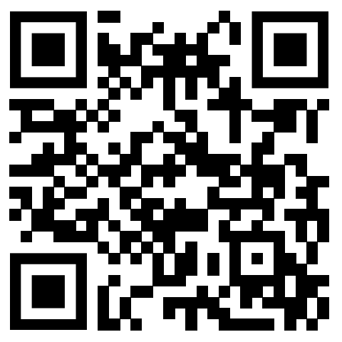
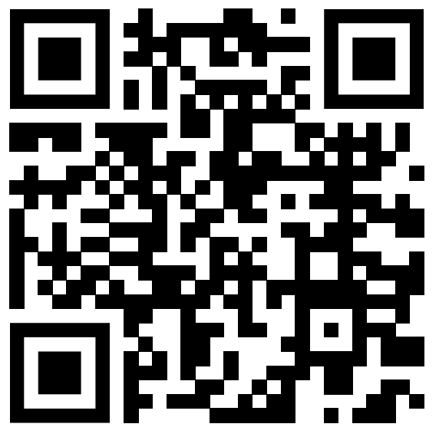
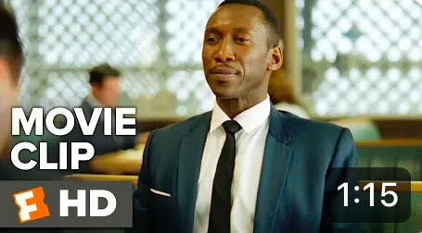
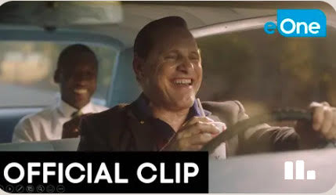
Watch Here
https://youtu.be/uKbnFxTMgtE?si=1ynNoB3n-vVrvpCc
https://youtu.be/ERttjRmZjm0?si=iA0PWsDUdCmt1qvR

Slide 5
Why I chose these scenes
・This movie portrays an unlikely friendship being formed between two
distinctly different individuals, overcoming class differences and
cultural biases.
・In many of the scenes, their miscommunication and mismatched
behaviors are humorously captured.
・These scenes, in particular, successfully highlight each of their
characteristics as well as the dynamic of their relationship.

Slide 6
Irony in Dr. Shirley’s speech ;
“You have a marvelous way with words when describing food.
‘Salty.’
So vivid, one can almost taste it.”
Dr. Shirley exudes refinedness by his proper sentences and polite vocabulary.
Here, it is deliberately used as sarcasm.
Tony does not recognize it and keeps explaining himself.

Slide 7
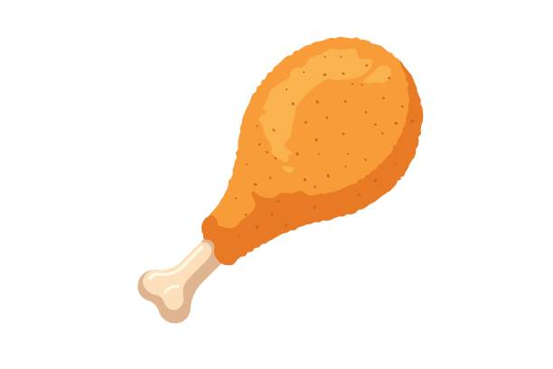
Cultural biases are at play ;
“It just seems … so unsanitary.”
Dr. Shirley is feeling uncomfortable eating chicken, as prompted by Tony,
in a “lower-class” manner.

Slide 8

Dr. Shirley gradually warming up to Tony ;
Throughs the chicken bone out of the window as demonstrated by Tony.
But then tells him off for throwing his drink.
This shows signs of Dr Shirley gradually loosening up and getting along
with Tony, while highlighting his yet moral and stubborn nature.

Slide 9
Quiz
What words can we use to describe each of the characters?
1. Outspoken
2. Polished
3. Meticulous
4. Rough
5. Relaxed
6. Dignity
Tony
Dr. Shirley

Slide 10
For further discission ;
Why do you think these two characters worked well as a duo?
What do you think each of the characters thought of each other?

Slide 11

What I learnt from this Active Learning
Miscommunications between individuals with cultural differences can be humorous as they tend to lead the conversation to unexpected places.
When facing cultural differences, we tend to become judgmental of the other person. However, we can always learn from each other.

