Slide 1









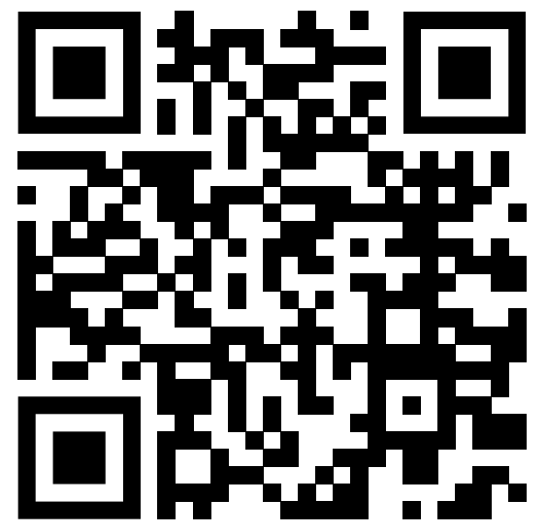






Let’s watch
“Green Book”
https://www.youtube.com/watch?v=3Y6-11P8S1o

Slide 2
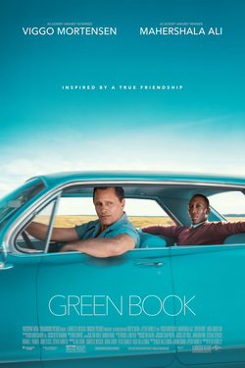
About the film
“Green Book” (2018) is a biographical comedy film by an American director Peter Farrelly. It features actual figures; Dr. Donald Shirley and Tony Lip (Frank Anthony Vallelonga).
Dr. Shirley is a prominent, talented pianist who lives alone in a huge property above the concert hall. He hires Tony, as a driver and bodyguard as he makes a tour to Deep South in 1962, where the Jim Crow Laws still existed.
Tony is a father of two, grew up in an Italian American community in Bronx, New York. He is famous as a strong, quick-witted man working at a night club. At first, Tony had a discriminative attitude toward African American people, although he accepts to work for Dr. Shirley to “put food on the table” for his family. He changes throughout the journey and forms friendship with Dr. Shirley

Slide 3
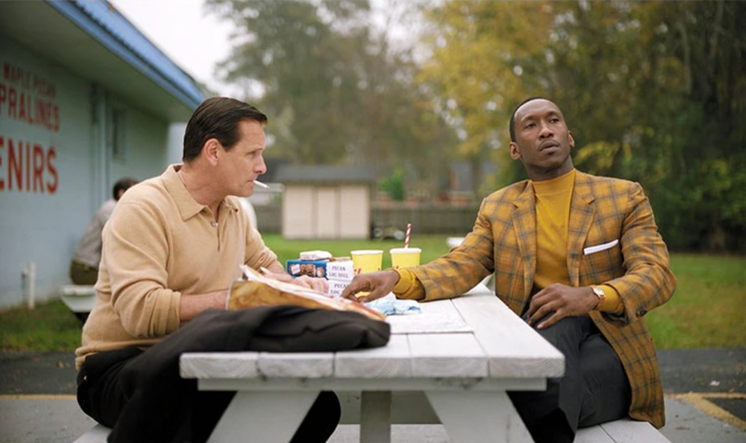
Why I chose this clip
Some critics say the movie includes inappropriate scenes, making the harsh discrimination against African Americans into a comedy. Dr. Shirley’s family point out that it is unclear whether Dr. Shirley in real life saw Tony as a friend. (This film was created after interviewing Dr. Shirley.)
While I understand the views, I was genuinely attracted to conversations between the two characters and how they changed throughout the film.
I chose the clip (page.5) because I found it heartwarming and thought it showed the characters’ friendship.

Slide 4
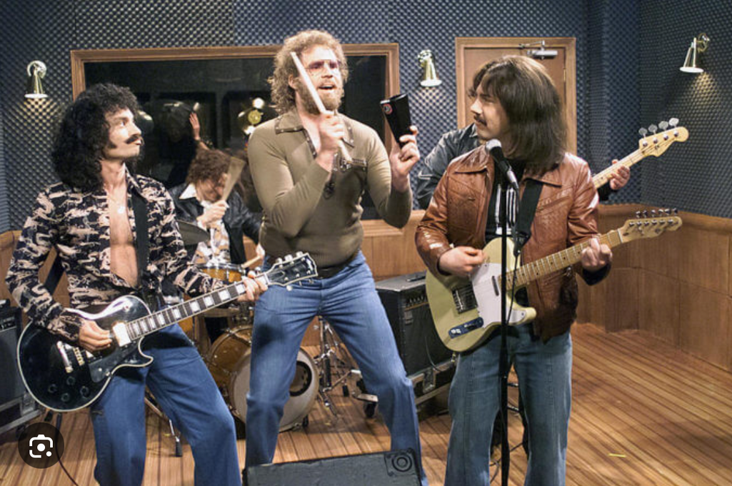
Vocab!
The Shostakovich No. 7
A classic symphony by Russian composer Dmitri Shostakovich.
Cowbell
A hand percussion instrument used in Rock or Latin music
Cowbell

Slide 5
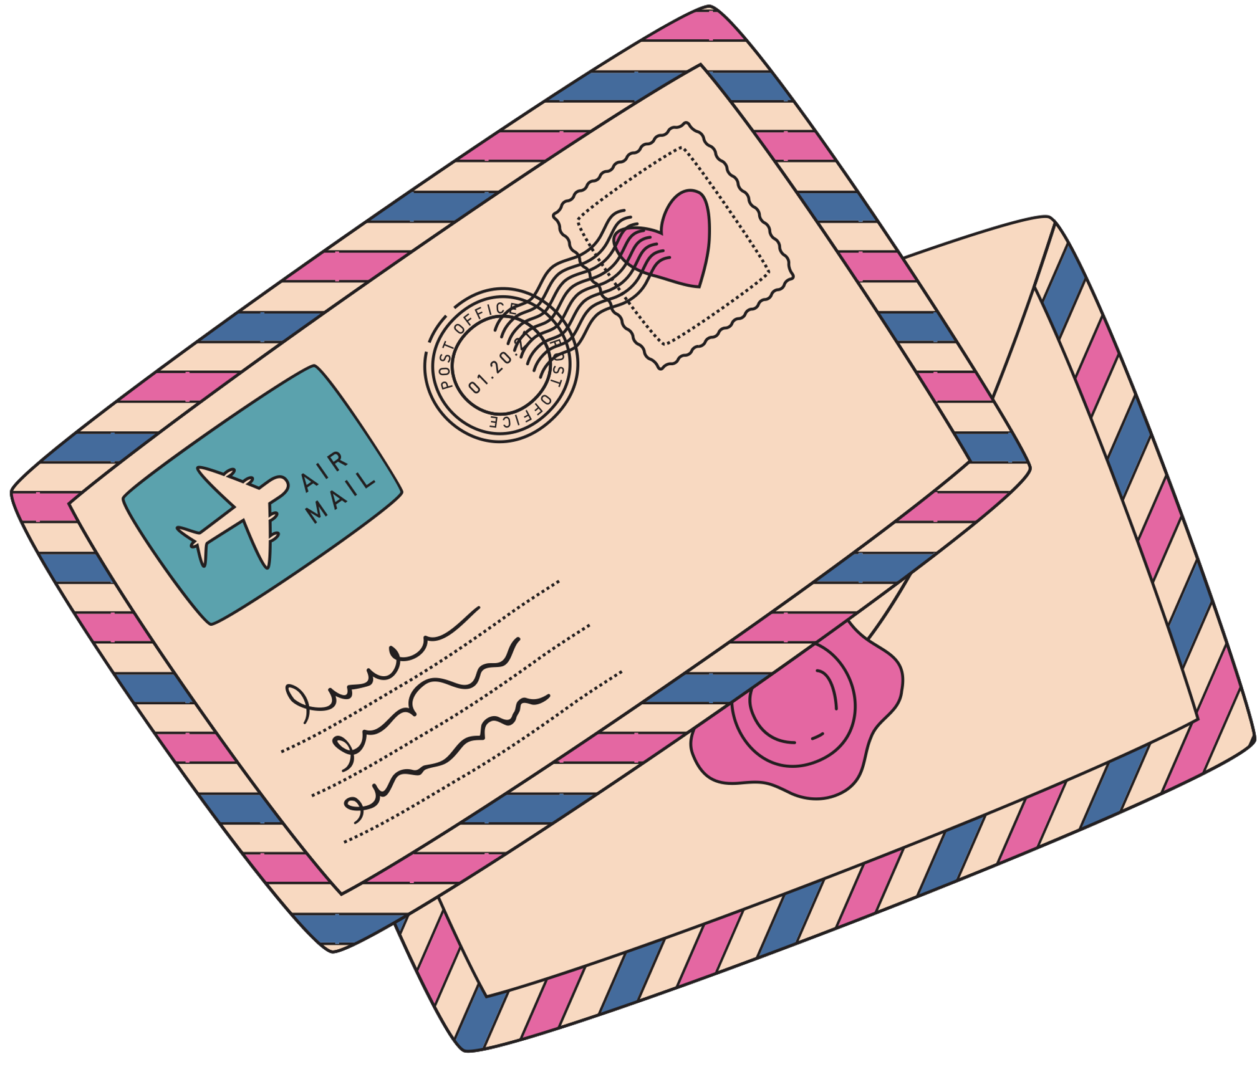

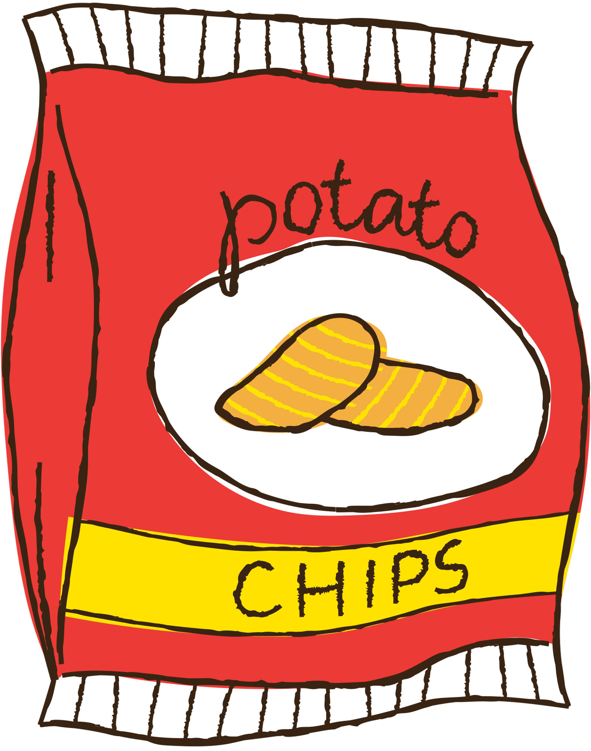
Clip: Writing a letter to Tony’s wife
https://www.youtube.com/watch?v=3Y6-11P8S1o
Dr. Shirley sees Tony writing a letter to his wife, Dolores. He reads the letter and tries to help with the content.

Slide 6



Why did Dr. Shirley say P.S. “like ringing a cowbell at the end of the Shostakovich No. 7” was perfect?
There is no correct answer to it..
Let us analyze the scene.

Slide 7
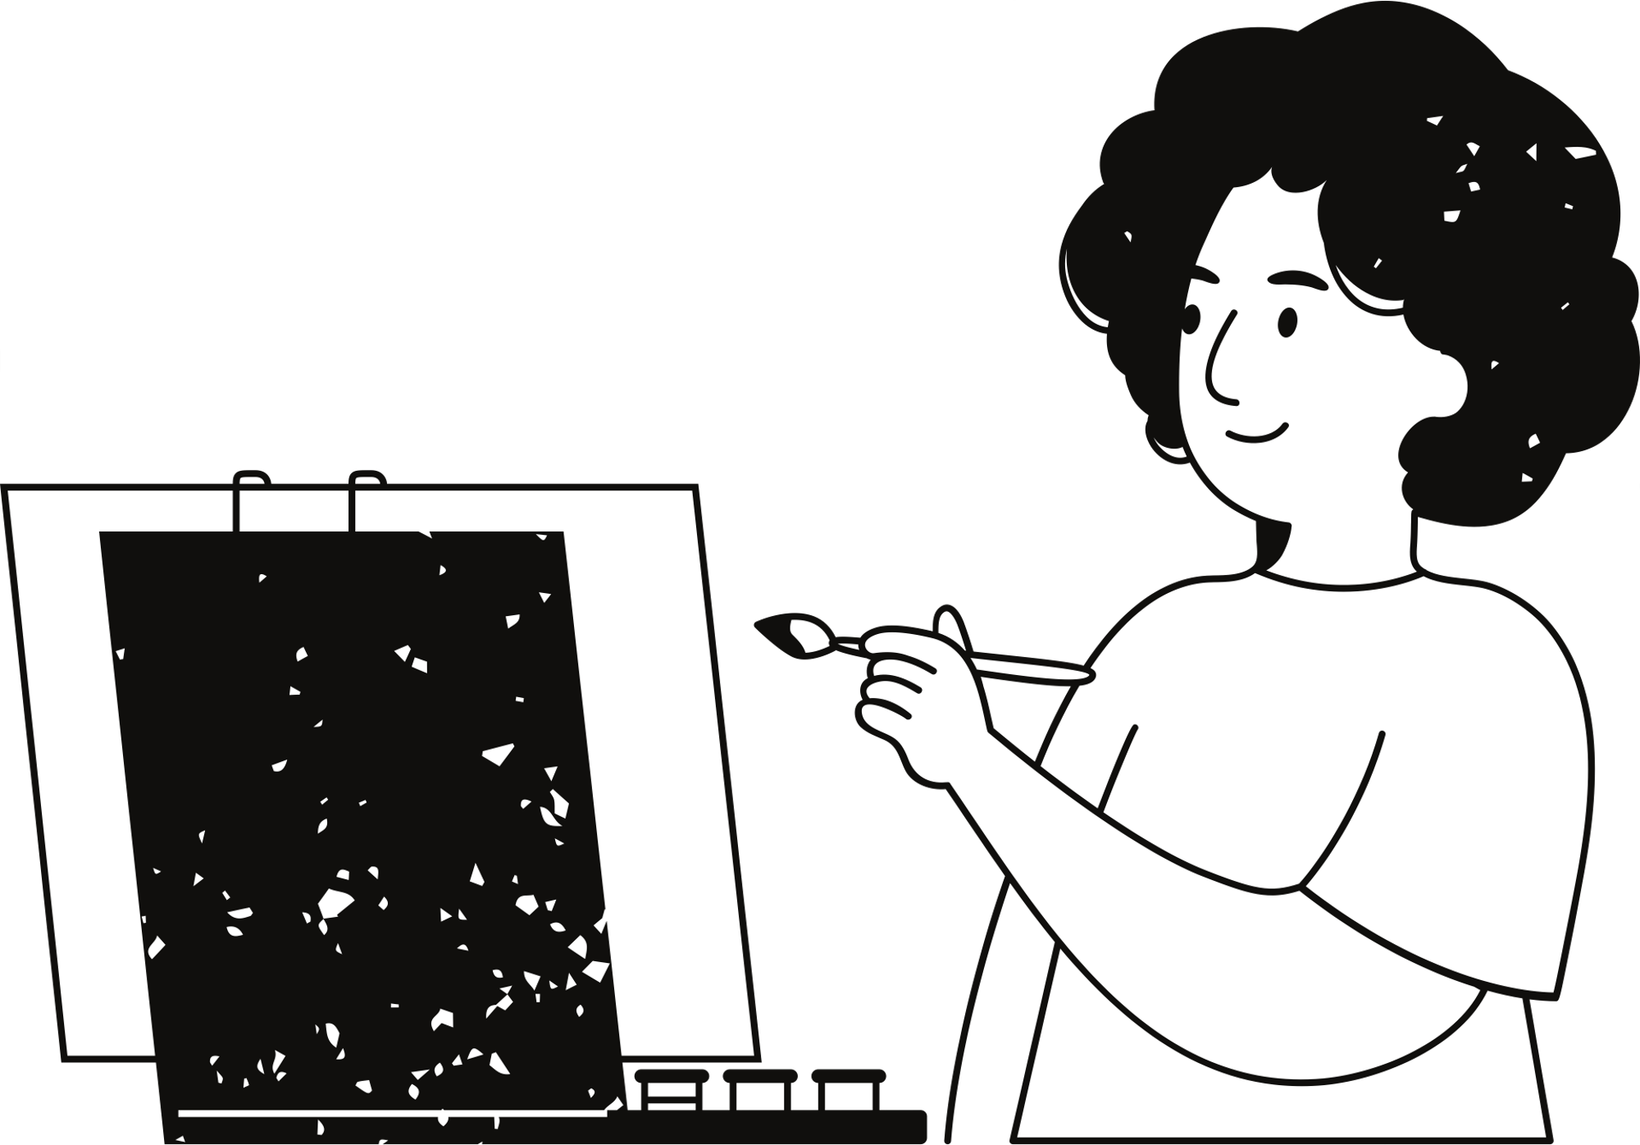
My answer:
In my opinion, it is because Dr. Shirley came to understand and accept Tony’s character and welcomed the way he wrote a letter in “the way no one else” did.
In other scenes before this, Dr. Shirley tries to correct Tony’s behavior and choice of words. Throughout the film, the way he reacts to Tony changes.
Of course, “P.S. kiss our kids” must sound sweet enough to anyone, though!

Slide 8
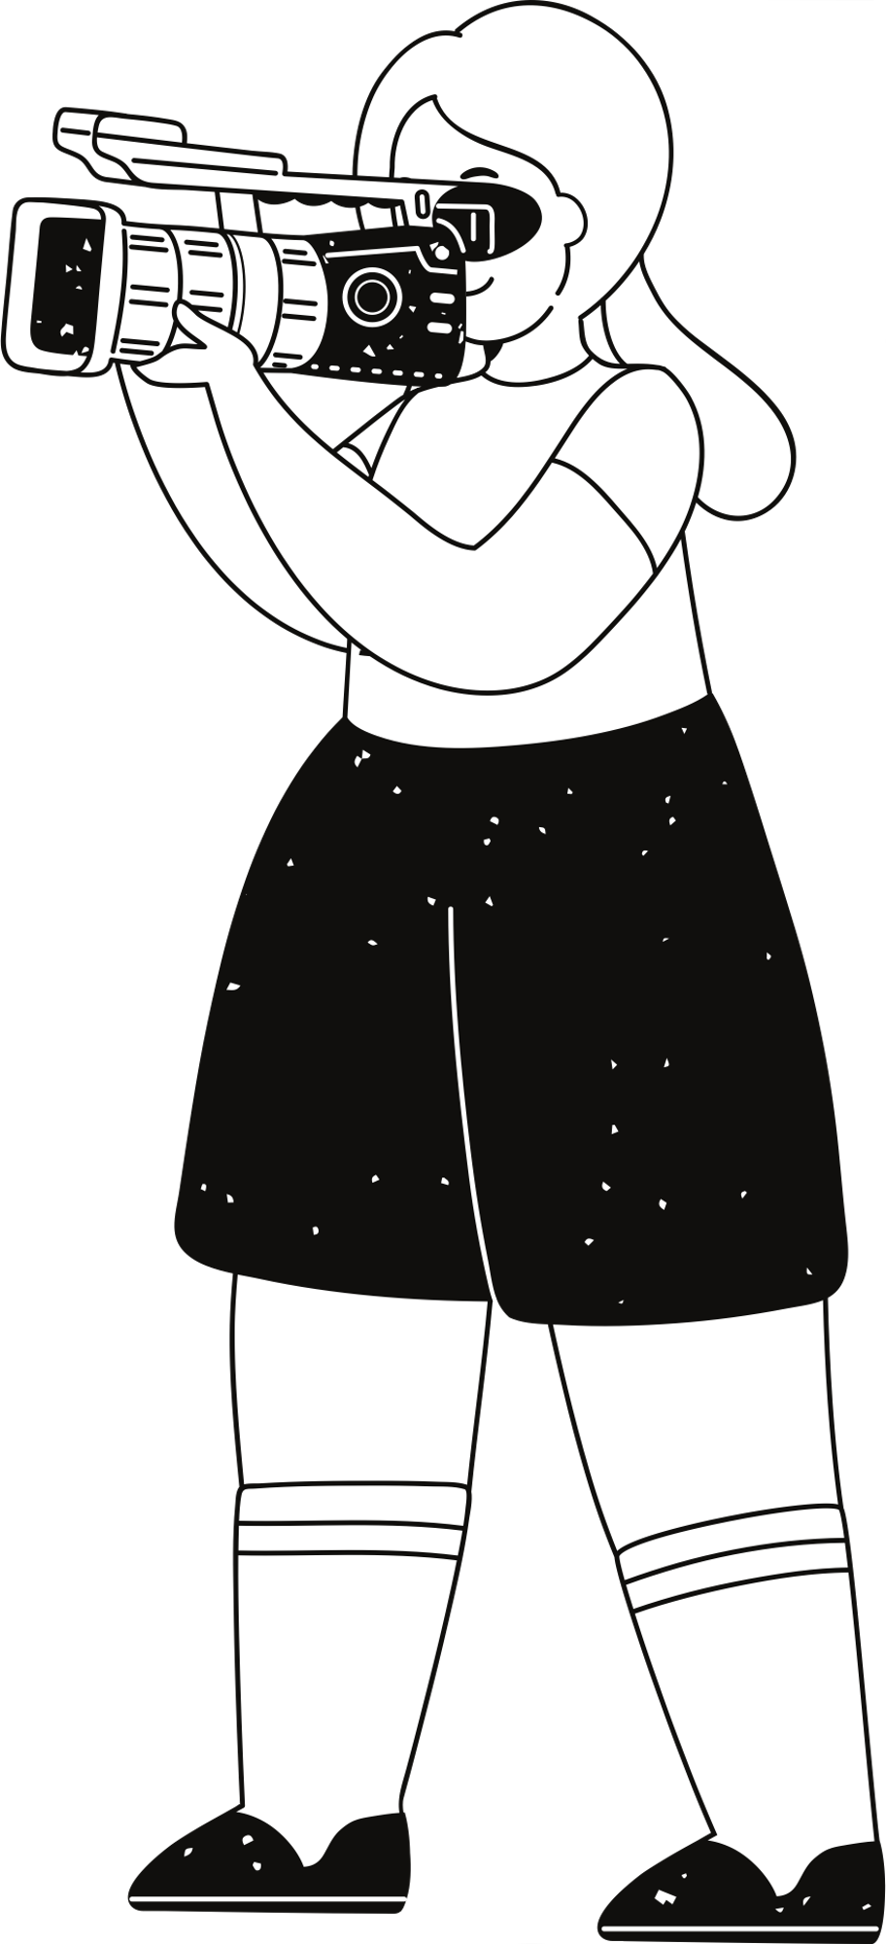



Activity:
Come up with another example which can paraphrase “P.S. kiss our kids”
My answer: Eating sushi and pasta in the same meal

Slide 9
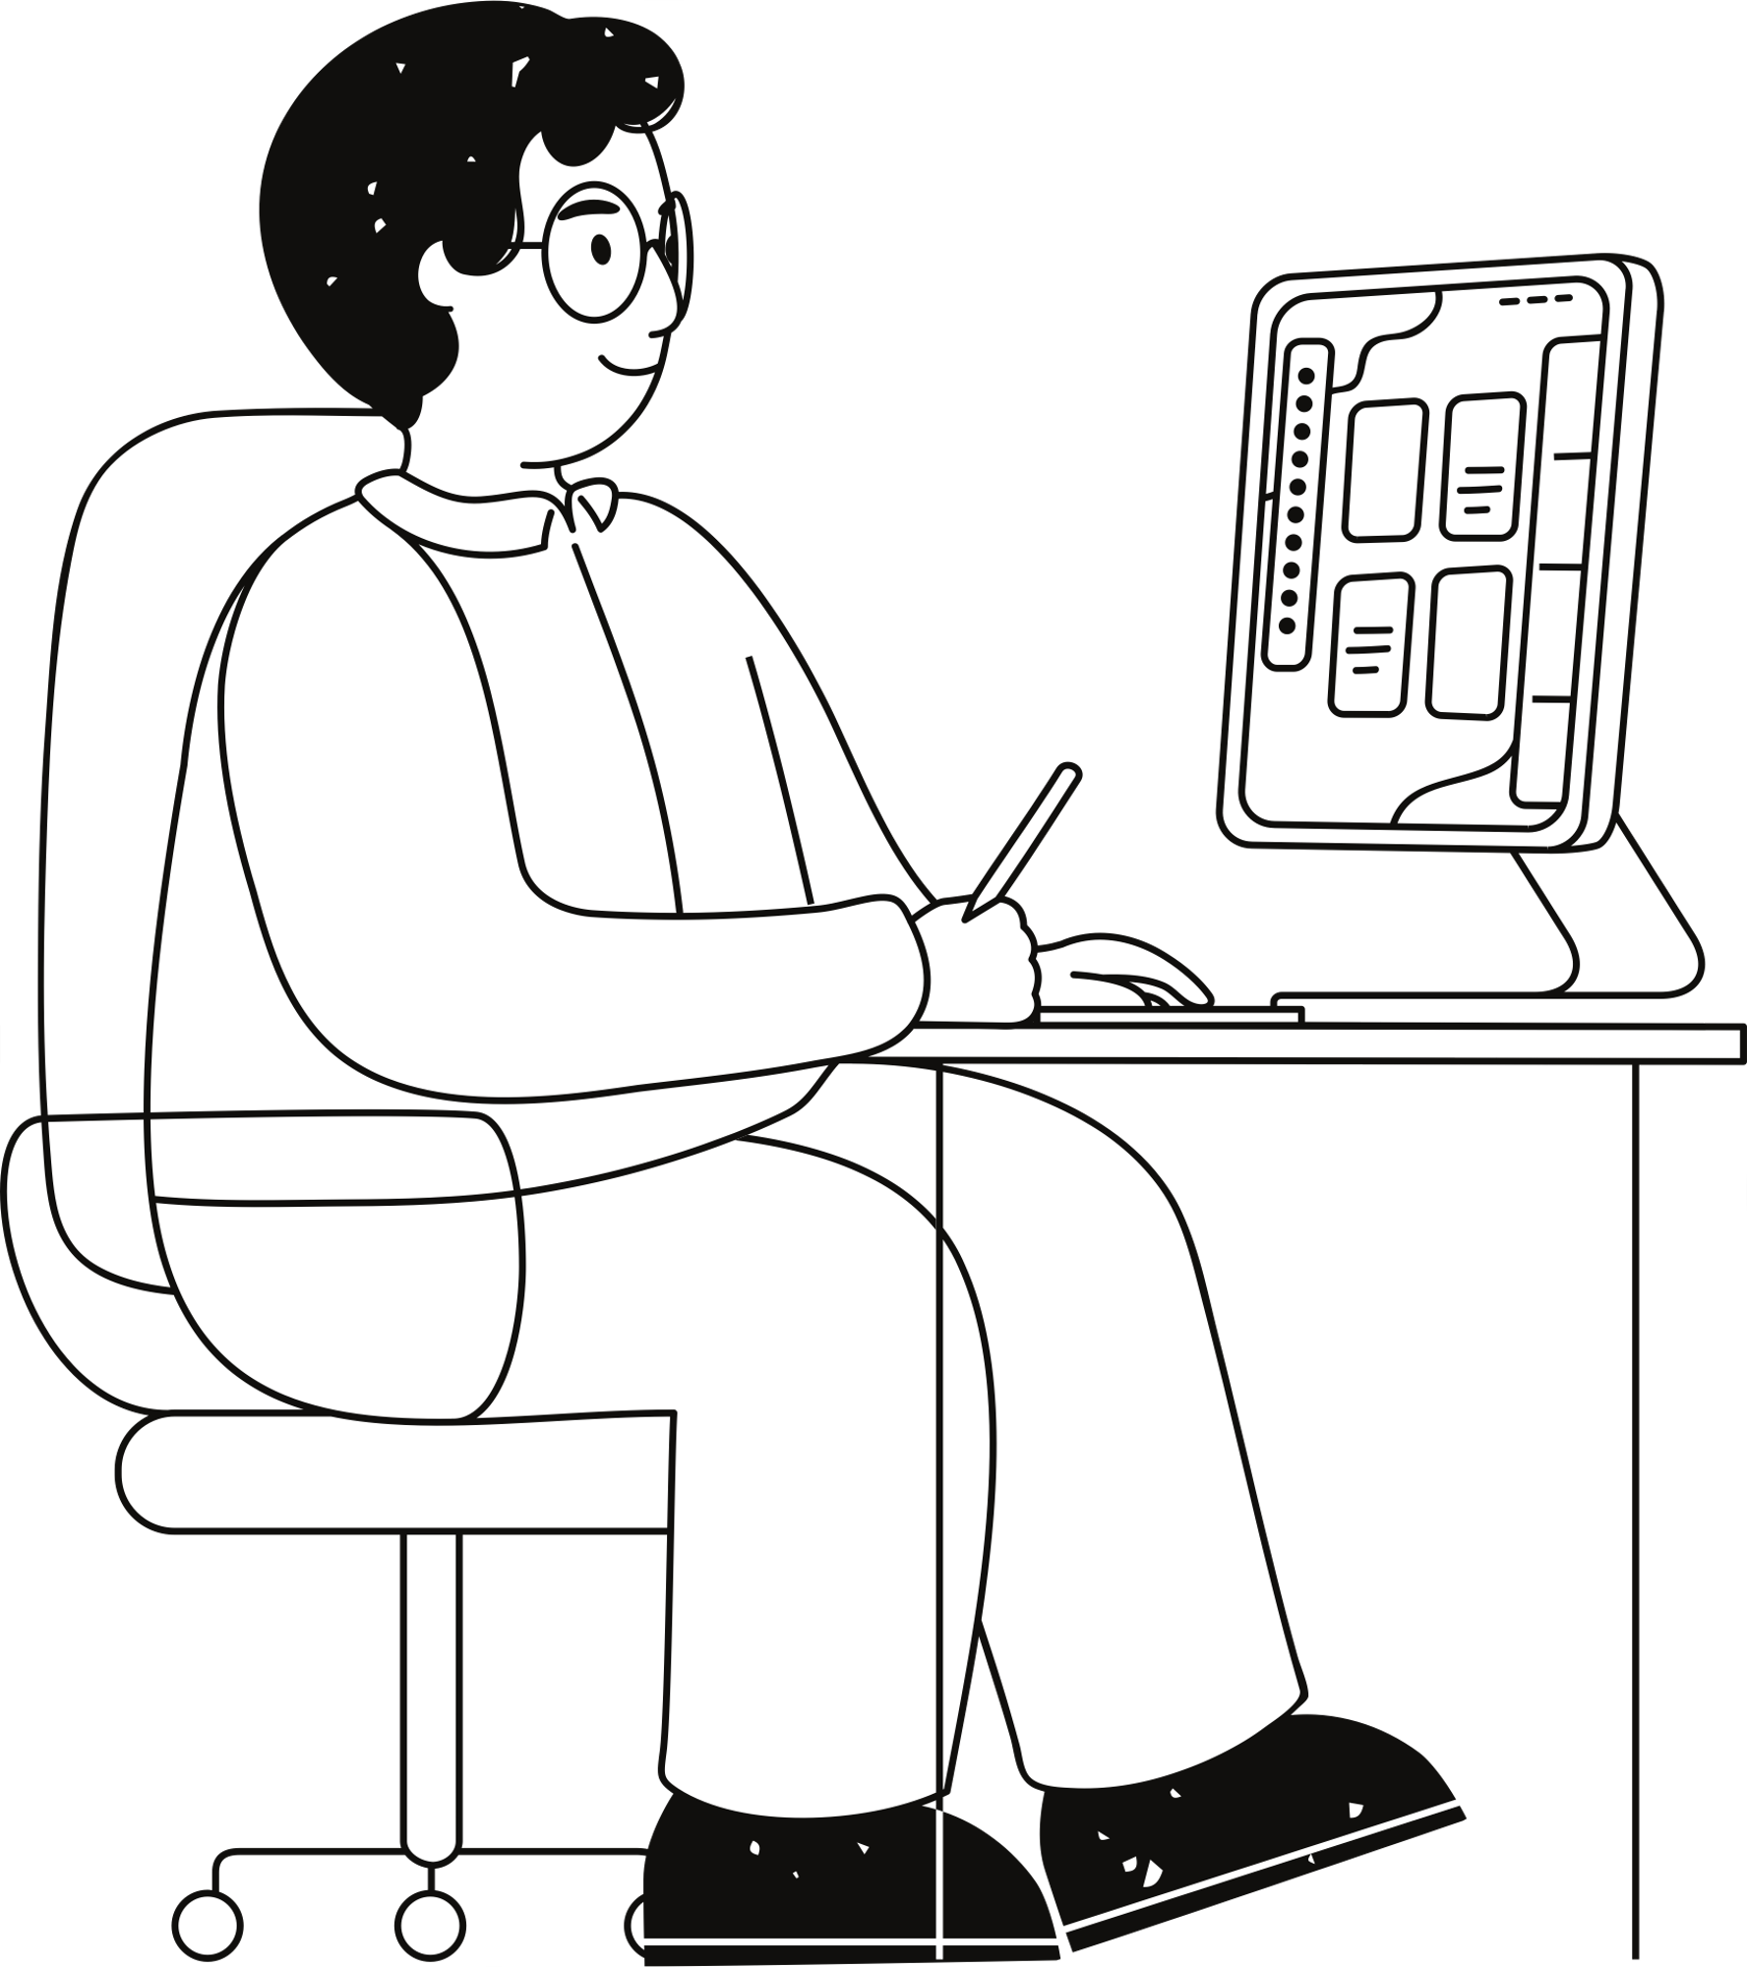
What I learned
As I watched the scene, I was attracted to Dr. Shirley’s smile as he said “That’s perfect, Tony” and wondered why he did not suggest “P.S. kiss our kids” to be deleted even though he found it “like ringing a cowbell at the end of the Shostakovich No. 7”. After watching the movie for the second time, I noticed how Dr. Shirley dealt with Tony’s bold character changed along the course. After all, Dr. Shirley’s smile said it all. He seems to like the way Tony is. This discovery made me understand more of humor and warmth of this scene.
I learned that some simple dialogues could imply important messages or changes in the film.

Slide 10
References
“「グリーンブック」オスカー受賞 論争呼んだ「友情物語」、評者はどう見る”『朝日新聞』2019年3月1日
«More Cowbell! » The Colorado Sounds. 2018.
https://coloradosound.org/more-cowbell/ (Accessed Jan. 2, 2025)
« Symphony No. 7 (Shostakovich) » Wikipedia.
https://en.wikipedia.org/wiki/Symphony_No._7_(Shostakovich) (Accessed Jan.2, 2025)

