Slide 1

Green book

Slide 2
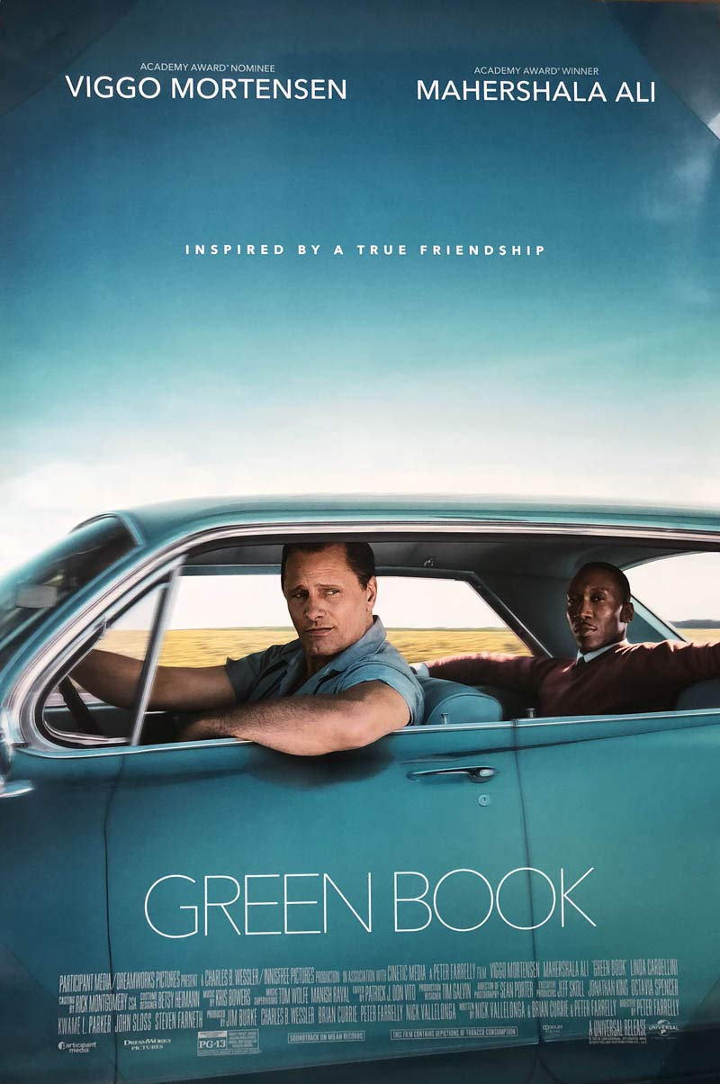
I chose A scene from “green book”
"Green Book" is a 2018 biographical drama set in 1962,
following the journey of Tony Vallelonga, a working-class Italian-American, who becomes the driver for Dr. Don Shirley, a refined African-American pianist touring the racially segregated South.
Despite their differences, they form an unlikely friendship while facing discrimination and challenges on the road, relying on the "Green Book" for safe accommodations.
The film highlights themes of racial inequality and the bond that bridges cultural divides.

Slide 3
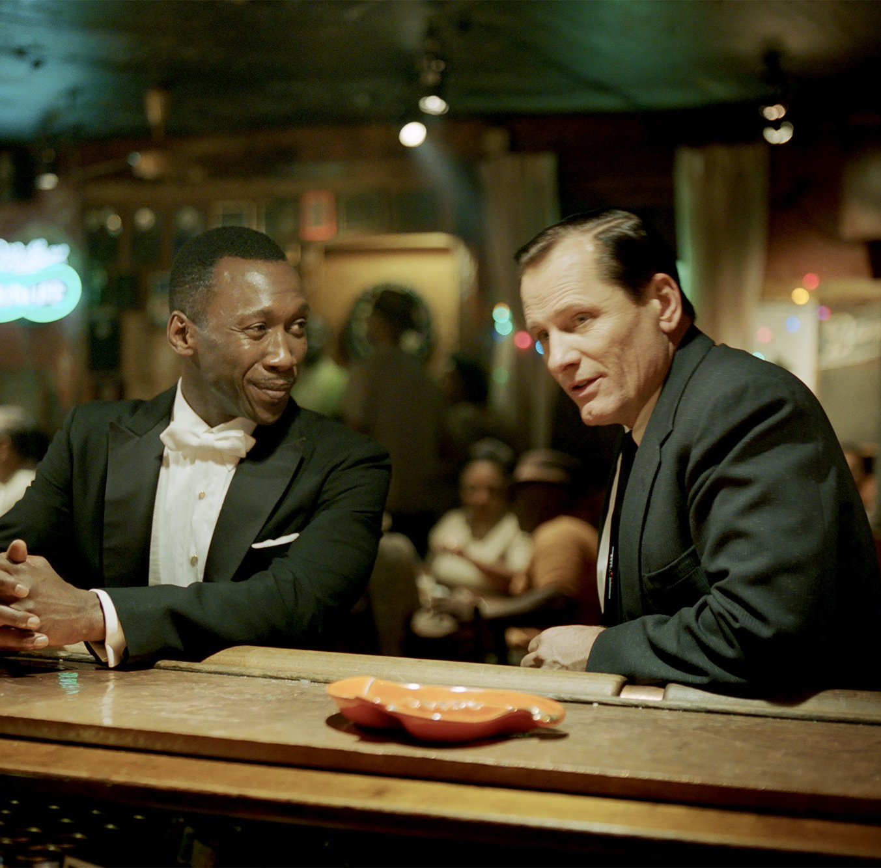
Why I chose this?
I was deeply moved by how two people from completely different cultures, classes, and personalities came to respect each other and grow closer.
The scene I chose highlights the prejudice underlying racial discrimination against Black people.

Slide 4
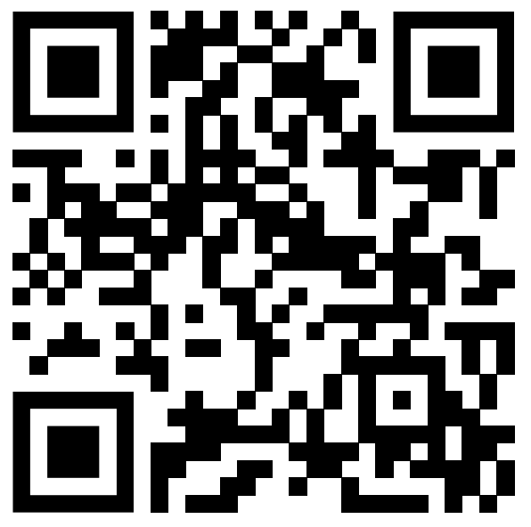
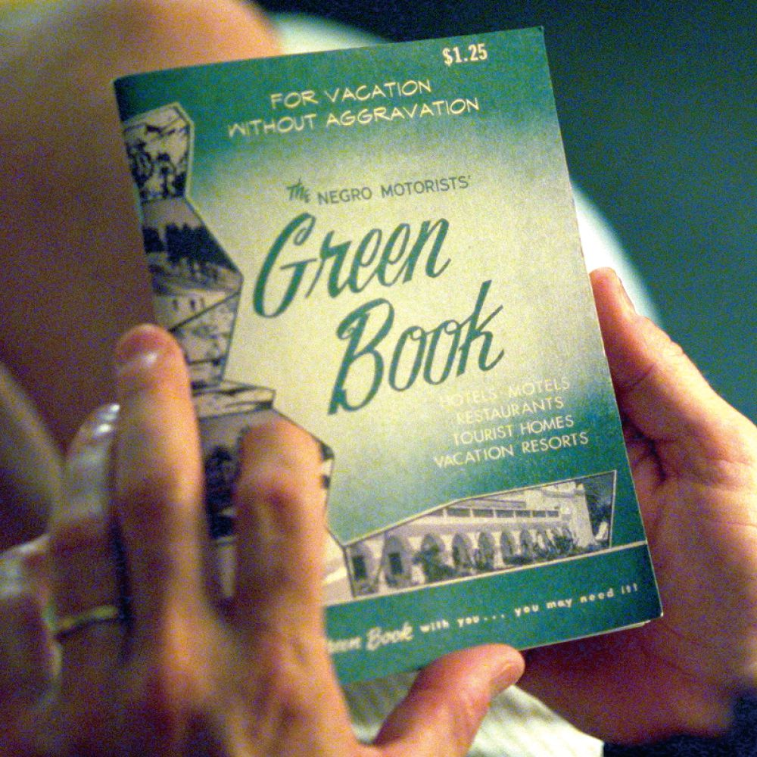
The scene
Background
While driving at night, Tony and Dr. Shirley are stopped by patrolling police officers and subjected to questioning. (they were in a south area where Black people were prohibited from being out at night.) When one of the officers asks Tony, "Do you have a nigger in yourself?" Tony loses his temper and punches the officer. Both of them are arrested, but Dr. Shirley calls President Kennedy, leading to their release.
The point of this scene
Tony realizes that stereotypes—such as assuming all Black people are a certain way or that wealthy people must fit a specific mold—struggle Dr. Don Shirley, as he doesn’t conform to those narrow expectations.

Slide 5
vocabulary
 | meaning | example
backwoods | Remote uncleared forest land | I grew up in the backwoods, with no cable TV and no internet access.
swamp | An area of vey wet, soft land | The Everglades are an area of swamp in southern Florida.
attenuate | To make something less or weaker | They propose more peacekeeping troops to attenuate the violence.
slight | An action that insults a person because someone fails to pay attention to them or to treat them with the respect that they deserve | I regarded her failure to acknowledge my greeting as a slight.

Slide 6
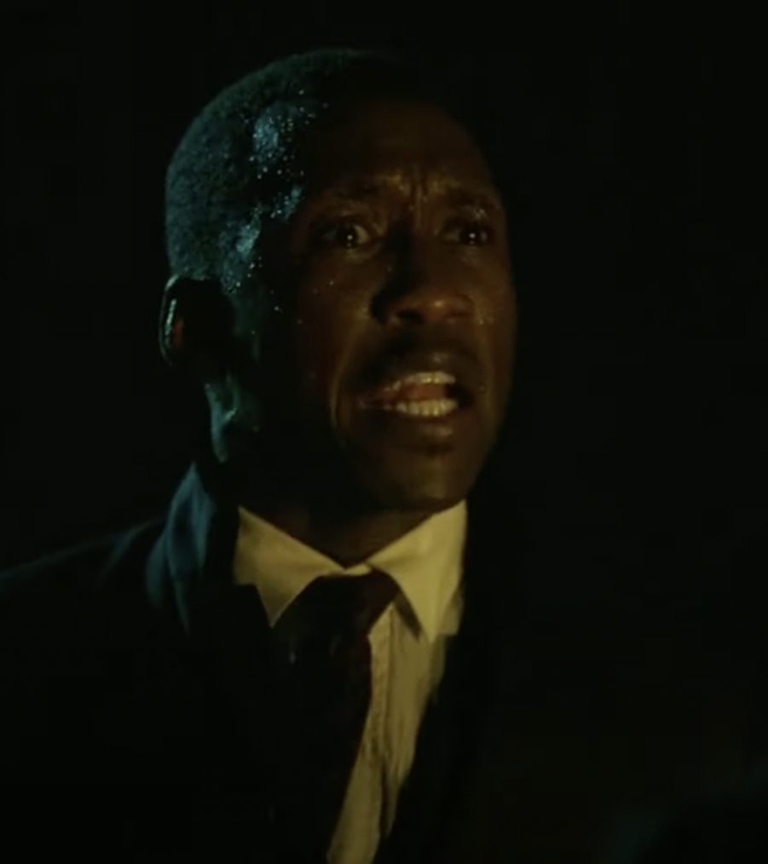
questions
What kind of stereotypes did Tony have of Black people?
Why did he say “I am blacker than you are”?
Why does Doc struggle with his personality?

Slide 7



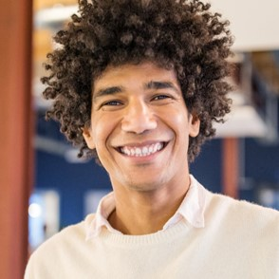
activity
LET’S EXAMINE OURSELVES FOR ANY POTENTIAL BIASES
When you look at these four people, what kind of image comes to mind?
Then, question whether those impressions are truly accurate.

Slide 8
What did I learn from this scene?
The difference between them
- Doc values behaving in a way that maintains his self-worth and always tries to live with integrity. This is likely because, as a Black person, he has been denied basic human dignity.
- From Tony's words, we can sense a distorted sense of pride due to his situation as an Italian immigrant, which is different from that of Black people, as well as feelings of inferiority related to his poor lifestyle.
At what point does Doc lose control of his emotions?
Tony kept speaking to Doc with his prejudice against Black people, and Doc’s loneliness, which didn’t fit that stereotype, exploded. Tony didn’t see Doc as an individual, but only through the lens of the "Black" image.

Slide 9
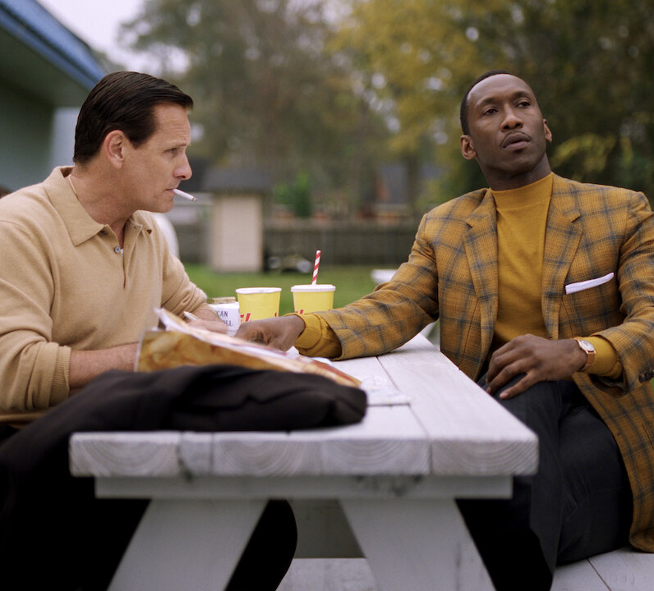
answers
We should be careful not to view others through the lens of unconscious prejudice when interacting with them.
Every person is unique, and we can't group people together based on race or class.
These assumptions can sometimes lead to feelings of alienation, just as it did for Doc.

Slide 10
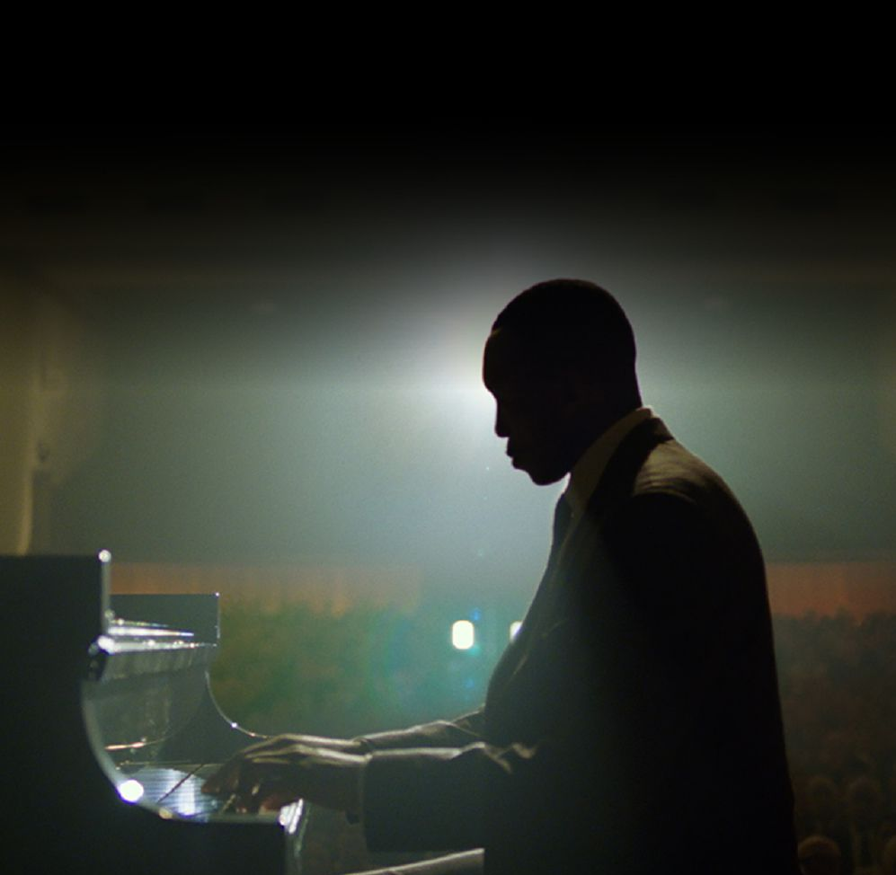
Thank you

