Slide 1
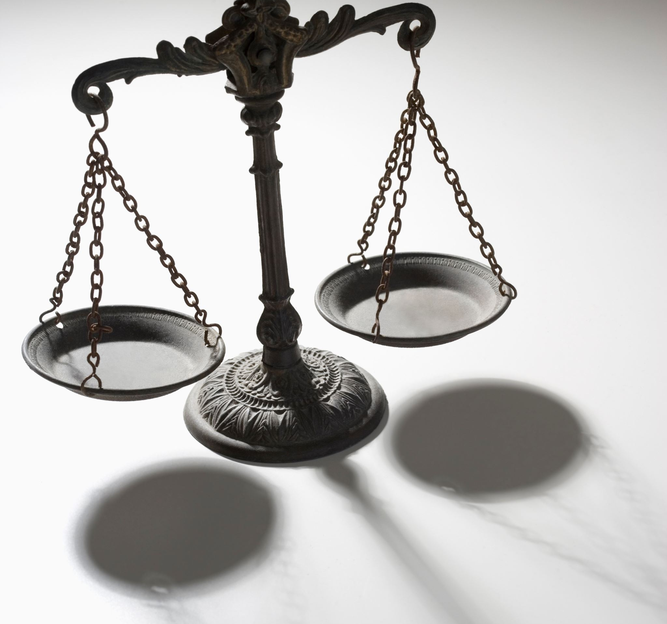
How
"second chance" laws could transform the US justice system

Slide 2
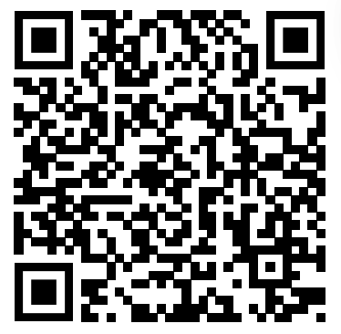
How
"second chance" laws could transform the US justice system

Slide 3
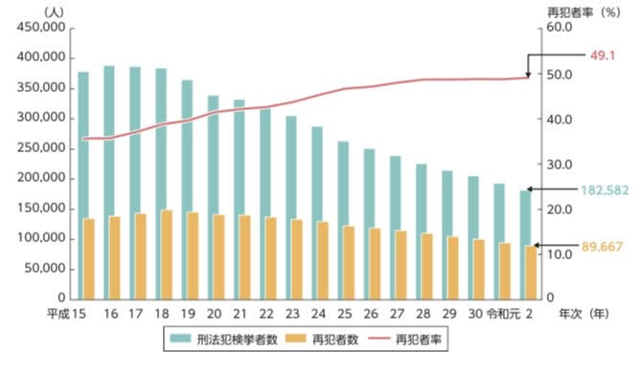
Why I Chose This Material
The situation for criminals is hard. 50% of criminals who serve a term in prison can not get a job. If people can’t get a job, they become easy to commit crime again.
The rate of repeat offense in Japan is 49.1% in 2020, the highest rate in the last 10 years. It is difficult for them to return to society. Can’t society give “second chance” for them?
＊法務省, 2021, 「再犯防止をめぐる近年の動向」, 『令和3年版 再犯防止推進白書』

Slide 4
Vocabulary Quiz
Clean Slate
Protectional discretion
Check
Record
a. The payable certificate instead of cash, issued by bank
b. The data of committing a crime
c. Deleting the data of crime
d. Judging which public prosecutor prosecutes a criminal or not, based on criminal’s character, age, crime itself

Slide 5
The answer of Vocabulary Quiz
A→c
B→d
C→a
D→b

Slide 6
The Situation of American Criminals.
Tips
There are than ( 1 ) Americans, that is one in three people, who have an arrest or conviction on their record.
More than 94 percent of ( 2 ), more than 90 percent ( 3 ) and 72 percent of ( 4 ) use background checks to screen out applicants, making it harder for millions of Americans to access jobs, housing and education.
90%
72%

Slide 7
The answer of
The Situation of American Criminals.1
1. 100 million
2. employers
3. landlords
4. colleges and universities

Slide 8
The Situation of American Criminals
Tips
Every state has laws on the books that allow a person to get their ( 5 ) once they're eligible. And right now, there are more than ( 6 ) million people who are eligible to get their ( 5 ).
Less than ( 7 )percent of those people actually get it done.
In some states people have to wait just about ( 8 ) to ( 9 ) years just to even qualify to get their ( 5 ). Then you have to appear in person to petition. . . . sometimes you have to pay processing fees up to ( 10 ) dollars per charge.
10%

Slide 9
The answer of
The Situation of American Criminals
5. record cleared
6. 30
7. 10
8. 5
9. 10
10. 500

Slide 10
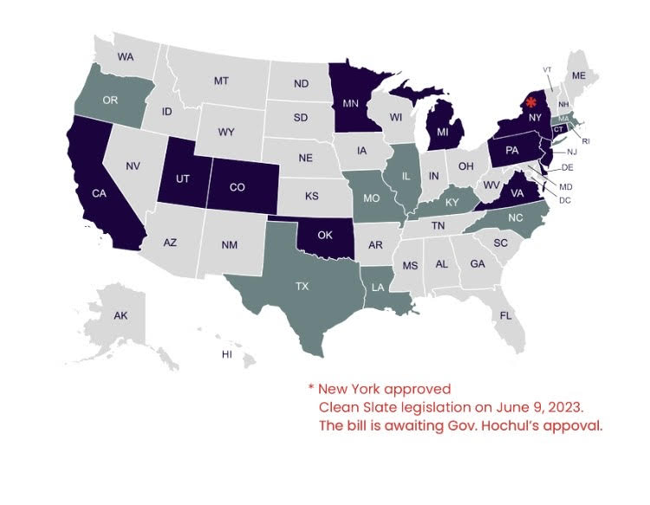
What are “Clean Slate” Laws?
“clean slate” is laws that say once a person has remained crime-free for a set period of time and they're eligible, a set period of time by the state’s definition, remaining crime-free, that their record is automatically cleared.
In just the last three years, we've been able to help
6 states pass clean slate laws. (At present, the number of state that have passed the laws increases to 12 states.)
That has resulted in 3 million people getting their records cleared.
THE CLEAN SLATE INITIATIVE,
Clean Slate in States, https://www.cleanslateinitiative.org/states
(9 July 2023)

Slide 11
Questions about “Clean Slate” Laws
What do you think about “Clean Slate” laws?
What do you think about getting criminal records cleared?

Slide 12
My answer of
The Questions about “Clean Slate” Laws
It is good to help criminals after their stay in prison. After a certain period of time, they could commit a crime at the next opportunity. It means that the punishment would become righter. However, this makes the effect of deterrence weak if they commit futher crime because they cannot gain employment after prison. We have to carefully consider the effect of the law.
It would be effective to protect criminals from committing another crime. However, this should be limited to the situation related to their career about job, school and so on. When being punished again, their criminal records should be referred to.

Slide 13
References
法務省, 2021, 「再犯防止をめぐる近年の動向」, 『令和3年版 再犯防止推進白書』
THE CLEAN SLATE INITIATIVE, Clean Slate in States, https://www.cleanslateinitiative.org/states, (9 July 2023)
Sheena Meade, 2023, “How “second chance” laws could transform the US justice system”, TED talks, https://www.ted.com/talks/sheena_meade_how_second_chance_laws_could_transform_the_us_justice_system/c, (9 July 2023)

