Slide 1
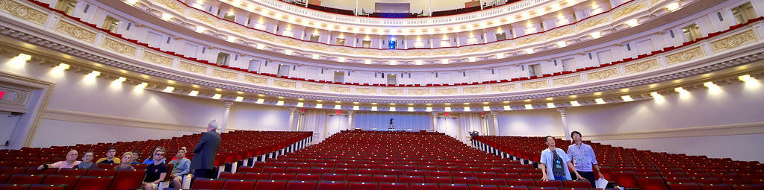
Page 01/10
HOW ARCHITECTURE HELPED MUSIC EVOLVE
Carnegie Hall

Slide 2
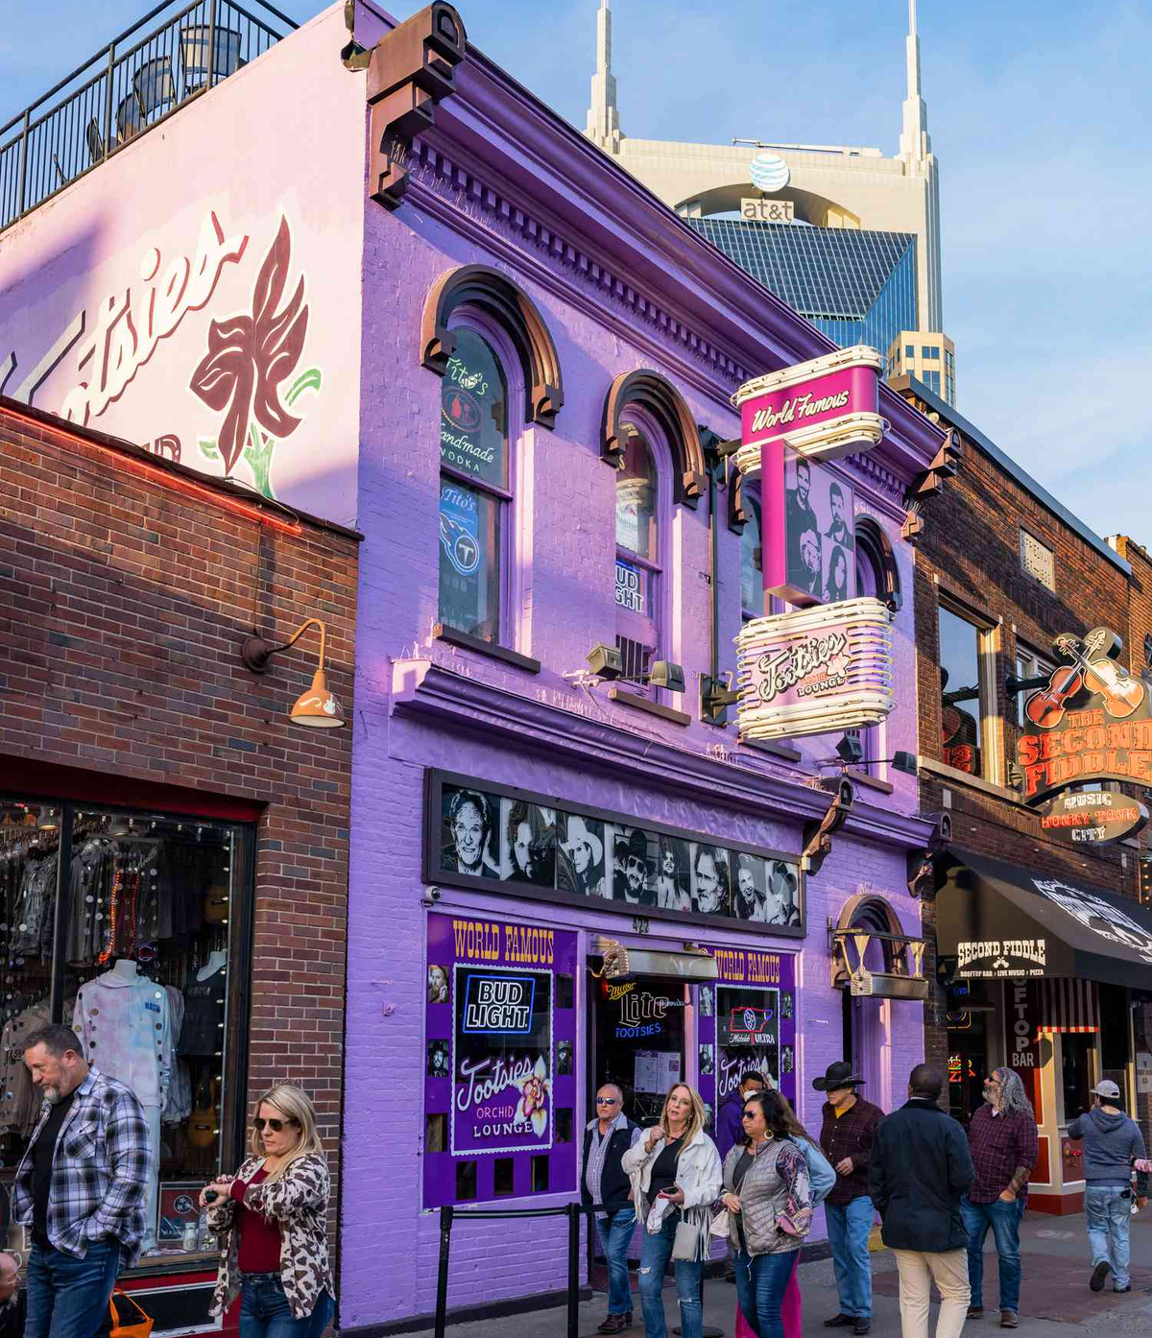
Page 02/10
TABLE OF CONTENT
WHY I CHOOSE THIS TOPIC
VOCABLARY
ENGAGING QUESTIONS
FUN ACTIVITY
tootsies orchid lounge

Slide 3
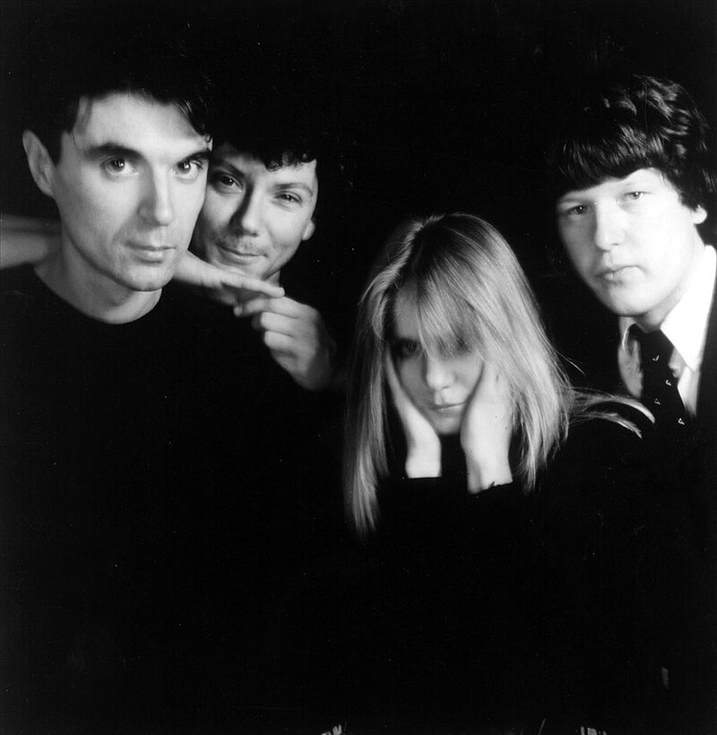
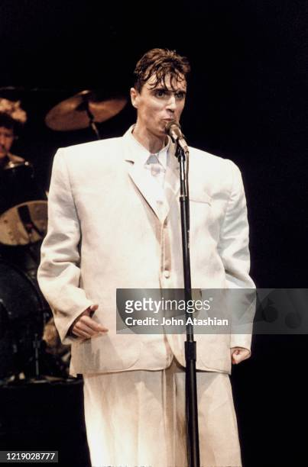
WHY I CHOOSE THIS TOPIC
Page 03/10
David byrne
・Firstly, I love music, so I was exploring topics related to it.
・Recently, I watched a live concert film of David Byrne's band, Talking Heads, and my interest in him has grown.
・The connection between architecture and music was very unexpected to me, and I found it fascinating.
talking heads
www.reallygreatsite.com

Slide 4
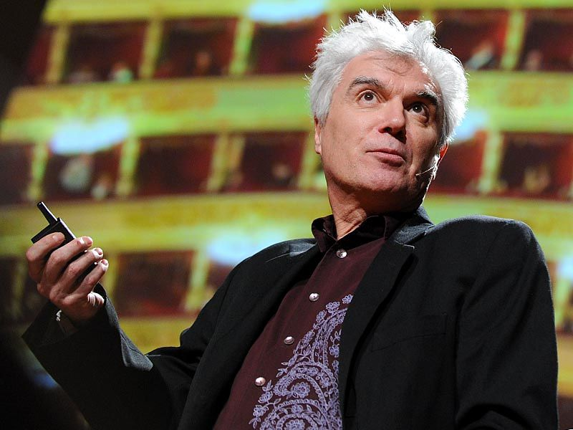
Page 04/10
VOCABLARY
VENUE
the location where an event or activity takes place
INTERICATE
complex, detailed, or having many interconnected parts
REVERBERATION
he persistence of sound in a space after the source stops, caused by echoes off surfaces
HOLLER
to shout or call out loudly
TRANSMIT
to send or convey signals, information, or data from one place to another

Slide 5
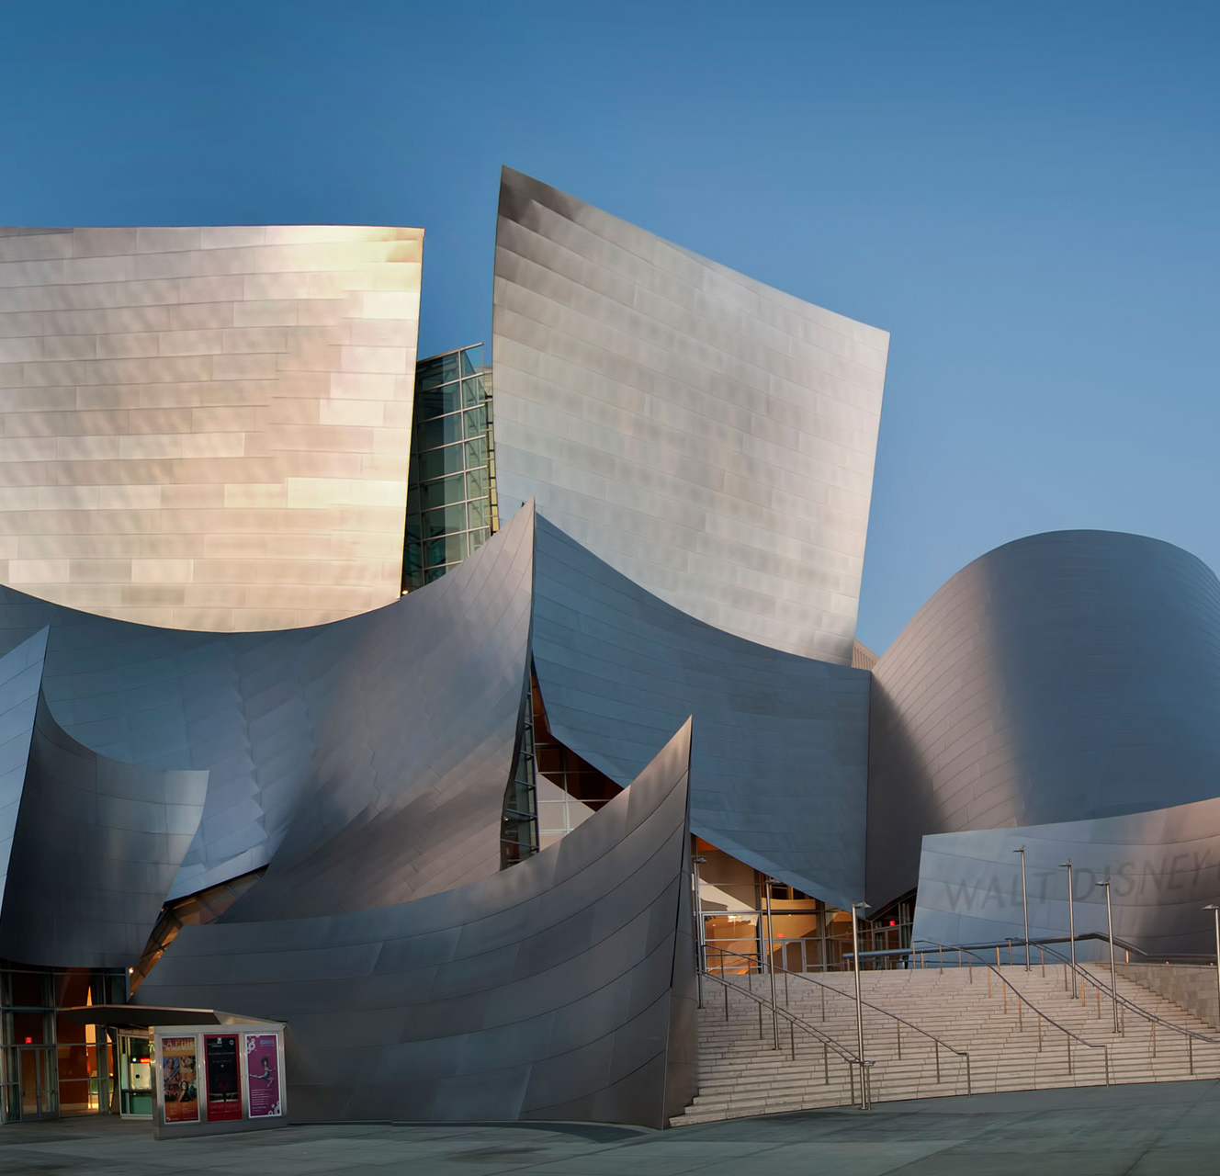

ENGAGING QUESTIONS
Page 07/10
Did you imagine the relationship between architecture and music?
Are there venues in Japan with specific purposes?
Which live performance venue did you find the most enjoyable?
What are your thoughts on live performances at Tokyo Dome?
Walt Disney Concert Hall
in Los Angeles, California, USA

Slide 6
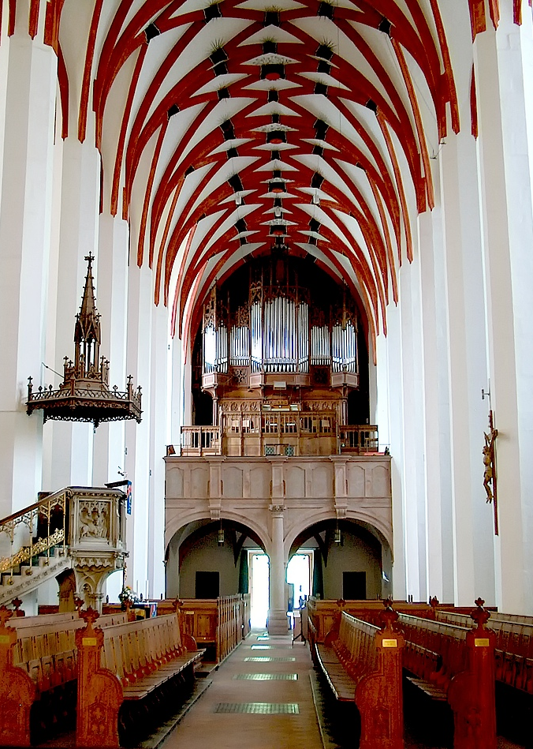

FUN ACTIVITY:
QUIZ
Page 06/10
HOW TO PLAY
  Listen to multiple live recordings,
  View photos of some of concert halls
  Try to match each audio recording to the respective concert hall
THE INTENTION IS…
Leipzig's central district
to make people aware of the connection between music genres and the architectural spaces where the music is performed.
Thomas Church, Leipzig

