Slide 1

How Language
Shape the Way We Think
Presenter: Lera Boroditsky

Slide 2
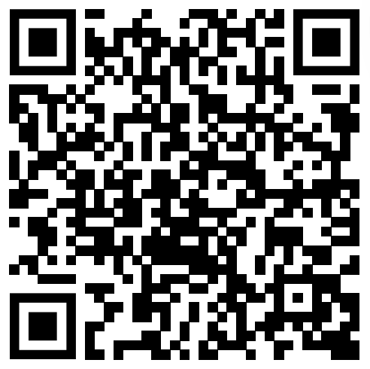
Watch here:
https://www.ted.com/talks/lera_boroditsky_how_language_shapes_the_way_we_think/transcript

Slide 3
Why I chose this topic
I find that my personality changes when I speak different languages, and thought some of it might have to do with the structure of the language shaping the way I think.
When we are taught English in Japan, many students seem to find it difficult to get used to the difference in structure and the cultural influences. (vocabularies, accents, cadence, flow of the conversation, etc)
It is interesting to know how the way you think is influenced by the language you use, and how this understanding can add a deeper meaning to language learning.

Slide 4
Summary and Vocabulary
・Language
It allows us to transmit our ideas cross vast reaches of space and time, and transmit knowledge across minds.
It enables abstract thinking and supports social and cultural activities.
・Differences
The cognitive ability such as orientation, perception of time, color, and quantity differ depending on the language.
→ linguistic diversity
・Exclusion
Since most human sciences are based on studies by English-speaking undergraduates at universities, many others are denied access to these ideas.
→ a language can limit and narrow people’s thoughts

Slide 5
Comprehension
・According to the presenter, who argued that language crafts reality?
・The presenter talks about five effects of which language shape the way we think. What are they?
1. 2. 3. 4. 5.
・Why is a language worth preserving?

Slide 6
Think
Are there words you know that only make sense in Japanese?
Give an example:
Have you noticed a change in yourself (attitude, mindset, etc) when talking or writing in English?
Share your experience:

Slide 7
Opinion
・Knowing that different languages encapsulate different worldviews and knowledges that have been developed within a culture can change the way you think of language learning.
・Learning a language is not only about memorizing the words and grammar, but more importantly, it is about getting to know a new perspective of the world or having a better understanding of a culture and the people who speak the language.

