Slide 1
How language shapes the way we think

Slide 2
Table of the content
1. The Reasons Why I Chose this Topic
2. The Vocabulary and the Contents of the Video
3. Engaging Questions
4. Fun Activity

Slide 3
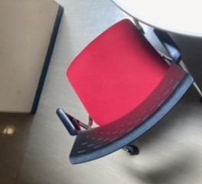
1. The Reasons Why I Chose this Topic

Slide 4
The Reasons
This video is recommended by my friend who is studying in other university, so I chose this video. However, it is not the only reason. When I saw this video’s title, I became interested in this video because I’m curious about language. Then I saw the video, the content is really fascinating for me, so I decided to make slides with this video.

Slide 5

2. The Vocabulary and the Contents of the Video

Slide 6
Important Vocabulary
Oriented knowing about direction, South, East, North, West.
Perceptual relating to how we perceive the information

Slide 7
Brief Wrap-up of the Contents
Does the language we speak shape the way we think?
These days, there are some data to answer this question.

Slide 8
Brief Wrap-up of the Contents
For example…
Language which shows right and left, up and down by using direction makes people easy to be oriented.
Language which differ light blue and deep blue makes people more sensitive about the color change.
etc.

Slide 9
Brief Wrap-up of the Contents
Language affect …
Big things like how to think about space and time
Deep things like counting ability
Perceptual decision like how to feel color
Personal weight like how we blame and punish

Slide 10

3. Engaging Questions

Slide 11
Engaging Questions
1. Do you think the language we speak shape the way we think?
2. How does Japanese (as a language) affect us?
3. Do you think that we can get new way of thinking by learning new language?

Slide 12
My answer
1. Yes, I think so. Because we usually use the words in our brain when we think something, we may be affected by our language.
2. I think Japanese makes us sensitive about rice. We differ the name of rice depends on its looks or way of use such as Ine or Gohan.
3. I think we can. Because through learning new language, we learn many new words including the ones we cannot perfectly replace the Japanese meaning, we can know the new concept and it may affect our way of thinking.

Slide 13
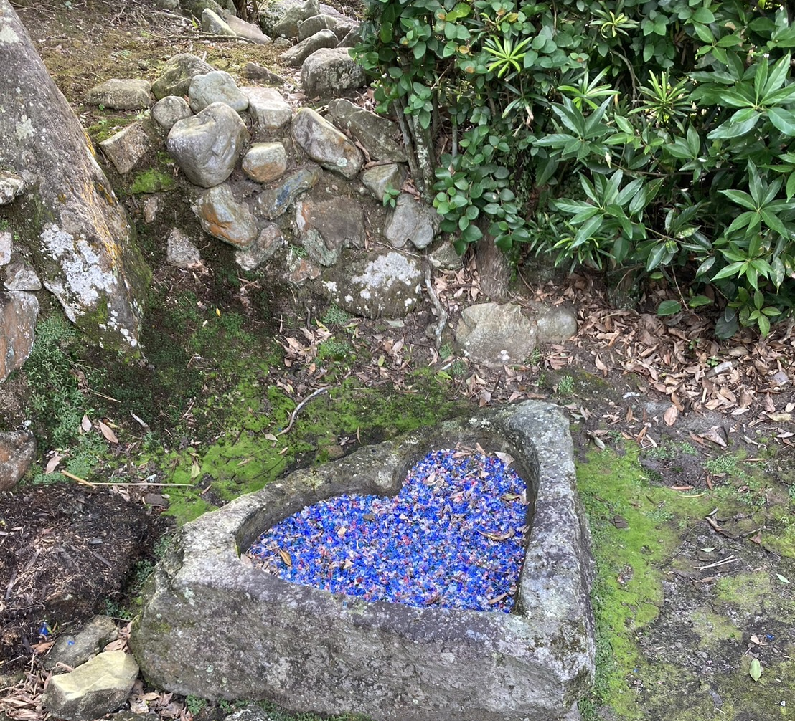
4. Fun Activity

Slide 14
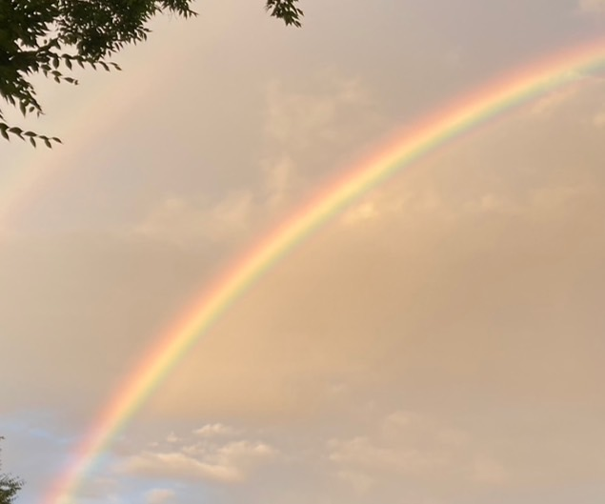
Fun Activity
Let’s think about your major language.
How many colors does it have in your language?

Slide 15
Sourse
Title: How language shapes the way we think
Speaker: Lera Boroditsky
Link: https://www.ted.com/dubbing/lera_boroditsky_how_language_shapes_the_way_we_think/transcript?language=en&subtitle=en&audio=en

Slide 16
Thank You!

