Slide 1

“How movies teach manhood?”

Slide 2

Before we get down to business,
What are your TOP 3 favorite movies?
Keep that movies in mind!

Slide 3
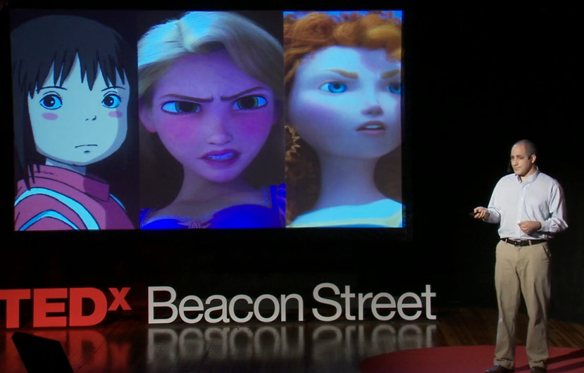

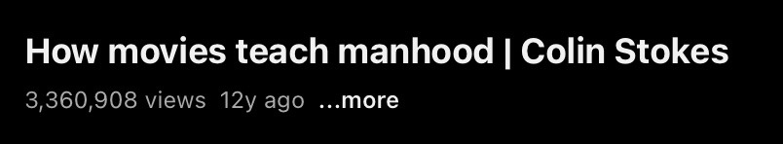
01
Why This Topic?
Interest in gender perspectives
12 years ago
Thumbnail image

Slide 4


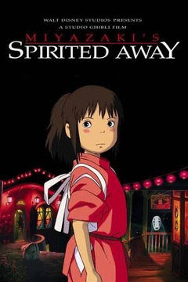
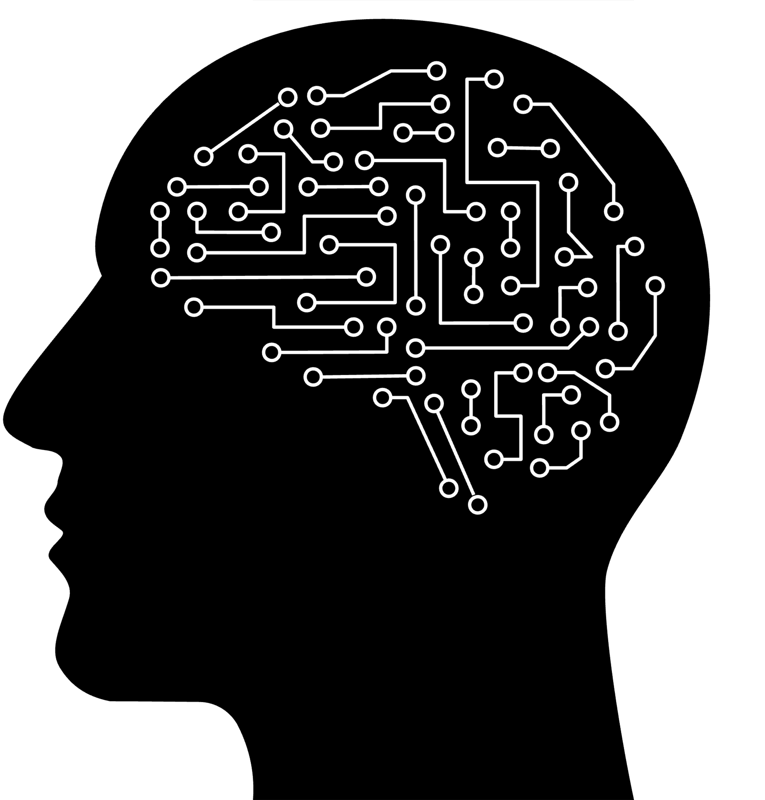

To be more specific,
Thumbnail image：
While many TED TALKs have an image of academic topics that are difficult to approach, I found it interesting that it was about characters I know, and Ghibli characters at that!
Interest in gender perspectives 12 years ago:
“Manhood” is not a word that can be used easily in these times. I thought this TED TALK video might help us understand the progress of human gender perspectives over the past 12 years.

Slide 5

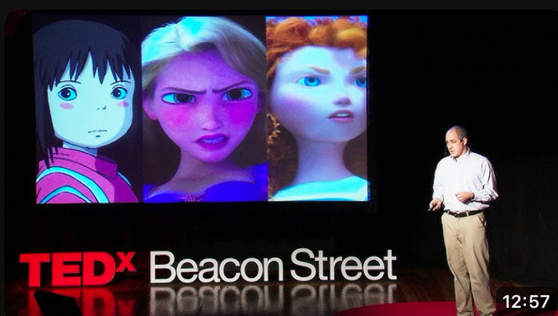
Let’s watch the TED TALK!
How movies teach manhood Colin Srokes
https://youtu.be/ueOqYebVhtc?si=zFgtOI8R2at4S53g

Slide 6
02
Vocablary check
assaulted
The definition of __________ is already turning upside down.
soaking
It _________ on him.
imprinted
How to defend against the __________.
If you are a boy, you are a _________ animal.
manhood
phenomenal
They are doing a _________ job of teaching girls.
dopey
We have tools at our _________ like “girls power.”
patriarchy
Are we ________ up the story?
They have been sexually ________ some time in their life.
disposal

Slide 7

03
Questions
Q1. What did Colin Stokes mention about the similarities and differences between the movies Star Wars and The Wizard of Oz?
Q2. How many out of every one American women, according to statistics at the time, had been sexually assaulted?
Q3. Why does the daughter of Colin Stokes like Obi-Wan from Star Wars and Dorothy from The Wizard of Oz?

Slide 8
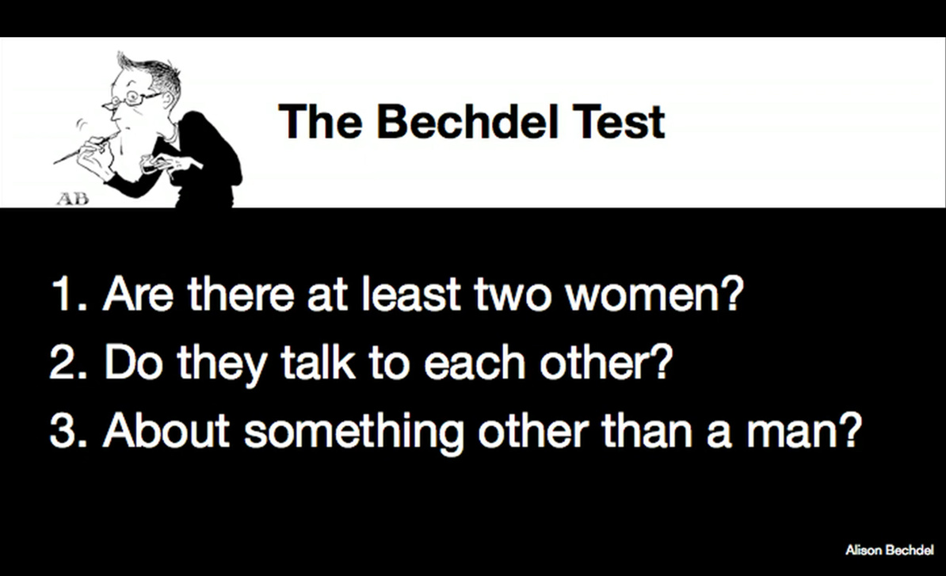
Before moving on to the work,
Do you remember the Bechdel test?
A measure of gender representation in films. A movie passes the test if it meets these three criteria.

Slide 9

04
Indivisual work
Let's rate the favorite 3 movies you listed, according to the criteria of the Bechdel Test!
At least 2 woman?
Do they talk to each other?
Abot something other than a man?
Movie A
Movie B
×
Movie C

Slide 10



05
Discussions
・Do your favorite movies clear the criteria?
・What did you think of this TED TALK? Did you learn anything new?
・Now that 12 years have passed, do you think gender equality has improved?

Slide 11
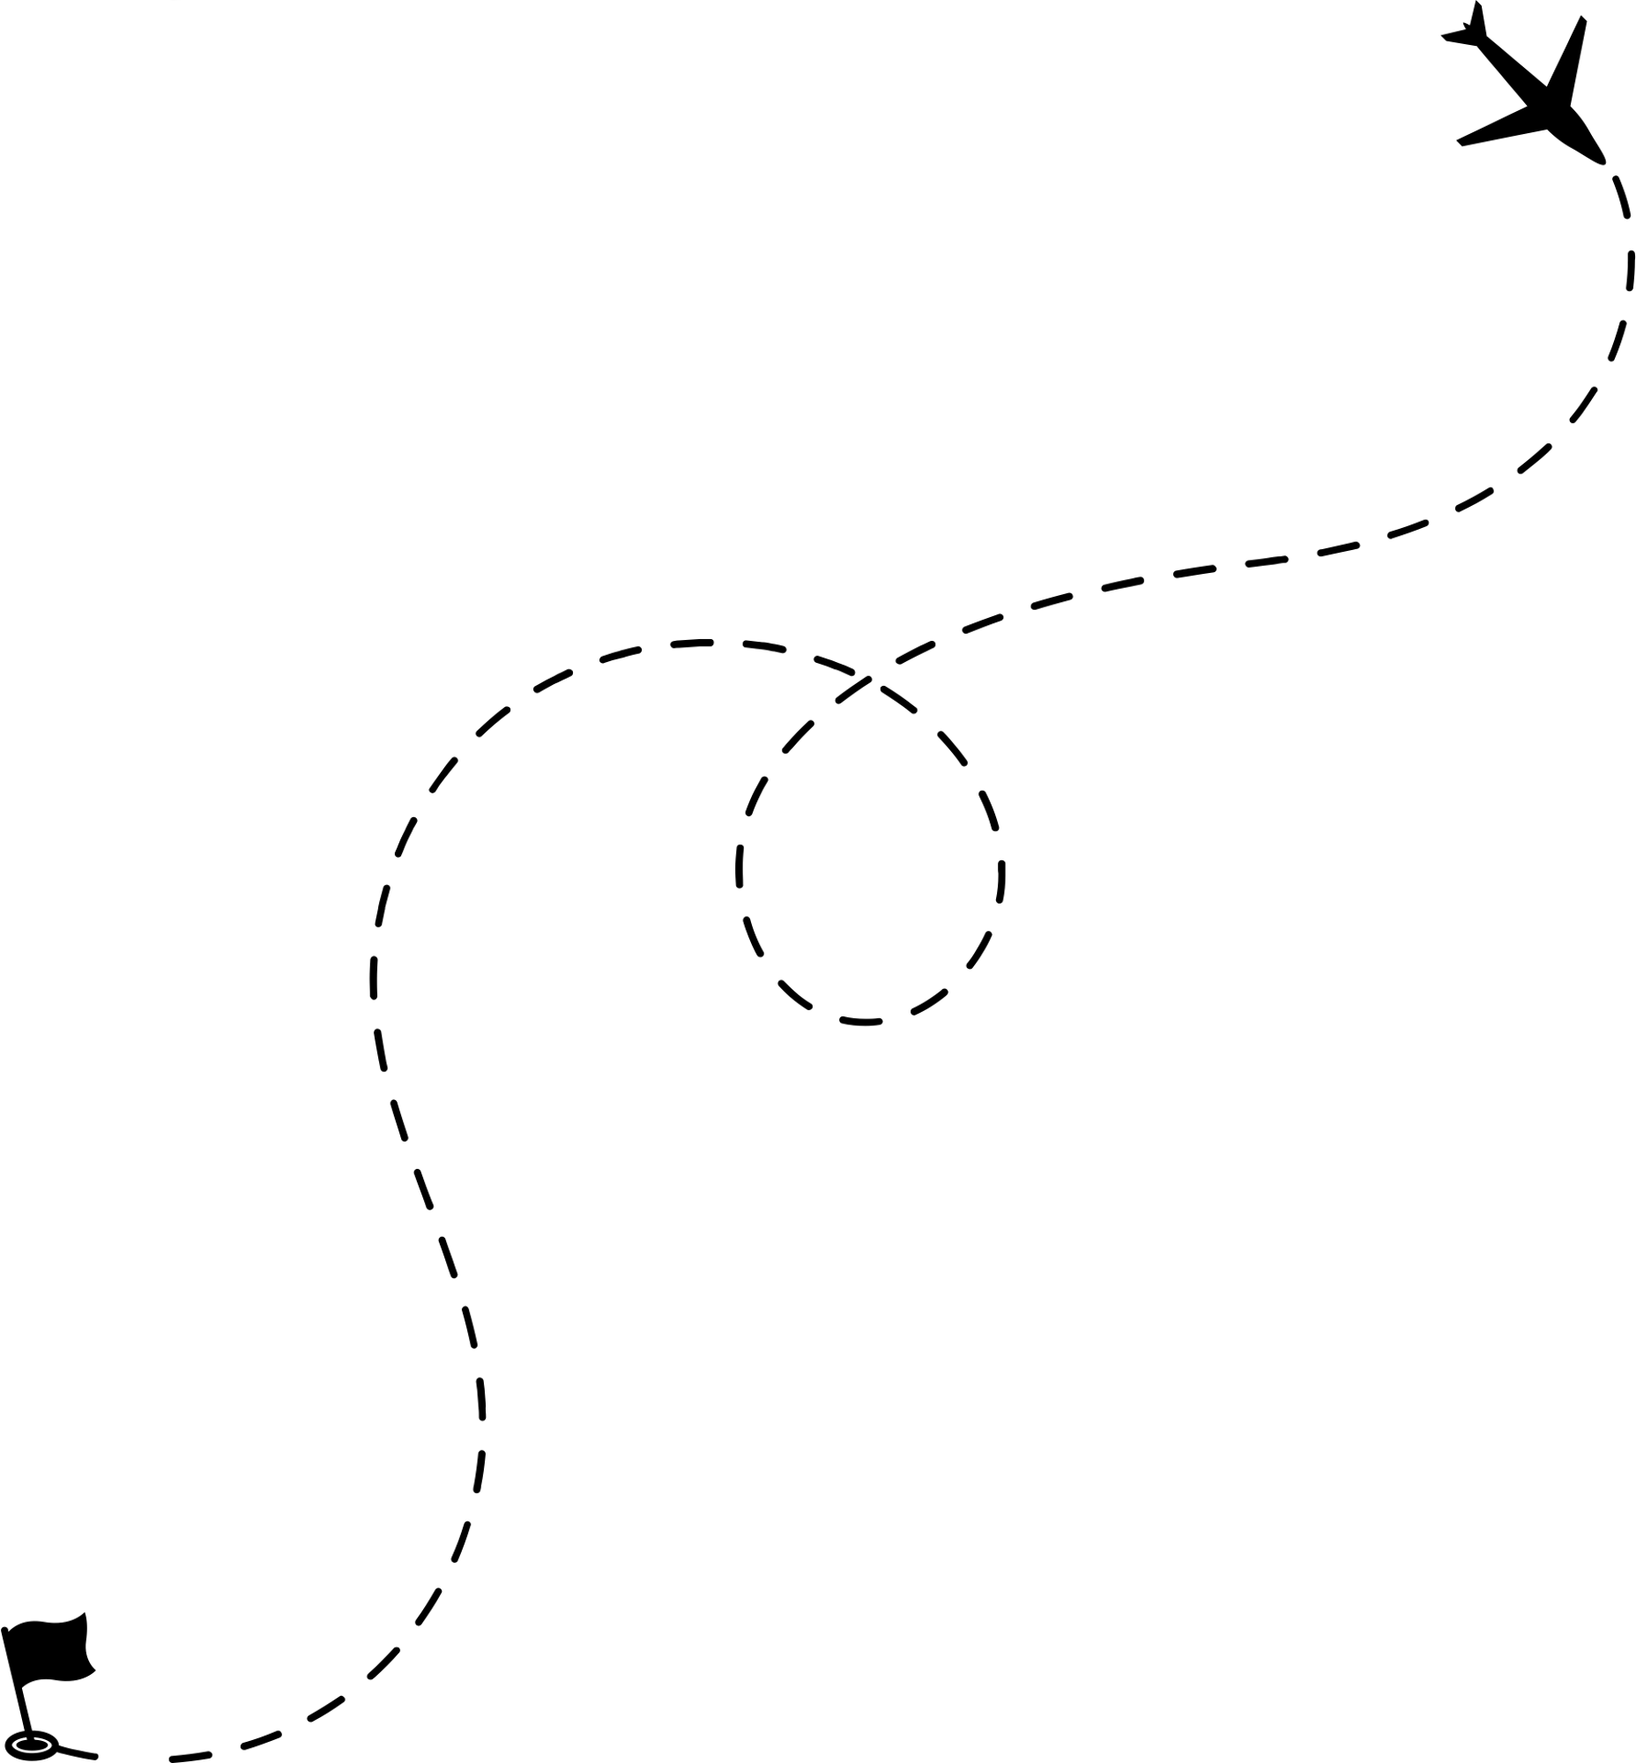
Thank you for reading!

Slide 12
My answer ▶︎▶︎▶︎

Slide 13
02
Vocablary check
manhood
The definition of __________ is already turning upside down.
It _________ on him.
imprinted
patriarchy
How to defend against the __________.
dopey
If you are a boy, you are a _________ animal.
They are doing a _________ job of teaching girls.
phenomenal
disposal
We have tools at our _________ like “girls power.”
Are we ________ up the story?
soaking
assaulted
They have been sexually ________ some time in their life.

Slide 14
03
Questions
Q1. What did Colin Stokes mention about the similarities and differences between the movies Star Wars and The Wizard of Oz?
The similarities are that the features of some characters and how they rescued a girl.
The differences are that compared to Star Wars, The Wizard of Oz has little violence and more characters are female whether they are heroic, wise or villainous.
Q2. How many out of every one American women, according to statistics at the time, had been sexually assaulted?
5
Q3. Why does the daughter of Colin Stokes like Obi-Wan from Star Wars and Dorothy from The Wizard of Oz?
Because they are experts ,know more than anybody else and love sharing their knowledge with other people to help them reach their potential. (It is not just because the sparkly dress!)

Slide 15
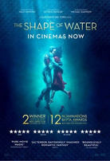

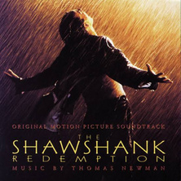
04
Indivisual work
Let's rate the favorite 3 movies you listed, according to the criteria of the Bechdel Test!
At least 2 woman?
Do they talk to each other?
Abot something other than a man?
△
The shape of water
△
△
Shin Godzilla
×
×
△
The Shawshank
redemptioon

Slide 16
05
Discussions
・Do your favorite movies clear the criteria?
Unfortunately NO, but if I chose more battle movies, they may clear all of the criteria.
・What did you think of this TED TALK? Did you learn anything new?
I realized the thoughtfulness of the speakers who have been raising this issue for the past 12 years, even though they are referring to a perspective that is obvious to me, living 12 years from now.
One of the new lessons I learned was to clearly understand in numbers how female characters have been portrayed as powerless in the male-centered film world of a decade ago.
・Now that 12 years have passed, do you think gender equality has improved?
I think progress has been made. The latest Disney movie he mentioned, "Brave," was immediately followed by "Frozen," a movie that featured female characters who did not need to rely on a prince for redemption, and I feel that the number of movies with female leads has continued to increase in Hollywood since then.

