Slide 1
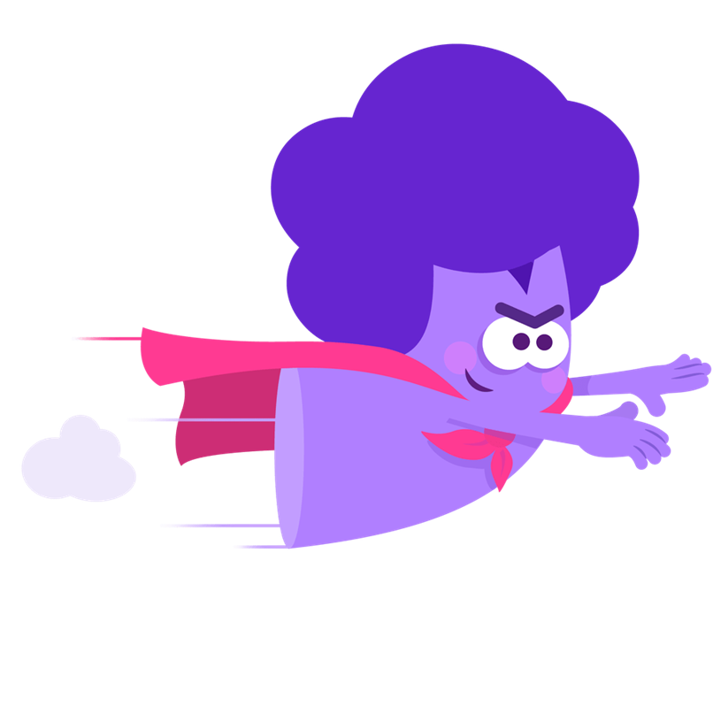
How movies teach manhood

Slide 2
“How movies teach manhood”
TED talk
Watch from this link
https://www.ted.com/talks/colin_stokes_how_movies_teach_manhood?subtitle=en

Slide 3
Why I chose this?
I always wondered why films and cartoons for boys were so offensive.
I think we brainwash children from childhood that boys should have physical power. So what kind of films have a positive impact on children?
That is why I chose this TED Talk.

Slide 4
Vocabulary
・Perseverance
determination to keep trying to achieve something in spite of difficulties – use this
to show approval
・Adequate
enough in quantity or of a good enough quality for a particular purpose
・Dopey
thinking or reacting slowly, as if you have taken a drug
・Patriarchy
a social system in which men have all the power
・flunk
to fail a test
・protagonist
the most important character in a play, film, or story

Slide 5
Engaging Questions
Q1:what are two big differences between
“The Wizard of Oz”and the movies we watch today?
Answer
1) There is very little violence.
2) Most of the heroic characters are female.
Q2:Who is Alison Bechdel?
A. A comic book artist
B. An actress
C. A director
Answer: A

Slide 6
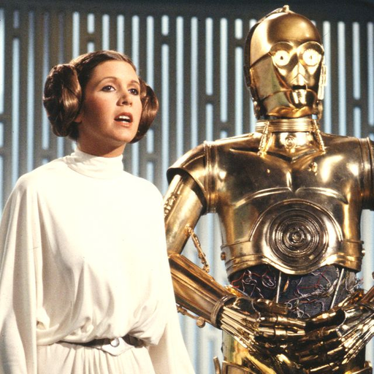
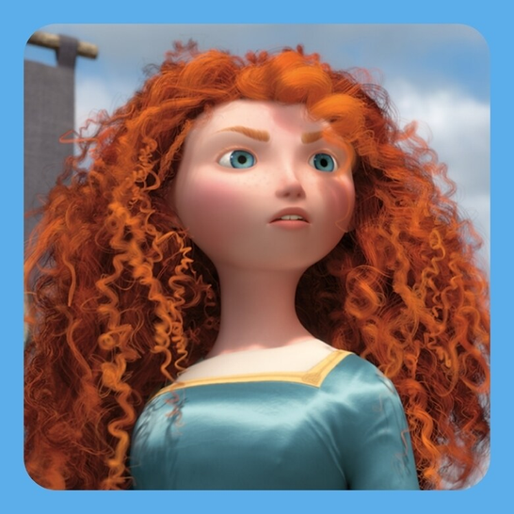
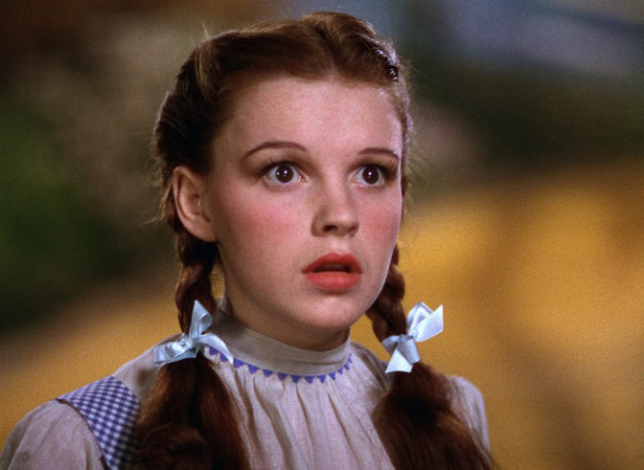
Q3. According to speaker, which character is not good as reader?
A
B
C
Answer: A

Slide 7
FunQuestion
Q1. Which movie was your favorite in your childhood?
Answer: Alice in Wonderland, Peter Pan
Q2. Do you know any movie which describes good reader well?
Answer: I don’t come up with any...

Slide 8
Answer
Engaging Question
Q1: 1)there’s very little violence. 2)most characters are female.
Q2: A
Q3: A

