Slide 1









How should we use ChatGPT?

Slide 2



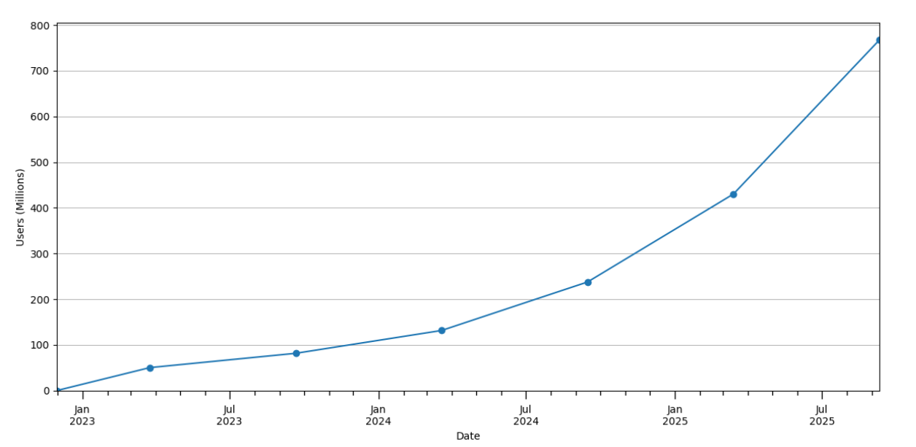

The trend in the world
The number of active ChatGPT users
More than 7 billion people, about 10% of people in the world, use ChatGPT.
Useres
Date

Slide 3



Why do I choose this topic?

Slide 4




Why do I choose this topic?
・ChatGPT causes controversial problems.
→ 1. cheating of assignments
2. security risk
3. declining the ability to think, etc...

Slide 5
Why do I choose this topic?
However...
ChatGPT is a useful tool and helps
our activity.
So,
I want to think about how we should use ChatGPT together!!

Slide 6




TED TALK
“Should we let students use ChatGPT?”
Her idea:
・We won’t be able to avoid AI.
・Schools need to tell students how to use AI safely and effectively.
Natasha Berg

Slide 7



Questions

Slide 8






Question
  What do you think about permitting the use of AI for school activities or tasks?
2. What do you think about AI’s risk? Do you feel
a sense of crisis?
3. How should we use AI, such as ChatGPT?

Slide 9
Vocabulary
&
Idiom

Slide 10



Vocabulary
1
2
3
AI arms race
a competition between two or more states to develop AI technologies
telenovela
a television novel in Spanish or Portugal
regress
return to a former or less developed state

Slide 11

Idiom
be awash in
→ containing too many things or people of a particular kind

Slide 12
Answers

Slide 13
Answers to the questions
  I think that schools should not permit the use of AI in schools. If children rely on AI, their ability to think doesn’t grow. At least schools should provide the opportunity to make children think themselves.
  I feel a crisis in AI, such as ChatGPT. It makes us lazy. Also, because of the existence, some students may be suspected of cheating on their homework.
  I think that AI is a good tool to gather information and the resources. However, we should not rely on it when we think about something like writing an essay. It is not beneficial for us.

Slide 14
Activity

Slide 15
Activity
Let’s play with ChatGPT!
  Let’s use the voice function and communicate in English or other foreign languages with ChatGPT!
  Let’s play Othello with ChatGPT!
  Let’s make ChatGPT read our palms!

Slide 16




Reference
・OpenAI、ChatGPTの利用実態調査を公開 男女差は解消、利用目的の半数は情報収集/IT media
https://www.itmedia.co.jp/news/articles/2509/16/news060.html
・HOW PEOPLE USE CHATGPT /Chatterji et al./Working Paper 34255
https://www.nber.org/system/files/working_papers/w34255/w34255.pdf
・Should we let students use ChatGPT?/Natasha Berg/TEDxSioux Falls
https://www.youtube.com/watch?v=ogcSQ-cFRVM
・ChatGPTの面白い使い方26選！SNSで話題の活用法や注意点まで紹介/SHIFT AI TIMES
https://shift-ai.co.jp/blog/27806/
・ChatGPTの面白い使い方50選！AIが遊び相手に？面白い解答で会話のネタに/MiraLab AI
https://miralab.co.jp/media/interesting_ways_chatgpt/

Slide 17



THANK YOU

